Slide 1
To Register for the AP Exam
PAY YOUR FEES - the DEADLINE for ALL students and ALL fees is Tuesday November 12, 1:00pm (end of lunch).
$69.00 – paid to Julia in the finance office

Slide 2
Homework: Notes: Autotrophs and Heterotrophs
The Chapter 8 Homework is due on Sunday, November 17 at 11:59 pm.
The Chapter 8 Test will be on Monday November 18

Slide 3
Intro to Photosynthesis and Light
0
Chapter 8

Slide 4
You Must Know
How photosystems convert light energy into chemical energy. (There will be more on this in the next couple of days.)
How leaf and chloroplast anatomy relate to photosynthesis.

Slide 5
Figure 8.UN01
Photosynthesis is an endergonic process; the energy boost is provided by
light.
becomes reduced
becomes oxidized
Notes:
5
Endergonic Reaction: A nonspontaneous chemical reaction in which free energy is absorbed from the surroundings. ∆ G > 0
Photosynthesis reverses the direction of electron flow compared to respiration.
Photosynthesis is a redox process in which H₂O is oxidized and CO₂ is reduced.
Photosynthesis is an anabolic process.

Slide 6
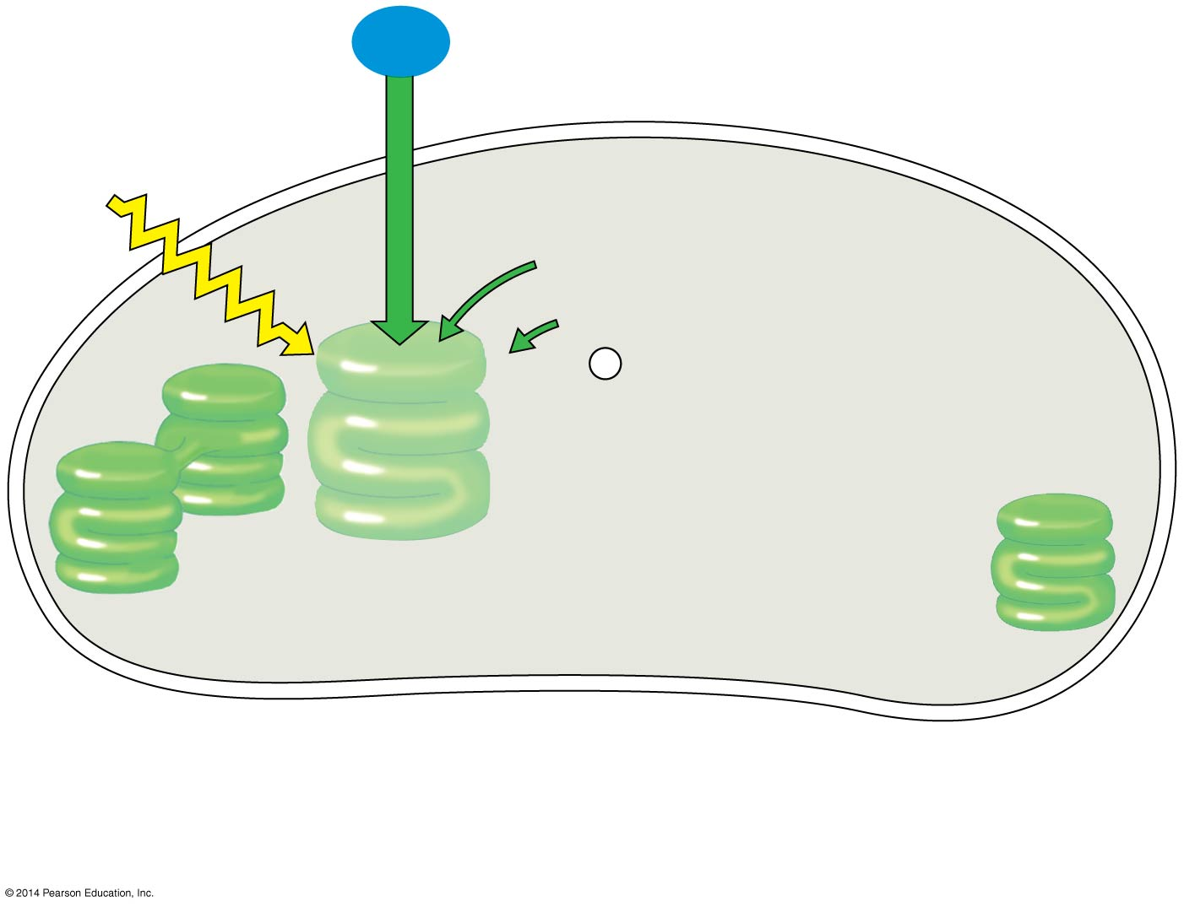
Figure 8.5-1
H₂O
CO₂
carbon fixation
Light
NADP⁺
ADP
+
P _{i}
Calvin
Cycle
Calvin
Cycle
Light
Reactions
ATP
NADPH
Chloroplast
O₂
[CH₂O]
(sugar)
Two Stages of Photosynthesis
Notes:
6
Photosynthesis consists of the light reactions (the photo part) and Calvin cycle (the synthesis part)
The light reactions (in the thylakoids)
Split H₂O
Release O₂
Reduce the electron acceptor, NADP⁺, to NADPH
Generate ATP from ADP by adding a phosphate group, photophosphorylation.
The Calvin cycle (in the stroma) forms sugar from CO₂, using ATP and NADPH.
The Calvin cycle begins with carbon fixation, incorporating CO₂ into organic molecules.

Slide 7
Figure 8.3a
Leaf cross section
Chloroplasts
Vein
Stomata
CO₂
O₂
Why green?
Notes:
7
Leaves are the major locations of photosynthesis.
Their green color is from chlorophyll, the green pigment within chloroplasts.
CO₂ enters and O₂ exits the leaf through microscopic pores called stomata.

Slide 8
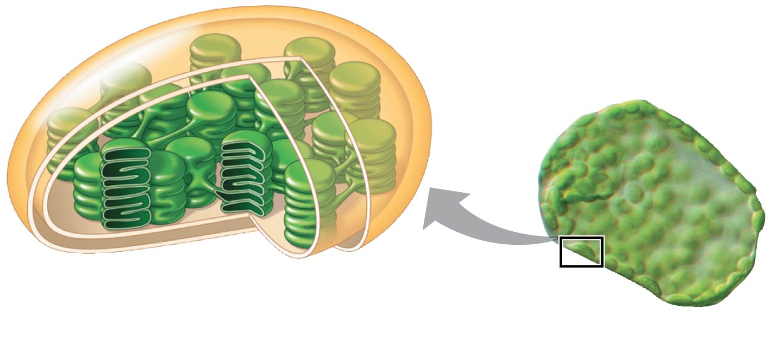
Figure 8.3b
Chloroplast
Thylakoid
Thylakoid
space
Stroma
20 μm
Notes:
8
The chlorophyll is in the membranes of thylakoids (connected sacs in the chloroplast); thylakoids may be stacked in columns called grana. Chloroplasts also contain stroma, a dense interior fluid.

Slide 9
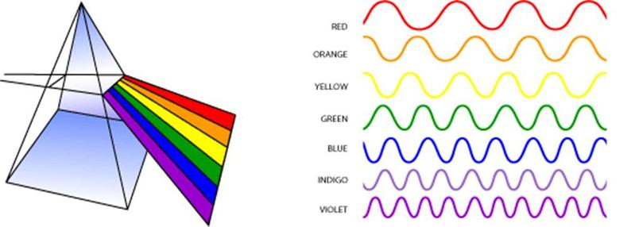
Light travels in waves
Visible light
380
450
500
550
600
650
700
750 nm
Shorter wavelength
Longer wavelength
Higher energy
Lower energy
Notes:
Light is a form of electromagnetic energy, also called electromagnetic radiation.
Like other electromagnetic energy, light travels in rhythmic waves.
Wavelength is the distance between crests of waves.
Wavelength determines the type of electromagnetic energy.
The electromagnetic spectrum is the entire range of electromagnetic energy, or radiation.
Visible light consists of wavelengths (including those that drive photosynthesis) that produce colors we can see.

Slide 10
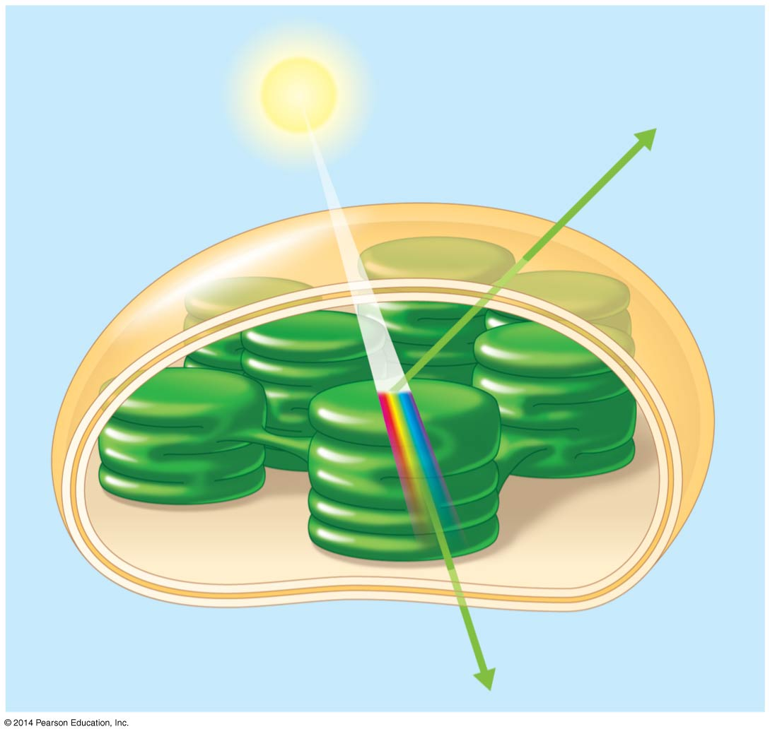
Figure 8.7
Light
Reflected
light
Chloroplast
Absorbed
light
Transmitted
light
Notes:
10
Light also behaves as though it consists of discrete particles, called photons.
Pigments are substances that absorb visible light.
Different pigments absorb different wavelengths.
Wavelengths that are not absorbed are reflected or transmitted.
Leaves appear green because chlorophyll reflects and transmits green light.

Slide 11
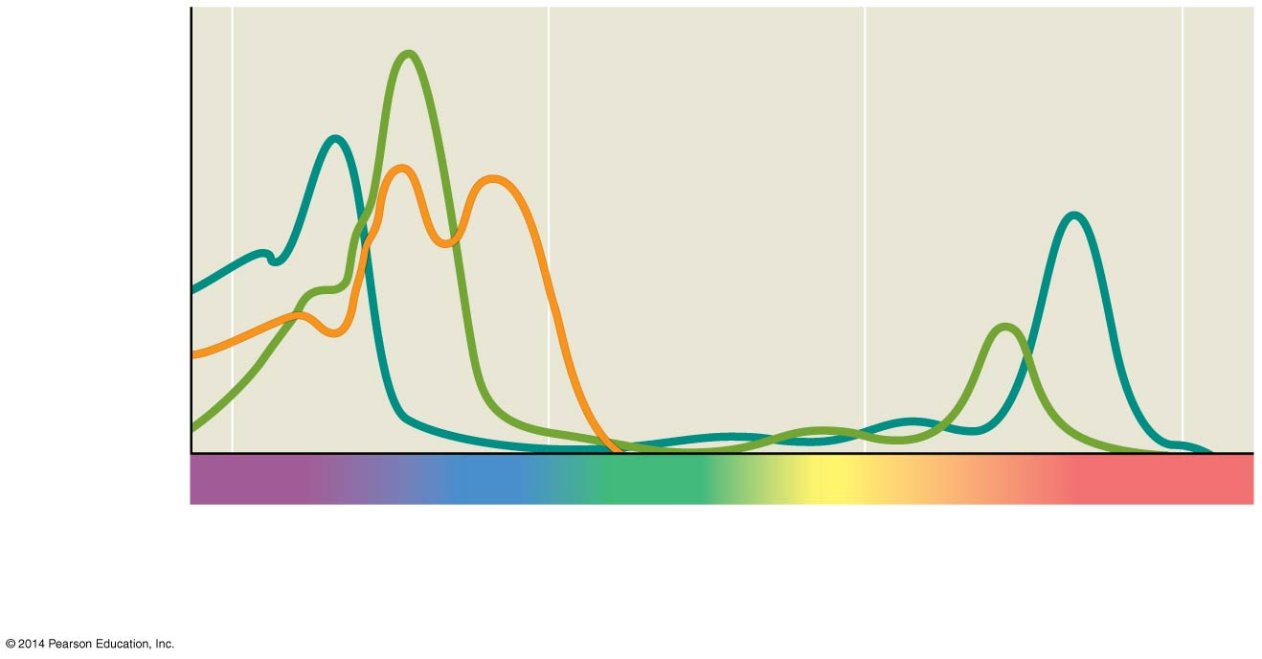
An absorption spectrum is a graph plotting a pigment’s light absorption versus wavelength.
Chloro-
phyll a
Chlorophyll b
Absorption of light
by chloroplast
pigments
Carotenoids
400
500
600
700
Wavelength of light (nm)
(a) Absorption spectra
Notes:
11
An absorption spectrum is a graph plotting a pigment’s light absorption versus wavelength.
The absorption spectrum of chlorophyll a suggests that violet-blue and red light work best for photosynthesis.
Accessory pigments include chlorophyll b and a group of pigments called carotenoids.

Slide 12
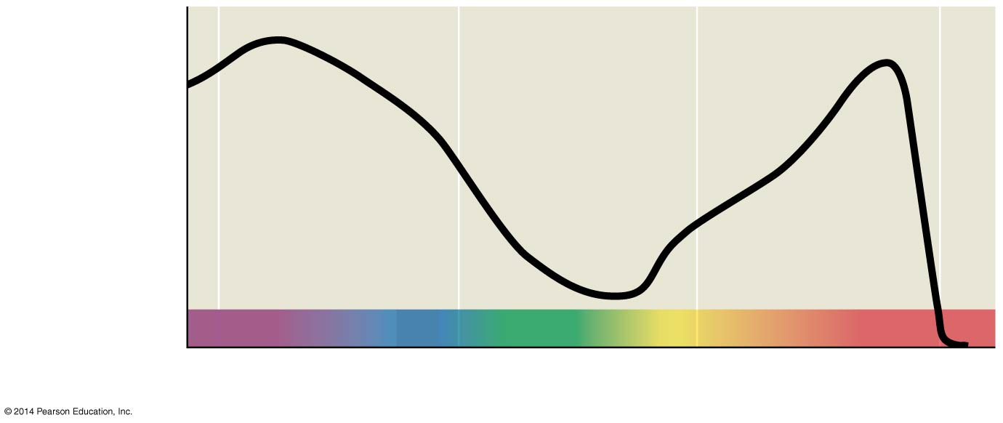
Figure 8.9b
Rate of
photosynthesis
(measured by O₂
release)
400
500
600
700
(b) Action spectrum
What does this show?
Notes:
12
An action spectrum profiles the relative effectiveness of different wavelengths of radiation in driving a process.

Slide 13
Setup for Theodor W. Engelmann’s 1883 experiment.

Slide 14
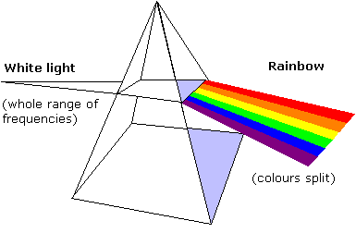
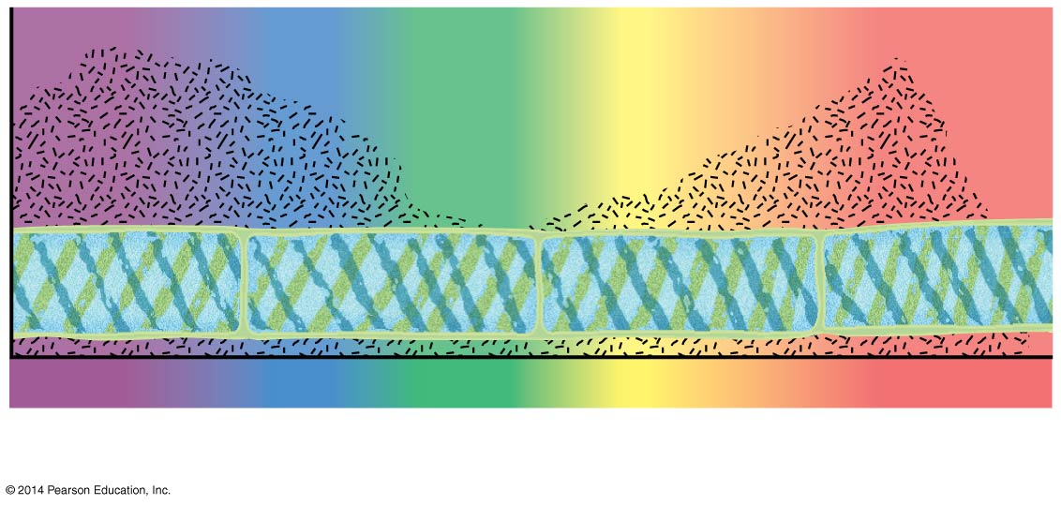
O₂ is a waste product of the light reaction of photosynthesis
Aerobic bacteria
Aerobic bacteria
Filament
of alga
Filament
of alga
500
400
500
400
600
700
Engelmann’s experiment - 1883
(c) Engelmann’s experiment - 1883
Notes:
14
The action spectrum of photosynthesis was first demonstrated in 1883 by Theodor W. Engelmann.
In his experiment, he exposed different segments of a filamentous alga to different wavelengths.
Areas receiving wavelengths favorable to photosynthesis produced excess O_{2.}
He used the growth of aerobic bacteria clustered along the alga as a measure of O₂ production.
.

Slide 15
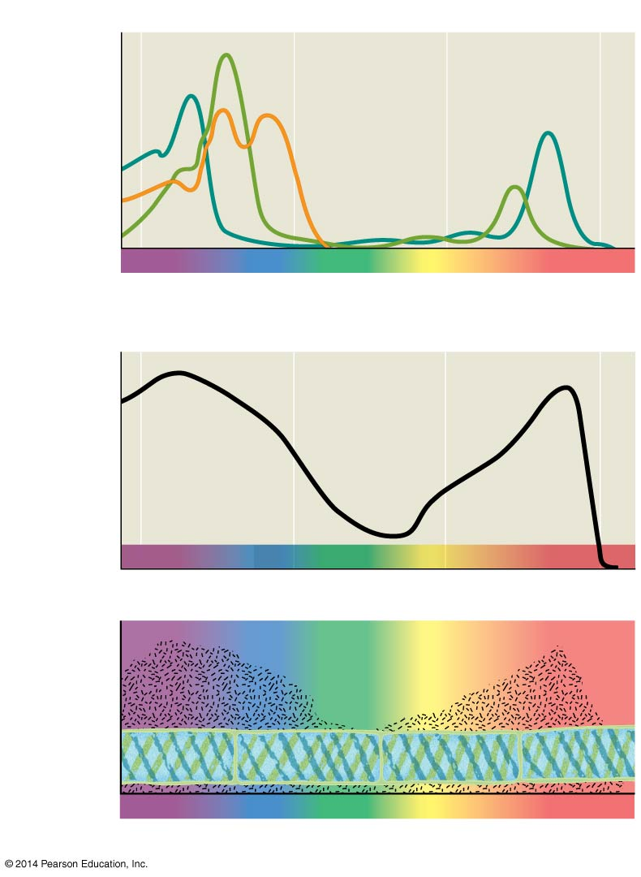
Figure 8.9
Results
Chloro-
phyll a
Chlorophyll b
Absorption of light
by chloroplast
pigments
Carotenoids
400
500
600
700
Wavelength of light (nm)
(a) Absorption spectra
Rate of
photosynthesis
(measured by O₂
release)
400
500
600
700
(b) Action spectrum
Aerobic bacteria
Filament
of alga
400
500
600
700
(c) Engelmann’s experiment
Notes:
15

Slide 16
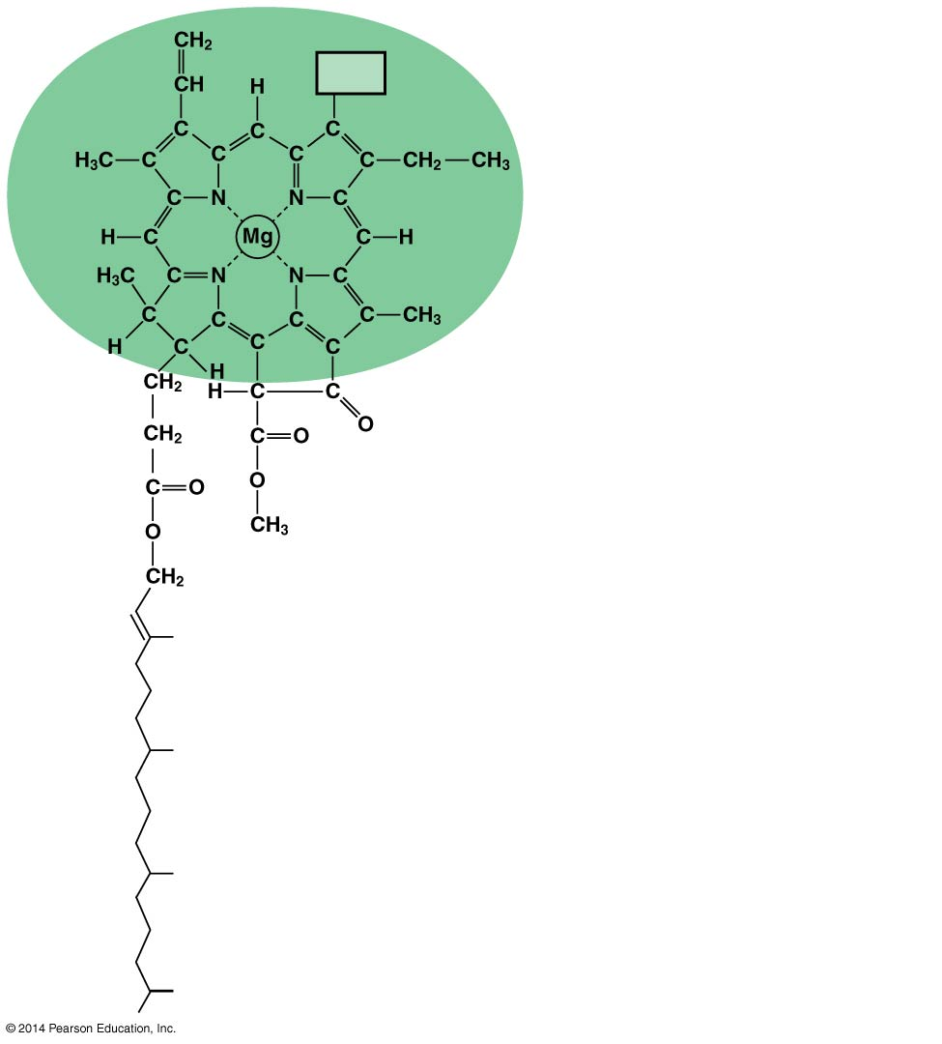
Figure 8.10
CH₃ in chlorophyll a
CH₃
CHO in chlorophyll b
Porphyrin ring:
light-absorbing
“head” of molecule;
note magnesium
atom at center
A slight structural difference between chlorophyll a and chlorophyll b causes them to absorb slightly different wavelengths.
Hydrocarbon tail:
interacts with hydrophobic
regions of proteins inside
thylakoid membranes of
chloroplasts; H atoms not
shown
Notes:
16
Chlorophyll a is the main photosynthetic pigment.
Accessory pigments, such as chlorophyll b, broaden the spectrum used for photosynthesis.
Accessory pigments called carotenoids absorb excessive light that would damage chlorophyll.
(You don’t need to memorize the blue text from this slide.)

Slide 17
Figure 8.11
Excited
state
Excited
state
Excited
state
Excited
state
e⁻
e⁻
e⁻
e⁻
Heat
Heat
Energy of electron
Energy of electron
Energy of electron
Photon
(fluorescence)
Photon
(fluorescence)
Photon
Photon
Photon
Ground
state
Ground
state
Photon
Ground
state
Chlorophyll
molecule
Chlorophyll
molecule
Chlorophyll
molecule
Chlorophyll
molecule
(a) Excitation of isolated chlorophyll molecule
(a) Excitation of isolated chlorophyll molecule
(a) Excitation of isolated chlorophyll molecule
(b) Fluorescence
Notes:
17
When a pigment absorbs light, it goes from a ground state to an excited state, which is unstable.
When excited electrons fall back to the ground state, photons are given off, an afterglow called fluorescence.
If illuminated, an isolated solution of chlorophyll will fluoresce, giving off light and heat.

