Slide 1
Deadline for AP Exams
Deadline to pay is Wednesday November 13, 1:00pm (end of lunch).

Slide 2
Photosynthetic Prokaryotes, C₄ and CAM Plants
0
Chapter 8

Slide 3
You Must Know
That photosynthetic prokaryotes (cyanobacteria) oxygenated the atmosphere
Photorespiration
The difference between C₃, C₄, and CAM plants.

Slide 4
Life first evolved about 3.5 billion years ago. Very little O₂ was available in the atmosphere until about 2.7 billion years ago.

Slide 5
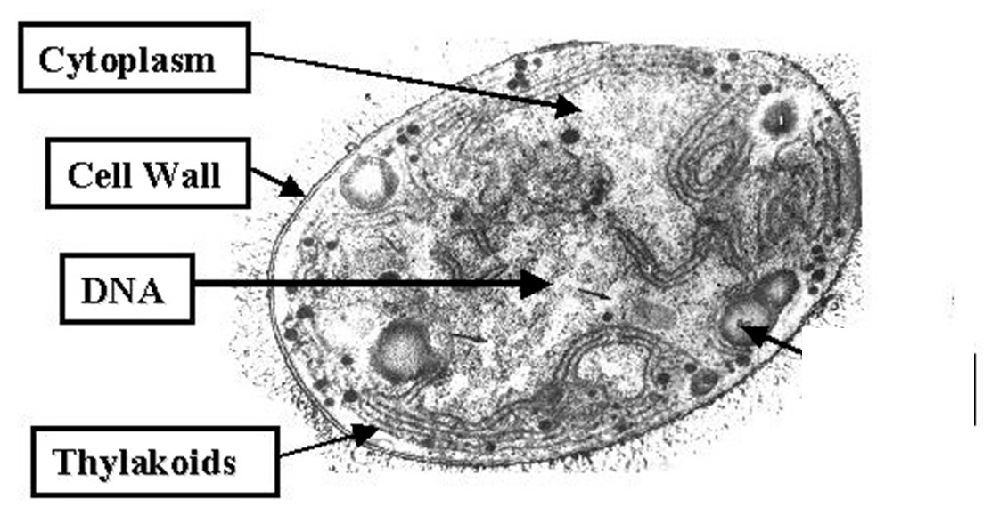
The 1st photosynthetic organisms were cyanobacteria, a type of prokaryote.

Slide 6
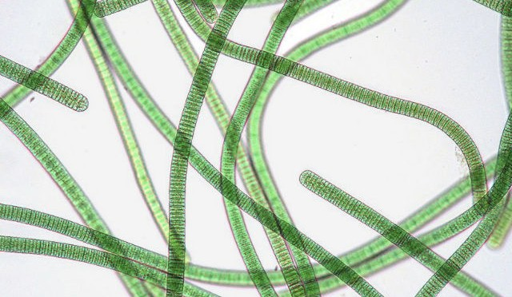
Cyanobacteria oxygenated the atmosphere!

Slide 7
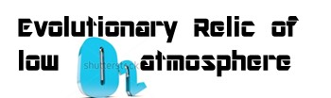
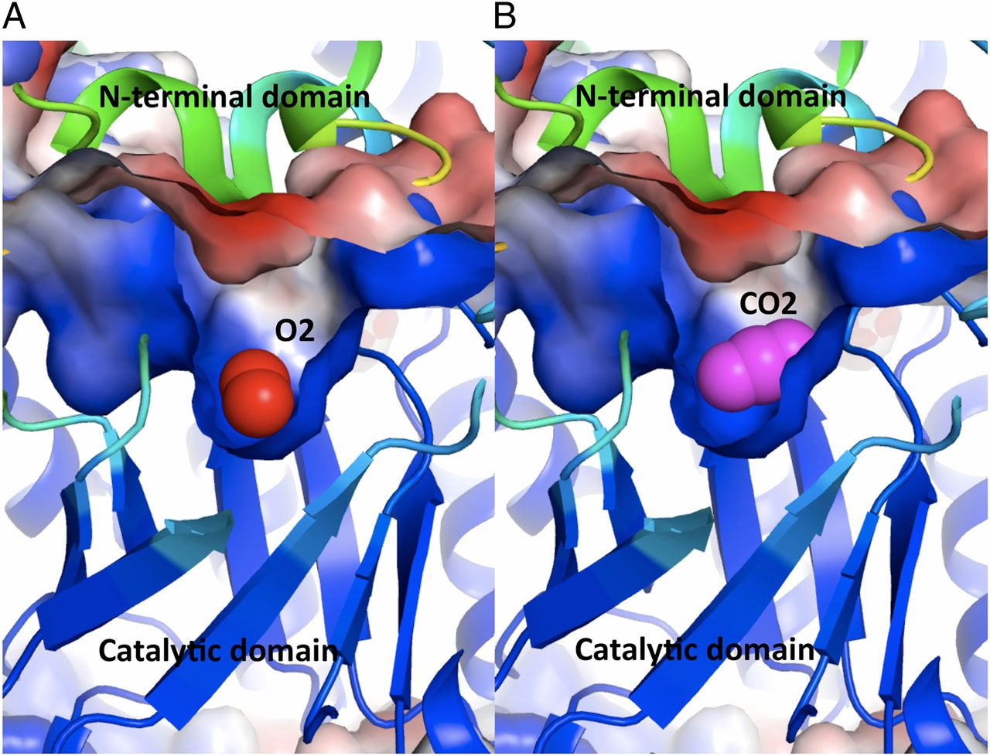
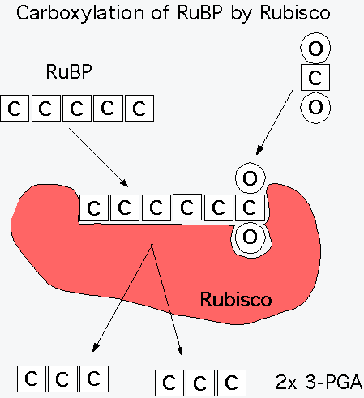
Rubisco
In photorespiration, rubisco adds O₂ instead of
CO₂ in the Calvin cycle, producing a two-carbon compound. It uses up ATP without producing any sugar.
competitive inhibition
Notes:
In most plants (C₃ plants), initial fixation of CO₂, via rubisco, forms a three-carbon compound (3-phosphoglycerate).
Photorespiration decreases photosynthetic output by consuming ATP, O₂, and organic fuel and releasing CO₂ without producing any ATP or sugar.
Photorespiration may be an evolutionary relic because rubisco first evolved at a time when the atmosphere had far less O₂ and more CO₂ .
Photorespiration limits damaging products of light reactions that build up in the absence of the Calvin cycle.

Slide 8
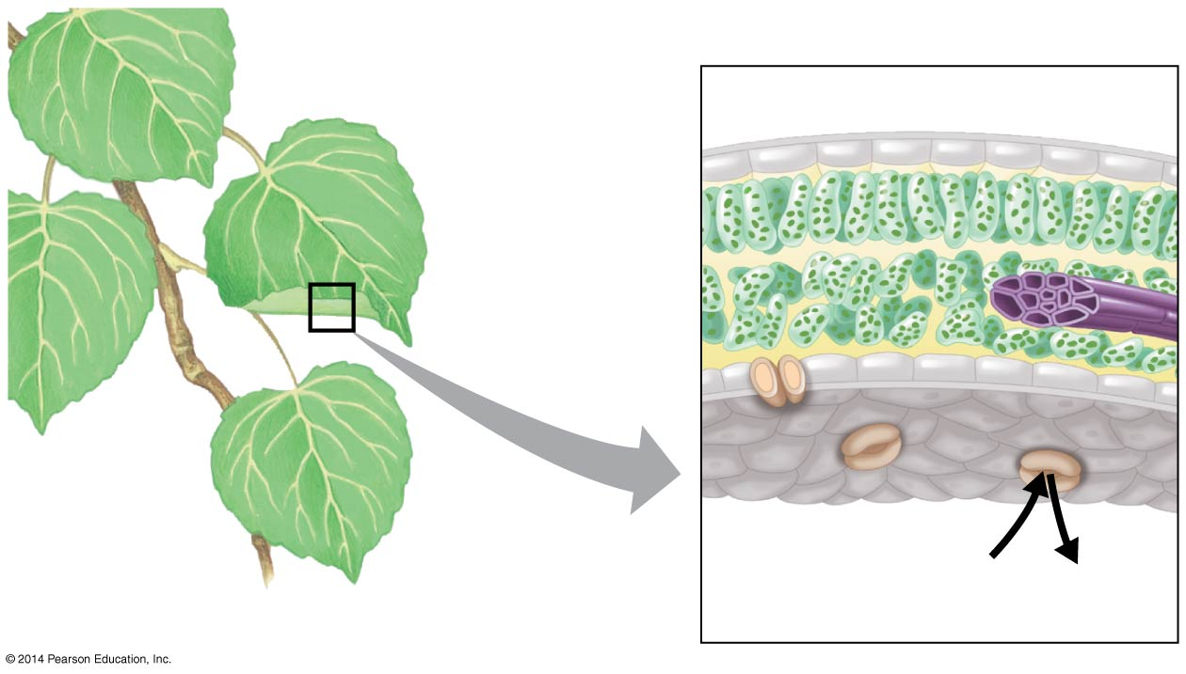
Figure 8.3a
Leaf cross section
Chloroplasts
Vein
Mesophyll
Stomata
CO₂
O₂
What happens when a plant closes its stomata?
Water loss decreases
CO₂ concentrations decreases
O₂ concentrations increase
H₂O
Notes:
8
CO₂ enters and O₂ exits the leaf through microscopic pores called stomata.
Water also exits the leaf through the stomata.
Adaptation to dehydration is a problem for land plants, sometimes requiring trade-offs with other metabolic processes, especially photosynthesis.
On hot, dry days, plants close stomata, which conserves H₂O but also limits photosynthesis.
The closing of stomata reduces access to CO₂ and causes O₂ to build up.
These conditions favor an apparently wasteful process called photorespiration.

Slide 9
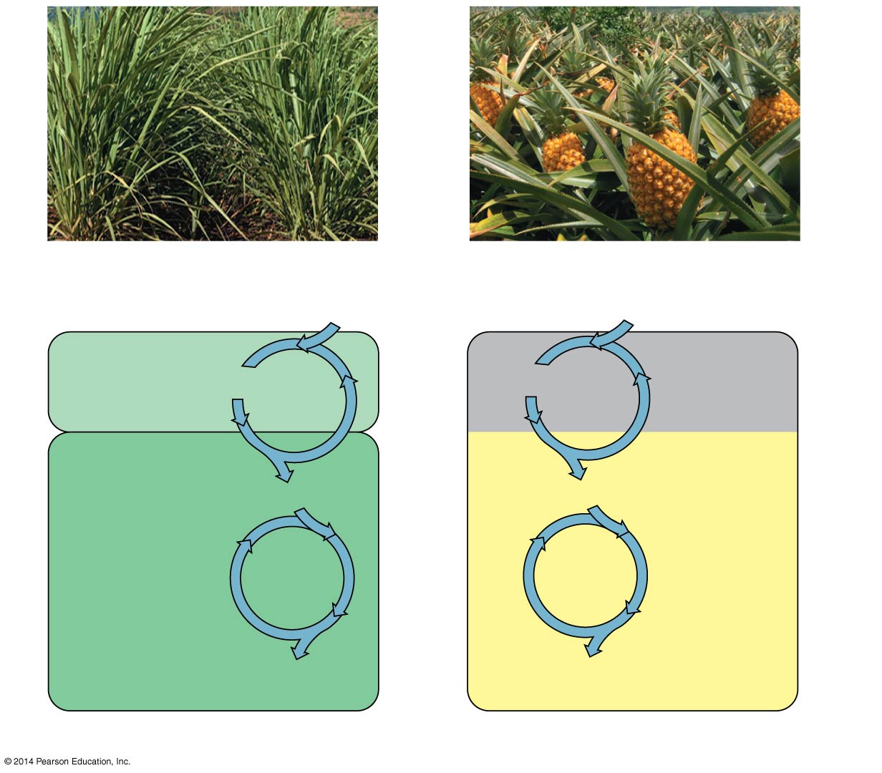
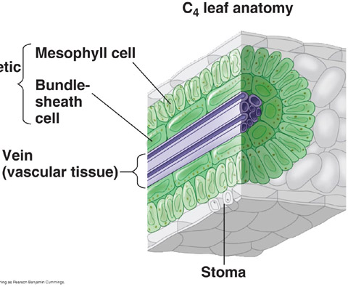
C₄
An enzyme in the mesophyll cells has a high affinity for CO₂ and can fix carbon into a four-carbon compound even when CO₂ concentrations are low.
This takes energy!
1
CO₂
C₄
Mesophyll
cell
Organic
acid
CO₂
2
Bundle-
sheath
cell
Calvin
Cycle
Sugar
(a) Spatial separation of steps
Notes:
9
C₄ plants minimize the cost of photorespiration by incorporating CO₂ into a four-carbon compound.
An enzyme in the mesophyll cells has a high affinity for CO₂ and can fix carbon even when CO₂ concentrations are low.
These four-carbon compounds are exported to bundle-sheath cells, where they release CO₂ that is then used in the Calvin cycle.

Slide 10
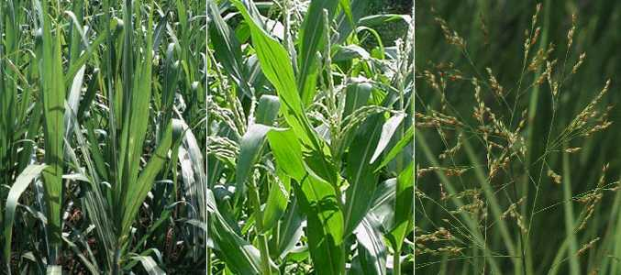
C₄ Plants
Sugarcane Corn Switchgrass

Slide 11
CAM Plants
CAM plants open their stomata at night, incorporating CO₂ into organic acids.
Stomata close during the day, and CO₂ is released from organic acids and used in the Calvin cycle.
This takes energy!
1
CO₂
CAM
Organic
acid
Night
CO₂
2
Day
Calvin
Cycle
Sugar
(b) Temporal separation of steps
Notes:
11
Some plants, including succulents, use crassulacean acid metabolism (CAM) to fix carbon.

Slide 12
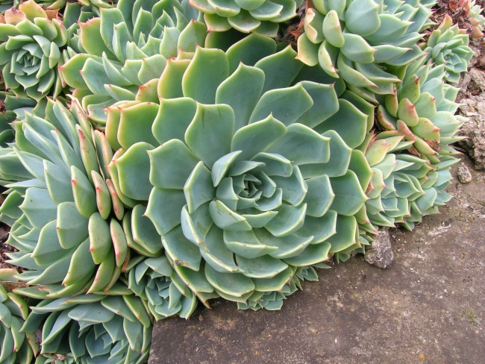
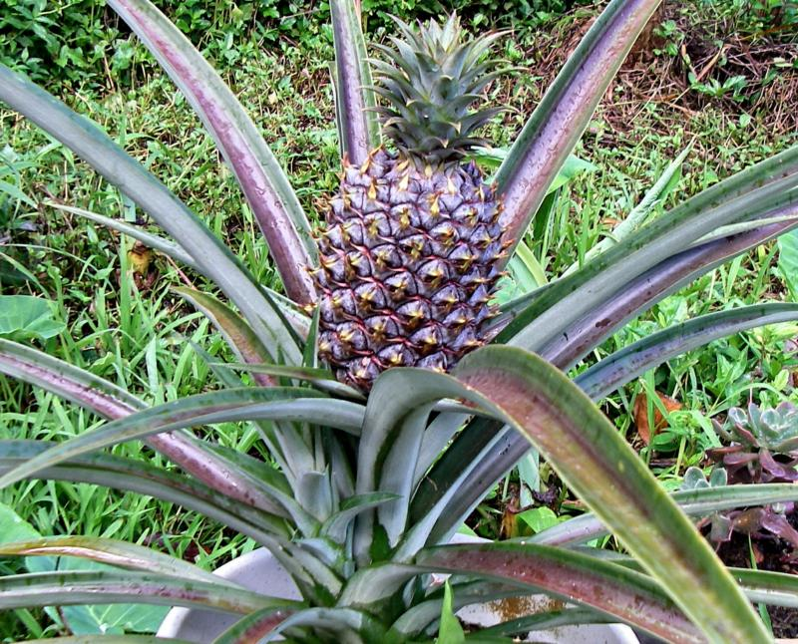
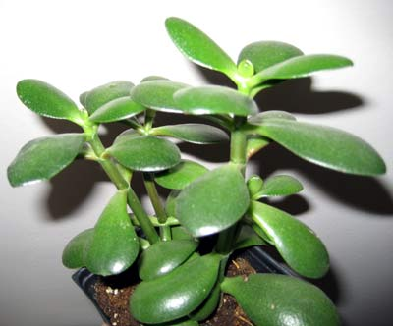
CAM Plants
Notes:
CAM photosynthesis, is a carbon fixation pathway that evolved in some plants as an adaptation to arid conditions. In a plant using full CAM, the stomata in the leaves remain shut during the day to reduce water loss, but open at night to collect carbon dioxide. The CO₂ is stored as an organic acid , and then used during photosynthesis during the day. The pre-collected CO₂ is concentrated around the enzyme rubisco, increasing photosynthetic efficiency.

Slide 13
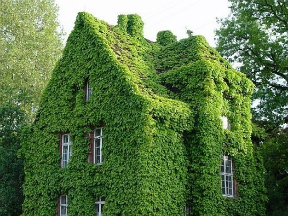
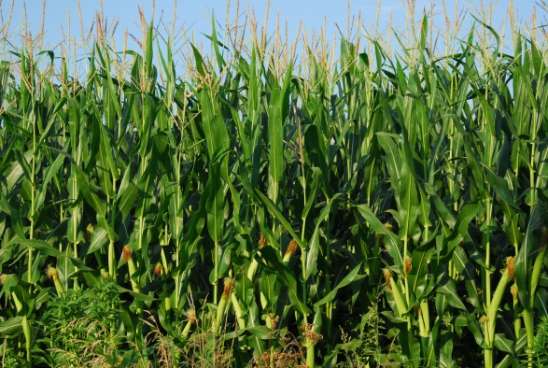
CAM
C₃
C₄
Advantages?
Disadvantages?
Notes:
C₄ and CAM plants have a competitive advantage over C₃ plants under conditions of drought, high temperature, or CO₂ limitation because they lose less water through their stomata when they fix CO_{2.} The disadvantage is that it takes more ATP to make the same amount of G3P.

