Slide 1
Calvin Cycle
0
Chapter 8

Slide 2
You Must Know
How the Calvin cycle uses the energy molecules of the light reactions (ATP and NADPH) to produce carbohydrates (G3P) from CO₂.

Slide 3
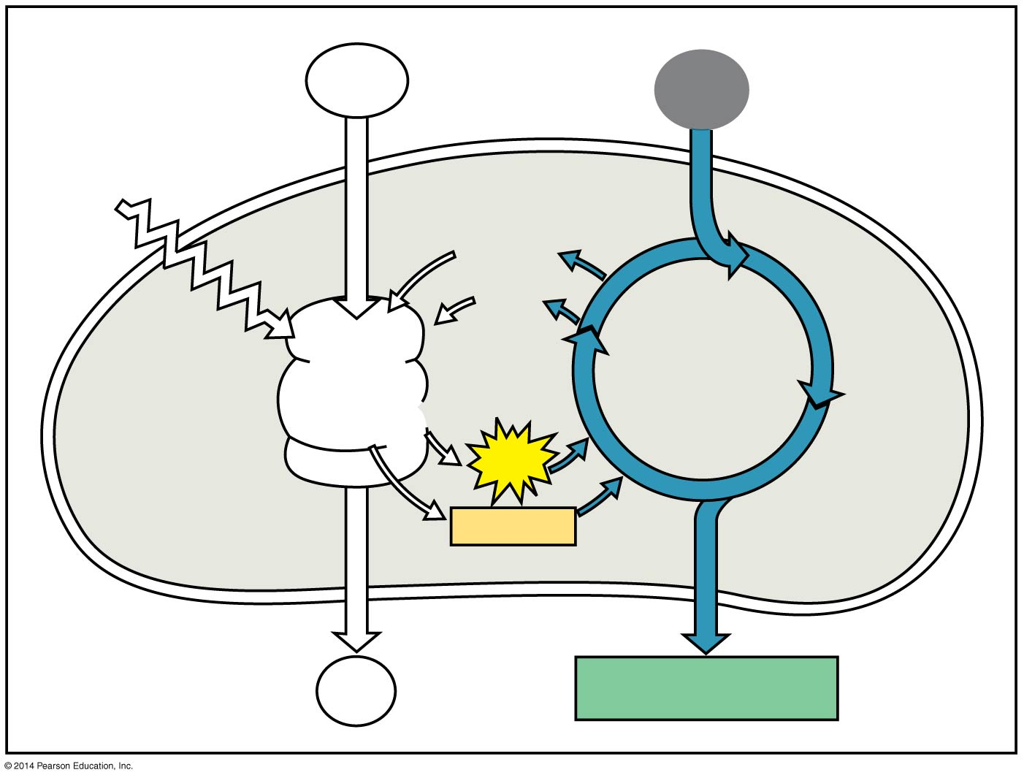
Figure 8.UN03
anabolic
H₂O
CO₂
Light
NADP⁺
ADP
Calvin
Cycle
Light
Reactions
ATP
NADPH
O₂
[CH₂O] (sugar)
Notes:
3
Concept 8.3: The Calvin cycle uses the chemical energy of ATP and NADPH to reduce CO₂ to sugar
The Calvin cycle is anabolic. It builds sugar from smaller molecules by using ATP and the reducing power of electrons carried by NADPH.

Slide 4
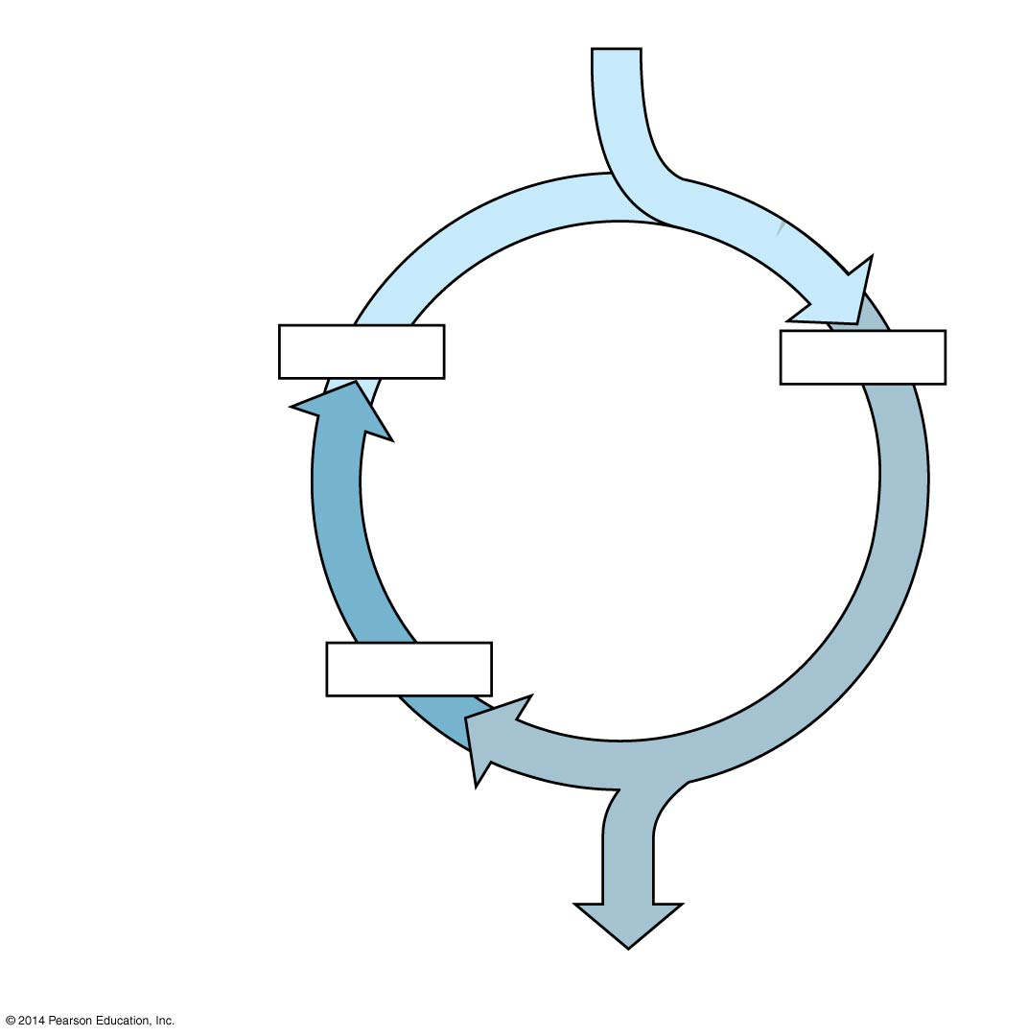
For net synthesis of one G3P, the cycle must take place three times, fixing three molecules of CO₂
3 CO₂
Carbon fixation
3 × 5C
6 × 3C
Calvin
Cycle
Regeneration of
CO₂ acceptor
5 × 3C
Reduction
1 G3P (3C)
Notes:
4
Carbon enters the cycle as CO₂ and leaves as a sugar named glyceraldehyde 3-phospate (G3P)
For net synthesis of one G3P, the cycle must take place three times, fixing three molecules of CO₂
The Calvin cycle has three phases
Carbon fixation
Reduction
Regeneration of the CO₂ acceptor

Slide 5
(Note: for the next three slides, you only need to remember the names of molecules that are marked with a red arrow.)

Slide 6
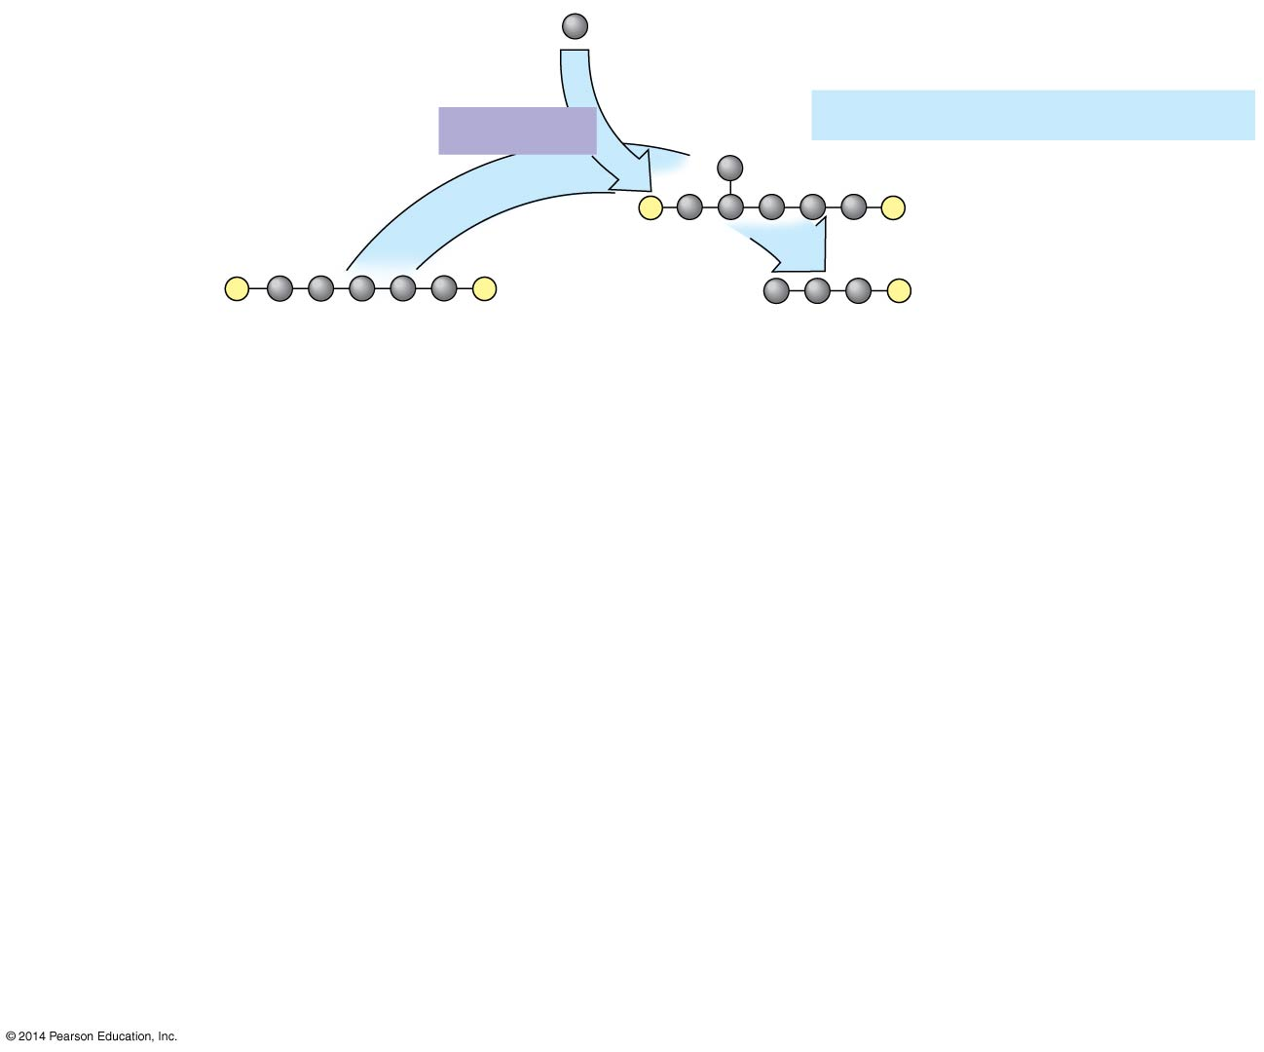
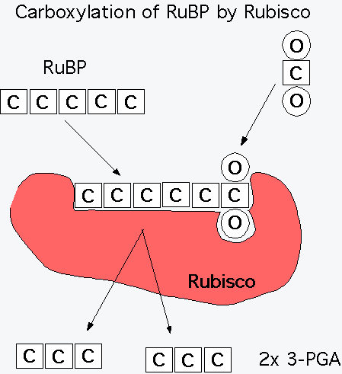
Figure 8.17-1
Input 3
as 3 CO₂
Rubisco
Phase 1: Carbon fixation
3
P
P
3
P
P
6
P
RuBP
3-Phosphoglycerate
Calvin
Cycle
R u
BP?
Notes:
6
Phase 1, carbon fixation, involves the incorporation of the CO₂ molecules into ribulose bisphosphate (RuBP) using the enzyme rubisco

Slide 7
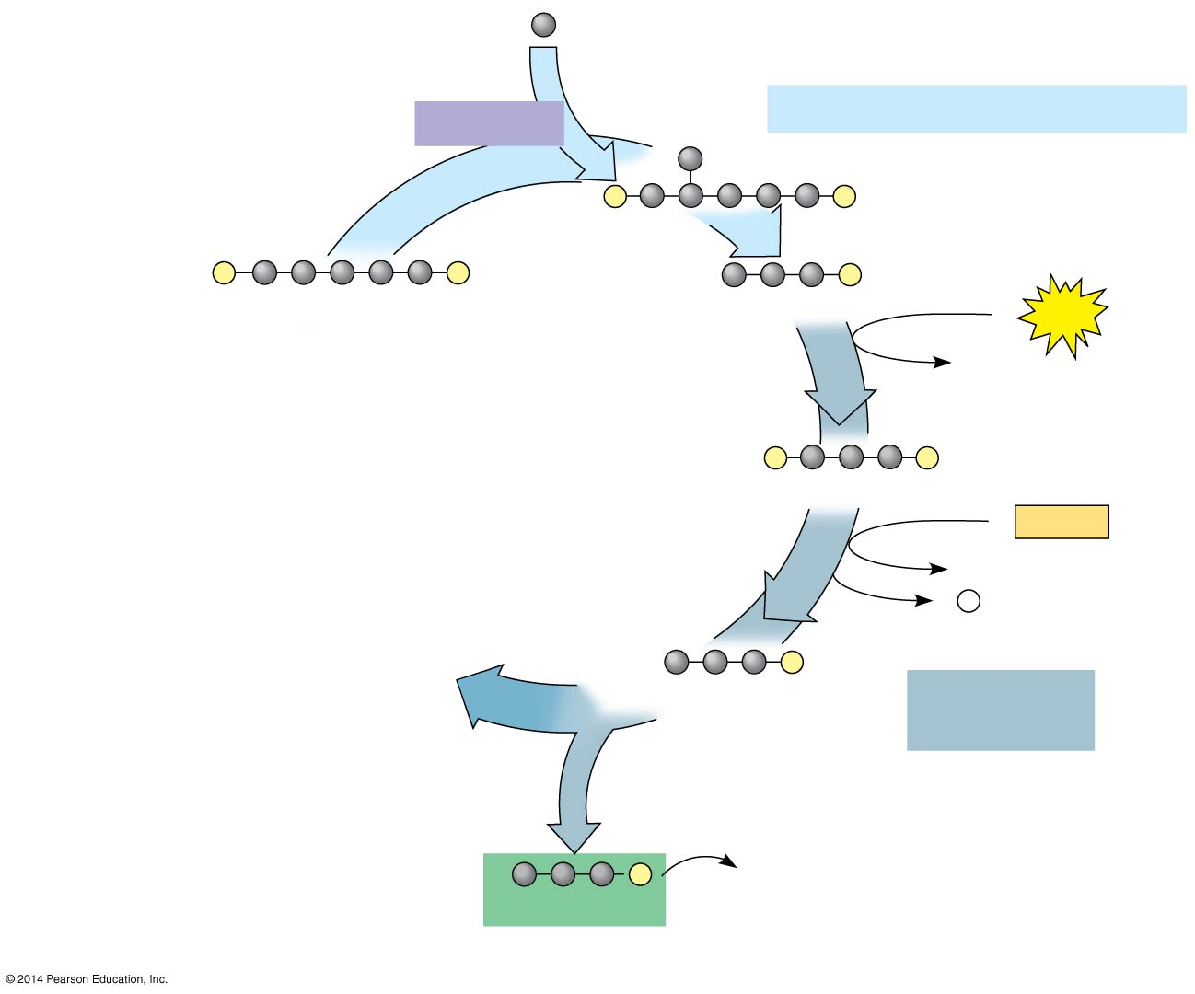
Figure 8.17-2
Input 3
as 3 CO₂
Rubisco
Phase 1: Carbon fixation
phosphorylation
3
P
P
3
P
P
6
P
RuBP
3-Phosphoglycerate
6
ATP
6 ADP
reduction
Calvin
Cycle
6
P
P
1,3-Bisphosphoglycerate
6
NADPH
6 NADP⁺
6 P _{i}
6
P
G3P
Phase 2:
Reduction
1
P
Glucose and
other organic
compounds
G3P
Output
Notes:
7
Phase 2, reduction, involves the reduction and phosphorylation of 3-phosphoglycerate to G3P.

Slide 8
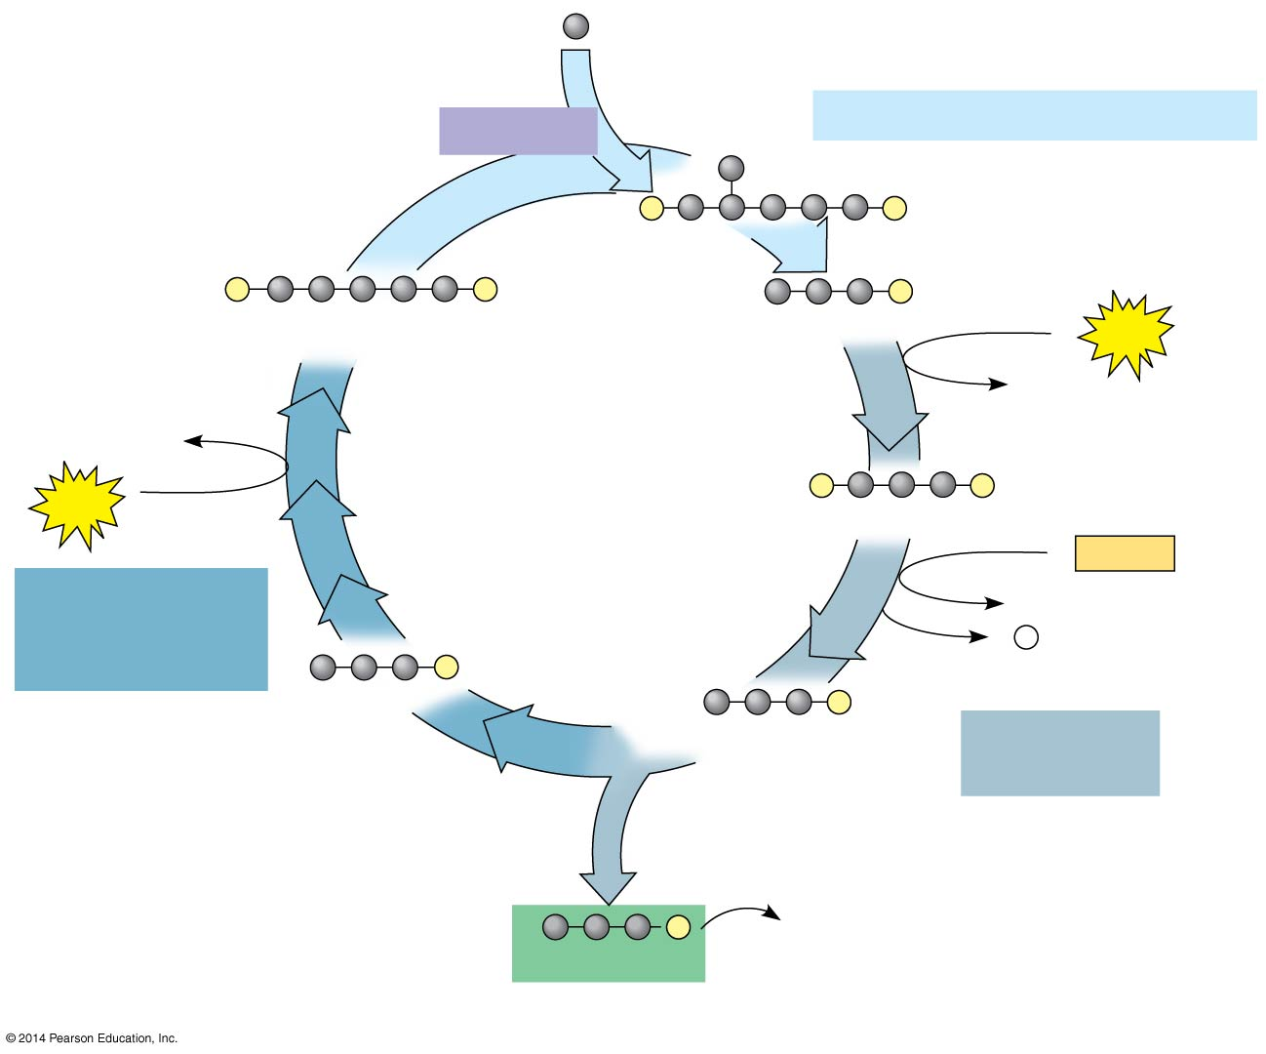
Figure 8.17-3
Input 3
as 3 CO₂
Rubisco
Phase 1: Carbon fixation
3
P
P
3
P
P
6
P
RuBP
3-Phosphoglycerate
6
ATP
6 ADP
3 ADP
Calvin
Cycle
3
ATP
6
P
P
1,3-Bisphosphoglycerate
6
NADPH
Phase 3:
Regeneration
of RuBP
6 NADP⁺
6 P _{i}
5
P
G3P
6
P
G3P
Phase 2:
Reduction
1
P
Glucose and
other organic
compounds
G3P
Output
Notes:
8
Phase 3, regeneration, involves the rearrangement of G3P to regenerate the initial CO₂ receptor, RuBP
You do not have to recreate the figure from memory, but you should be able to explain the process.

