Slide 1
Autotrophs and Heterotrophs
0
Chapter 8
Ps

Slide 2
Overview: The Process That Feeds the Biosphere
Photosynthesis is the process that converts solar energy into chemical energy
Directly or indirectly, photosynthesis nourishes almost the entire living world
© 2014 Pearson Education, Inc.
Notes:
2

Slide 3
Autotrophs sustain themselves without eating anything derived from other organisms
Autotrophs are the producers of the biosphere, producing organic molecules from CO₂ and other inorganic molecules
Almost all plants are photoautotrophs, using the energy of sunlight to make organic molecules
© 2014 Pearson Education, Inc.
Notes:
3

Slide 4
Heterotrophs obtain their organic material from other organisms
Heterotrophs are the consumers of the biosphere
Almost all heterotrophs, including humans, depend on photoautotrophs for food and O₂
© 2014 Pearson Education, Inc.
Notes:
4

Slide 5
Photosynthesis occurs in plants, algae, certain other protists, and some prokaryotes
These organisms feed not only themselves but also most of the living world
© 2014 Pearson Education, Inc.
Notes:
5

Slide 6
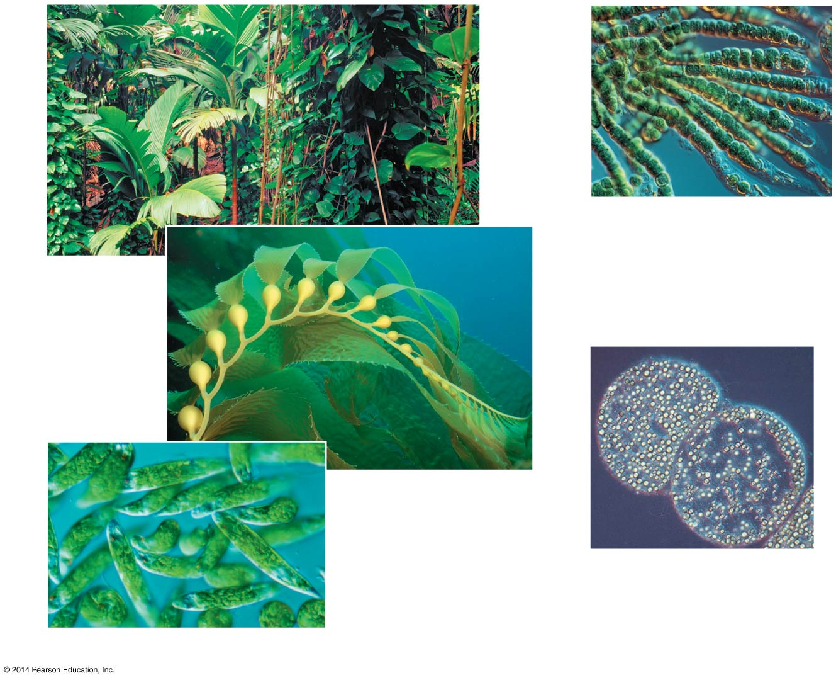
Figure 8.2
40 μm
(d) Cyanobacteria
(a) Plants
(b) Multicellular
alga
1 μm
(e) Purple sulfur
bacteria
10 μm
(c) Unicellular eukaryotes
Notes:
6
Figure 8.2 Photoautotrophs

Slide 7
Concept 8.1: Photosynthesis converts light energy to the chemical energy of food
The structural organization of photosynthetic cells includes enzymes and other molecules grouped together in a membrane
This organization allows for the chemical reactions of photosynthesis to proceed efficiently
Chloroplasts are structurally similar to and likely evolved from photosynthetic bacteria
© 2014 Pearson Education, Inc.
Notes:
7

