Slide 1
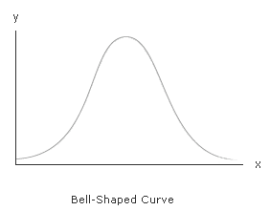
Parametric Data
The underlying source population is normally distributed.
We are going to assume that we are dealing with parametric data.

Slide 2
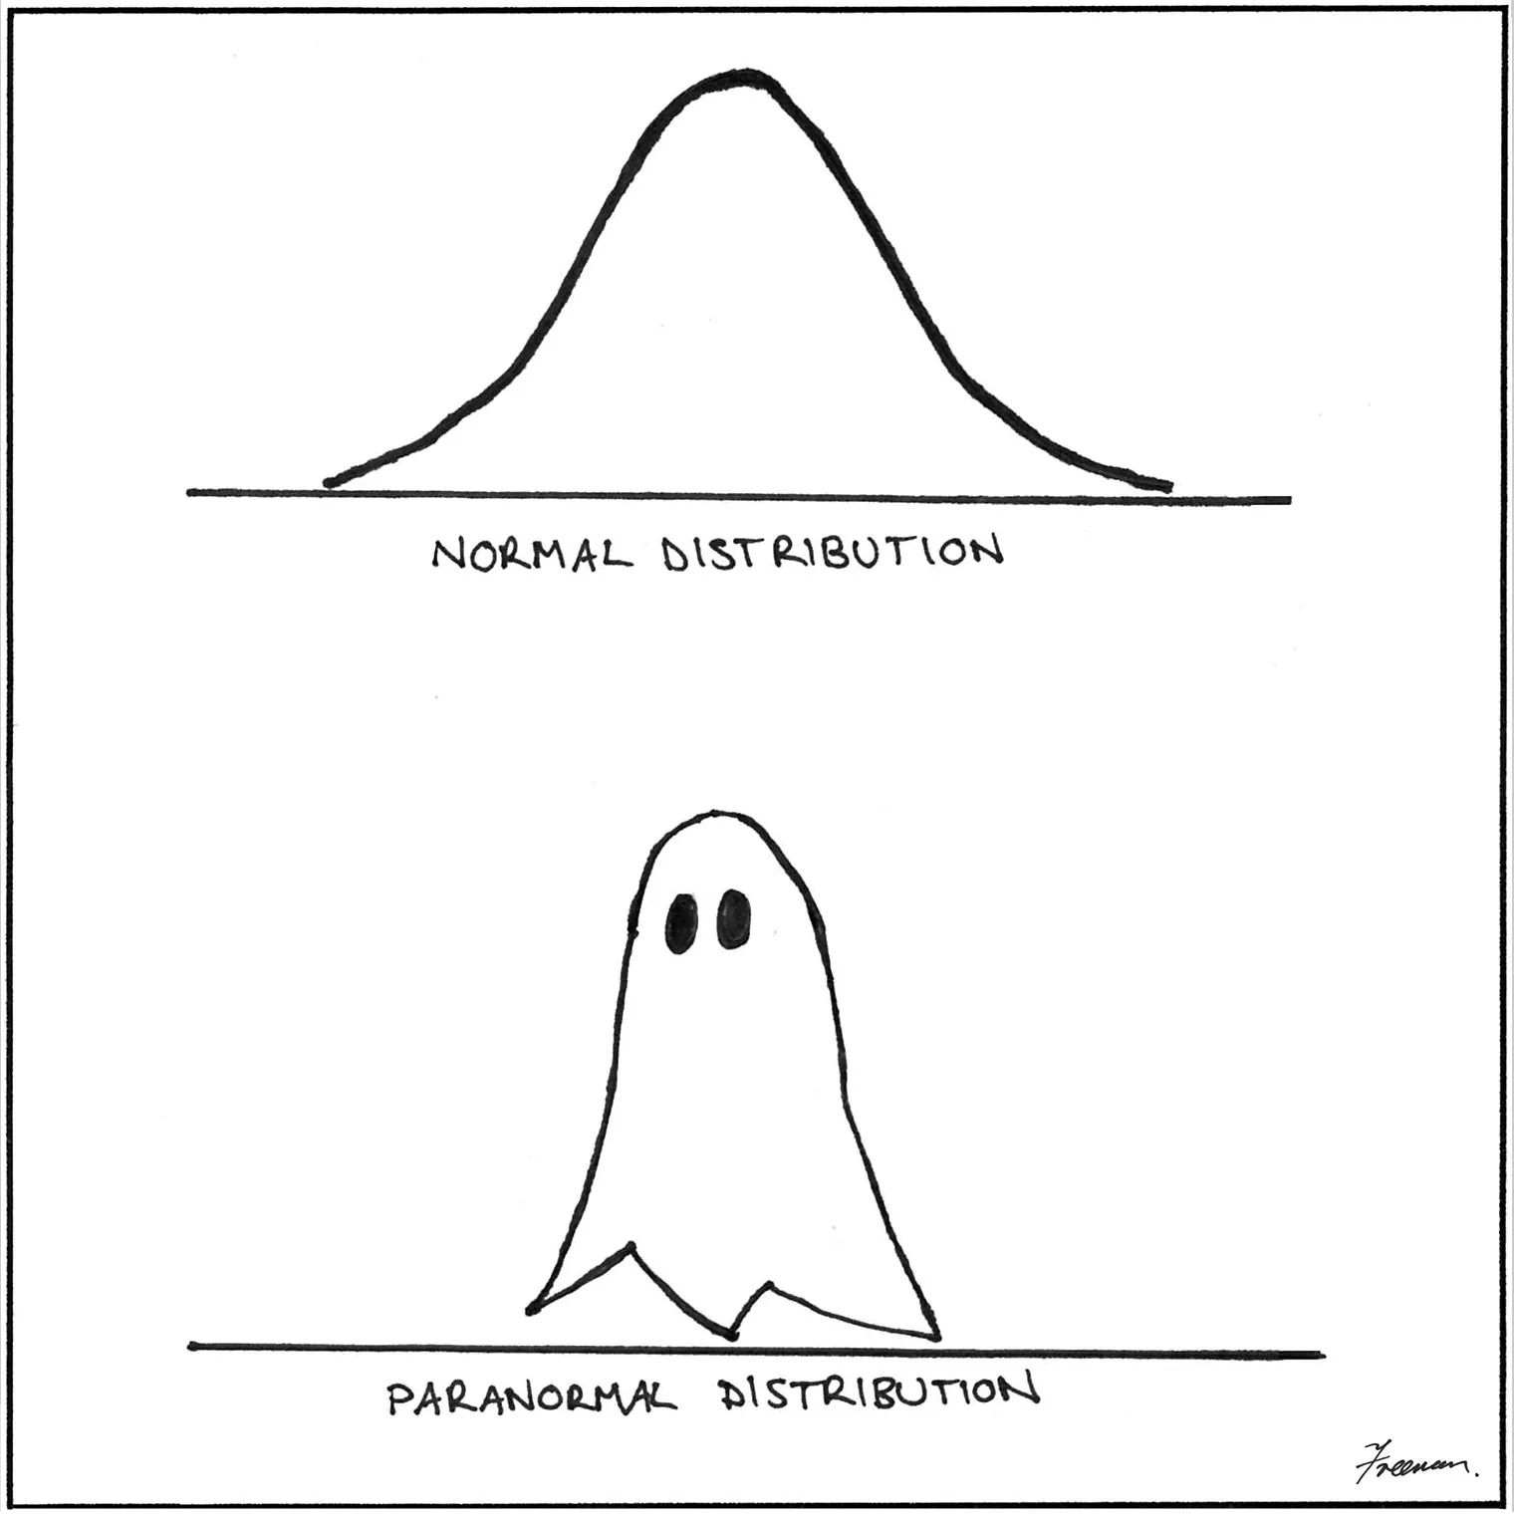

Slide 3
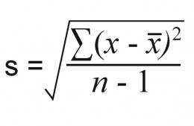
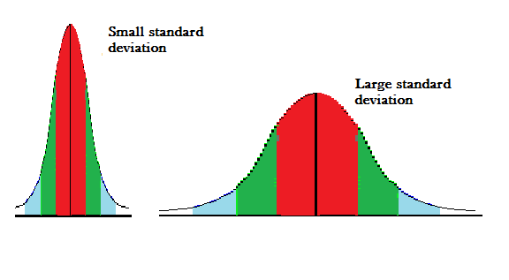
Standard Deviation
The standard deviation a way to measure how close together the elements are in a set of data. The standard deviation is the average distance between each data point and the mean.
X = each value
= mean
N = number of values

Slide 4
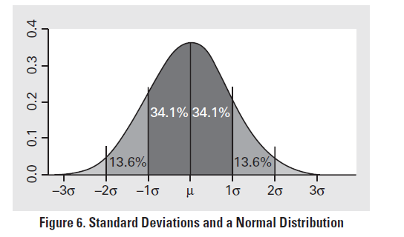
A little more that two-thirds of the data points fall between +1 standard deviation and -1 standard deviation from the sample mean. More than 95% of the data falls between ±2 standard deviations from the sample mean.
http://www.bozemanscience.com/standard-deviation/
http://www.bozemanscience.com/standard-error/

Slide 5
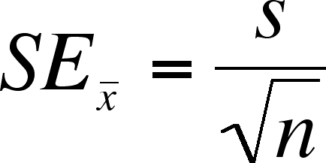
Standard Error
A statistic that allows you to make an inference about how well the sample mean matches up to the true population mean.
A sample mean of ±1 SE describes the range of values about which an investigator can have approximately 67% confidence that the range includes the true population mean. A sample with a ±2 SE defines a range of values with approximately a 95% certainty.

Slide 6
Example

Slide 7
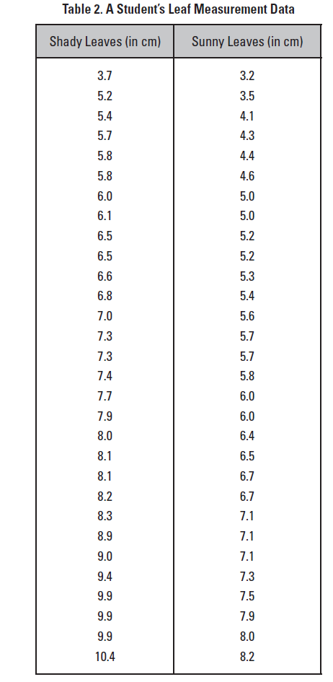
Do English ivy leaves grown in the shade have a larger surface area than English ivy leaves grown in the sun?

Slide 8
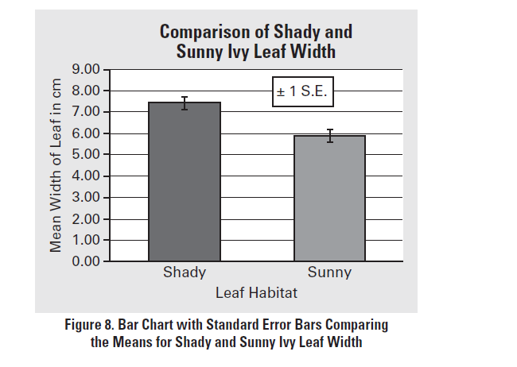
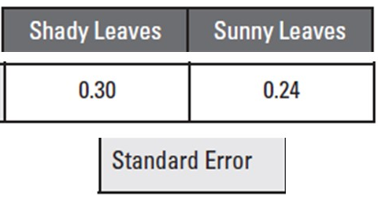
A sample mean of ±1 SE describes the range of values about which an investigator can have approximately 67% confidence that the range includes the true population mean. A sample with a ±2 SE defines a range of values with approximately a 95% certainty.

Slide 9
Notes:
It is evident from the graph that the error bars for the shady leaf mean do not overlap with the error bars for the sunny leaf mean. In fact, had the researchers chosen to plot ±2SE error bars, they, too, would not have overlapped. This non-overlap strongly suggests that there is a high probability that the two populations are indeed different from each other.

