Slide 1
There will be a double POGIL quiz on Monday

Slide 2
Fun Fact
If ATP could not be regenerated from ADP, humans would use up nearly their body weight in ATP each day.

Slide 3
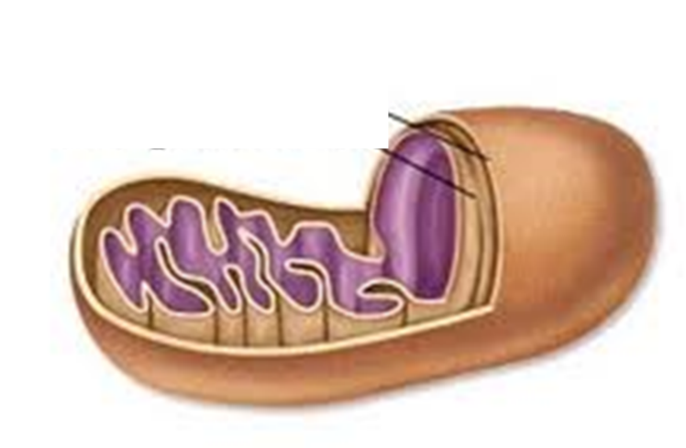
Model Mitochondria
Roll one sheet of paper into a tube and tape it closed. Make the tube as wide as you can. This represents the outer membrane of the mitochondrion.
Take another sheet of paper and fold it into a fan. (For best results, make each fold a little less than a centimeter.) Roll the fan-shaped paper into a tube to place it in the tube created in step one.
Outer memb.
Inner membrane
Not used.

Slide 4
0
Chapter 7
Oxidative Phosphorylation

Slide 5
You Must Know
How electrons from NADH and FADH₂ are passed to a series of electron acceptors to produce ATP by chemiosmosis.
The roles of the mitochondrial membrane, proton (H⁺) gradient, and ATP synthase in generating ATP.

Slide 6
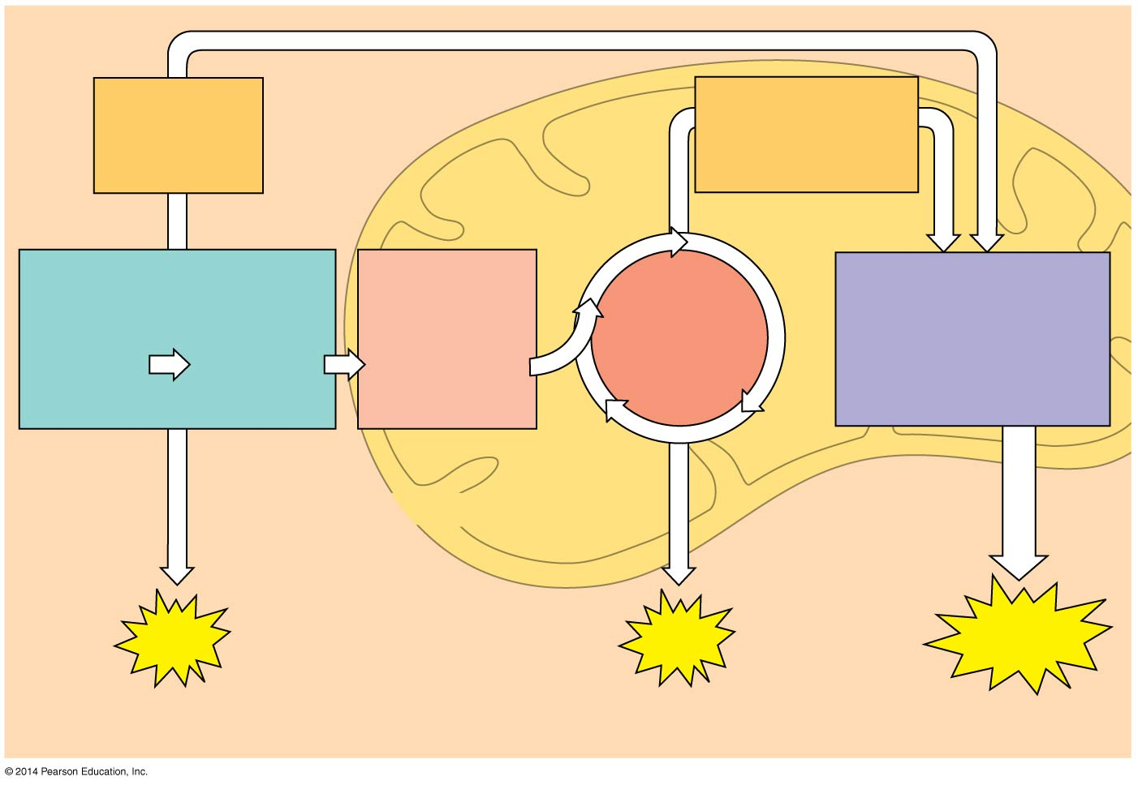
Figure 7.6-3
Electrons
via NADH and
FADH₂
Electrons
via NADH
Pyruvate
oxidation
Oxidative
phosphorylation:
electron transport
and
chemiosmosis
Glycolysis
Citric
acid
cycle
Video Overview
Glucose
Pyruvate
Acetyl CoA
CYTOSOL
MITOCHONDRION
ATP
ATP
ATP
Substrate-level
Substrate-level
Oxidative
90%
Notes:
6
Concept 7.4: During oxidative phosphorylation, chemiosmosis couples electron transport to ATP synthesis.
Following glycolysis and the citric acid cycle, NADH and FADH₂ account for most of the energy extracted from food.
These two electron carriers donate electrons to the electron transport chain, which powers ATP synthesis via oxidative phosphorylation.
Oxidative phosphorylation accounts for most of the ATP synthesis.
The process that generates most of the ATP is called oxidative phosphorylation because it is powered by redox reactions.
Oxidative phosphorylation accounts for almost 90% of the ATP generated by cellular respiration.

Slide 7
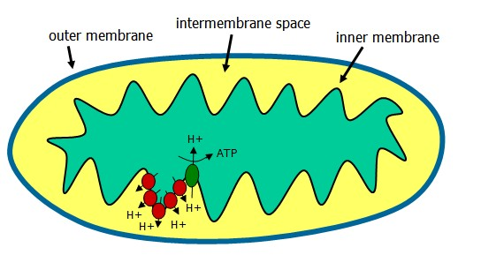

Slide 8
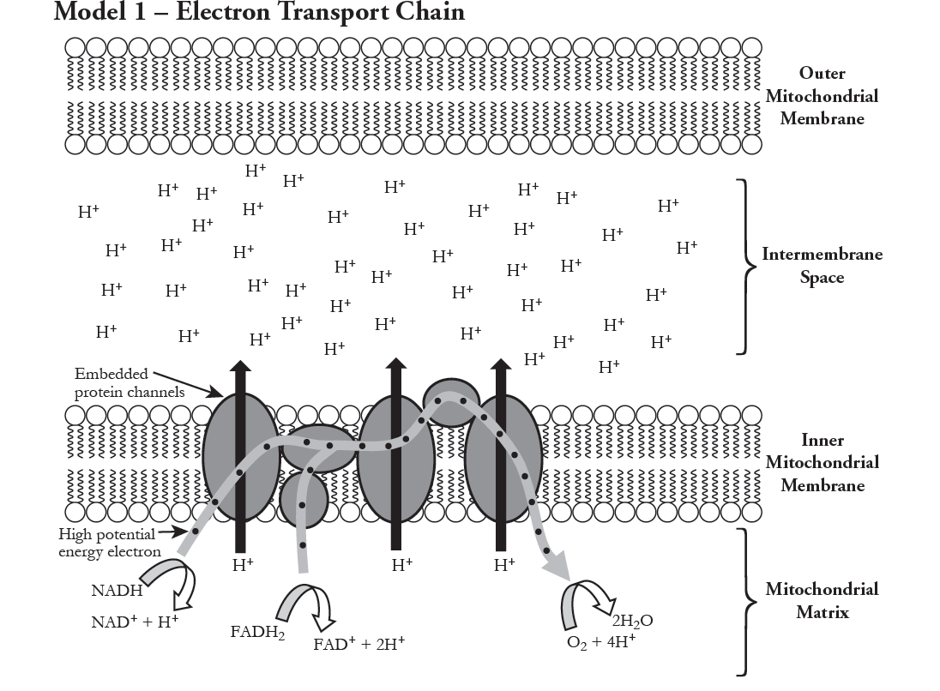
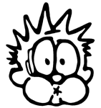
proton-motive force
Notes:
The electron transport chain is in the inner membrane (cristae) of the mitochondrion.
Most of the chain’s components are proteins, which exist in multiprotein complexes.
The carriers alternate reduced and oxidized states as they accept and donate electrons.
Electrons drop in free energy as they go down the chain and are finally passed to O₂, forming H₂O.
Electrons are transferred from NADH or FADH₂ to the electron transport chain.
Electron transfer in the electron transport chain causes proteins to pump H⁺ from the mitochondrial matrix to the intermembrane space.
The electron transport chain generates no ATP directly.
It breaks the large free-energy drop from food to O₂ into smaller steps that release energy in manageable amounts.

Slide 9
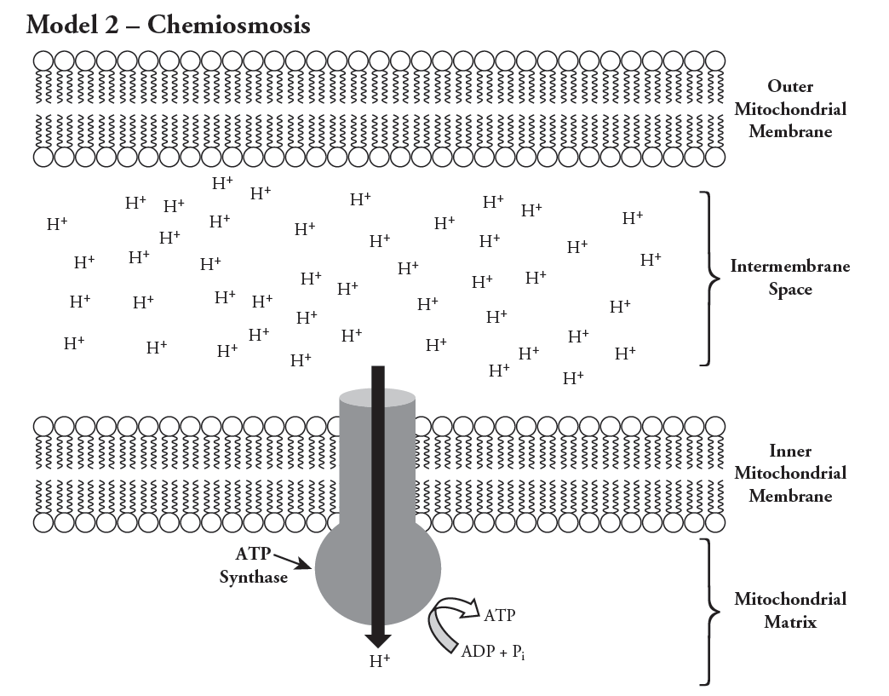
proton-motive force
ATP synthase uses the exergonic flow of H⁺ to drive phosphorylation of ATP.
Notes:
H⁺ then moves back across the membrane, passing through the protein complex, ATP synthase.
ATP synthase uses the exergonic flow of H⁺ to drive phosphorylation of ATP.
This is an example of chemiosmosis, the use of energy in a H⁺ gradient to drive cellular work.
The energy stored in a H⁺ gradient across a membrane couples the redox reactions of the electron transport chain to ATP synthesis.
The H⁺ gradient is referred to as a proton-motive force, emphasizing its capacity to do work.

Slide 10
H+
H+
H+
H+
H+
H+
H+
proton-motive force

Slide 11
H+
H+
H+
H+
H+
H+
H+
No proton-motive force

Slide 12
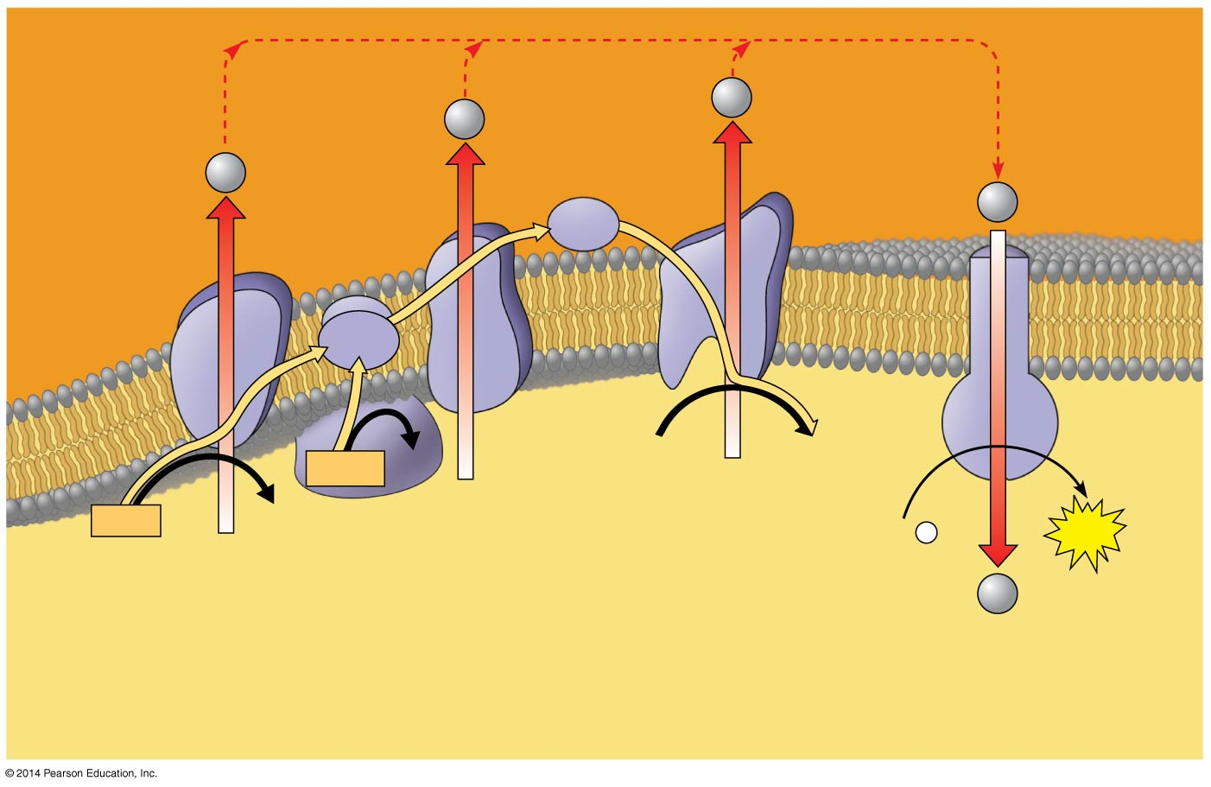
Figure 7.14
H⁺
H⁺
Protein
complex
of electron
carriers
H⁺
H⁺
Cyt c
Q
IV
I
III
ATP
synthase
II
2 H⁺ + ½ O₂
H₂O
FADH₂
FAD
NADH
NAD⁺
ADP +
P
ATP
(carrying electrons
from food)
_{i}
H⁺
1
Electron transport chain
2
Chemiosmosis
Oxidative phosphorylation
Notes:
12

Slide 13
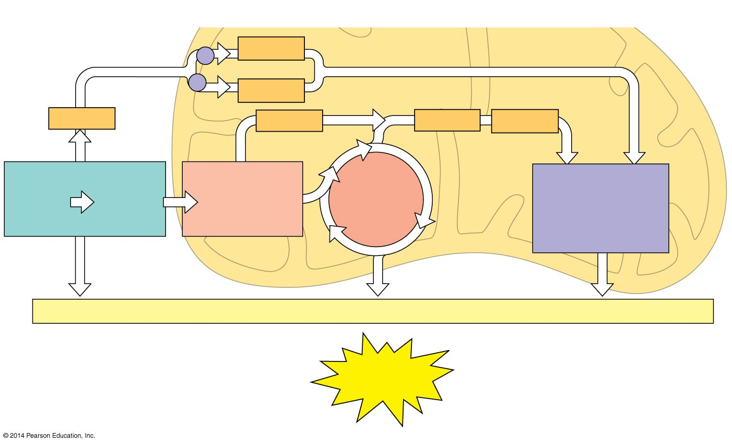
Electron shuttles
span membrane
NADH
MITOCHONDRION
CYTOSOL
FADH₂
NADH
NADH
NADH
FADH₂
or
Glycolysis
Pyruvate
oxidation
Acetyl CoA
Citric
acid
cycle
Oxidative
phosphorylation:
electron transport
and
chemiosmosis
Glucose
Pyruvate
+ 2 ATP
+ 2 ATP
+ about 26 or 28 ATP
Maximum per glucose:
About
30 or 32 ATP
During cellular respiration, most energy flows in the following sequence:
glucose →
NADH →
electron transport chain →
proton-motive force →
ATP
Notes:
13
About 34% of the energy in a glucose molecule is transferred to ATP during cellular respiration, making about 32 ATP.
ATP.

Slide 14
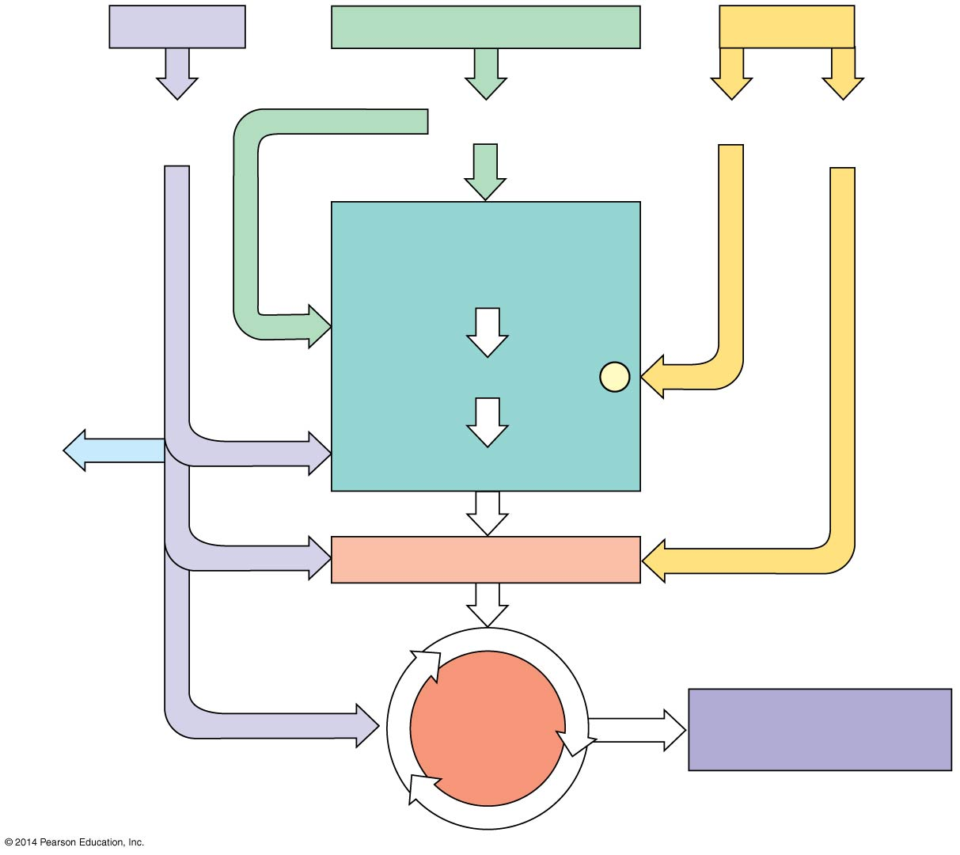
Proteins
Carbohydrates
Fats
Carbohydrates
Sugars
Amino
acids
Sugars
Glycerol
Fatty
acids
Glycolysis
Glycolysis
Glucose
Glucose
NH₃
Pyruvate
Pyruvate
Acetyl CoA
Acetyl CoA
Citric
acid
cycle
Citric
acid
cycle
Citric
acid
cycle
Oxidative
phosphorylation
Oxidative
phosphorylation
Notes:
14
You don’t need to memorize the details of the figure. You do need to remember the notes below.
Catabolic pathways funnel electrons from many kinds of organic molecules into cellular respiration.
An oxidized gram of fat produces more than twice as much ATP as an oxidized gram of carbohydrate.
The body uses small molecules to build other substances. Some of these small molecules come directly from food; others can be produced during glycolysis or the citric acid cycle.

