Slide 1
0
Chapter 7
Oxidation and Reduction
Energy transfers

Slide 2
You
Your lunch

Slide 3
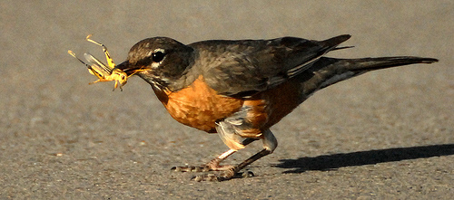
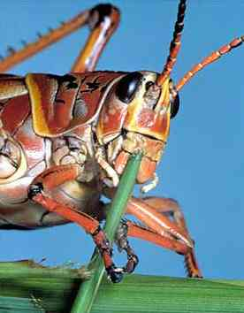
Overview: Life Is Work
Living cells require energy from outside sources.
Cells use chemical energy stored in organic molecules to regenerate ATP, which powers work.
© 2014 Pearson Education, Inc.
Notes:
3
Some animals obtain energy by eating plants, and some animals feed on other organisms that eat plants.

Slide 4
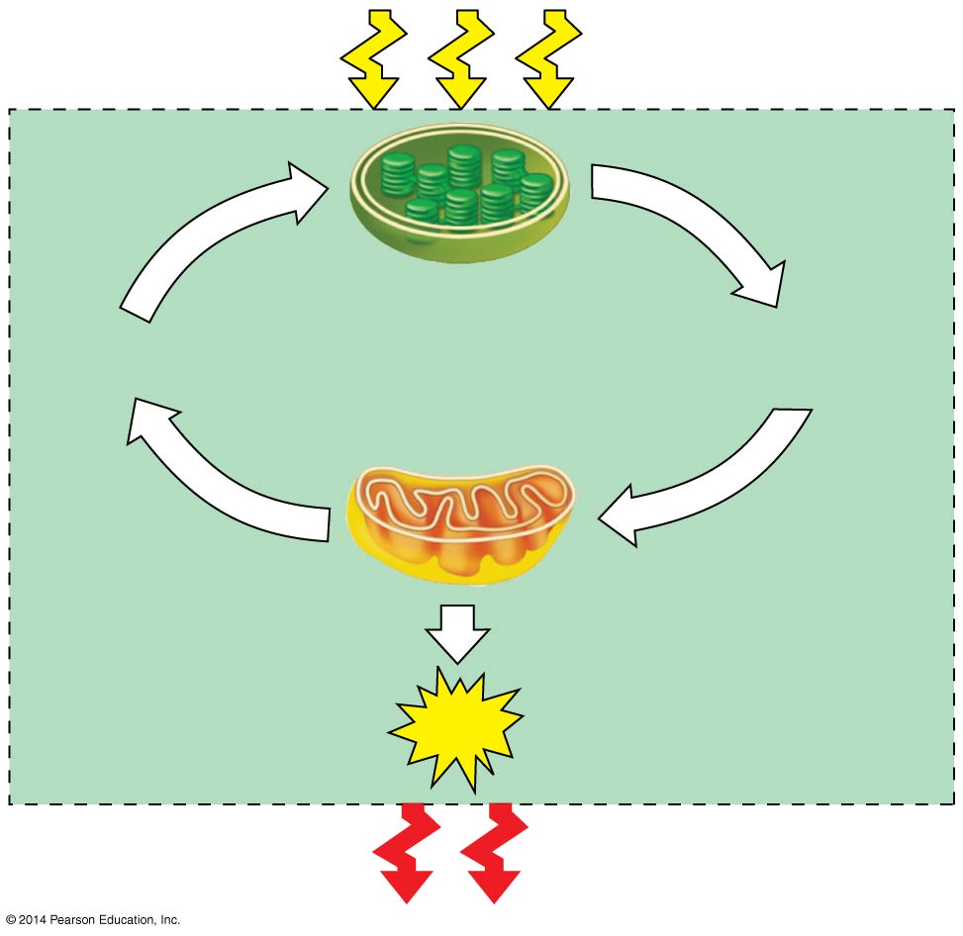
Light
energy
ECOSYSTEM
Photosynthesis
in chloroplasts
CO₂ + H₂O
Organic
molecules
+ O₂
Cellular respiration
in mitochondria
ATP
ATP powers
most cellular work
Heat
energy
Do plants have mitochondria?
Yes!
Notes:
4
Matter is recycled in ecosystems
Energy flows into an ecosystem as sunlight and leaves as heat
Photosynthesis generates O₂ and organic molecules, which are used as fuel for cellular respiration.

Slide 5
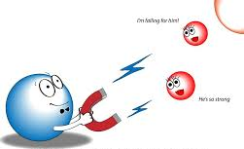
Electronegativity

Slide 6
Redox Reactions: Oxidation and Reduction
The transfer of electrons during chemical reactions releases energy stored in organic molecules. This released energy is ultimately used to synthesize ATP.
Chemical reactions that transfer electrons between reactants are called oxidation-reduction reactions, or redox reactions.
Notes:
6

Slide 7
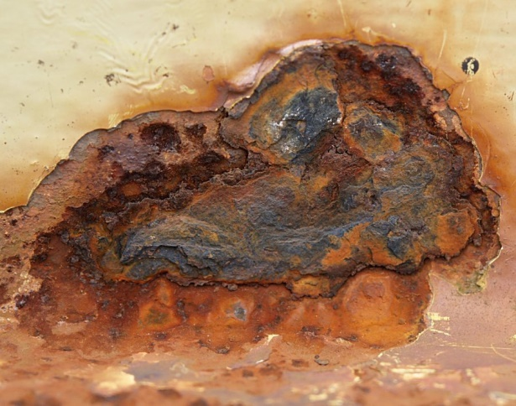
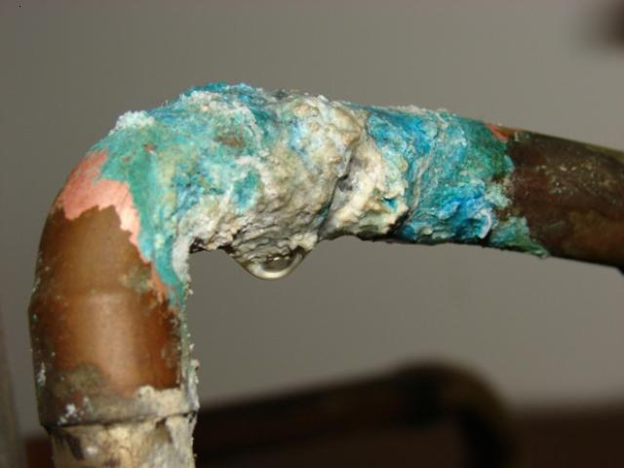
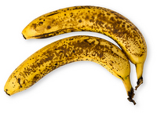
Oxidation
In oxidation, a substance loses electrons, or is oxidized.

Slide 8
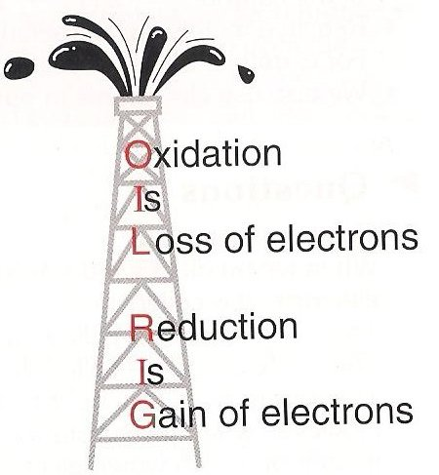
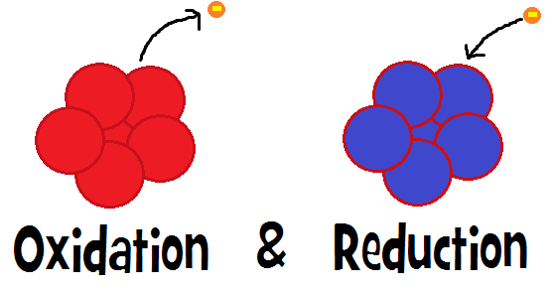
Reduction
In reduction, a substance gains electrons, or is reduced (the amount of positive charge is reduced).
© 2014 Pearson Education, Inc.
Notes:
8

Slide 9
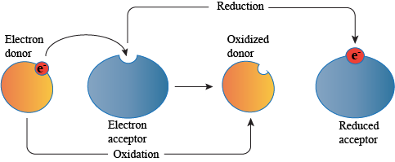

Slide 10
Figure 7.UN02
becomes
oxidized
becomes
reduced
The electron donor is called the reducing agent. (X)
The electron acceptor is called the oxidizing agent. (Y)
Notes:
10

Slide 11
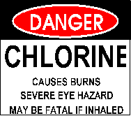
becomes oxidized
(loses electron)
becomes reduced
(gains electron)
(Na)
The electron donor AKA the reducing agent. _____
The electron acceptor AKA the oxidizing agent. _____
(Cl)
Notes:
11

Slide 12
Some redox reactions do not transfer electrons but change the electron sharing in covalent bonds.
Reactants
Products
becomes oxidized
becomes reduced
(reducing
agent)
Water
Methane
(oxidizing
agent)
Carbon dioxide
Oxygen
Notes:
12
An example is the reaction between methane and O_{2.}
Redox reactions that move electrons closer to electronegative atoms, like oxygen, release chemical energy that can be put to work.
“Energy must be added to pull an electron away from an atom, just as energy is required to push a ball uphill. The more electronegative the atom, the more energy is required to take an electron away from it. An electron loses potential energy when it shifts from a less electronegative atom toward amore electronegative one, just as a ball loses potential energy when it rolls downhill. A redox reaction that moves electrons closer to oxygen, such as the burning (oxidation) of methane, therefore releases chemical energy that can be put to work. “ Textbook p. 137

