Slide 1
0
Chapter 7
Glycolysis and the Citric Acid Cycle

Slide 2
You Must Know
NAD+ and NADH
The role of glycolysis in oxidizing glucose to two molecules of pyruvate.
How pyruvate is moved from the cytosol into the mitochondria and introduced into the citric acid cycle.
That the citric acid cycle oxidizes organic molecules to produce NADH and FADH₂

Slide 3
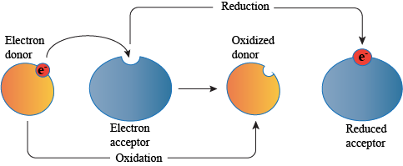

Slide 4
Respiration
becomes oxidized
becomes reduced
For each molecule of glucose degraded to CO₂ and water by respiration, the cell makes up to 32 molecules of ATP
Notes:
4
During cellular respiration, the fuel (such as glucose) is oxidized, and O₂ is reduced.
Organic molecules with an abundance of hydrogen, like carbohydrates and fats, are excellent fuels.
As hydrogen (with its electron) is transferred to oxygen, energy is released that can be used in ATP synthesis.

Slide 5
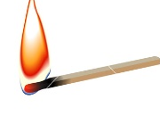
Notes:
In cellular respiration, glucose and other organic molecules are broken down in a series of steps.

Slide 6
What is the difference?
NAD⁺
NADH

Slide 7
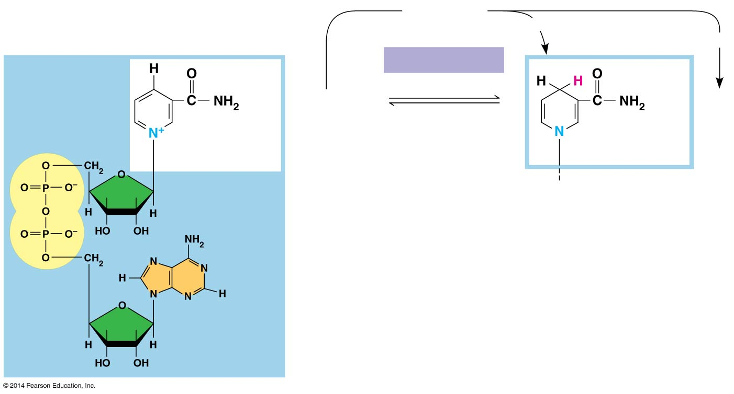
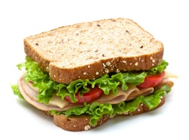
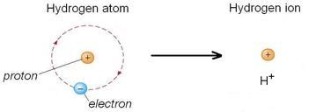
During respiration, electrons from organic compounds are usually first transferred to NAD⁺ thus forming NADH
Oxidized form
NAD⁺
2 e⁻+ 2 H⁺
2 e⁻ + H⁺
H⁺
Dehydrogenase
Reduction of NAD⁺
+
+ 2[H]
(from food)
H⁺
Oxidation of NADH
Nicotinamide
(oxidized form)
Nicotinamide
(reduced form)
NADH
Reduced form
Notes:
7
As an electron acceptor, NAD⁺ functions as an oxidizing agent during cellular respiration. Each NADH (the reduced form of NAD⁺) represents stored energy that is tapped to synthesize ATP.
(You don’t need to know what NAD+ and NADH look like)

Slide 8
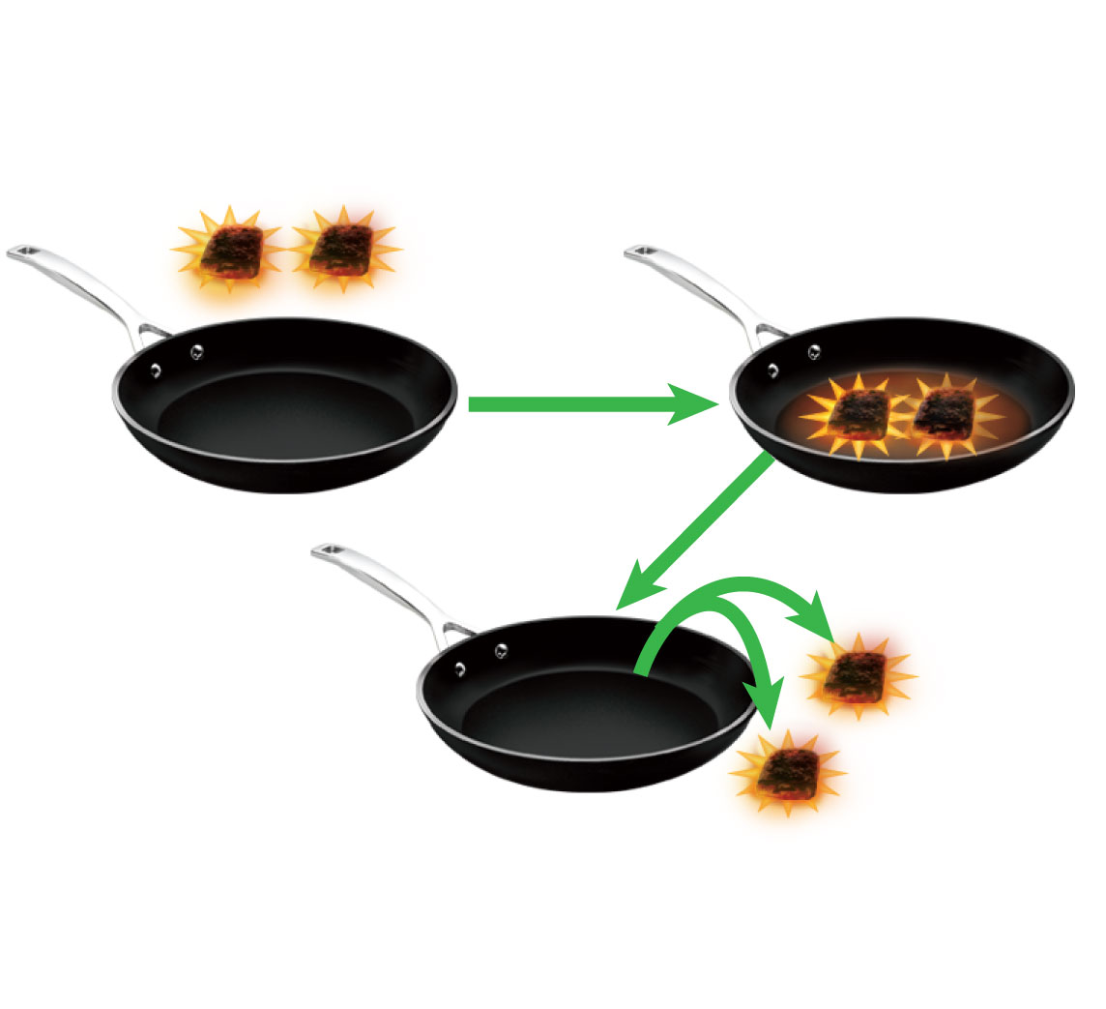
Complete the analogy
Electrons
1.
NADH
2.
3.
NAD⁺
NAD⁺
Electrons
NADH
2.
NAD⁺
1.
Electrons
Notes:
Encourage students to think of the high-energy electron as being similar to a hot coal.
Like a pan being used to carry hot coals, NAD+ carries pairs of electrons and an H+ ion from place to place.

Slide 9
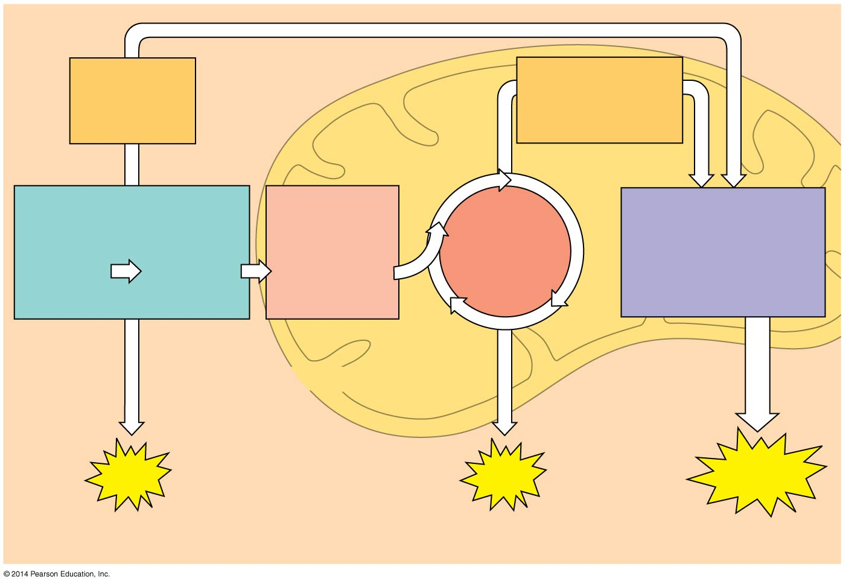
Overview of cellular respiration
Electrons
via NADH and
FADH₂
Electrons
via NADH
Pyruvate
oxidation
Oxidative
phosphorylation:
electron transport
and
chemiosmosis
Glycolysis
Citric
acid
cycle
Glucose
Pyruvate
Acetyl CoA
CYTOSOL
MITOCHONDRION
ATP
ATP
ATP
Substrate-level
Substrate-level
Oxidative
Notes:
9

Slide 10
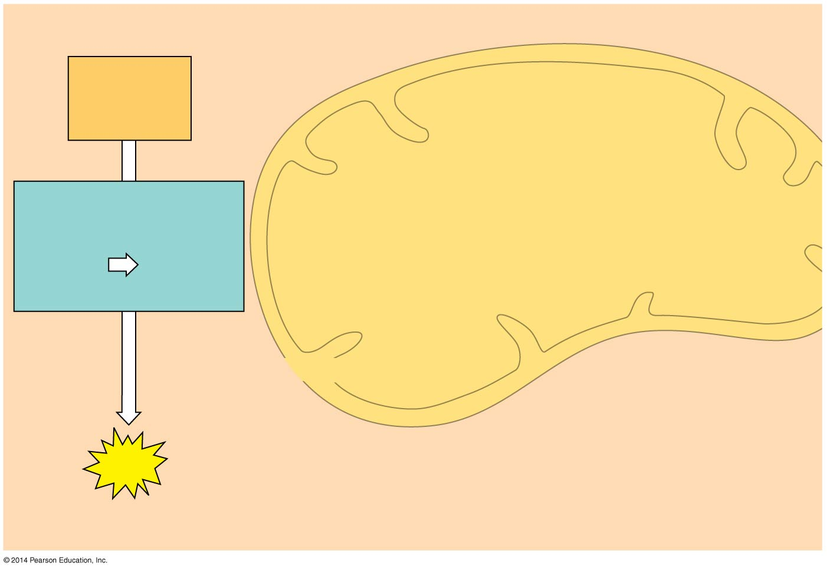
Glycolysis occurs whether or not O₂ is present.
Electrons
via NADH
Glycolysis
Glucose
Pyruvate
CYTOSOL
MITOCHONDRION
ATP
Substrate-level
Net gain of 2 ATP
Notes:
10
Glycolysis (breaks down glucose into two molecules of pyruvate)
A net gain of 2 ATP are formed by substrate level phosphorylation

Slide 11
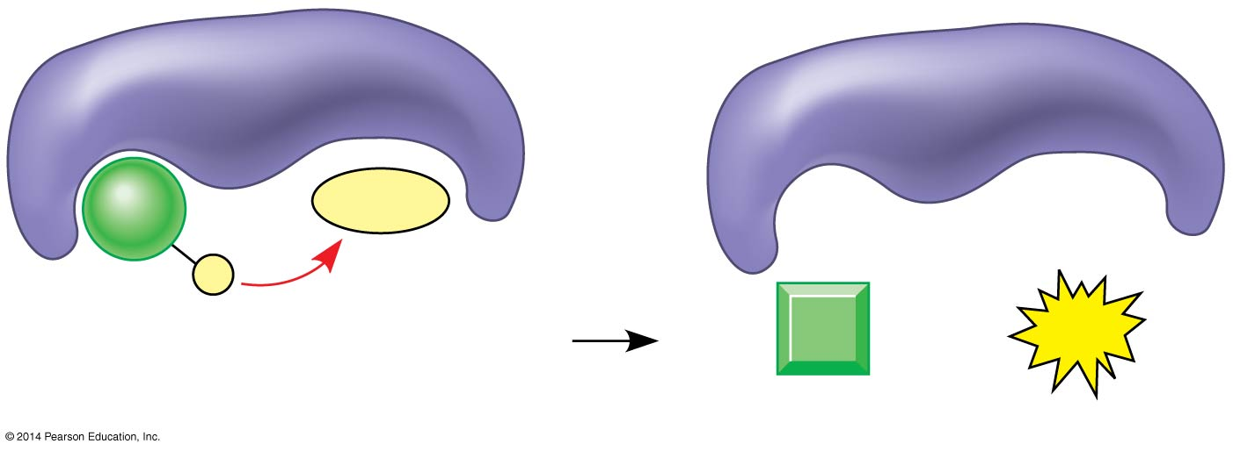
Substrate-level phosphorylation
Enzyme
Enzyme
ADP
P
Substrate
+
ATP
Product
Notes:
11
Figure 7.7

Slide 12
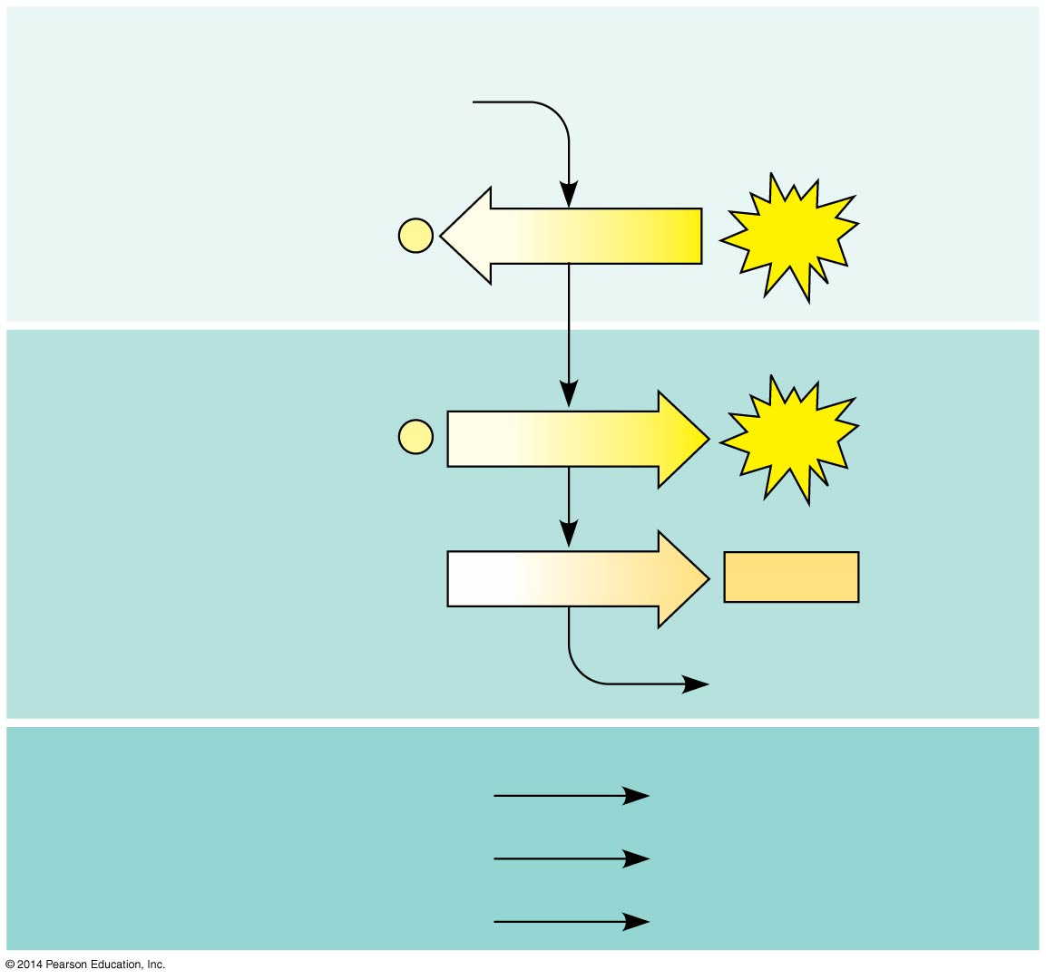
Glycolysis
Energy Investment Phase
Glucose
2 ADP + 2
P
2 ATP
used
Energy Payoff Phase
4 ADP + 4
P
4 ATP
formed
2 NAD⁺ + 4 e⁻ + 4 H⁺
2 NADH
+ 2 H⁺
2 Pyruvate + 2 H₂O
Net
Glucose
2 Pyruvate + 2 H₂O
4 ATP formed − 2 ATP used
2 ATP
2 NAD⁺ + 4 e⁻ + 4 H⁺
2 NADH + 2 H⁺
Notes:
12
Glycolysis harvests chemical energy by oxidizing glucose to pyruvate.
Glycolysis (“sugar splitting”) breaks down glucose into two molecules of pyruvate.
Glycolysis occurs in the cytoplasm and has two major phases.
Energy investment phase
Energy payoff phase
You only need to remember the details of the “net”

Slide 13
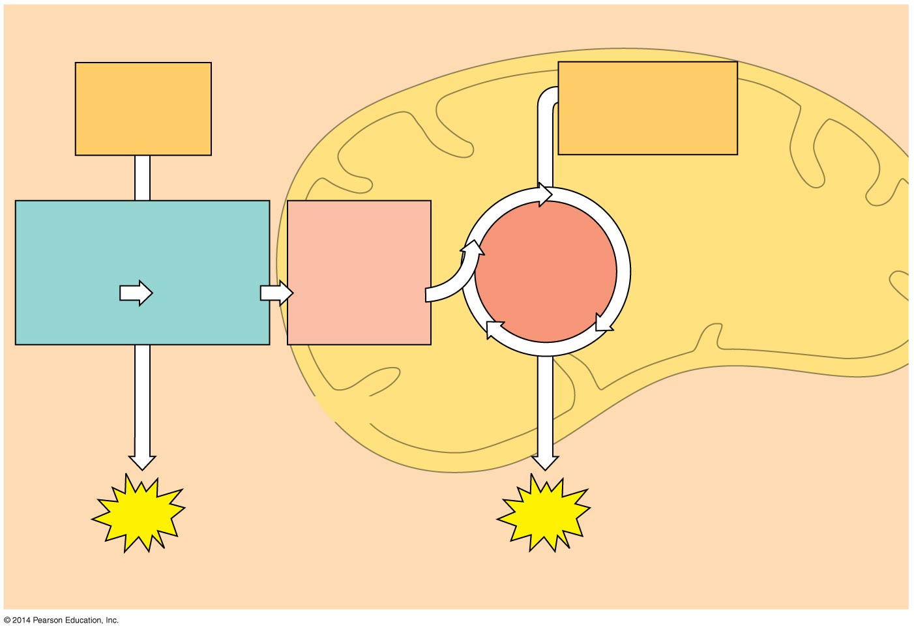
Figure 7.6-2
Electrons
via NADH and
FADH₂
Electrons
via NADH
Pyruvate
oxidation
Glycolysis
Citric
acid
cycle
Glucose
Pyruvate
Acetyl CoA
CYTOSOL
MITOCHONDRION
ATP
ATP
Substrate-level
Substrate-level
Notes:
13
Pyruvate oxidation and the citric acid cycle (aka the Krebs Cycle) (completes the breakdown of glucose)
A small amount of ATP are formed by substrate level phosphorilation. : After pyruvate is oxidized, the citric acid cycle completes the energy-yielding oxidation of organic molecules.

Slide 14
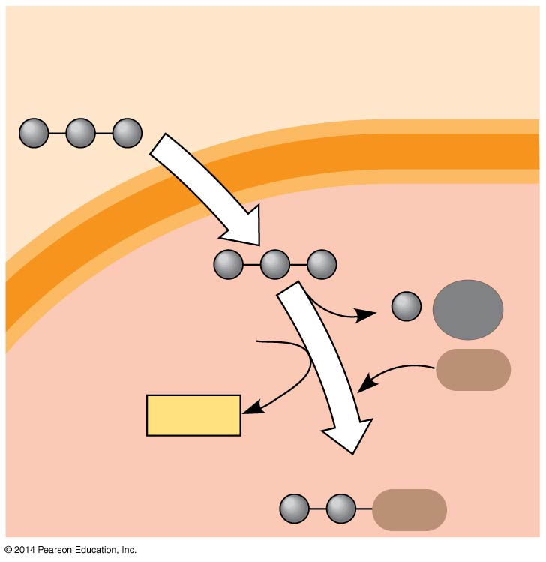
In the presence of O₂, pyruvate enters the mitochondrion
Pyruvate
(from glycolysis,
2 molecules per glucose)
CYTOSOL
Pyruvate is oxidized
CO₂
NAD⁺
CoA
NADH
+ H⁺
Acetyl CoA
MITOCHONDRION
CoA
Notes:
14
Before the citric acid cycle can begin, pyruvate must be converted to acetyl coenzyme A (acetyl CoA), which links glycolysis to the citric acid cycle.
After glycolysis, pyruvate is oxidized to acetyl CoA. This junction between glycolysis and the citric acid cycle is shown in Figure 7.1. Note the following steps in the figure:
A transport protein moves pyruvate from the cytosol into the matrix of the mitochondria.
In the matrix an enzyme complex catalyzes three reactions: a CO₂ is removed, electrons are stripped from pyruvate to convert NAD+ to NADH, and coenzyme A joins with the remaining two-carbon fragment to form acetyl CoA.

Slide 15
Figure 7.6-2
Electrons
via NADH and
FADH₂
Electrons
via NADH
Pyruvate
oxidation
Glycolysis
Citric
acid
cycle
Glucose
Pyruvate
Acetyl CoA
CYTOSOL
MITOCHONDRION
ATP
ATP
Substrate-level
Substrate-level
Notes:
15

Slide 16
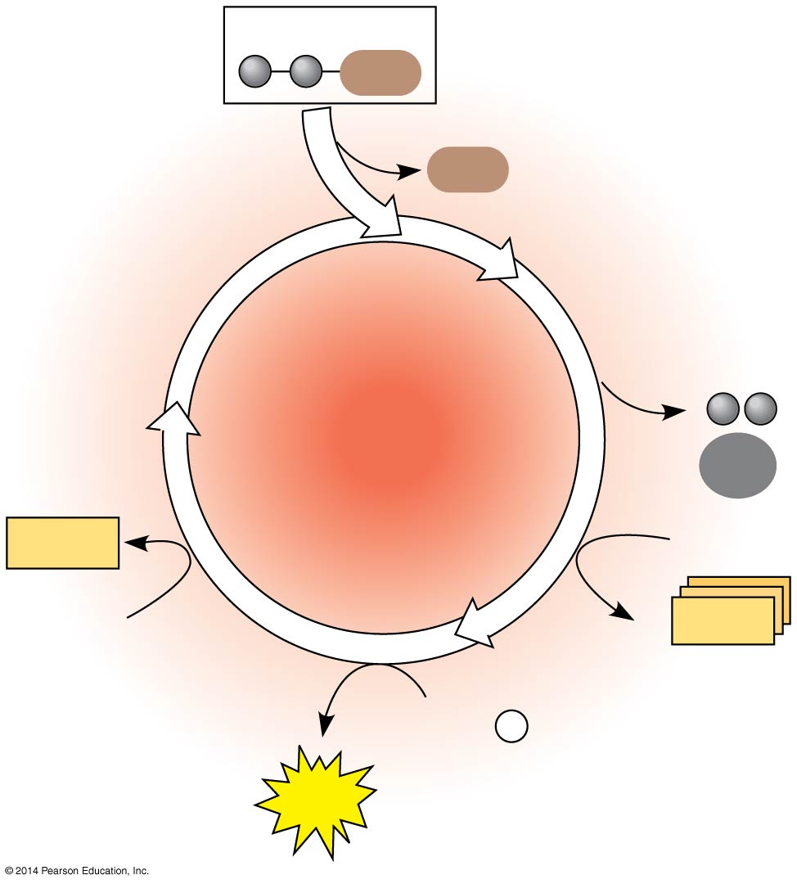
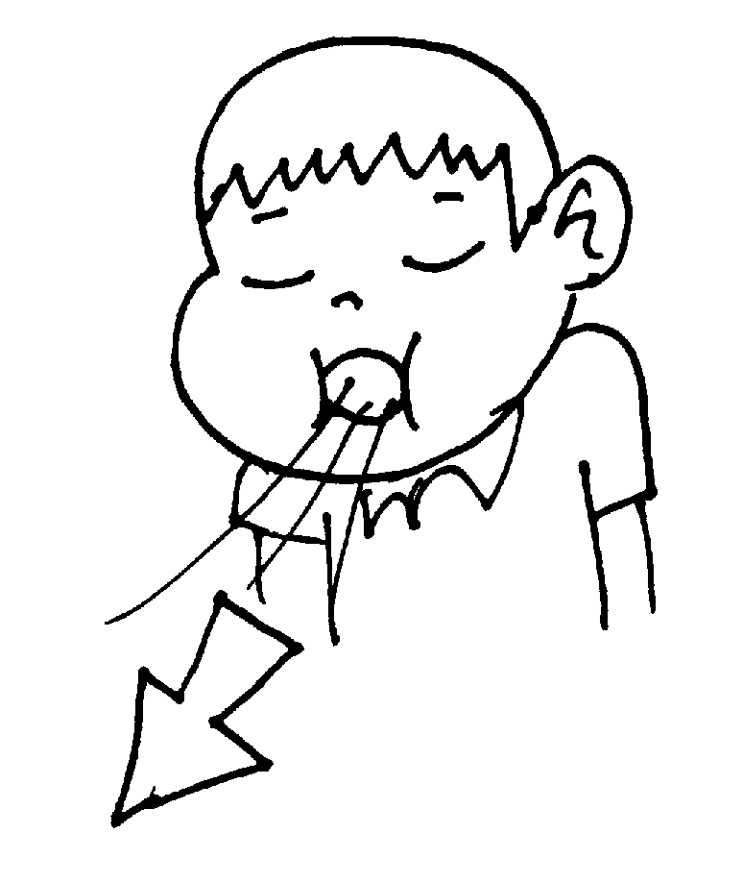
Figure 7.10b
Citric Acid Cycle
Acetyl CoA
CoA
Oxidized
CoA
Citric
acid
cycle
Reduced
2
CO₂
FADH₂
3 NAD⁺
FAD
3
NADH
+ 3 H⁺
Reduced
ADP +
P
_{i}
ATP
The NADH and FADH₂ produced by the cycle relay electrons extracted from food to the electron transport chain.
Notes:
16
The citric acid cycle, also called the Krebs cycle, completes the breakdown of pyruvate to CO_{2.}
All along the citric acid cycle organic molecules are oxidized and NAD⁺ is reduced to become NADH and FAD is reduced to become FADH₂.
The cycle oxidizes organic fuel derived from pyruvate, generating 1 ATP, 3 NADH, and 1 FADH₂ per turn.
Because each glycose yields two pyruvates, the total products of the citric acid cycle are usually listed as the result of two cycles: 4CO_{2,} 6 NADH, 2 FADH₂, and 2 ATP.

