Slide 1
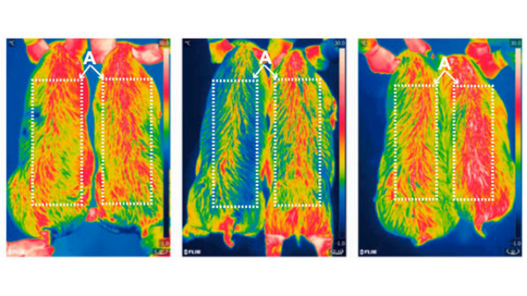
CRISPR Bacon: Chinese Scientists Create Genetically Modified Low-Fat Pigs
October 23, 2017
Notes:
(You don’t need to know this for the test)
Significance
Uncoupling protein 1 (UCP1) is responsible for brown adipose tissue-mediated thermogenesis and plays a critical role in protecting against cold and regulating energy homeostasis. Modern pigs lack functional UCP1, which makes them susceptible to cold and prone to fat deposition and results in neonatal mortality and decreased production efficiency. In the current study, a CRISPR/Cas9-mediated homologous recombination-independent approach was established, and mouse adiponectin-UCP1 was efficiently inserted into the porcine endogenous UCP1 locus. The resultant UCP1 KI pigs showed an improved ability to maintain body temperature, decreased fat deposition, and increased carcass lean percentage. UCP1 KI pigs are a potentially valuable resource for the pig industry that can improve pig welfare and reduce economic losses.
Reconstitution of UCP1 using CRISPR/Cas9 in the white adipose tissue of pigs decreases fat deposition and improves thermogenic capacity (Proceedings of the National Academy of Sciences)

Slide 2
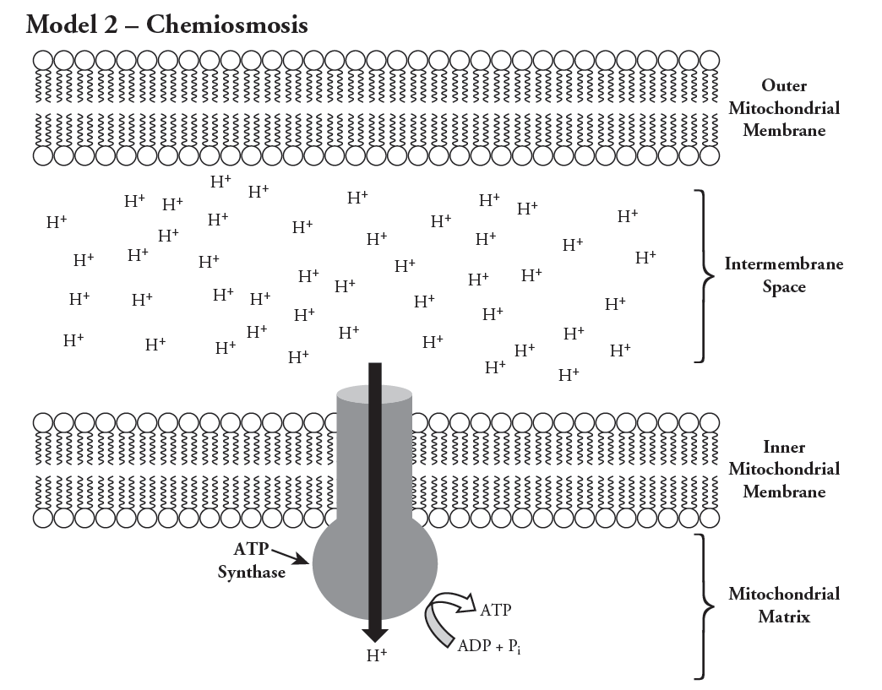
proton-motive force
UCP1
Heat

Slide 3
0
Chapter 7
Fermentation

Slide 4
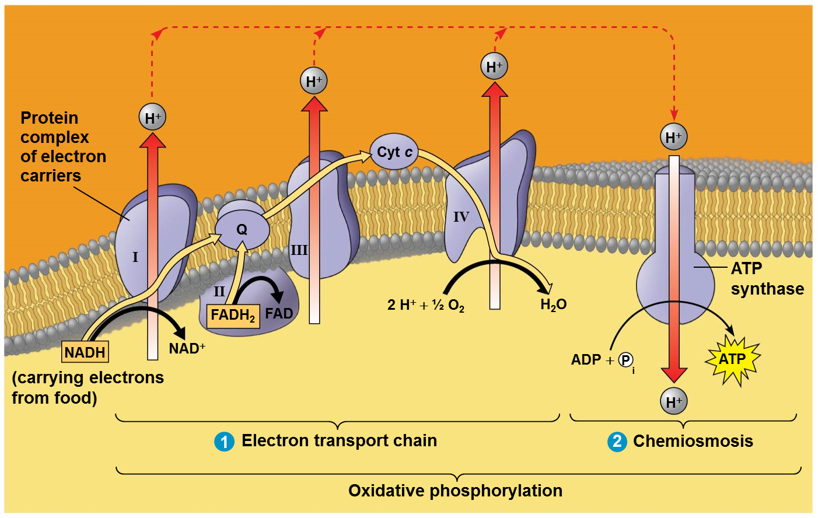
What will happen to the electron transport chain (ETC) if no O₂ is available?
The ETC will stop.
Notes:
4
Without O₂, the electron transport chain will cease to operate, a proton motive force will not be created and no ATP will be made by oxidative phosphorylation. If the electron transport chain is not operating, glycolysis couples with fermentation to produce ATP.

Slide 5
Will oxidative phosphorylation produce ATP if no O₂ is available?
NO
Notes:
5

Slide 6
Will NADH be oxidized to NAD+ if no O₂ is available?
NO
Notes:
6

Slide 7
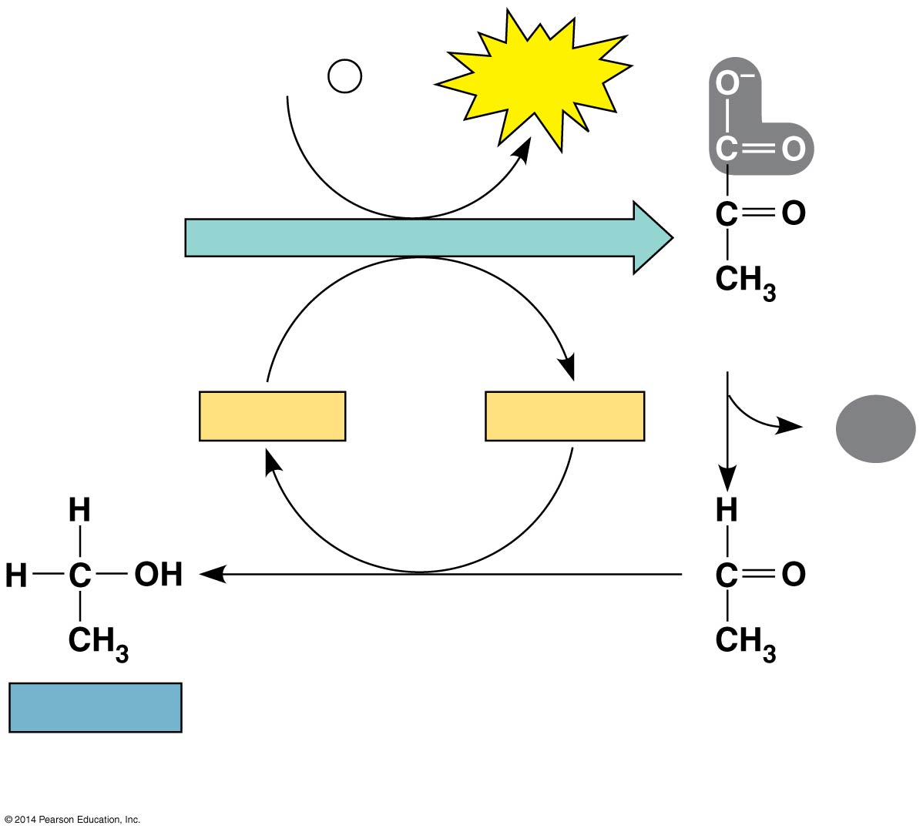
Figure 7.16a
2 ADP + 2
P
_{i}
2 ATP
Reactants
Glucose
Glycolysis
2 Pyruvate
2 NAD⁺
2 NADH
2
Can glycolysis occur without NAD+?
NO
Notes:
7

Slide 8
Fermentation
Occurs under anaerobic conditions (no O₂)
Consists of glycolysis plus reactions that regenerate NAD⁺, which can be reused by glycolysis.
Two common types are alcoholic and lactic acid.

Slide 9
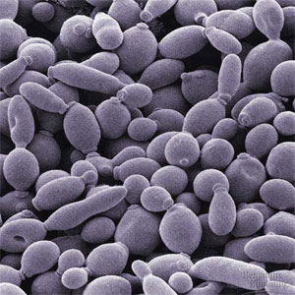
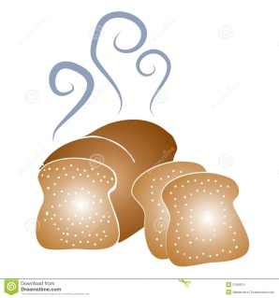
2 ADP + 2
P
2 ATP
_{i}
2 ATP
Glucose
Glycolysis
2 Pyruvate
2 NAD⁺
2 NADH
2
CO₂
+ 2 H⁺
2 Ethanol
(a) Alcohol fermentation
Notes:
9
Fermentation consists of glycolysis plus reactions that regenerate NAD⁺, which can be reused by glycolysis.
Ethanol and CO₂ are waste products of alcohol fermentation.
In alcohol fermentation, pyruvate is converted to ethanol and CO₂ is released.
Alcohol fermentation by yeast is used in brewing, winemaking, and baking.
(You don’t need to know the chemical formulas for the test.)

Slide 10
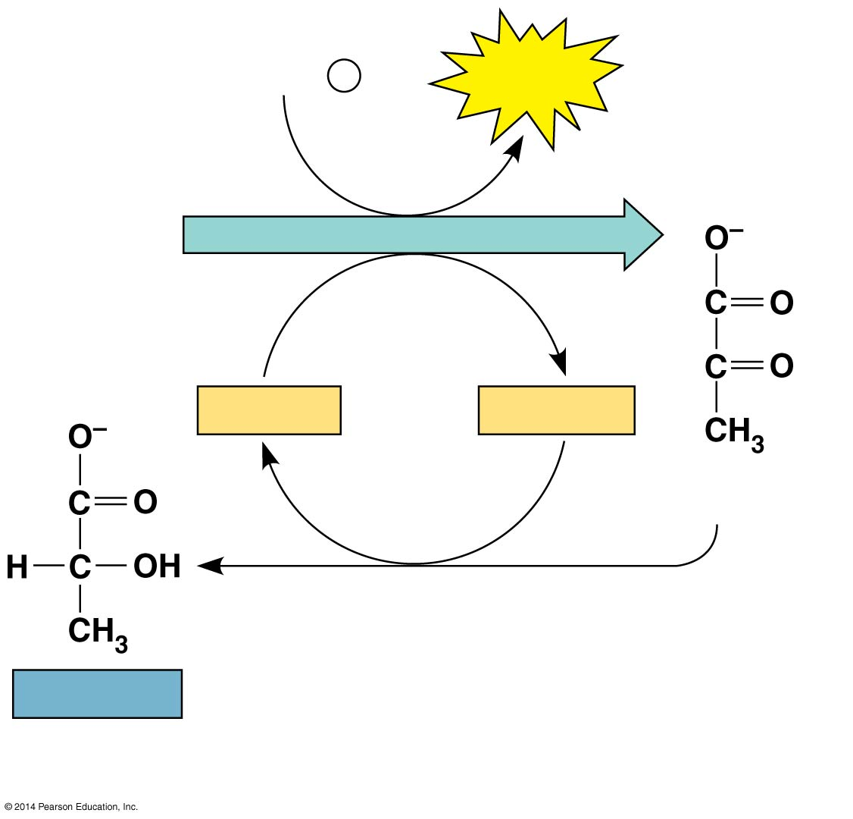
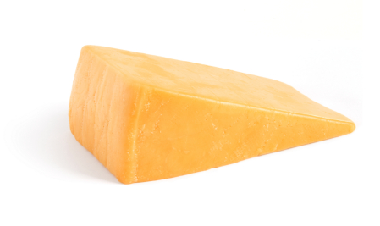
Lactic acid fermentation
2 ADP + 2
P
_{i}
2 ATP
Glucose
Glycolysis
2 NAD⁺
2 NADH
+ 2 H⁺
2 Pyruvate
2 Lactate
Notes:
10
In lactic acid fermentation, pyruvate is reduced by NADH, forming lactate as an end product, with no release of CO_{2.}
Lactic acid fermentation by some fungi and bacteria is used to make cheese and yogurt.
Human muscle cells use lactic acid fermentation to generate ATP when O₂ is scarce.
(You don’t need to know the chemical formulas for the test.)

Slide 11
Obligate anaerobes
carry out only fermentation or anaerobic respiration and cannot survive in the presence of O_{2.}
© 2014 Pearson Education, Inc.
Notes:
11
You don’t need to worry about anaerobic respiration for this test….

Slide 12
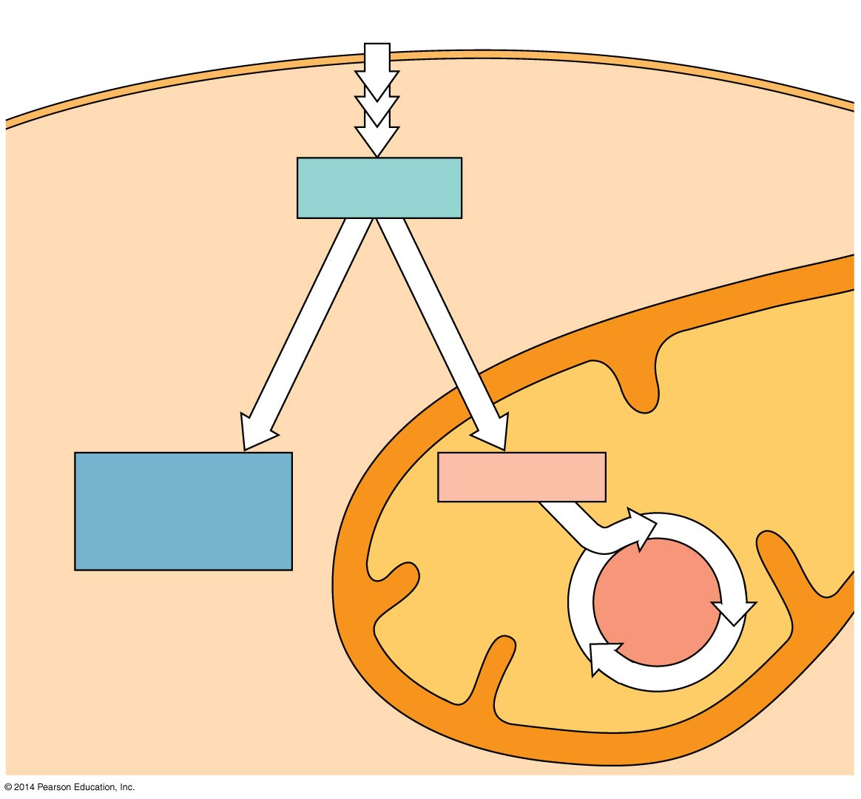
Facultative anaerobes
Glucose
Glycolysis
CYTOSOL
Pyruvate
No O₂ present:
Fermentation
O₂ present:
Aerobic cellular
respiration
MITOCHONDRION
Ethanol,
lactate, or
other products
Acetyl CoA
Citric
acid
cycle
Notes:
12
Yeast and many bacteria are facultative anaerobes, meaning that they can survive using either fermentation or cellular respiration.
In a facultative anaerobe, pyruvate is a fork in the metabolic road that leads to two alternative catabolic routes. Facultative anaerobes living in a anaerobic environment will use more glucose than the same anaerobe living in an aerobic environment.

Slide 13
The Evolutionary Significance of Glycolysis
Life first evolved about 3.5 billion years ago. Very little O₂ was available in the atmosphere until about 2.7 billion years ago.
Therefore, the first life forms were probably __________ __________
Glycolysis is the most widespread metabolic pathway!
anaerobic
prokaryotes.
Notes:
13
Ancient prokaryotes are thought to have used glycolysis long before there was oxygen in the atmosphere.
Very little O₂ was available in the atmosphere until about 2.7 billion years ago, so early prokaryotes likely used only glycolysis to generate ATP.
Glycolysis is a very ancient process.

