Slide 1
The Chapter 6 Homework is due on Tuesday, October 22 at 11:59 pm.

Slide 2
https://www.youtube.com/watch?v=j0h7eljFb0Q
Chapter 6
0
Metabolism and Energy
Is this mess going to clean itself up?

Slide 3
You Must Know
Catabolic and anabolic pathways
Different types of energy
The 1st and 2nd Laws of Thermodynamics and how they relate to the energy in organisms.

Slide 4
Concept 6.1: An organism’s metabolism transforms matter and energy
Metabolism is the totality of an organism’s chemical reactions.
A metabolic pathway begins with a specific molecule and ends with a product.
Each step is catalyzed by a specific enzyme.
Enzyme 1
Enzyme 2
Enzyme 3
Starting
molecule
A
B
C
D
Product
Reaction 1
Reaction 2
Reaction 3
© 2014 Pearson Education, Inc.
Notes:
4

Slide 5
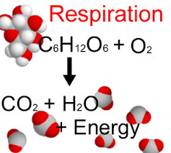
Catabolic pathways:
release energy by breaking down complex molecules into simpler compounds.
© 2014 Pearson Education, Inc.
Notes:
5
Cellular respiration, the breakdown of glucose in the presence of oxygen, is an example of a pathway of catabolism.

Slide 6
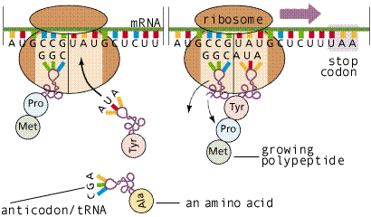
Anabolic pathways:
consume energy to build complex molecules from simpler ones.
Anna
Energy source (cookie)
Notes:
6
The synthesis of protein from amino acids is an example of anabolism.

Slide 7
Forms of Energy
Energy is the capacity to cause change.
Energy exists in various forms, some of which can perform work.
© 2014 Pearson Education, Inc.
Notes:
7

Slide 8
Kinetic energy:
energy associated with motion.
Thermal energy:
kinetic energy associated with random movement of atoms or molecules.
Heat:
is thermal energy in transfer from one object to another.
© 2014 Pearson Education, Inc.
Notes:
8

Slide 9
Potential energy:
energy that matter possesses because of its location or structure.
Chemical energy:
potential energy available for release in a chemical reaction.
Energy can be converted from one form to another.
© 2014 Pearson Education, Inc.
Notes:
9

Slide 10
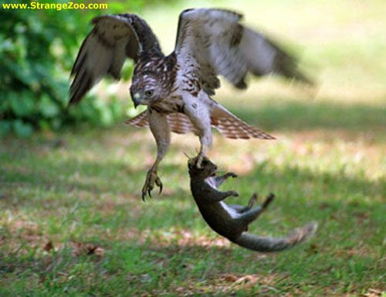
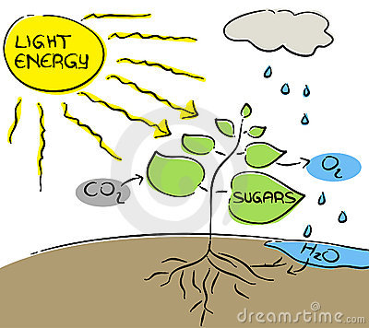
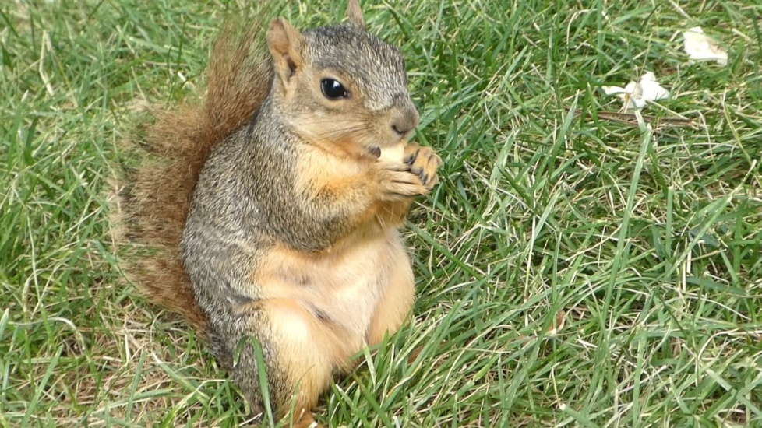
The Laws of Energy Transformation
In an open system, energy and matter can be transferred between the system and its surroundings.
Organisms are open systems.
Notes:
10

Slide 11
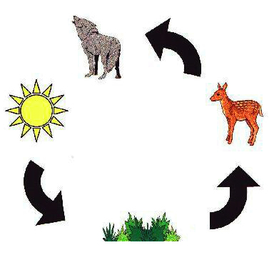
The First Law of Thermodynamics
According to the first law of thermodynamics, the energy of the universe is constant.
Energy can be transferred and transformed, but it cannot be created or destroyed.
© 2014 Pearson Education, Inc.
Notes:
11
The first law is also called the principle of conservation of energy.

Slide 12
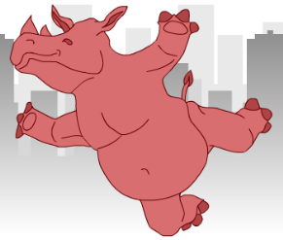
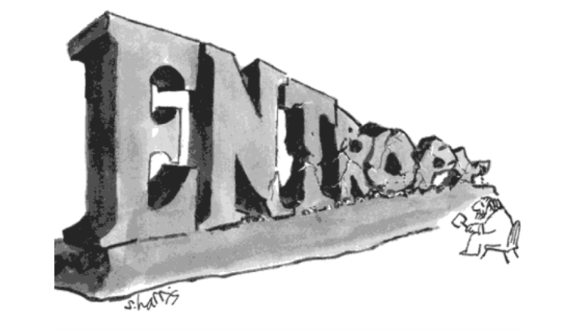
The Second Law of Thermodynamics
During every energy transfer or transformation, some energy is unusable and is often lost as heat.
Entropy is a measure of disorder, or randomness.
According to the second law of thermodynamics
Every energy transfer or transformation increases the entropy of the universe
© 2014 Pearson Education, Inc.
Notes:
12

Slide 13
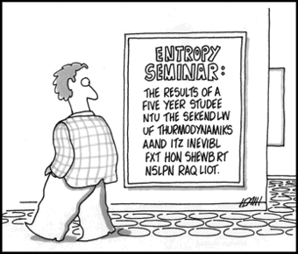

Slide 14
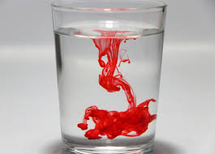
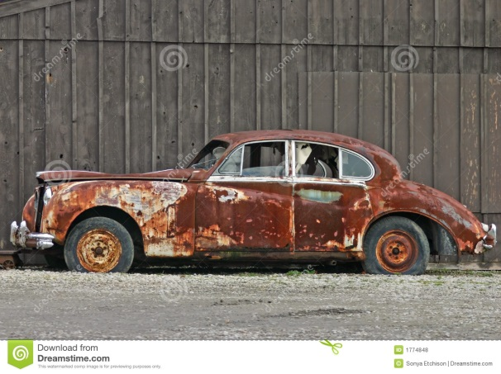
Living cells unavoidably convert organized forms of energy to heat.
Spontaneous processes occur without energy input; they can happen quickly or slowly.
For a process to occur without energy input, it must increase the entropy of the universe.
© 2014 Pearson Education, Inc.
Notes:
14

Slide 15
Biological Order and Disorder
Cells create ordered structures from less ordered materials.
CO₂ and H₂O
© 2014 Pearson Education, Inc.
Notes:
15

Slide 16
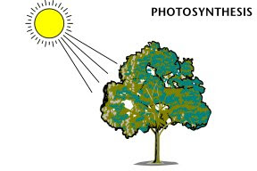
Biological Order and Disorder
Organisms also replace ordered forms of matter and energy with less ordered forms.
.
Heat
CO₂
© 2014 Pearson Education, Inc.
Notes:
16
Energy flows into an ecosystem in the form of light and exits in the form of heat.

Slide 17
The evolution of more complex organisms does not violate the second law of thermodynamics.
Entropy (disorder) may decrease in an organism, but the universe’s total entropy increases.
Organisms are islands of low entropy in an increasingly random universe.
© 2014 Pearson Education, Inc.
Notes:
17

