Slide 1
0
Chapter 6
Free Energy, Exergonic and Endergonic Reactions

Slide 2
You Must Know
Exergonic and endergonic reactions
Free energy

Slide 3
Free-Energy
A living system’s free energy (G) is energy that can do work when temperature and pressure are uniform, as in a living cell.
© 2014 Pearson Education, Inc.
Notes:
3

Slide 4
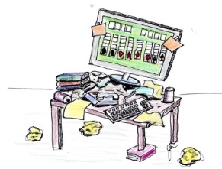
initial
final
In the figure, the _______ state has more free energy.
initial
-∆G
The process _____ occur spontaneously.
will
∆G = G_{final state} – G_{initial state}
© 2014 Pearson Education, Inc.
Notes:
4
The change in free energy (∆G) during a chemical reaction is the difference between the free energy of the final state and the free energy of the initial state. Only processes with a negative ∆G are spontaneous.

Slide 5
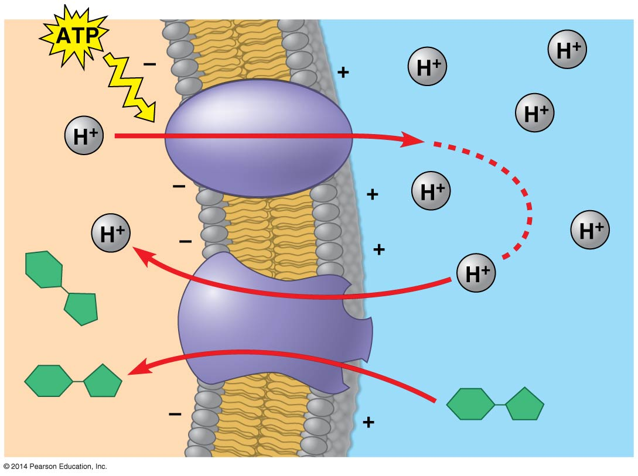
Spontaneous processes can be harnessed to perform work.
Proton pump
Sucrose-H⁺
cotransporter
Diffusion of H⁺
Sucrose
Sucrose
© 2014 Pearson Education, Inc.
Notes:
5

Slide 6
initial
final
In the figure, the _______ state has more free energy.
final
+∆G
won’t
The process ________ occur spontaneously.
The process can’t be harnessed to preform work
∆G = G_{final state} – G_{initial state}
Notes:
6

Slide 7
initial
final
In the figure, the _______ state has more free energy.
initial
-∆G
The process _____ occur spontaneously.
will
The process can be harnessed to preform work
∆G = G_{final state} – G_{initial state}
Notes:
7

Slide 8
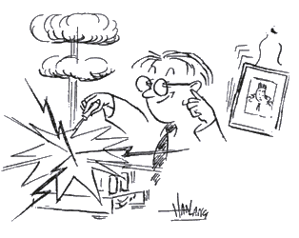
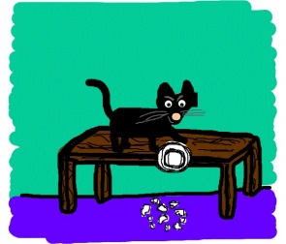
Exergonic and Endergonic Reactions in Metabolism
An exergonic reaction proceeds with a net release of free energy and is spontaneous; ∆G is negative.
catabolic
Notes:
8
Exergonic reactions are catabolic.

Slide 9
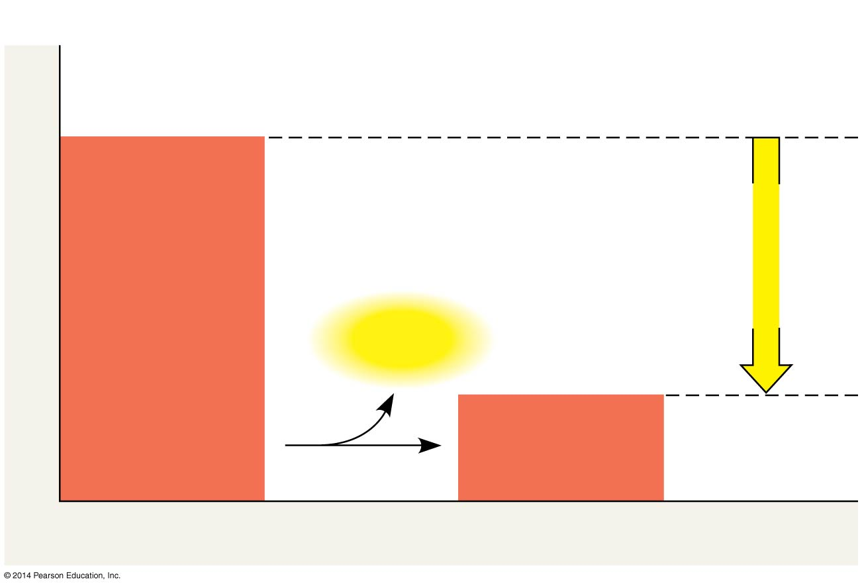
Exergonic reaction:
Energy is released
Spontaneous
Reactants
Amount of
energy
released
(ΔG < 0)
Energy
Free energy
Products
Progress of the reaction
Notes:
9
Figure 6.6a Free energy changes (ΔG) in exergonic and endergonic reactions (part 1: exergonic)

Slide 10
An endergonic reaction absorbs free energy from its surroundings and is nonspontaneous; ∆G is positive.
Anna
Energy source (cookie)
© 2014 Pearson Education, Inc.
Notes:
10
Endergonic reactions are anabolic

Slide 11
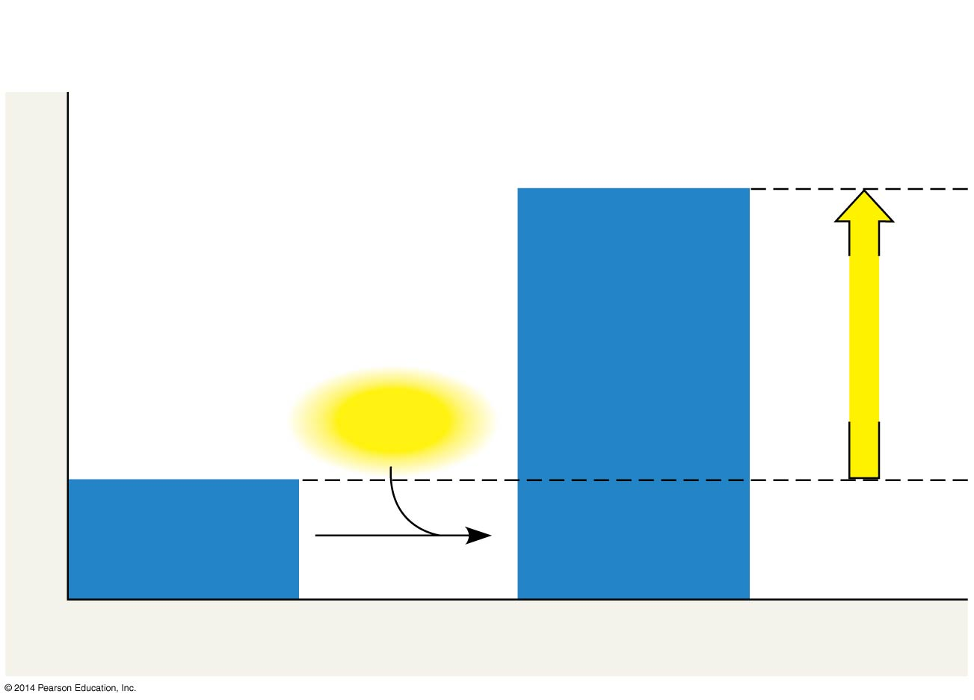
Endergonic reaction:
energy required
nonspontaneous
Products
Amount of
energy
required
(ΔG > 0)
Energy
Free energy
Reactants
Progress of the reaction
Notes:
11
Figure 6.6b Free energy changes (ΔG) in exergonic and endergonic reactions (part 2: endergonic)

Slide 12
Summary Slide
Free energy is a measure of a system’s instability, its tendency to change to a more stable state.
During a spontaneous change, free energy decreases and the stability of a system increases.
More free energy (higher G)
Less stable
Greater work capacity
In a spontaneous change
The free energy of the system decreases (ΔG < 0)
The system becomes more stable
The released free energy can be harnessed to do work
Less free energy (lower G)
More stable
Less work capacity
Notes:
12

