Slide 1
0
Chapter 6
Enzymes and Feedback Inhibition

Slide 2
You Must Know
How enzymes work

Slide 3
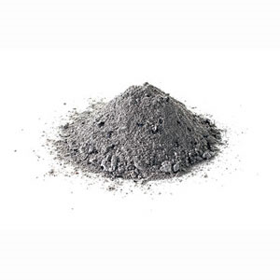
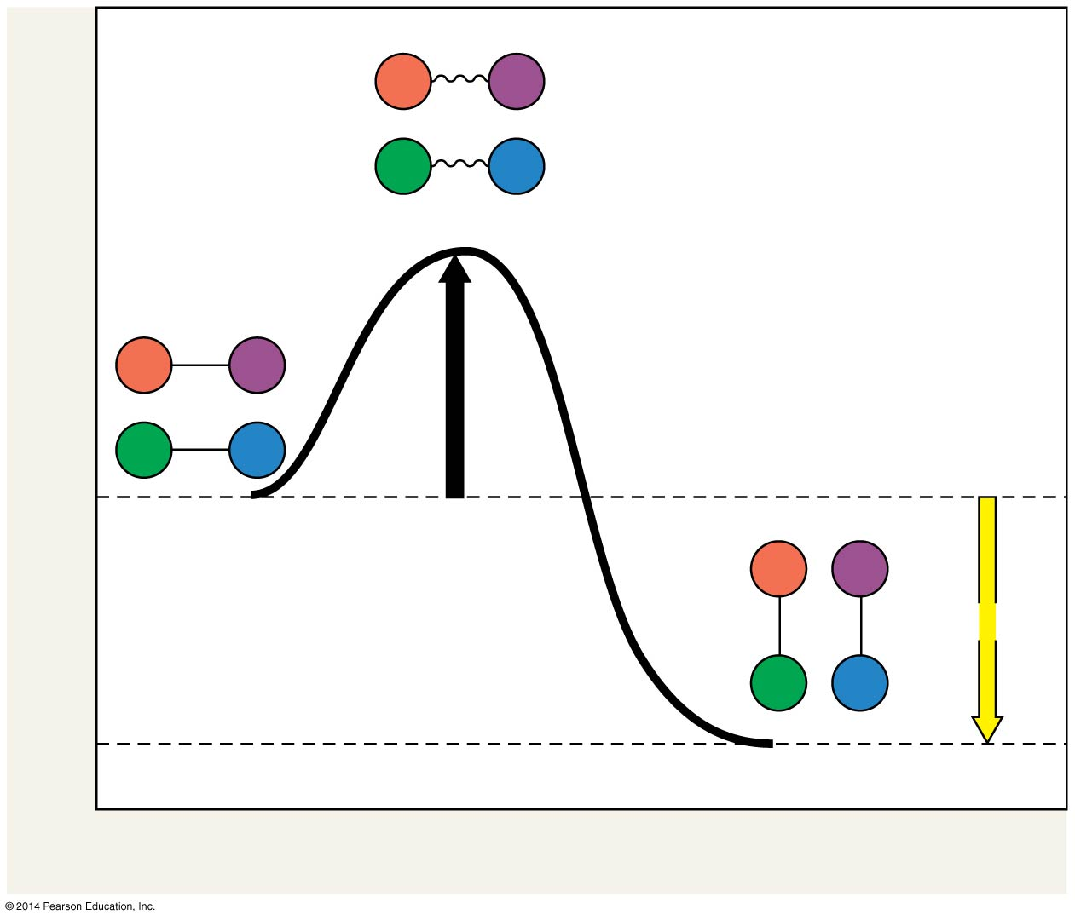
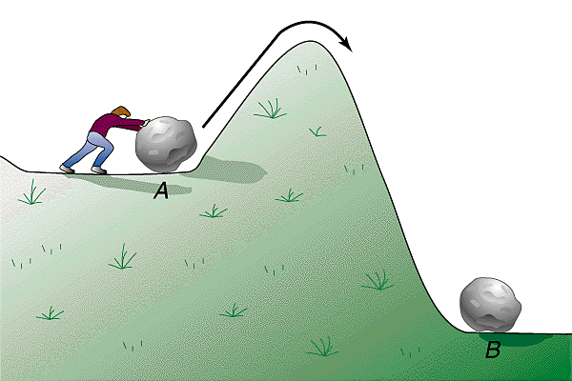
Activation energy
Energy needed to start a chemical reaction
Transition state
E_{A}
Free energy
Reactants
ΔG < 0
Products
Progress of the reaction
Notes:
Every chemical reaction between molecules involves bond breaking and bond forming.
The initial energy needed to start a chemical reaction is called the free energy of activation, or activation energy (E_{A}).
Activation energy is often supplied in the form of thermal energy that the reactant molecules absorb from their surroundings

Slide 4
Catalyst
Speeds up chemical reactions by lowering the activation energy.

Slide 5
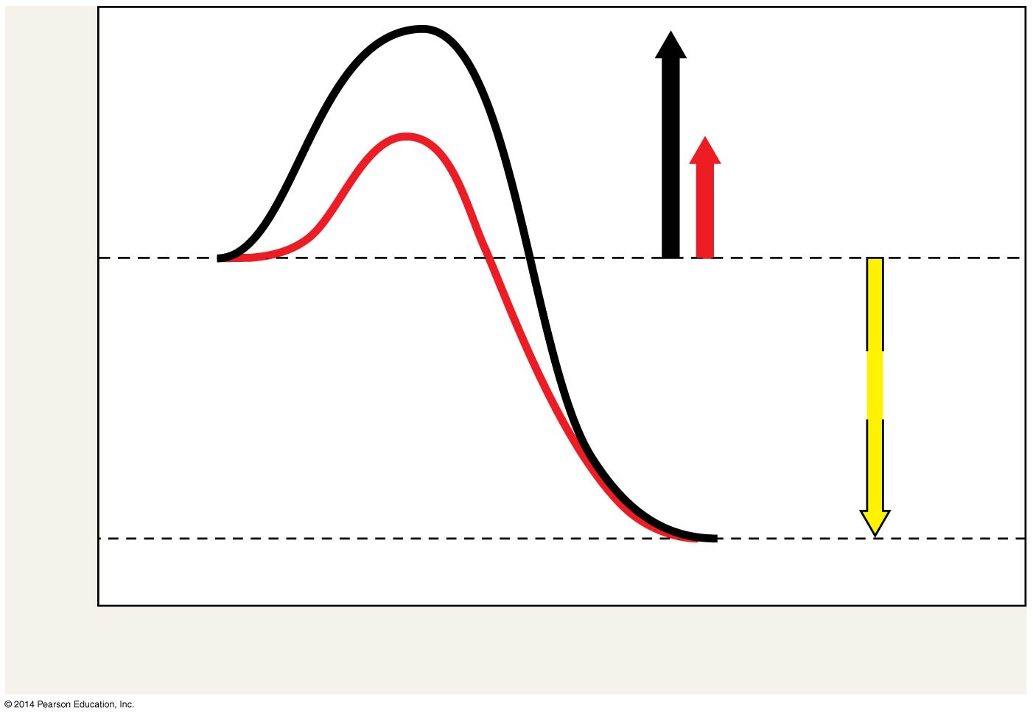
Figure 6.13
Course of
reaction
without
enzyme
E_{A}
without
enzyme
E_{A} with
enzyme
is lower
Reactants
Free energy
Course of
reaction
with enzyme
ΔG is unaffected
by enzyme
Products
Progress of the reaction
Notes:
5
A catalyst is a chemical agent that speeds up a reaction without being consumed by the reaction.
An enzyme is a catalytic protein.
Enzymes catalyze reactions by lowering the E_{A} barrier.
Enzymes do not affect the change in free energy (∆G); instead, they hasten reactions that would occur eventually.

Slide 6
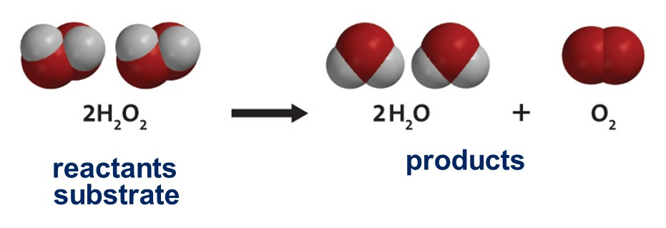
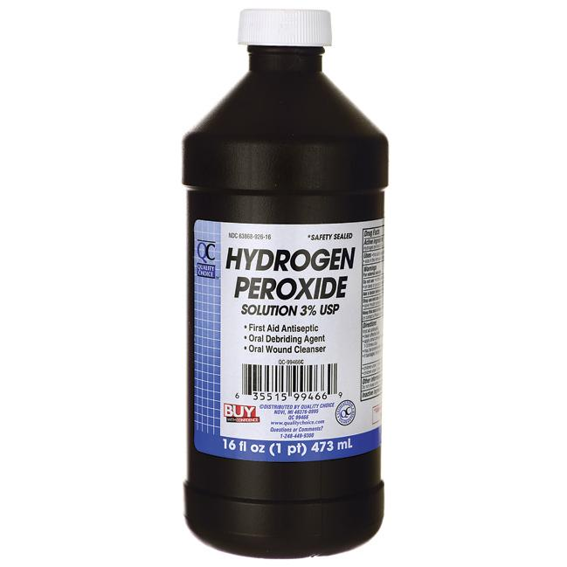
Why is there an expiration date on the bottle?
H₂O₂

Slide 7
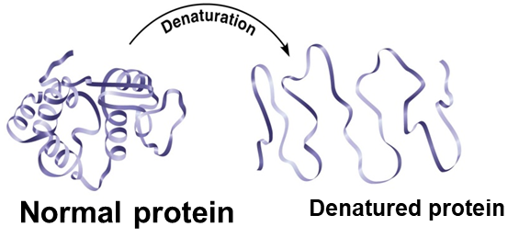

Slide 8
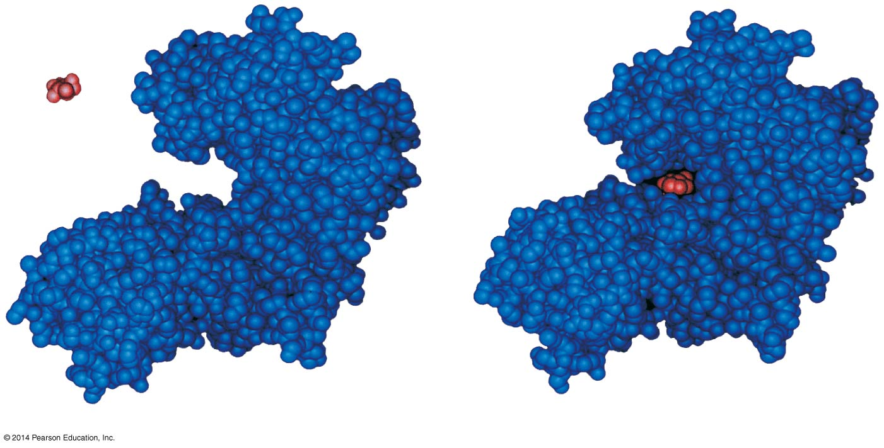
Substrate
Induced fit
Active site
Enzyme
Enzyme-substrate
complex
Notes:
8
The reactant that an enzyme acts on is called the enzyme’s substrate.
The enzyme binds to its substrate, forming an enzyme-substrate complex.
The active site is the region on the enzyme where the substrate binds.
Enzyme specificity results from the complementary fit between the shape of its active site and the substrate shape.
Enzymes change shape due to chemical interactions with the substrate
This induced fit of the enzyme to the substrate brings chemical groups of the active site into positions that enhance their ability to catalyze the reaction.
In an enzymatic reaction, the substrate binds to the active site of the enzyme.

Slide 9
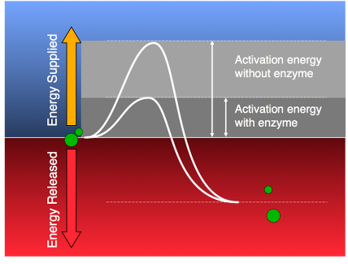
The active site of the enzyme can lower an E_{A} barrier by
Orienting substrates correctly
Straining substrate bonds
Providing a favorable microenvironment
Covalently bonding to the substrate
© 2014 Pearson Education, Inc.
Notes:
9

Slide 10
Figure 6.15-1
Substrates are
held in active site by
weak interactions.
Substrates enter
active site.
2
1
Substrates
Enzyme-substrate
complex
Notes:
10

Slide 11
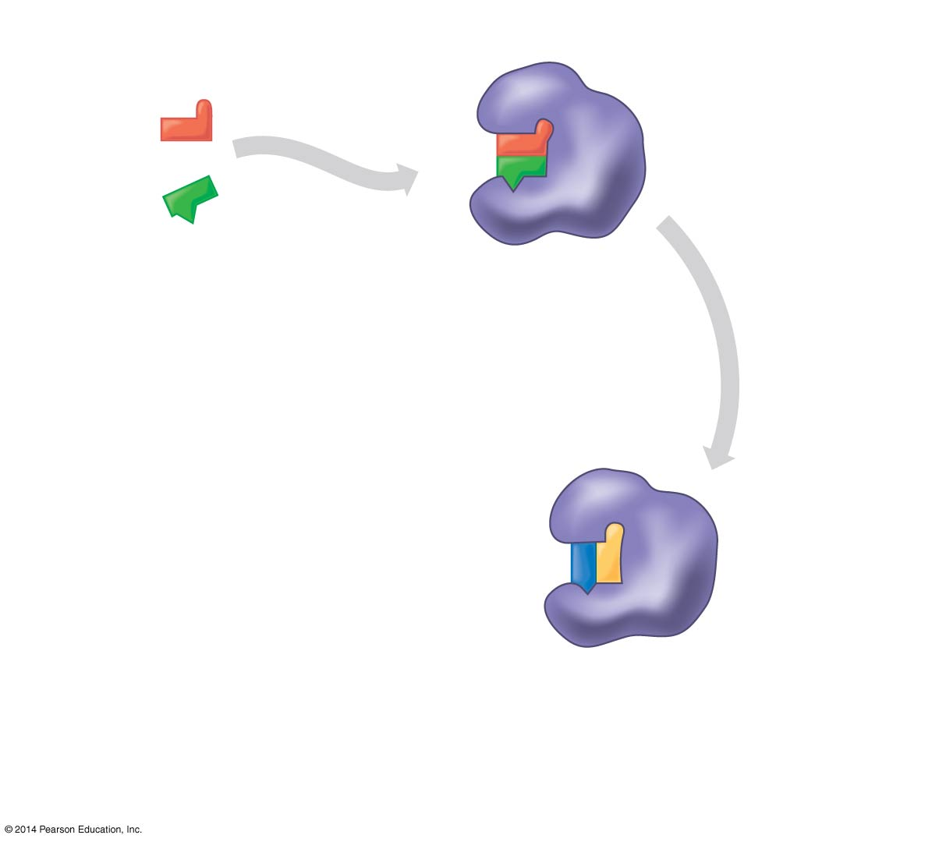
Figure 6.15-2
Substrates are
held in active site by
weak interactions.
Substrates enter
active site.
2
1
Substrates
Enzyme-substrate
complex
Substrates are
converted to
products.
3
Notes:
11

Slide 12
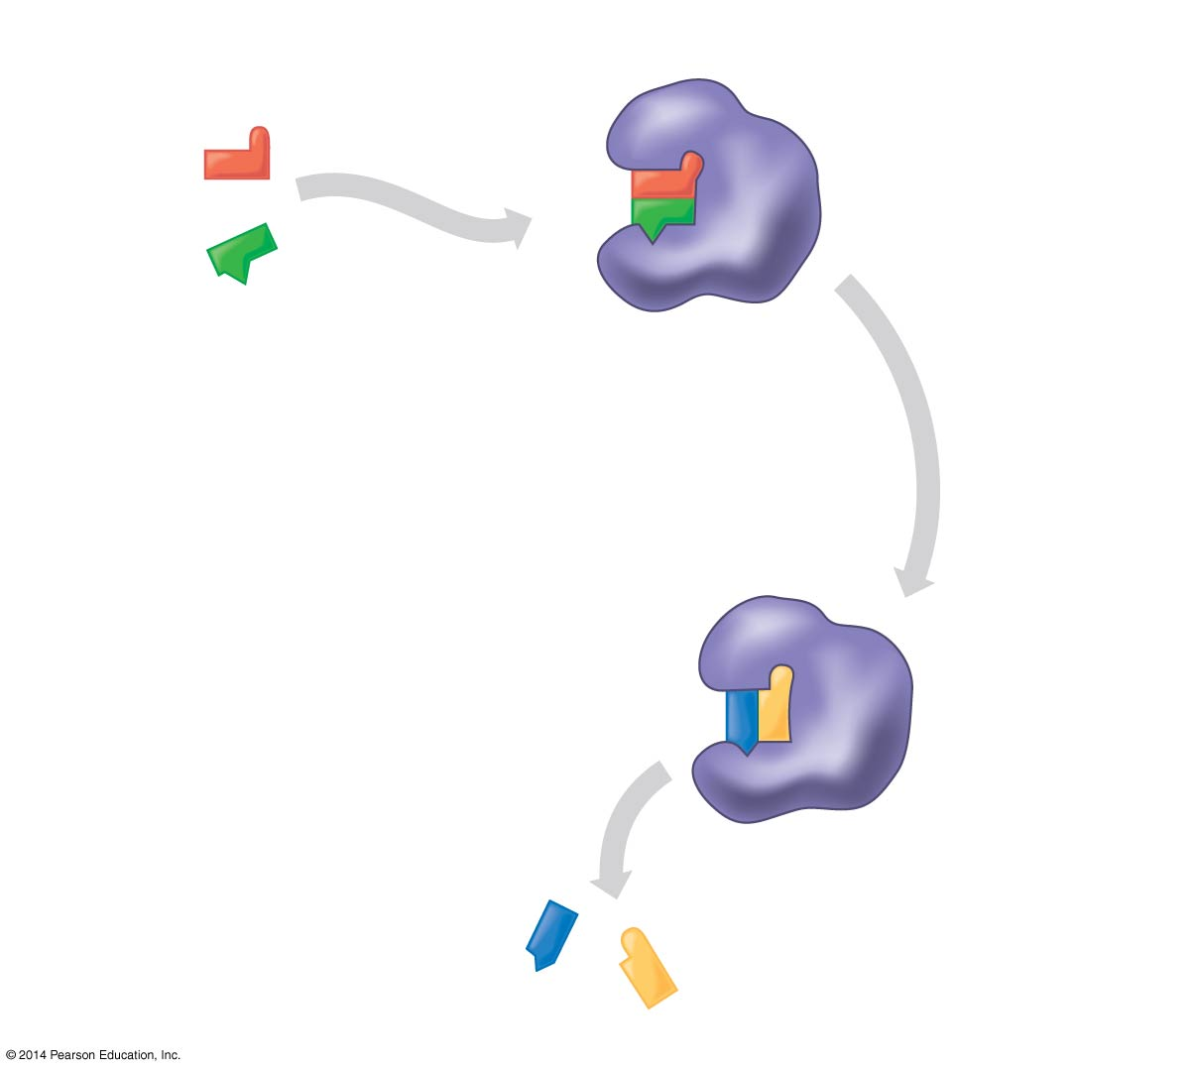
Figure 6.15-3
Substrates are
held in active site by
weak interactions.
Substrates enter
active site.
2
1
Substrates
Enzyme-substrate
complex
Products are
released.
4
Substrates are
converted to
products.
3
Products
Notes:
12

Slide 13
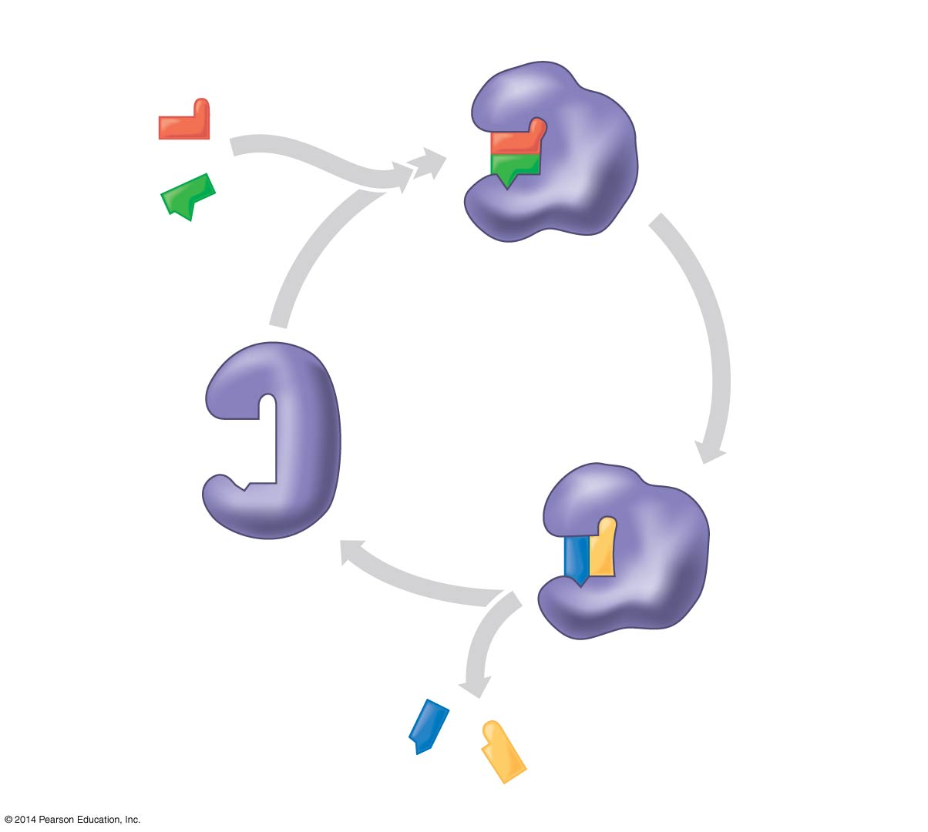
Figure 6.15-4
Substrates are
held in active site by
weak interactions.
Substrates enter
active site.
2
1
Substrates
Enzyme-substrate
complex
Active
site is
available
for new
substrates.
5
Enzyme
Products are
released.
4
Substrates are
converted to
products.
3
Products
Notes:
13

Slide 14
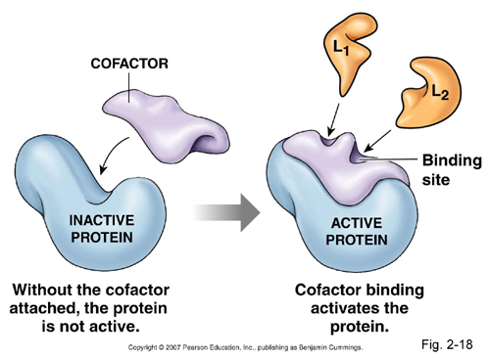
Cofactors: Nonprotein enzyme helpers
© 2014 Pearson Education, Inc.
Notes:
14
Cofactors are nonprotein enzyme helpers.
Cofactors may be inorganic (such as a metal in ionic form) or organic.
An organic cofactor is called a coenzyme.
Coenzymes include vitamins.

Slide 15
Concept 6.5: Regulation of enzyme activity helps control metabolism
Chemical chaos would result if a cell’s metabolic pathways were not tightly regulated.
A cell does this by switching on or off the genes that encode specific enzymes or by regulating the activity of enzymes.
© 2014 Pearson Education, Inc.
Notes:
15

Slide 16
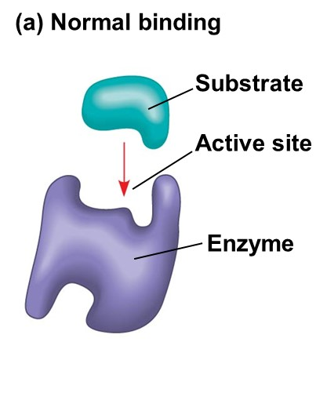
(b) Competitive inhibition
(c) Noncompetitive
inhibition
Competitive
inhibitor
Noncompetitive
inhibitor
Notes:
16
Competitive inhibitors bind to the active site of an enzyme, competing with the substrate.
Noncompetitive inhibitors bind to another part of an enzyme, causing the enzyme to change shape and making the active site less effective.
Examples of inhibitors include toxins, poisons, pesticides, and antibiotics.

Slide 17
Notes:
Allosteric regulation may either inhibit or stimulate an enzyme’s activity.
Allosteric regulation occurs when a regulatory molecule binds to a protein at one site and affects the protein’s function at another site.
Most allosterically regulated enzymes are made from polypeptide subunits.
Each enzyme has active and inactive forms.
The binding of an activator stabilizes the active form of the enzyme.
The binding of an inhibitor stabilizes the inactive form of the enzyme.

Slide 18
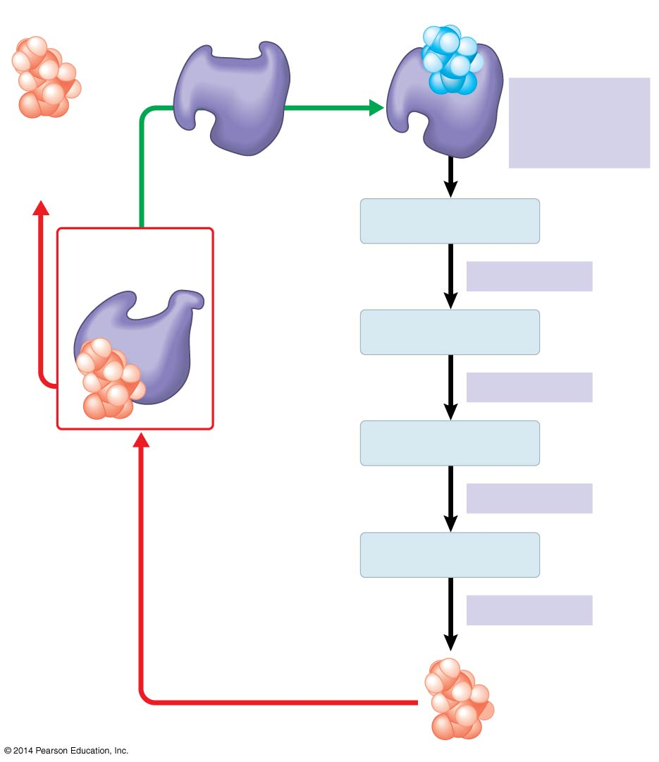
Active site available
Active site available
Threonine
in active site
Threonine
in active site
Enzyme 1
(threonine
deaminase)
Enzyme 1
(threonine
deaminase)
Isoleucine
used up by
cell
Intermediate A
Intermediate A
Intermediate A
Feedback
inhibition
Feedback
inhibition
Enzyme 2
Enzyme 2
Intermediate B
Intermediate B
Enzyme 3
Enzyme 3
Intermediate C
Isoleucine
binds to
allosteric
site.
Intermediate C
Isoleucine
binds to
allosteric
site.
Enzyme 4
Enzyme 4
Intermediate D
Intermediate D
Enzyme 5
Enzyme 5
End product
(isoleucine)
End product
(isoleucine)
Feedback Inhibition
Animation
Notes:
18
In feedback inhibition, the end product of a metabolic pathway shuts down the pathway.
Feedback inhibition prevents a cell from wasting chemical resources by synthesizing more product than is needed.

Slide 19
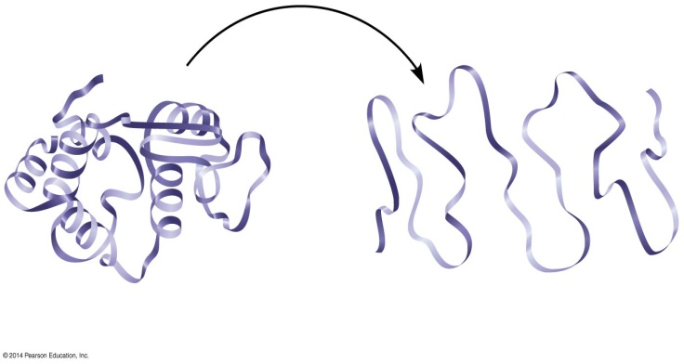
Optimal temperature for
typical human enzyme
(37°C)
Optimal temperature for
enzyme of thermophilic
(heat-tolerant)
bacteria (77°C)
Rate of reaction
0
20
40
60
80
100
120
Temperature (°C)
(a) Optimal temperature for two enzymes
Optimal pH for pepsin
(stomach
enzyme)
Optimal pH for trypsin
(intestinal
enzyme)
Normal protein
Denatured protein
Rate of reaction
0
1
2
3
4
5
6
7
8
9
10
pH
(b) Optimal pH for two enzymes
Notes:
19
An enzyme’s activity can be affected by
General environmental factors, such as temperature and pH.
Chemicals that specifically influence the enzyme.
Each enzyme has an optimal temperature in which it can function.
Each enzyme has an optimal pH in which it can function.
Optimal conditions favor the most active shape for the enzyme molecule.

