Slide 1
0
Chapter 6
ATP and Energy Coupling

Slide 2
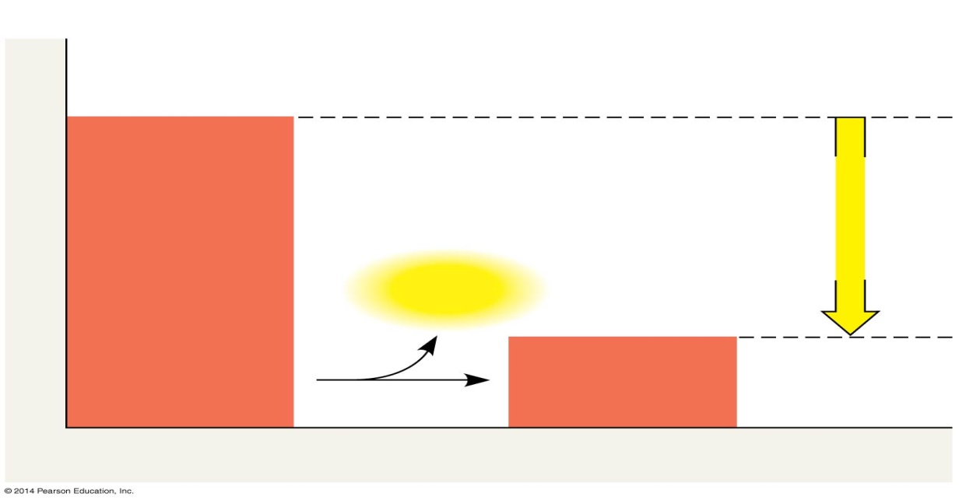
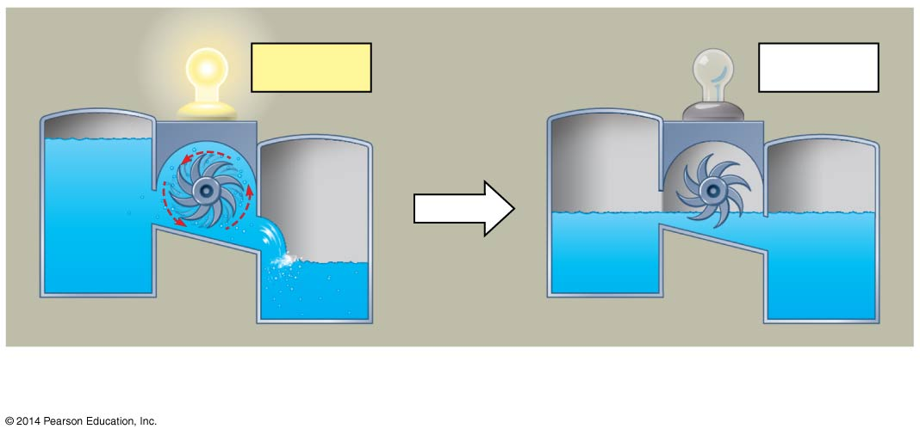
Exergonic reaction
Reactants
Energy
Free energy
Products
Progress of the reaction
A process is spontaneous and can perform work only when it is moving toward equilibrium.
ΔG < 0
ΔG = 0
ΔG < 0
Which direction will the water flow?
At equilibrium, forward and reverse reactions occur at the same rate; it is a state of maximum stability.
Equilibrium = Death
Notes:
2
Reactions in a closed system eventually reach equilibrium and then do no work.
A defining feature of life is that metabolism is never at equilibrium.

Slide 3
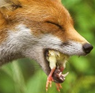
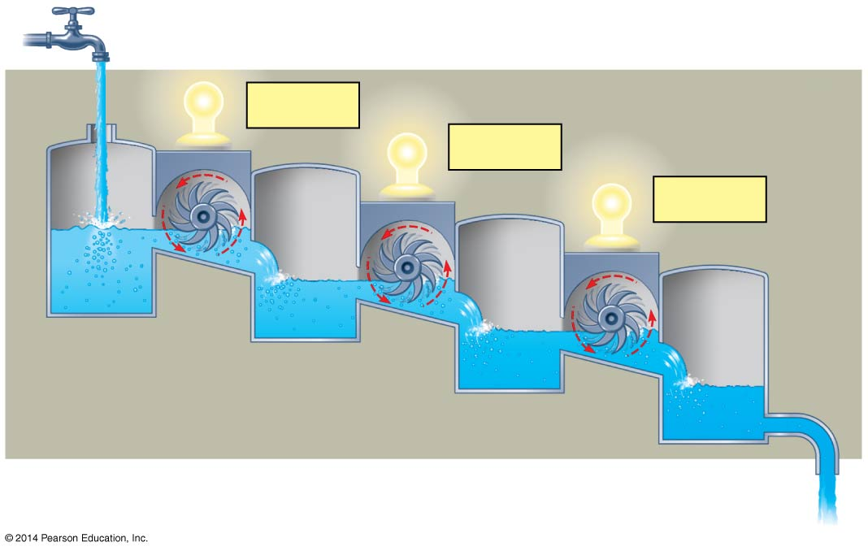
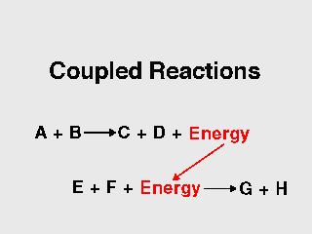
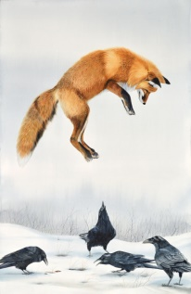
Food, or some other energy source like the sun.
Cells are not in equilibrium; they are open systems experiencing a constant flow of materials.
ΔG < 0
ΔG < 0
ΔG < 0
Exergonic
Endergonic
Notes:
3
To do work, cells manage energy resources by energy coupling, the use of an exergonic process to drive an endergonic one.
Most energy coupling in cells is mediated by ATP.

Slide 4
Endergonic
Exergonic

Slide 5
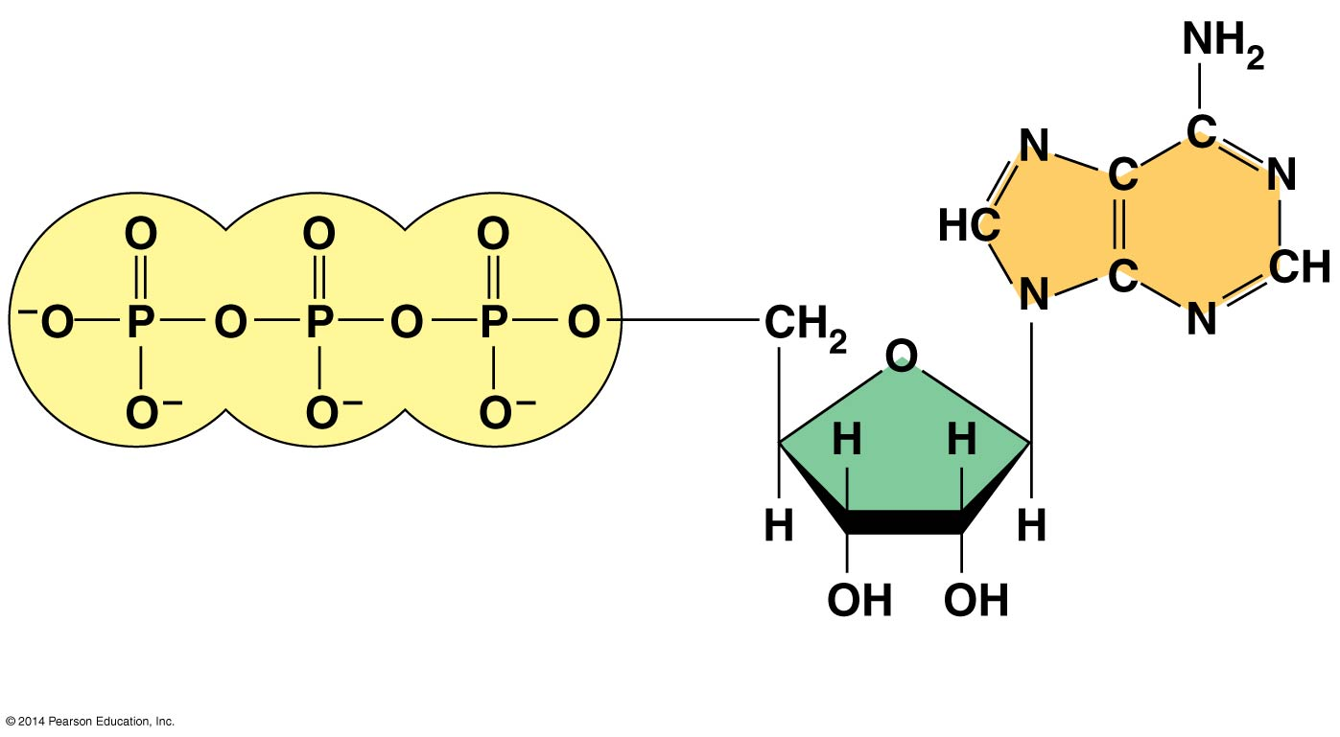
Figure 6.8a
Adenine
Phosphate groups
Ribose
(a) The structure of ATP
Notes:
5
ATP (adenosine triphosphate) is composed of ribose (a sugar), adenine (a nitrogenous base), and three phosphate groups.

Slide 6
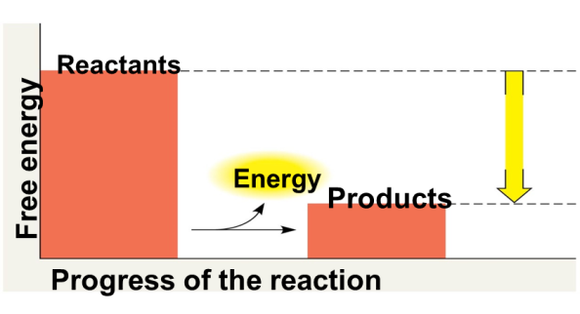
Adenosine triphosphate (ATP)
The hydrolysis of ATP
Energy
Inorganic
phosphate
Adenosine diphosphate (ADP)
Notes:
6
The bonds between the phosphate groups of ATP can be broken by hydrolysis.
Energy is released from ATP when the terminal phosphate bond is broken.
This release of energy comes from the chemical change to a state of lower free energy, not from the phosphate bonds themselves.

Slide 7
How the Hydrolysis of ATP Performs Work
The three types of cellular work (mechanical, transport, and chemical) are powered by the hydrolysis of ATP.
In the cell, the energy from the exergonic reaction of ATP hydrolysis can be used to drive an endergonic reaction.
Overall, the coupled reactions are exergonic.
© 2014 Pearson Education, Inc.
Notes:
7

Slide 8
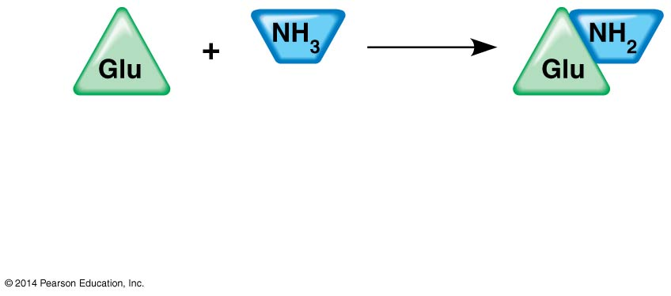
Glutamic acid
Ammonia
Glutamine
ΔG_{Glu} = +3.4 kcal/mol
Will this reaction happen spontaneously?
No
Is this reaction catabolic or anabolic?
Anabolic
Is this reaction exergonic or endergonic?
Endergonic

Slide 9
ATP drives endergonic reactions by phosphorylation, transferring a phosphate group to some other molecule, such as a reactant.
Glutamic acid
Phosphorylated
intermediate
Phosphorylated
intermediate
Glutamine
Notes:
9
ATP drives endergonic reactions by phosphorylation, transferring a phosphate group to some other molecule, such as a reactant. The recipient molecule is now called a phosphorylated intermediate. ATP hydrolysis leads to a change in a protein’s shape and often its ability to bind to another molecule.

Slide 10
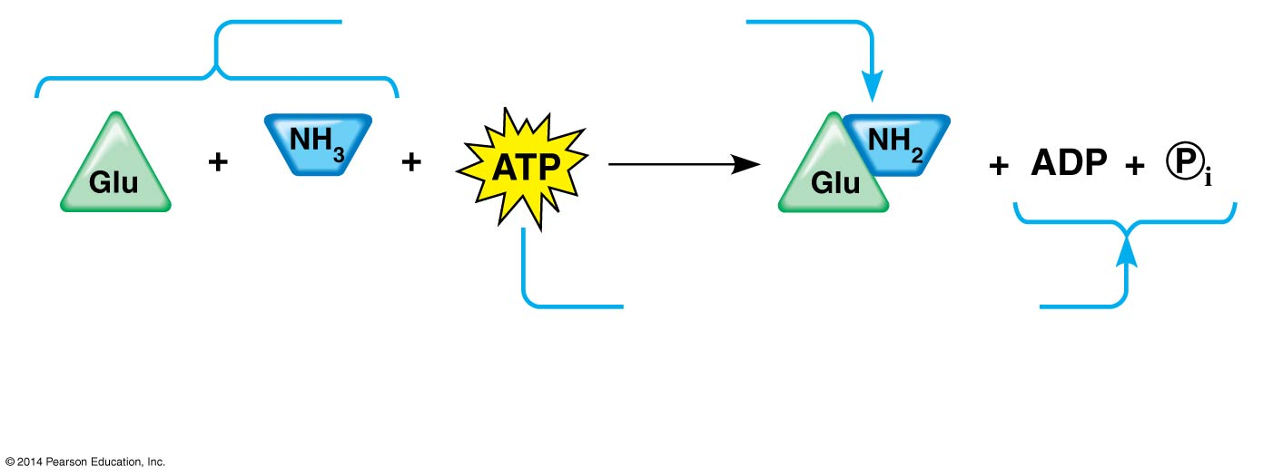
Free-energy change for coupled reaction
ΔG_{Glu} = +3.4 kcal/mol
ΔG_{Glu} = +3.4 kcal/mol
ΔG_{Glu} = +3.4 kcal/mol
ΔG_{ATP} = −7.3 kcal/mol
+
ΔG_{ATP} = −7.3 kcal/mol
Net
ΔG = −3.9 kcal/mol
Notes:
10
Figure 6.9c How ATP drives chemical work: energy coupling using ATP hydrolysis

Slide 11
Figure 6.10
Transport protein
Transport protein
Solute
Solute
Solute transported
Solute transported
(a) Transport work: ATP phosphorylates transport proteins.
(a) Transport work: ATP phosphorylates transport proteins.
Vesicle
Cytoskeletal track
Motor protein
Protein and
vesicle moved
(b) Mechanical work: ATP binds noncovalently to motor proteins
and then is hydrolyzed.
Notes:
11
Figure 6.10 How ATP drives transport and mechanical work

Slide 12
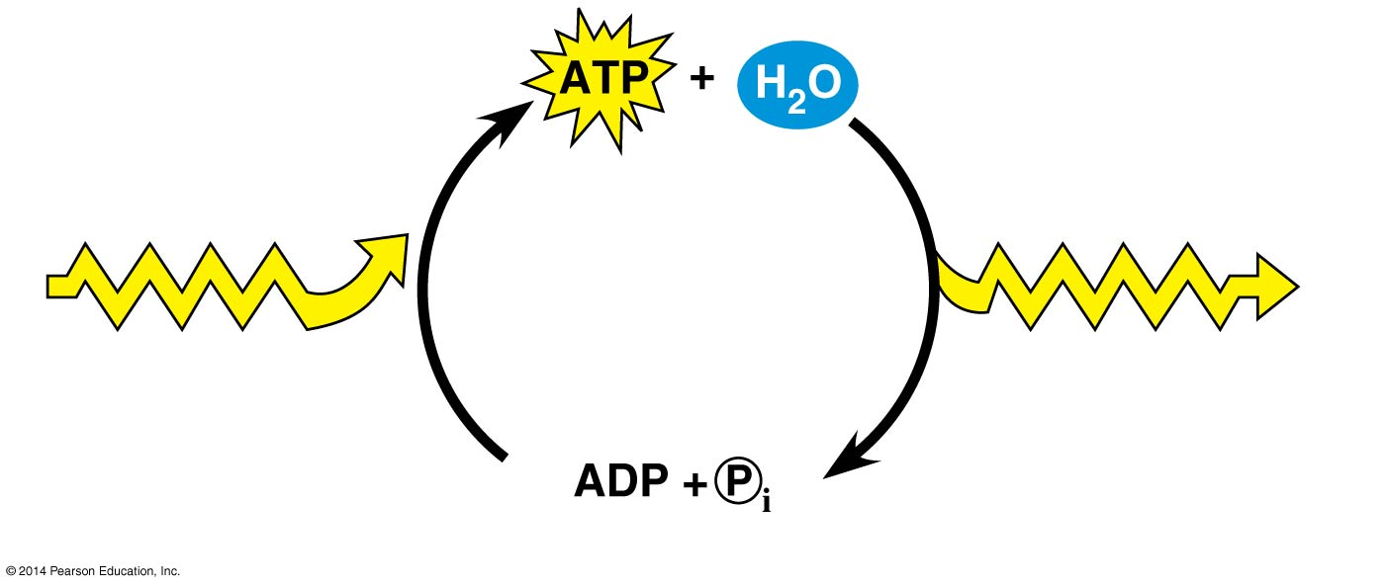
Figure 6.11
Energy from
catabolism
(exergonic, energy-
releasing processes)
Energy for cellular
work (endergonic,
energy-consuming
processes)
Notes:
12
Figure 6.11 The ATP cycle

