Slide 1
0
Chapter 5
Bulk Transport
Local and Long Distance Signaling

Slide 2
You Must Know
Bulk Transport
How cells communicate with each other.
The three stages of cell signaling.

Slide 3
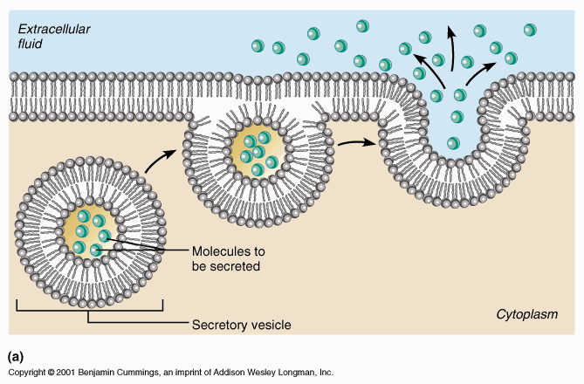
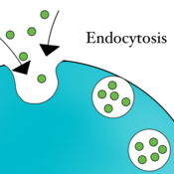
CONCEPT 5.5: Bulk transport across the plasma membrane occurs by exocytosis and endocytosis
Exocytosis
Endocytosis
© 2014 Pearson Education, Inc.
Notes:
3
Small solutes and water enter or leave the cell through the lipid bilayer or by means of transport proteins
Large molecules, such as polysaccharides and proteins, cross the membrane in bulk by means of vesicles
Bulk transport requires energy.
In exocytosis, transport vesicles migrate to the membrane, fuse with it, and release their contents.
Many secretory cells use exocytosis to export products.
In endocytosis, the cell takes in molecules and particulate matter by forming new vesicles from the plasma membrane
Endocytosis is a reversal of exocytosis, involving different proteins.

Slide 4
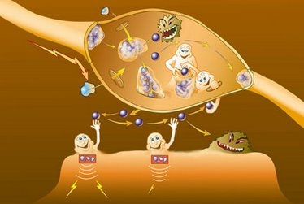
CONCEPT 5.6: The plasma membrane plays a key role in most cell signaling
In multicellular organisms, cell-to-cell communication allows the cells of the body to coordinate their activities.
© 2014 Pearson Education, Inc.
Notes:
4

Slide 5
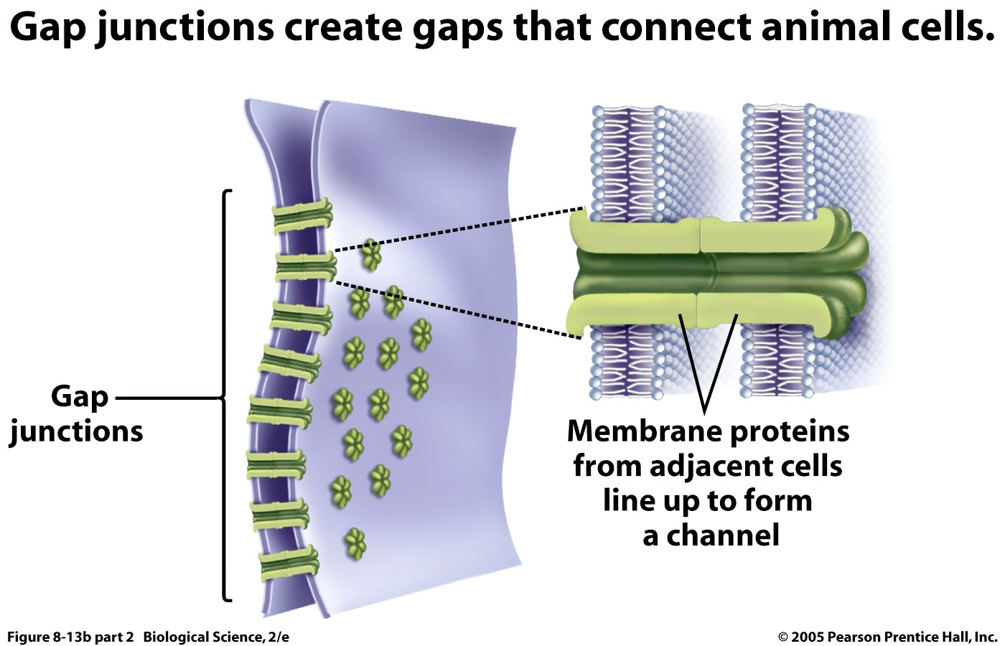
Local Signaling By Direct Contact
© 2014 Pearson Education, Inc.
Notes:
5
Eukaryotic cells may communicate by direct contact.
Animal and plant cells have junctions that directly connect the cytoplasm of adjacent cells.
These are called gap junctions (animal cells) and plasmodesmata (plant cells).
The free passage of substances in the cytosol from one cell to another is a type of local signaling.

Slide 6
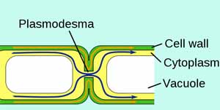
Local Signaling By Direct Contact
Plant Cells

Slide 7
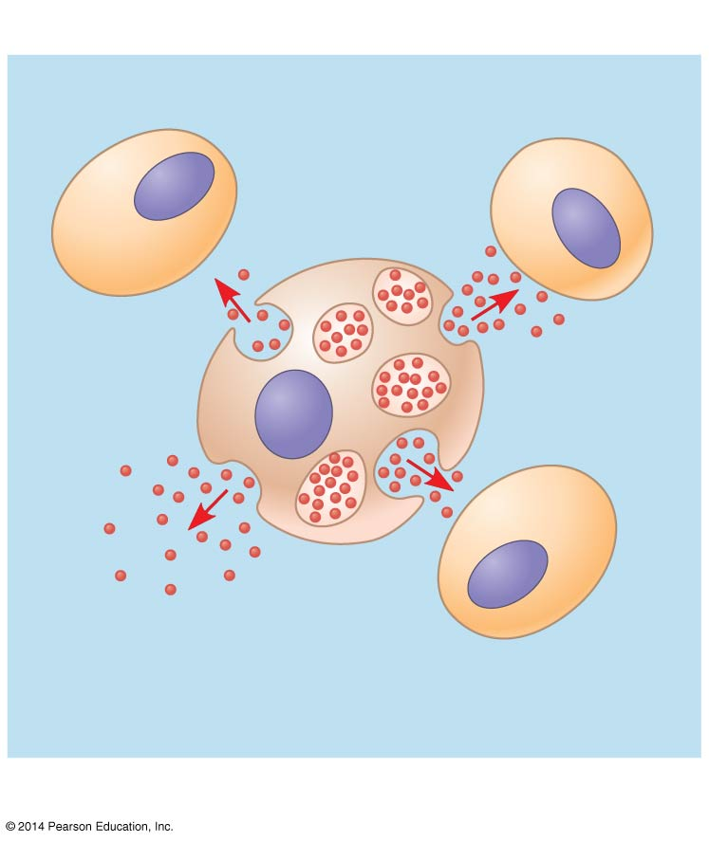
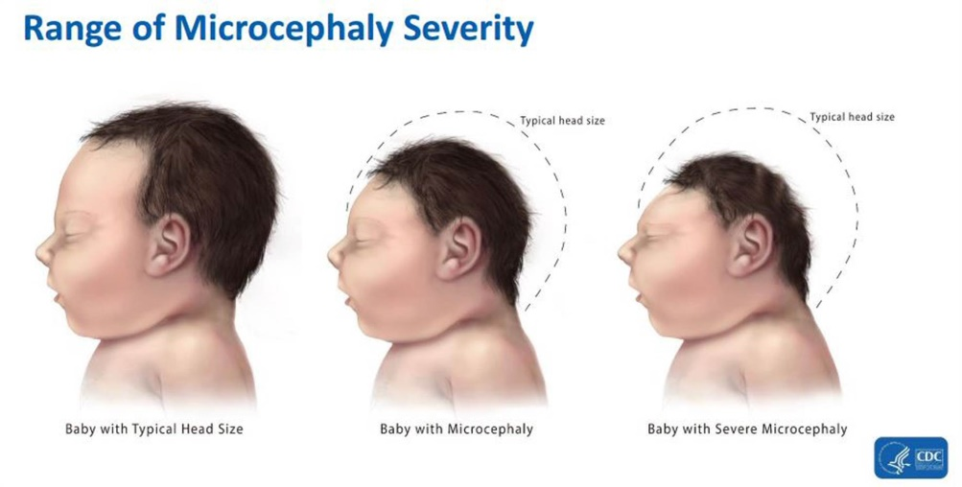

Paracrine signaling
Local signaling
Target cell
Ex. Growth Factors
Secreting
cell
Secretory
vesicle
Local regulator
diffuses through
extracellular fluid.
Notes:
7
In many cases of local signaling, messenger molecules are secreted by a signaling cell.
These messenger molecules, called local regulators, travel only short distances.
One class of these, growth factors, stimulates nearby cells to grow and divide.
This type of local signaling in animal cells is called paracrine signaling. (You won’t be tested on microcephaly or zika.)

Slide 8
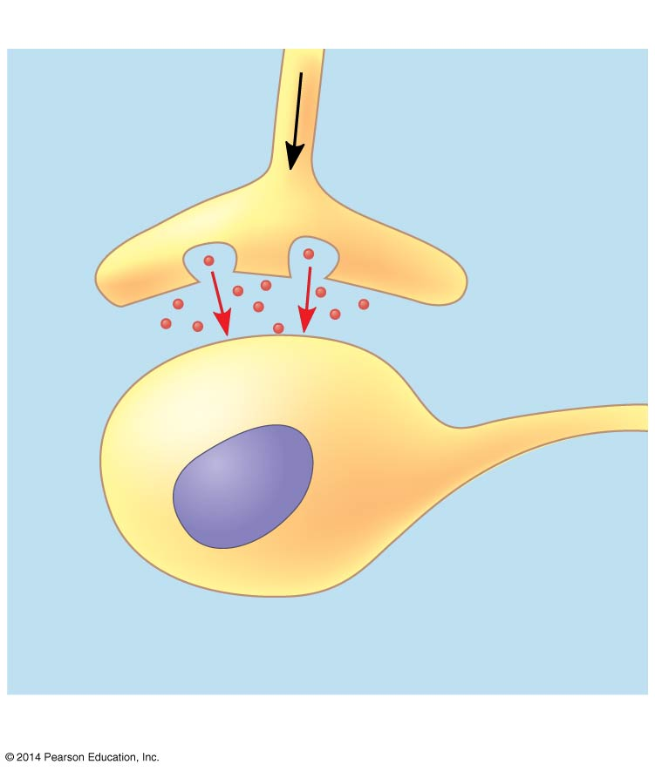
Synaptic signaling
Local signaling
Electrical signal
along nerve cell
triggers release
of neuro-
transmitter.
Neurotransmitter
diffuses across
synapse.
Target cell
is stimulated.
© 2014 Pearson Education, Inc.
Notes:
8
Another more specialized type of local signaling occurs in the animal nervous system.
This synaptic signaling consists of an electrical signal moving along a nerve cell that triggers secretion of neurotransmitter molecules.
These diffuse across the space between the nerve cell and its target, triggering a response in the target cell.

Slide 9
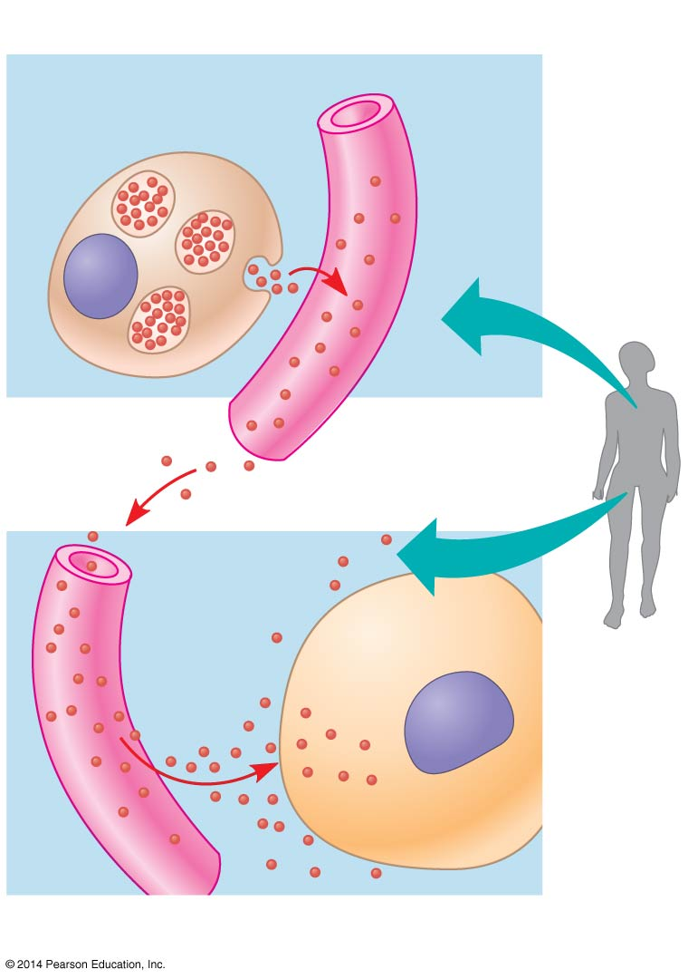
Endocrine (hormonal) signaling
Long-distance signaling
Endocrine cell
Blood
vessel
Hormone
travels in
bloodstream.
Target cell
specifically
binds
hormone.
© 2014 Pearson Education, Inc.
Notes:
9
In long-distance signaling, plants and animals use chemicals called hormones.
In hormonal signaling in animals (called endocrine signaling), specialized cells release hormone. molecules that travel via the circulatory system.
Hormones vary widely in size and shape.

Slide 10
The Three Stages of Cell Signaling
Cells receiving signals undergo three processes
  Reception
  Transduction
  Response
© 2014 Pearson Education, Inc.
Notes:
10

Slide 11
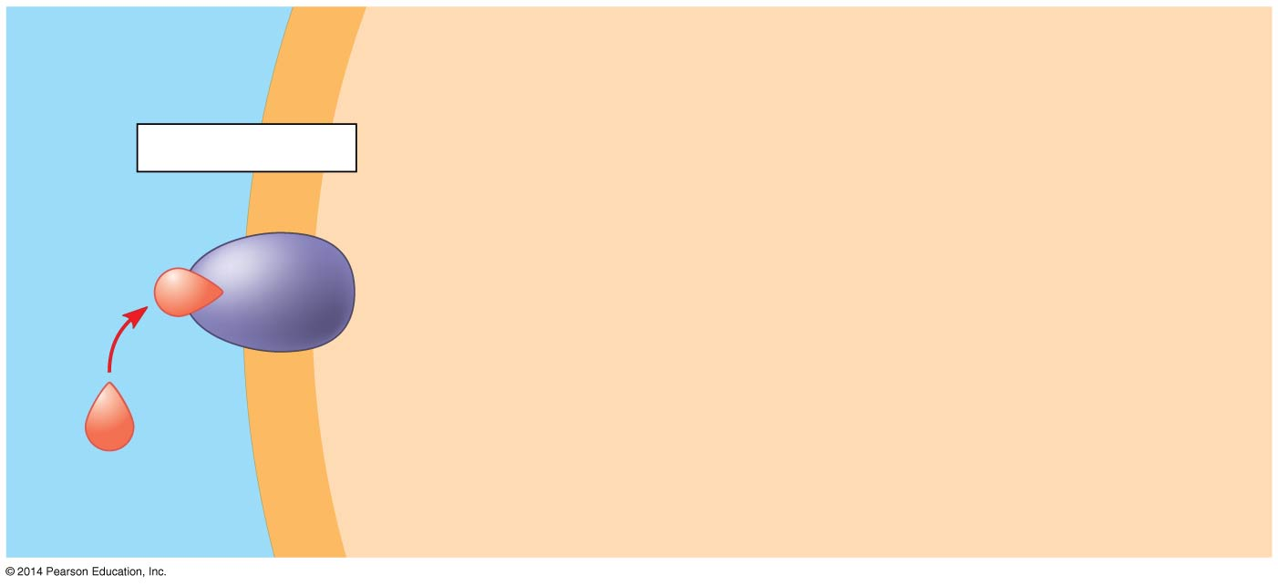
  Reception
EXTRACELLULAR
FLUID
CYTOPLASM
Plasma membrane
Reception
Receptor
The ligand is specific to the receptor
Plasma membrane protein
Signaling
Molecule
A.K.A. ligand
© 2014 Pearson Education, Inc.
Notes:
11
The binding between a signal molecule (ligand) and receptor is highly specific. Ligand binding generally causes a shape change in the receptor. Many receptors are directly activated by this shape change. Most signal receptors are plasma membrane proteins.

Slide 12
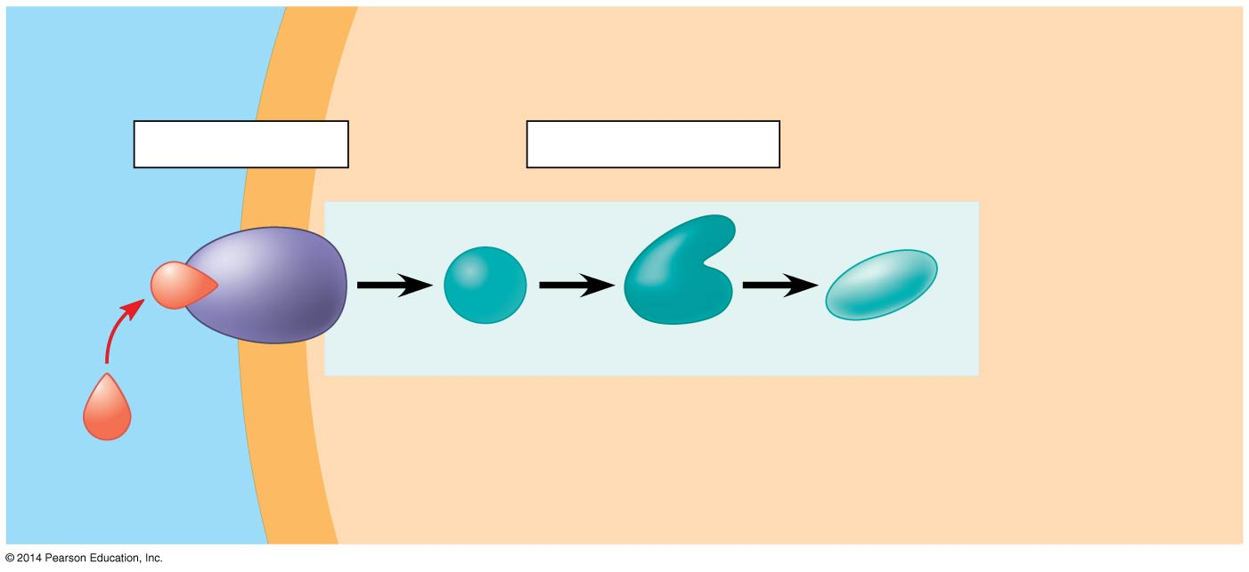
Figure 5.20-2
  Transduction
EXTRACELLULAR
FLUID
CYTOPLASM
Plasma membrane
Reception
Transduction
Receptor
Relay molecules
Signaling
molecule
© 2014 Pearson Education, Inc.
Notes:
12
Transduction is a step or series of steps that converts the signal to a form that can bring about a specific cellular response. Transduction usually requires a sequence of changes in a series of different molecules - a signal transduction pathway.

Slide 13
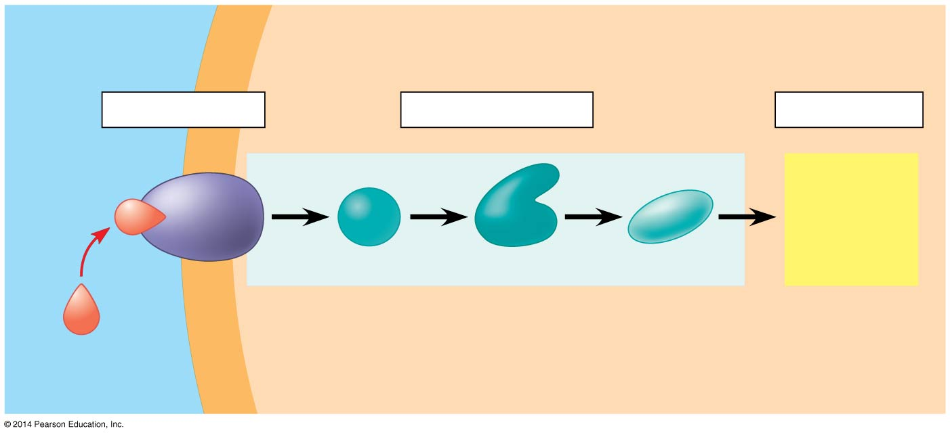
  Response
EXTRACELLULAR
FLUID
CYTOPLASM
Plasma membrane
Reception
Transduction
Response
Receptor
Activation
Relay molecules
Signaling
molecule
The response may be almost any imaginable cellular activity…
© 2014 Pearson Education, Inc.
Notes:
13
The response may be almost any imaginable cellular activity – such as catalysis by an enzyme, rearrangement of the cytoskeleton, or activation of specific genes in the nucleus.

Slide 14
  Reception
  Transduction
  Response

Slide 15
Receptors in the Plasma Membrane
There are two main types of membrane receptors
  G protein-coupled receptors
  Ligand-gated ion channels
CYTOPLASM
Plasma membrane
Reception
Receptor
hydro
philic
Plasma membrane protein
signaling molecule
Notes:
15
Most water-soluble signal molecules bind to specific sites on receptor proteins that span the plasma membrane. The signal molecules do not enter the cell.

Slide 16
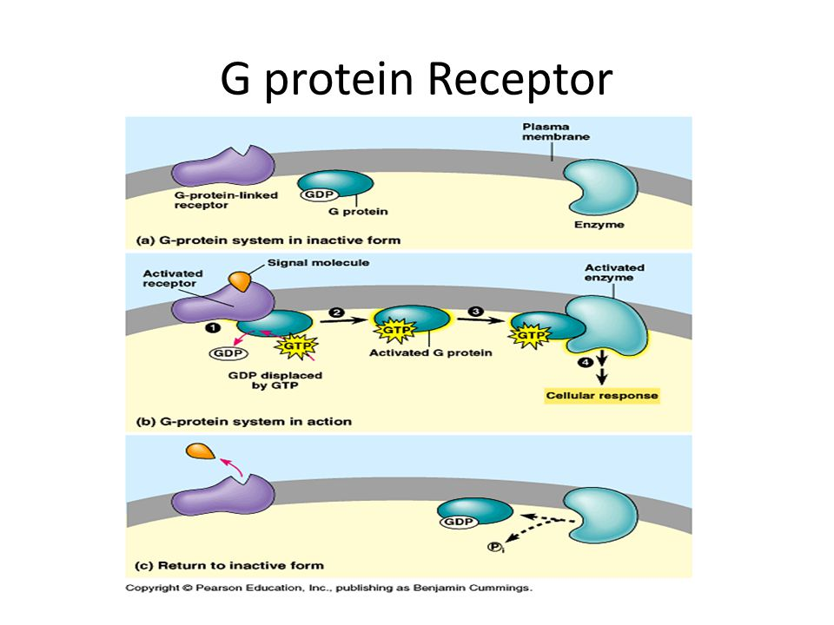
Ligand attaches to receptor protein.
G-protein activated
G-protein activates an enzyme
Transduction and cell response

Slide 17
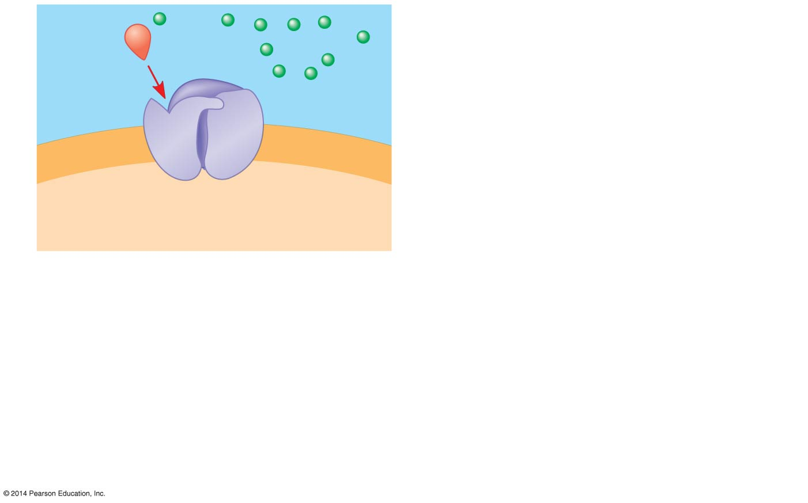
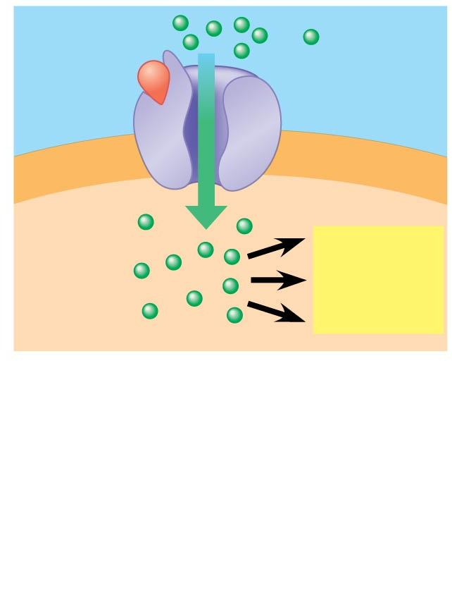
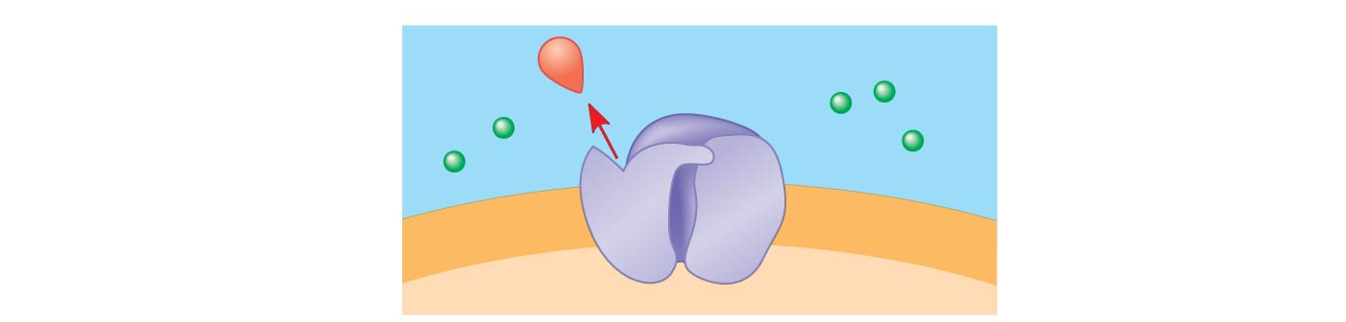
ligand-gated ion channel
Ions diffuse through the open channel
1
2
Gate
open
Gate
closed
Ions
Signaling
molecule
(ligand)
Plasma
membrane
Ligand-gated
ion channel receptor
Cellular
response
3
Gate closed
© 2014 Pearson Education, Inc.
Notes:
17
A ligand-gated ion channel receptor acts as a “gate” for ions when the receptor changes shape.
When a signal molecule binds as a ligand to the receptor, the gate allows specific ions, such as Na⁺ or Ca²⁺, through a channel in the receptor.
Ligand-gated ion channels are very important in the nervous system.
The diffusion of ions through open channels may trigger an electric signal.

Slide 18
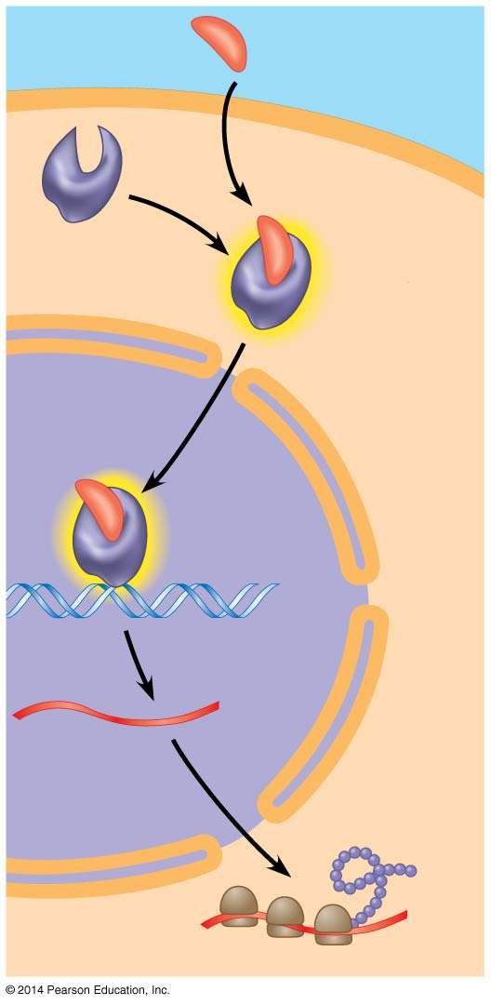
Only cells that contain receptors for the signal can respond to it.
EXTRA-
CELLULAR
FLUID
Hormone
(testosterone)
EXTRA-
CELLULAR
FLUID
Hormone
(testosterone)
EXTRA-
CELLULAR
FLUID
Intracellular receptors
Hormone
(testosterone)
Plasma
membrane
Plasma
membrane
Plasma
membrane
Hydrophobic
Hydrophobic
Receptor
protein
Hydrophobic
Receptor
protein
Hormone-
receptor
complex
Hormone-
receptor
complex
DNA
mRNA
New
protein
NUCLEUS
CYTOPLASM
Steroid hormone interacting with an intracellular receptor.
Notes:
18
Intracellular receptor proteins are found in the cytosol or nucleus of target cells.
Small or hydrophobic chemical messengers can readily cross the membrane and activate receptors.
Examples of hydrophobic messengers are the steroid and thyroid hormones of animals and nitric oxide (NO) in both plants and animals.
Testosterone behaves similarly to other steroid hormones.
Only cells that contain receptors for testosterone can respond to it.
The hormone binds the receptor protein and activates it.
The active form of the receptor enters the nucleus, acts as a transcription factor, and activates genes needed for male sex characteristics.

