Slide 1
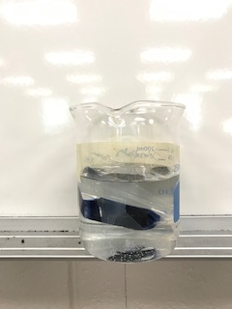

Slide 2
The glucose test trip changed color indication there was glucose in the water.
The tubes gained between 1 and 2 grams.

