Slide 1
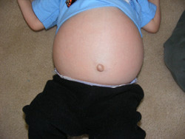
Gaucher Disease (this is a hereditary disease)
Symptoms
Distended abdomen
Bone pain
Anemia
Cognitive impairment

Slide 2
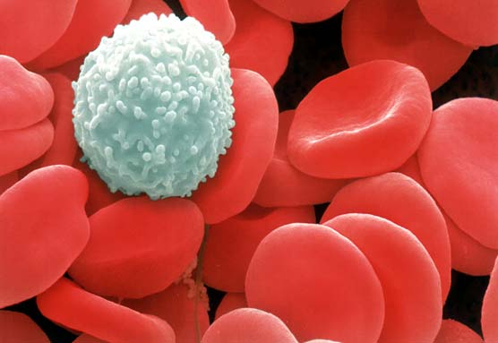
White blood cells have a type of lipid called glucocerebroside in their cell membranes. (Glucocerebroside is involved in cell to cell signaling.)
Judging by the name, what type of molecule is attached to the lipid?

Slide 3
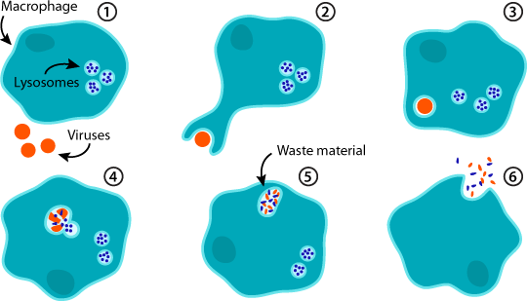
When the white blood cells are worn out, they get “eaten” by macrophages (another type of cell) and digested by the enzyme glucocerebrosidease in the lysosome.
White blood cells

Slide 4
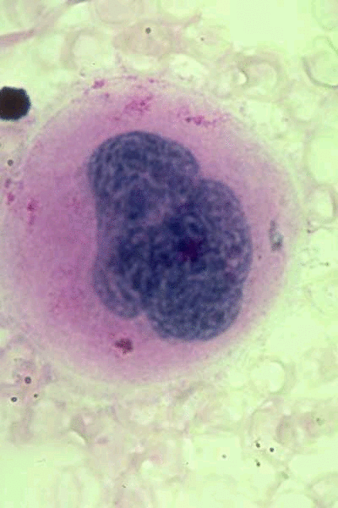
Gaucher Disease
The macrophages have a defective glucocerebrosidease enzyme so the glucocerebroside just builds up in the lysosome. The build-up causes the symptoms of the disease.
White blood cells

Slide 5
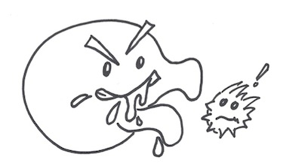
Lysosome containing
glucocerebrosidease
The cell membrane has glucocerebroside
Old white
blood
cell
Macrophage

Slide 6
Gaucher Disease
Lysosome containing
glucocerebrosidease
The cell membrane has glucocerebroside
Old white
blood
cell
Macrophage

Slide 7
Trace the path for synthesizing the protein glucocerebrosidease. (Start with DNA)
Trace the path for synthesizing the lipid glucocerebroside. (Synthesis of the lipid part starts in the smooth ER)
Explain the digestion of glucocerebroside by glucocerebrosidease.
Note: You will not be expected to remember the specifics of Gaucher disease on a test, but you may be asked about other lysosomal storage disorders.

Slide 8
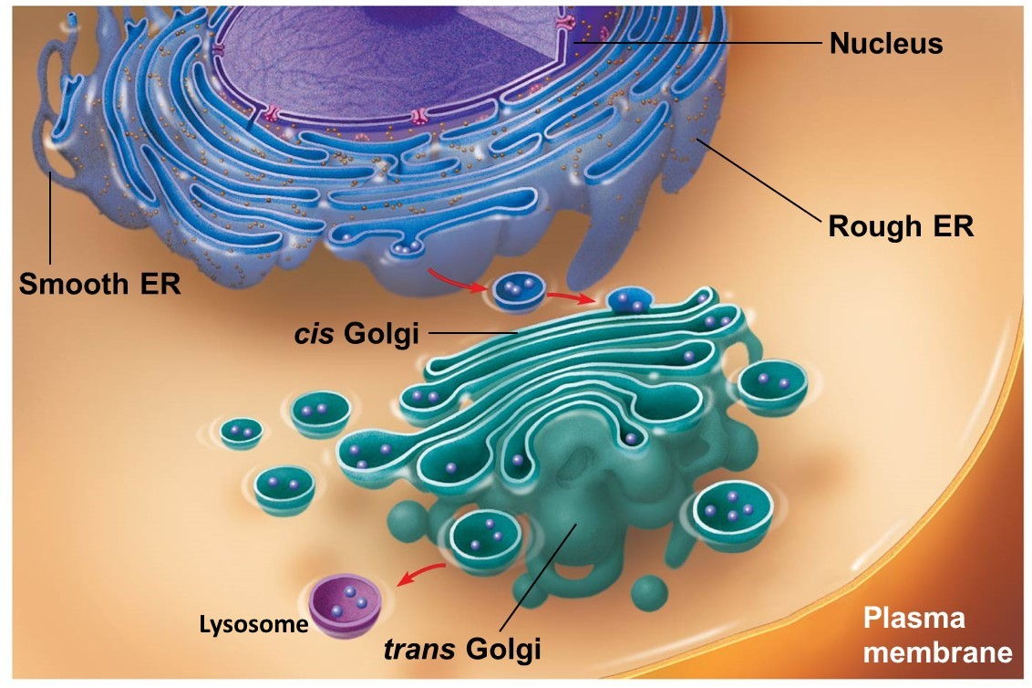
Trace the path for synthesizing the protein glucocerebrosidease.
DNA codes for the enzyme glucocerebrosidease.
RNA is made from the DNA
The RNA travels from the nucleus to the cytoplasm.
RNA binds to a free ribosome and protein synthesis begins.
The ribosome moves to the rough ER were synthesis is completed.
The protein is transported by a vesicle to the Golgi apparatus.
In the Golgi, the protein is modified and labeled for transport to the lysosome.
A vesicle transports the finished glucocerebrosidease to a lysosome.
Lysosome containing
glucocerebrosidease
Macrophage

Slide 9
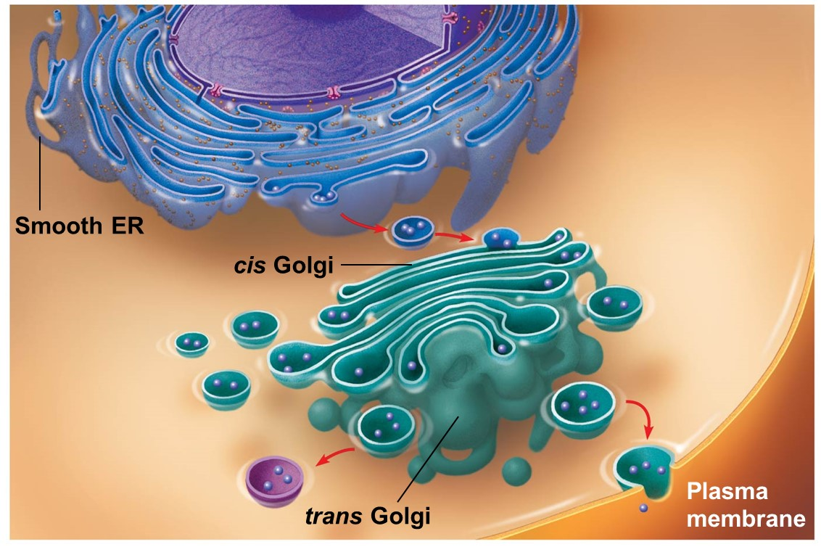
Trace the path for the production of glucocerebroside.
The cell membrane has glucocerebroside
Production of the lipid portion occurs in the smooth ER.
A vesicle pinches off of the smooth ER and travels to the Golgi.
In the Golgi, a sugar is attached to the lipid and it is labeled for transport to the cell membrane.
A vesicle containing the glucocerebroside pinches off of the Golgi and is transported to the plasma membrane.
White blood cell

Slide 10
Trace the digestion of glucocerebroside by glucocerebrosidease.
White blood cells
A macrophage engulfs a worn out cell that has glucocerebroside in its cell membrane (phagocytosis).
Vesicles transport the old cell to the lysosome.
Enzymes in the lysosome, including glucocerebrosidease, digest the old cell.

