Slide 1
Reminder: The Chapter 4 Homework is due tonight
There will be a test on Chapters 4 and 5 on Monday, October 7
The Chapter 5 Homework is due on Sunday, October 6 at 11:59 pm.

Slide 2
0
Chapter 5
Membrane composition and fluidity.

Slide 3
You Must Know
Why membranes are selectively permeable.
The structure and function of membrane proteins.

Slide 4
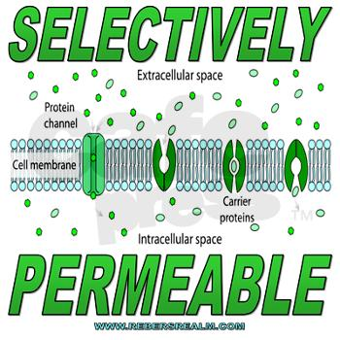
Notes:
The plasma membrane separates the living cell from its surroundings.
The plasma membrane exhibits selective permeability, allowing some substances to cross it more easily than others.

Slide 5
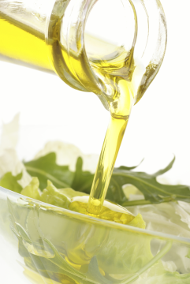
Figure 5.4-1
The Fluidity of Membranes
Membrane proteins
Mouse cell
Human cell
Membranes must be fluid to work properly; they are usually about as fluid as salad oil.
Notes:
5
Most of the lipids and some proteins in a membrane can shift about laterally.
The lateral movement of phospholipids is rapid; proteins move more slowly.
Some proteins move in a directed manner; others seem to be anchored in place.

Slide 6
Hydrophilic heads
Hydrophobic tails
Amphipathic molecules
Fluid Mosaic Model
Notes:
Phospholipids are the most abundant lipid in most membranes.
Phospholipids are amphipathic molecules, containing hydrophobic and hydrophilic regions.
A phospholipid bilayer can exist as a stable boundary between two aqueous compartments.
Most membrane proteins are also amphipathic and reside in the bilayer with their hydrophilic portions protruding.
The fluid mosaic model states that the membrane is a mosaic of protein molecules bobbing in a fluid bilayer of phospholipids.
Groups of certain proteins or certain lipids may associate in long-lasting, specialized patches.

Slide 7
Which of the amino acids below would you be more likely to find in section “A” of the protein?
A
Integral
protein

Slide 8
Which of the amino acids below would you be more likely to find in section “B” of the protein?
B
Integral
protein

Slide 9
Figure 5.2
Fibers of extra-
cellular matrix (ECM)
Glyco-
protein
Carbohydrate
Glycolipid
EXTRACELLULAR
SIDE OF
MEMBRANE
Cholesterol
Microfilaments
of cytoskeleton
Peripheral
proteins
Integral
protein
CYTOPLASMIC SIDE OF MEMBRANE
© 2014 Pearson Education, Inc.
Notes:
9
A membrane is a collage of different proteins, often grouped together, embedded in the fluid matrix of the lipid bilayer.
Proteins determine most of the membrane’s specific functions.
Integral proteins penetrate the hydrophobic interior of the lipid bilayer.
Integral proteins that span the membrane are called transmembrane proteins.
The hydrophobic regions of an integral protein consist of one or more stretches of nonpolar amino acids, often coiled into α helices.
Peripheral proteins are loosely bound to the surface of the membrane

Slide 10
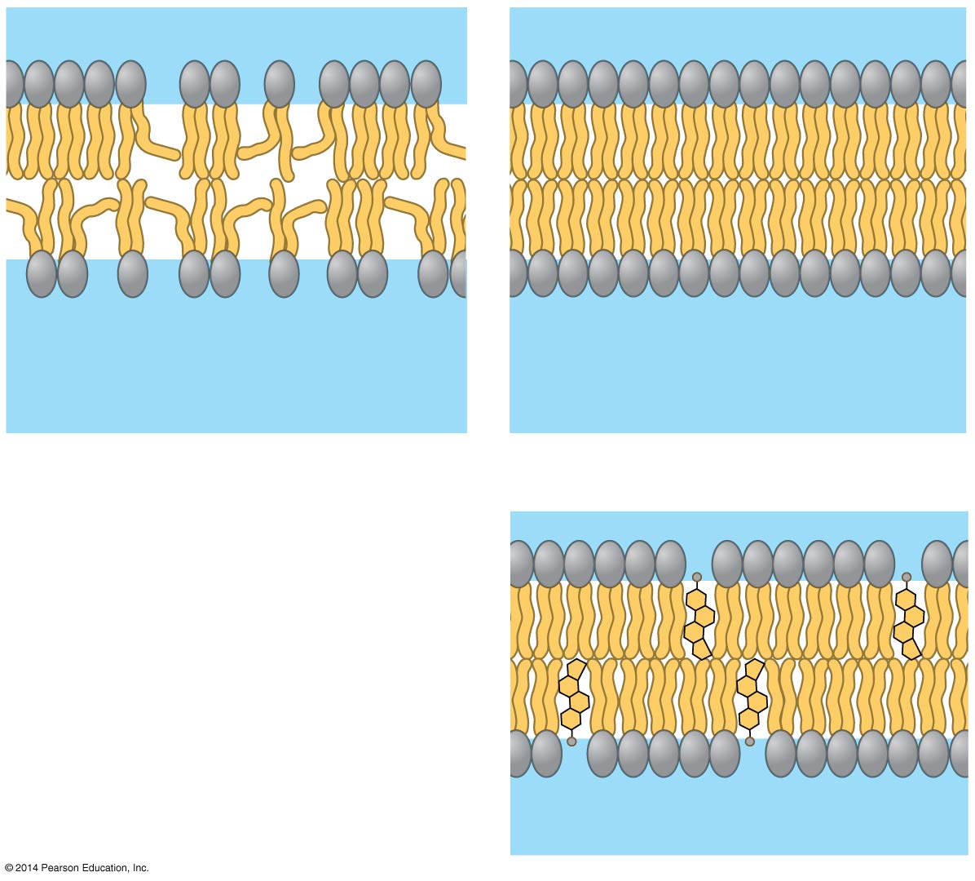
Figure 5.5
Fluid
Viscous
Unsaturated tails prevent
packing.
Saturated tails pack
together.
Cholesterol reduces
membrane fluidity at
moderate temperatures,
but at low temperatures
hinders solidification.
Cholesterol
© 2014 Pearson Education, Inc.
Notes:
10
As temperatures cool, membranes switch from a fluid state to a solid state.
The temperature at which a membrane solidifies depends on the types of lipids.
A membrane remains fluid to a lower temperature if it is rich in phospholipids with unsaturated hydrocarbon tails.
The steroid cholesterol has different effects on membrane fluidity at different temperatures.
At warm temperatures (such as 37ºC), cholesterol restrains movement of phospholipids.
At cool temperatures, it maintains fluidity by preventing tight packing.

Slide 11
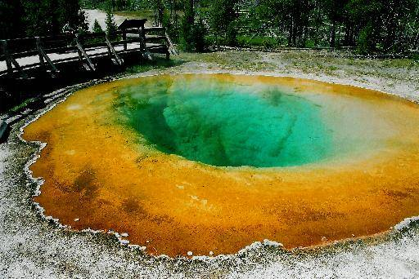
Evolution of Differences in Membrane Lipid Composition
Unsaturated tails
Saturated tails
Would bacteria adapted to living in very hot conditions have more saturated or unsaturated fatty acids in their membranes?
© 2014 Pearson Education, Inc.
Notes:
11
Variations in lipid composition of cell membranes of many species appear to be adaptations to specific environmental conditions.

Slide 12
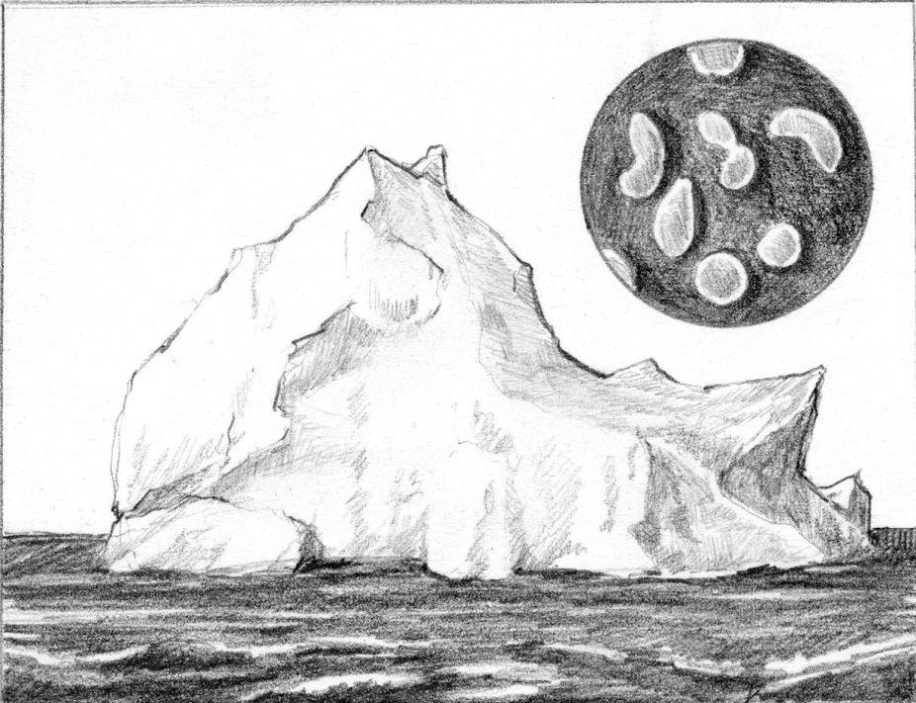
Evolution of Differences in Membrane Lipid Composition
Unsaturated tails
Saturated tails
Would bacteria adapted to living in very cold conditions have more saturated or unsaturated fatty acids in their membranes?
© 2014 Pearson Education, Inc.
Notes:
12
Variations in lipid composition of cell membranes of many species appear to be adaptations to specific environmental conditions.

Slide 13
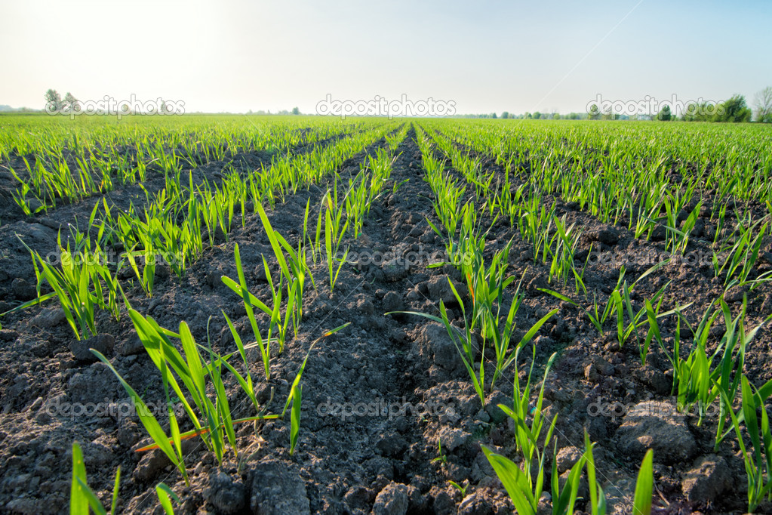
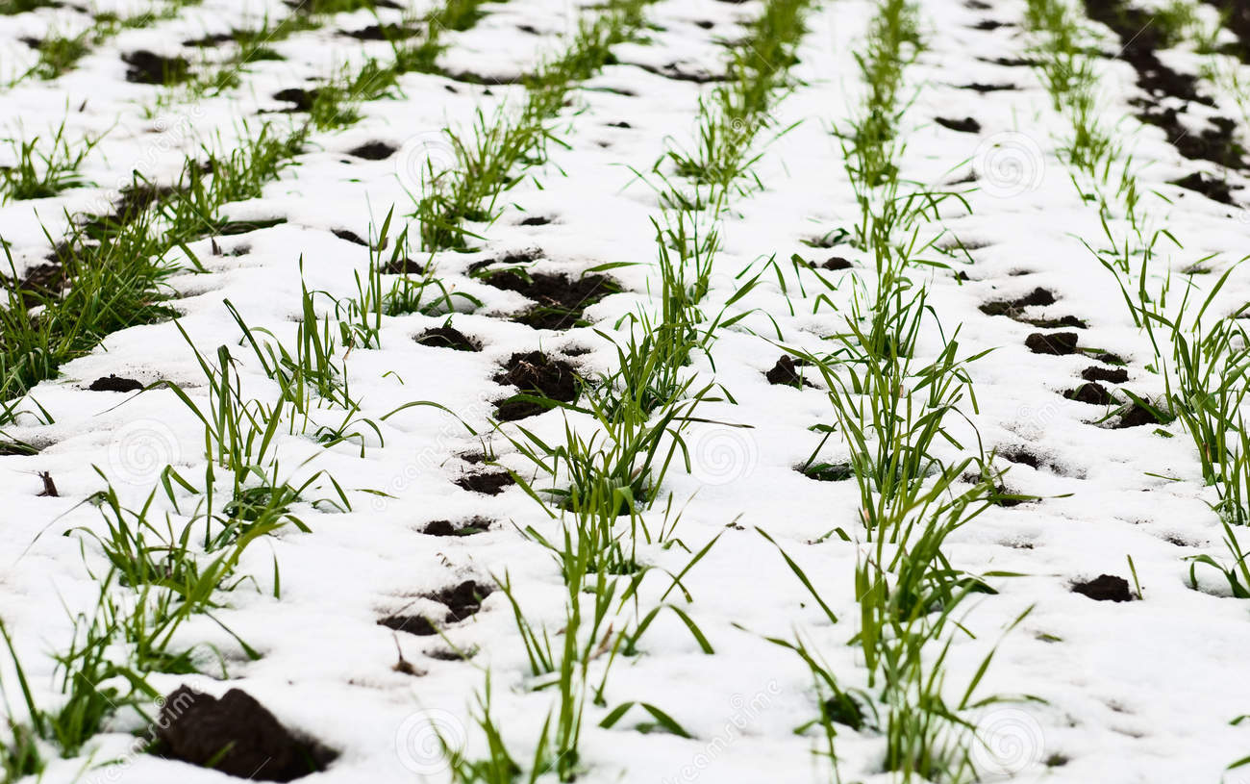
Evolution of Differences in Membrane Lipid Composition
The ability to change the lipid compositions in response to temperature changes has evolved in organisms that live where temperatures vary.
© 2014 Pearson Education, Inc.
Notes:
13

