Slide 1
Facilitated Diffusion and Active Transport
0
Chapter 5

Slide 2
You Must Know
The selective permeability of membranes.
The role of facilitated diffusion.
The role of active transport, including the sodium potassium pump and cotransport, in cells.

Slide 3
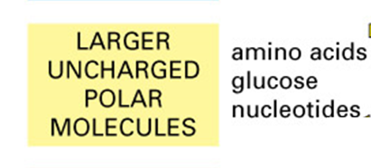
Put the following substances in order from most likely to least likely to make it across a lipid bilayer.

Slide 4
CONCEPT 5.2: Membrane structure results in selective permeability
© 2014 Pearson Education, Inc.
Notes:
4
A cell must regulate transport of substances across cellular boundaries.
Plasma membranes are selectively permeable, regulating the cell’s molecular traffic.
Hydrophobic (nonpolar) molecules, such as hydrocarbons, can dissolve in the lipid bilayer of the membrane and cross it easily.
Polar molecules, such as sugars, do not cross the membrane easily.

Slide 5
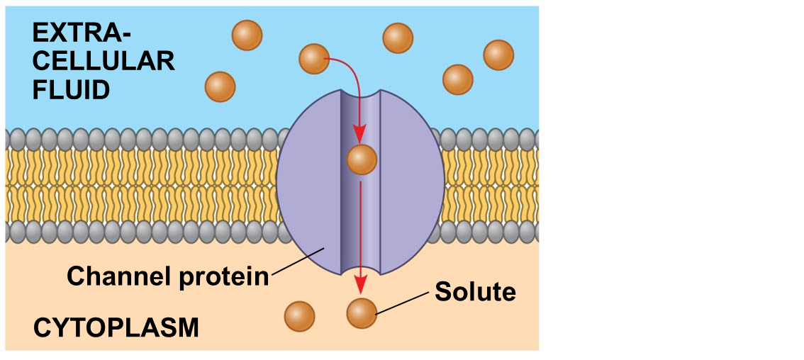
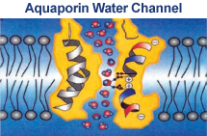
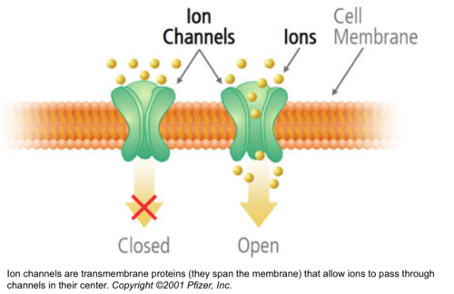
Facilitated Diffusion:
Channel Proteins
Hydrophilic
Facilitated diffusion does not alter the direction of transport
Notes:
5
Facilitated diffusion speeds transport of a solute by providing efficient passage through the membrane but does not alter the direction of transport.
Transport proteins allow passage of hydrophilic substances across the membrane.
Some transport proteins, called channel proteins, have a hydrophilic channel that certain molecules or ions can use as a tunnel.
A transport protein is specific for the substance it moves.
The aquaporin water channel allows single-file passage of up to 3 billion water molecules per second.
A transport protein is specific for the substance it moves.
Ion channels that open or close in response to a stimulus (gated channels)

Slide 6
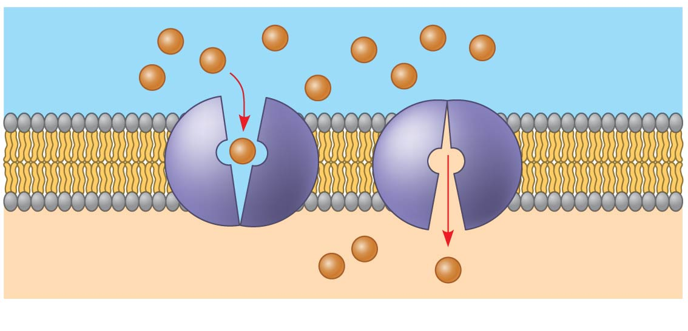
Facilitated Diffusion – Carrier Proteins
Carrier protein
Solute
(b) A carrier protein
© 2014 Pearson Education, Inc.
Notes:
6
Transport proteins allow passage of hydrophilic substances across the membrane. carrier proteins, bind to molecules and change shape to shuttle them across the membrane. Carrier proteins undergo a subtle change in shape that translocates the solute-binding site across the membrane. The shape change may be triggered by binding and release of the transported molecule. No net energy input is required.

Slide 7
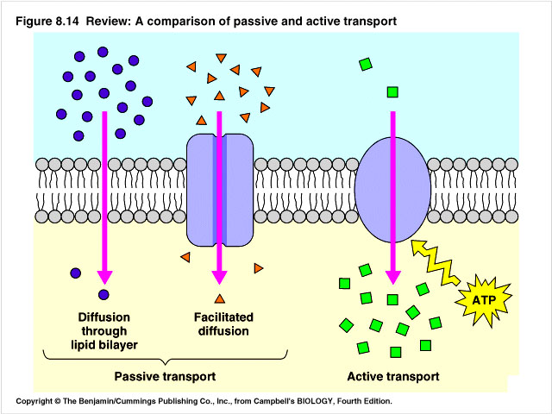
CONCEPT 5.4: Active Transport
Active transport moves substances against their concentration gradients.
Active transport requires energy, usually in the form of ATP.
© 2014 Pearson Education, Inc.
Notes:
7
Active transport allows cells to maintain concentration gradients that differ from their surroundings

Slide 8
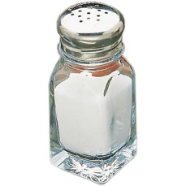
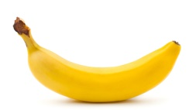
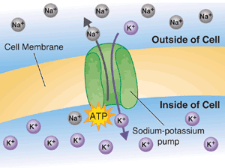
Sodium-potassium pump transports 3 sodium ions out of the cell and two potassium ions into the cell.
Cell

Slide 9
EXTRACELLULAR FLUID
[Na⁺] high
[K⁺] low
Phosphorylation
[Na⁺] low
1
CYTOPLASM
[K⁺] high
2
ADP
6
3
5
4
© 2014 Pearson Education, Inc.
Notes:
9
Cytoplasmic Na⁺ binds to the sodium-potassium pump. The affinity for Na⁺ is high when the protein has this shape.
Na⁺ binding stimulates phosphorylation by ATP.
Phosphorylation leads to a change in protein shape, reducing its affinity for Na⁺, which is released outside.
4. The new shape has a high affinity for K⁺, which binds on the extracellular side and triggers release of the phosphate group.
Loss of the phosphate group restores the protein’s original shape, which has a lower affinity for K⁺.
6. K⁺ is released; affinity for Na⁺ is high again, and the cycle repeats.

Slide 10
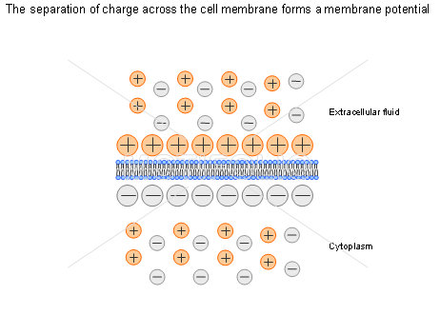
How Ion Pumps Maintain Membrane Potential
Membrane potential is the voltage across a membrane.
Voltage is created by differences in the distribution of positive and negative ions across a membrane.
© 2014 Pearson Education, Inc.
Notes:
10

Slide 11
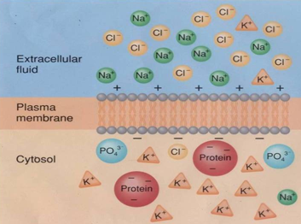
Two combined forces, collectively called the electrochemical gradient, drive the diffusion of ions across a membrane.
1. A chemical force (the ion’s concentration gradient).
2. An electrical force (the effect of the membrane potential on the ion’s movement).
Notes:
11

Slide 12
An electrogenic pump is a transport protein that generates voltage across a membrane.
The sodium-potassium pump is the major electrogenic pump of animal cells.
© 2014 Pearson Education, Inc.
Notes:
12

Slide 13
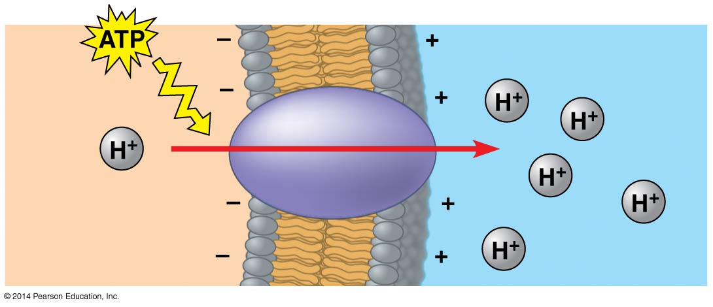
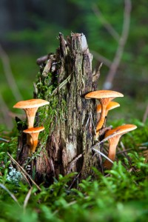
Figure 5.16
The main electrogenic pump of plants, fungi, and bacteria is a proton pump.
Electrogenic pumps help store energy that can be used for cellular work.
EXTRACELLULAR FLUID
Proton pump
CYTOPLASM
© 2014 Pearson Education, Inc.
Notes:
13
Figure 5.16 A proton pump

Slide 14
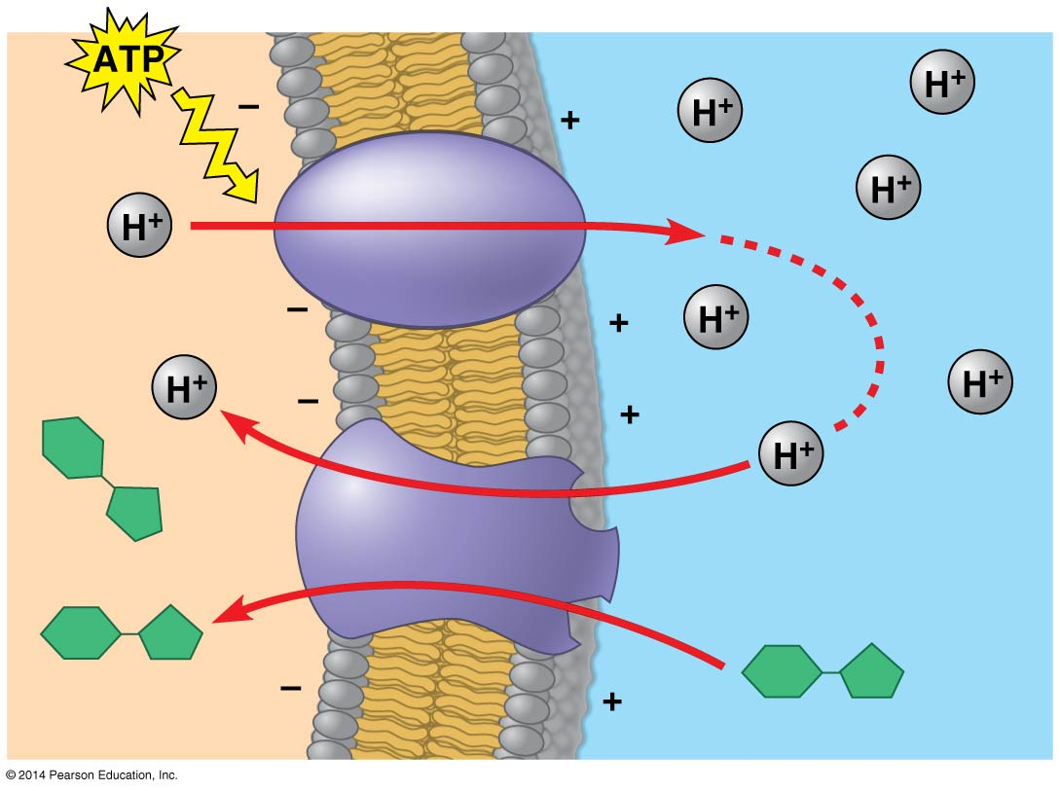
Cotransport: Coupled Transport by a Membrane Protein
Proton pump
Sucrose-H⁺
cotransporter
Diffusion of H⁺
Sucrose
Sucrose
© 2014 Pearson Education, Inc.
Notes:
14
Cotransport occurs when active transport of a solute indirectly drives transport of other solutes.
Plant cells use the gradient of hydrogen ions generated by proton pumps to drive active transport of nutrients into the cell

