Slide 1
0
Chapter 5
Diffusion and Osmosis

Slide 2
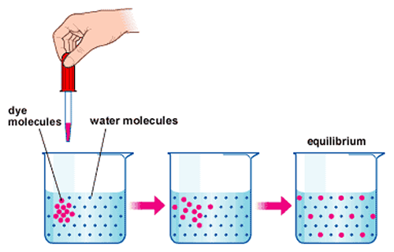
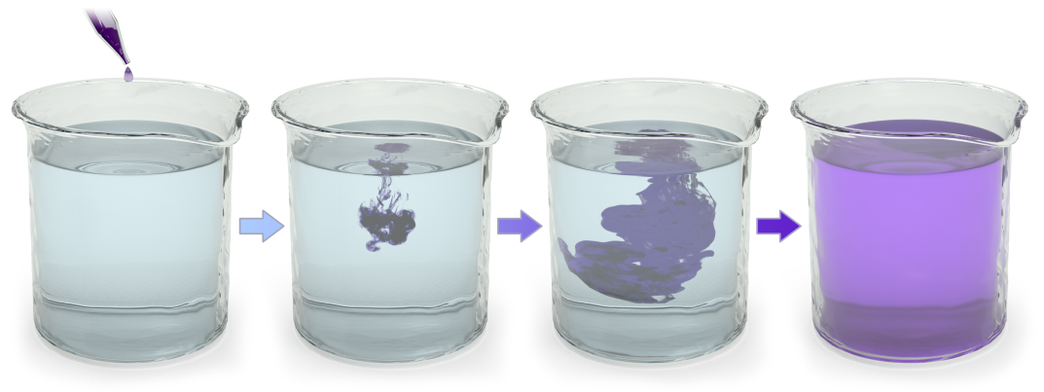
Diffusion
What is it?
Why does it occur?
Does it require added energy to make it happen?
What is misleading about the way the molecules are drawn in the equilibrium diagram?
Notes:
Passive transport is diffusion of a substance across a membrane with no energy investment. Diffusion is the tendency for molecules to spread out evenly into the available space. Although each molecule moves randomly, diffusion of a population of molecules may be directional. No work must be done to move substances down the concentration gradient. At dynamic equilibrium, as many molecules cross the membrane in one direction as in the other.

Slide 3
Substances diffuse down their concentration gradient, from where it is more concentrated to where it is less concentrated.

Slide 4
Diffusion of two solutes
Net diffusion
Net diffusion
Net diffusion
Net diffusion
Net diffusion
Equilibrium
Equilibrium
Net diffusion
Net diffusion
Net diffusion
Net diffusion
Net diffusion
Equilibrium
Equilibrium
Note that each substance diffuse down its own concentration gradient, unaffected by the concentration gradients of other substances.
© 2014 Pearson Education, Inc.
Notes:
4

Slide 5
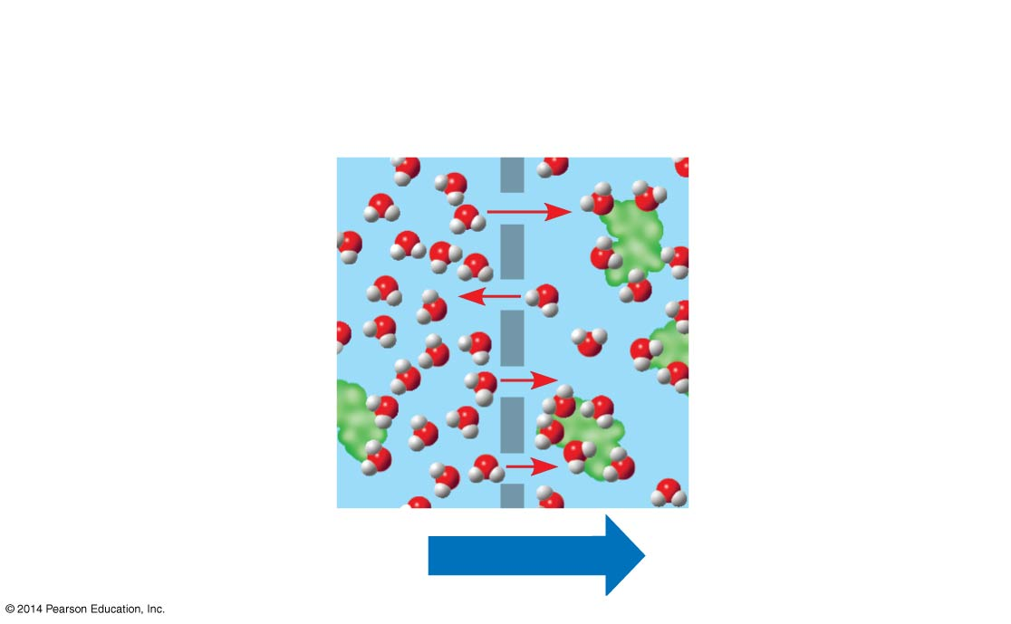
Osmosis
Selectively
permeable
membrane
Water molecules
can pass through
pores, but sugar
molecules cannot.
Water molecules
cluster around
sugar molecules.
This side has
fewer solute mol-
ecules, more free
water molecules.
This side has
more solute mol-
ecules, fewer free
water molecules.
Osmosis
© 2014 Pearson Education, Inc.
Notes:
5
Osmosis is the diffusion of free water across a selectively permeable membrane. Water diffuses across a membrane from the region of lower solute concentration to the region of higher solute concentration until the solute concentration is equal on both sides.

Slide 6
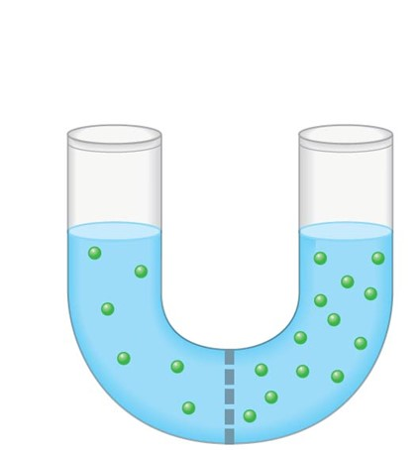
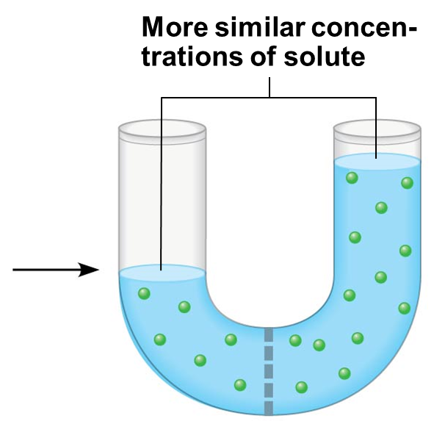
Lost mass
Gained mass
Lower
concentration
of solute (sugar)
Higher
concentration
of solute
Sugar
molecule
A
B
© 2014 Pearson Education, Inc.
Notes:
6

Slide 7
Water Balance of Cells
Tonicity is the ability of a surrounding solution to cause a cell to gain or lose water.
© 2014 Pearson Education, Inc.
Notes:
7

Slide 8
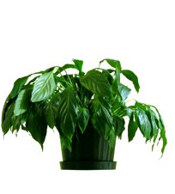
Water Balance of Cells
Isotonic solution:
Solute concentration outside of the cell is the same as inside the cell.
If a cell is in an isotonic solution, will there be a net movement of water across the plasma membrane?
No!
H₂O
H₂O
Flaccid
© 2014 Pearson Education, Inc.
Notes:
8
If a plant cell and its surroundings are isotonic, there is no net movement of water into the cell; the cell becomes flaccid (limp), and the plant may wilt.

Slide 9
Water Balance of Cells
Hypertonic solution:
Solute concentration outside of the cell is greater than that inside the cell
A cell in a hypertonic solution will ______ water.
lose
H₂O
Plasmolyzed
© 2014 Pearson Education, Inc.
Notes:
9
In a hypertonic environment, plant cells lose water; eventually, the membrane pulls away from the wall, a usually lethal effect called plasmolysis

Slide 10
Water Balance of Cells
Hypotonic solution:
Solute concentration outside of the cell is less than that inside the cell
A cell in a hypotonic solution will ______water.
gain
Hypotonic
H₂O
Cell wall
H₂O
Plant cell
Animal cell
Lysed
Turgid (normal)
Notes:
10
A plant cell in a hypotonic solution swells until the wall opposes uptake; the cell is now turgid (very firm).

