Slide 1
0
Chapter 4
Mitochondria and Chloroplast

Slide 2
You must know
The structure and function of mitochondria and chloroplasts.
The evolutionary origin of mitochondria and chloroplasts.

Slide 3
Concept 4.5: Mitochondria and chloroplasts change energy from one form to another
Mitochondria are the sites of cellular respiration, a metabolic process that uses oxygen to generate ATP.
Chloroplasts, found in plants and algae, are the sites of photosynthesis.
© 2014 Pearson Education, Inc.
Notes:
3

Slide 4
The Evolutionary Origins of Mitochondria and Chloroplasts
Mitochondria and chloroplasts have characteristics that are consistent with their having once been free living bacteria.
Enveloped by a double membrane.
Contain free ribosomes and circular DNA molecules.
Grow and reproduce somewhat independently in cells.
© 2014 Pearson Education, Inc.
Notes:
4

Slide 5
Endosymbiont Theory
Endoplasmic
reticulum
Nucleus
Engulfing of oxygen-
using nonphotosynthetic
prokaryote, which
becomes a mitochondrion
Nuclear
envelope
Ancestor of
eukaryotic cells
(host cell)
Mitochondrion
Engulfing of
photosynthetic
prokaryote
At least
one cell
Chloroplast
Nonphotosynthetic
eukaryote
Mitochondrion
Photosynthetic eukaryote
Notes:
5
The endosymbiont theory
An early ancestor of eukaryotic cells engulfed a nonphotosynthetic prokaryotic cell, which formed an endosymbiont relationship with its host.
The host cell and endosymbiont merged into a single organism, a eukaryotic cell with a mitochondrion.
At least one of these cells may have taken up a photosynthetic prokaryote, becoming the ancestor of cells that contain chloroplasts.

Slide 6
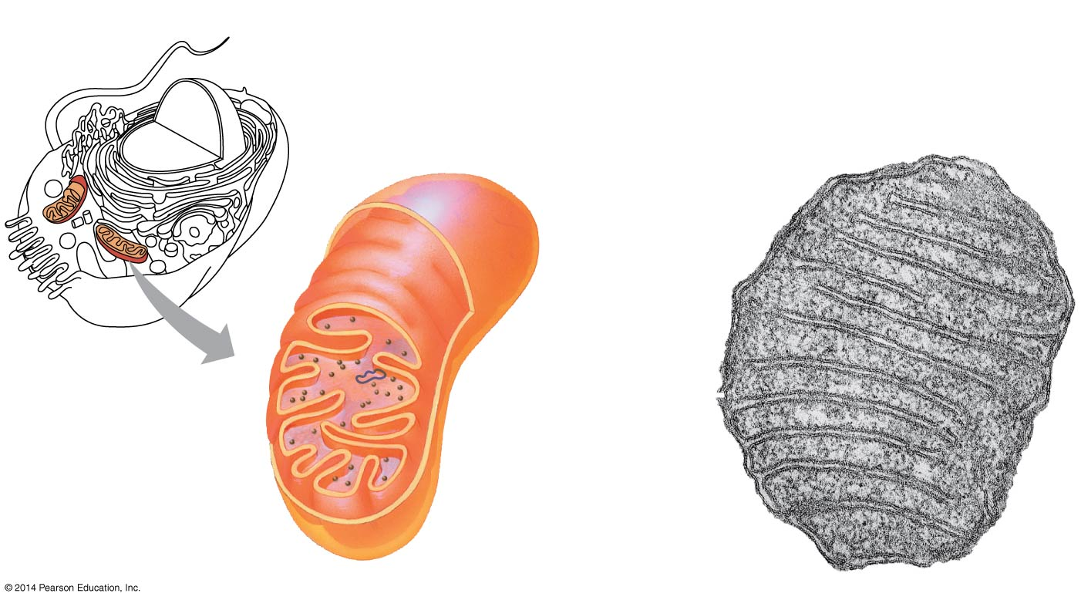
Mitochondria: Chemical Energy Conversion
Mitochondrion
Outer
membrane
DNA
Inner
membrane
Free
ribosomes
in the
mitochondrial
matrix
0.1 μm
Notes:
6
Mitochondria are in nearly all eukaryotic cells.
They have a smooth outer membrane and an inner membrane folded into cristae.
The inner membrane creates two compartments: intermembrane space and mitochondrial matrix.
Some metabolic steps of cellular respiration are catalyzed in the mitochondrial matrix.
Cristae present a large surface area for enzymes that synthesize ATP.

Slide 7
Feb 24, 2015 – UK approves three-person babies
How can a mother pass on a really, really debilitating mitochondrial disease? (Hint: It’s not a dominant and recessive thing and this picture is a simplification that hides the reason.)
Notes:
You don’t need to remember the details of this for a test.

Slide 8
Heteroplasmy
Notes:
You don’t need to remember the details of this for a test.

Slide 9
Chloroplasts: Capture of Light Energy
Chloroplasts contain the green pigment chlorophyll, as well as enzymes and other molecules that function in photosynthesis
Chloroplasts are found in leaves and other green organs of plants and in algae
© 2014 Pearson Education, Inc.
Notes:
9

Slide 10
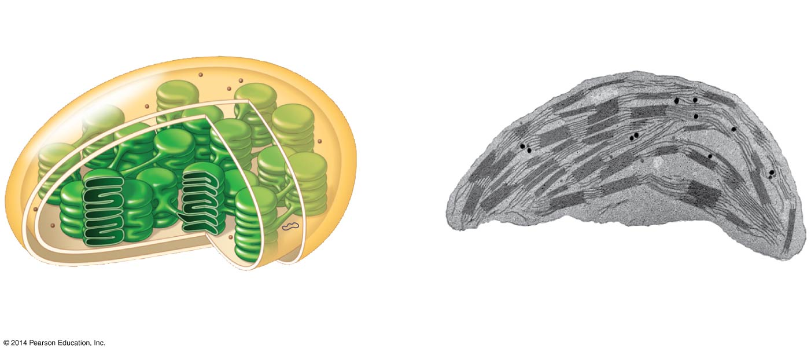
Ribosomes
Inner and outer
membranes
DNA
Intermembrane space
1 μm
Diagram of chloroplast
Notes:
10
Chloroplast structure includes
Thylakoids, membranous sacs, stacked to form a granum
Stroma, the internal fluid.
The chloroplast is one of a group of plant organelles called plastids

