Slide 1
0
Chapter 4
Endomembrane System

Slide 2
You Must Know
The structure and function of the endomembrane system.
How different cell types show differences in subcellular components.
As you are learning about cells, consider what cell features might be present in abundance or absent in certain cells based on their functions.

Slide 3
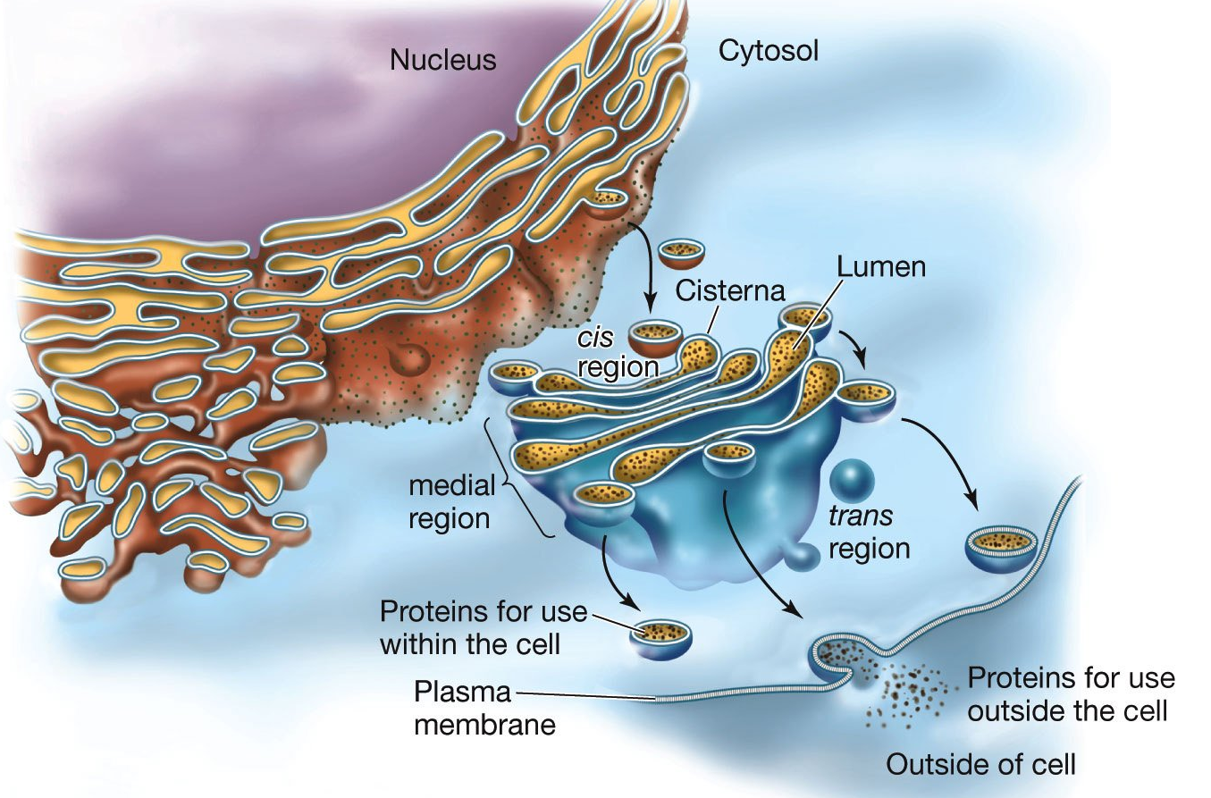
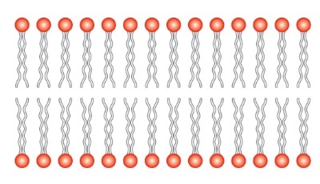
Concept 4.4: The endomembrane system regulates protein traffic and performs metabolic functions in the cell
Components of the endomembrane system
Nuclear envelope
Endoplasmic reticulum
Golgi apparatus
Lysosomes
Vacuoles
Plasma membrane
These components are either continuous or connected through transfer by vesicles
Notes:
3

Slide 4
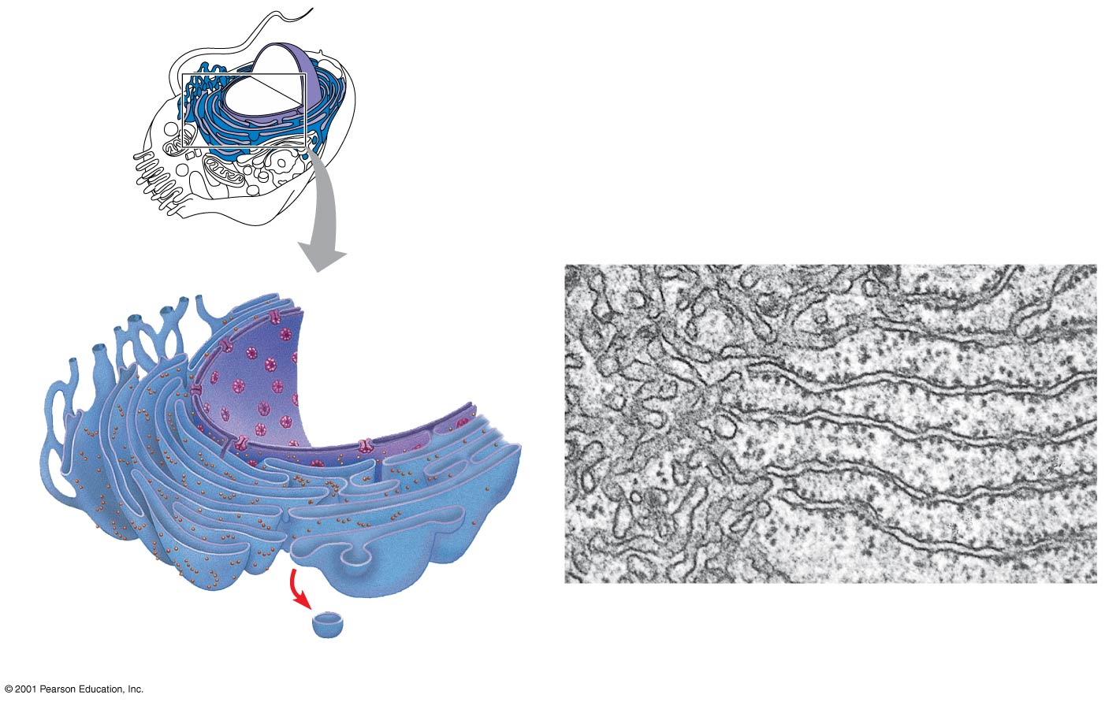
The Endoplasmic Reticulum: Biosynthetic Factory
Smooth ER
Rough ER
0.2 μm
Smooth ER
Rough
ER
Nuclear
envelope
ER lumen
Ribosomes
Transport vesicle
Notes:
4
The endoplasmic reticulum (ER) accounts for more than half of the total membrane in many eukaryotic cells. The ER membrane is continuous with the nuclear envelope. There are two distinct regions of ER
Smooth ER: lacks ribosomes
Rough ER: surface is studded with ribosomes

Slide 5
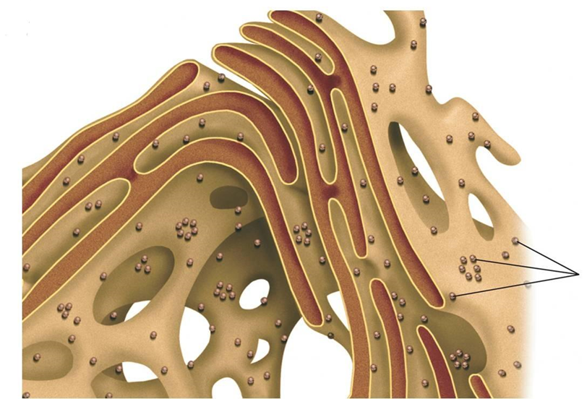
Functions of Rough ER
The rough ER
Proteins destined for secretion outside of the cell or insertion into cell membranes are processed in the rough ER. (Proteins that stay in the cytosol are not modified by the rough ER.)
Makes glycoproteins
Proteins modified in the rough ER are distributed in transport vesicles.
Ribosomes
Notes:
As far as we know, all protein synthesis starts on free ribosomes. Ribosomes that are synthesizing proteins that stay in the cytosol stay free. Ribosomes that are synthesizing proteins for secretion outside of the cell or for insertion into cell membranes move to the rough ER shortly after synthesis begins. The rough ER makes glycoproteins (proteins covalently bonded to carbohydrates).
5

Slide 6
What type of cells would have a lot of rough ER?
Cells that produce products for secretion.
For example, pancreatic cells which produce the protein insulin.

Slide 7
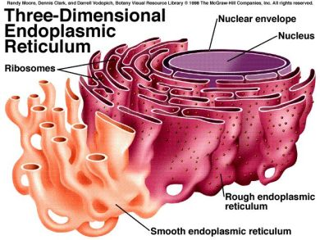
Functions of Smooth ER
The smooth ER
Synthesizes lipids including oils, phospholipids and steroids
Metabolizes carbohydrates
Detoxifies drugs and poisons
Stores calcium ions
Notes:
7

Slide 8
What type of cells would have a lot of smooth ER?
Cells that detoxify drugs – ex, liver
Cells that produce lots of lipids.
For example, the testes and ovaries which produce the steroids testosterone and estrogen.

Slide 9
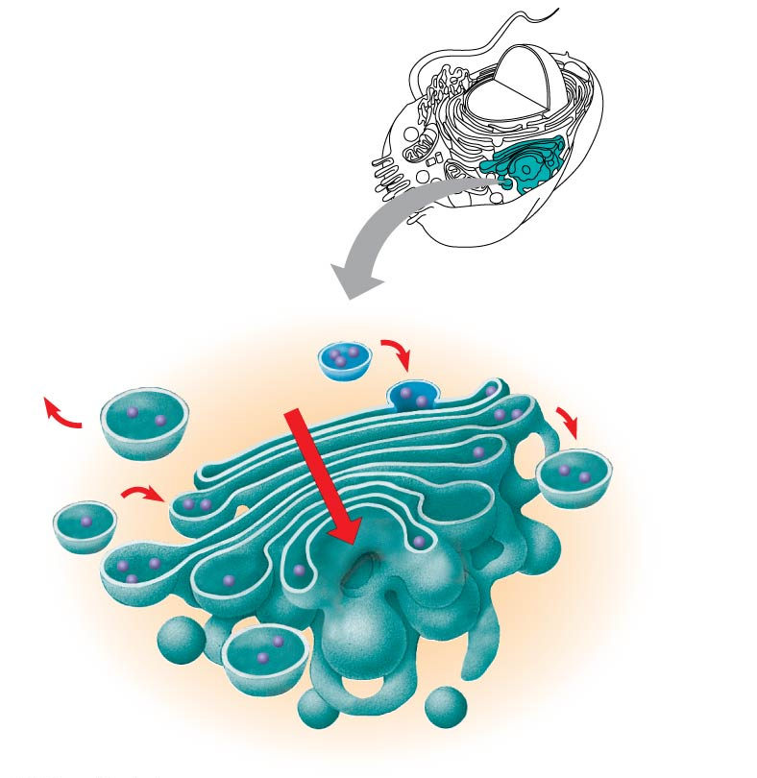
The Golgi Apparatus: Shipping and Receiving Center
Functions of the Golgi apparatus
Modifies products of the ER
Manufactures certain macromolecules (especially polysaccharides)
Sorts and packages materials into transport vesicles
Golgi
apparatus
cis face
(“receiving” side of
Golgi apparatus)
trans face
(“shipping”
side of Golgi
apparatus)
Notes:
9
The Golgi apparatus consists of flattened membranous sacs called cisternae.
The Golgi apparatus is directional – products enter the cis side and leave the trans side.

Slide 10
Lysosomes: Digestive Compartments
A lysosome is a membranous sac of hydrolytic enzymes that can digest macromolecules.
H+
Lysosome
Mitochondrion
Digestion
Vesicle
Lysosomes: Autophagy
© 2014 Pearson Education, Inc.
Notes:
Lysosomal enzymes can hydrolyze proteins, fats, polysaccharides, and nucleic acids.
Lysosomal enzymes work best in the acidic environment inside the lysosome.
Lysosomes also use enzymes to recycle the cell’s own organelles and macromolecules, a process called autophagy.
10

Slide 11
Digestive
enzymes
Lysosome
Plasma
membrane
Digestion
Food vacuole
Lysosomes: Phagocytosis
https://www.youtube.com/watch?v=Z_mXDvZQ6dU
Notes:
11
Some types of cell can engulf another cell by phagocytosis; this forms a food vacuole.
A lysosome fuses with the food vacuole and digests the molecules.
Food vacuoles are formed by phagocytosis

Slide 12
Vacuoles: Diverse Maintenance Compartments
Vacuoles are large vesicles derived from the endoplasmic reticulum and Golgi apparatus
© 2014 Pearson Education, Inc.
Notes:
12

Slide 13
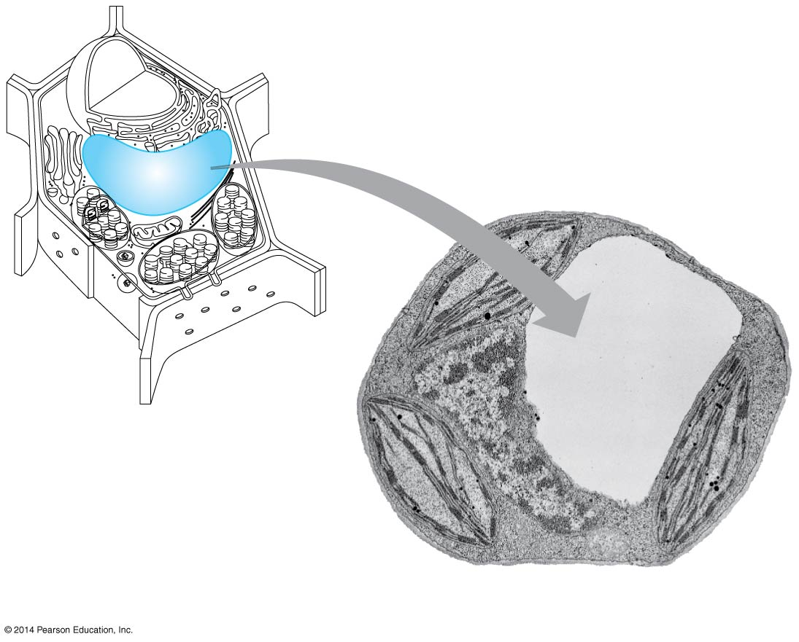
Central vacuoles, found in many mature plant cells, hold organic compounds and water.
Certain vacuoles in plants and fungi carry out enzymatic hydrolysis like lysosomes.
Central vacuole
Central
vacuole
Plant cell vacuole
5 μm
Notes:
13
Figure 4.14 The plant cell vacuole

Slide 14
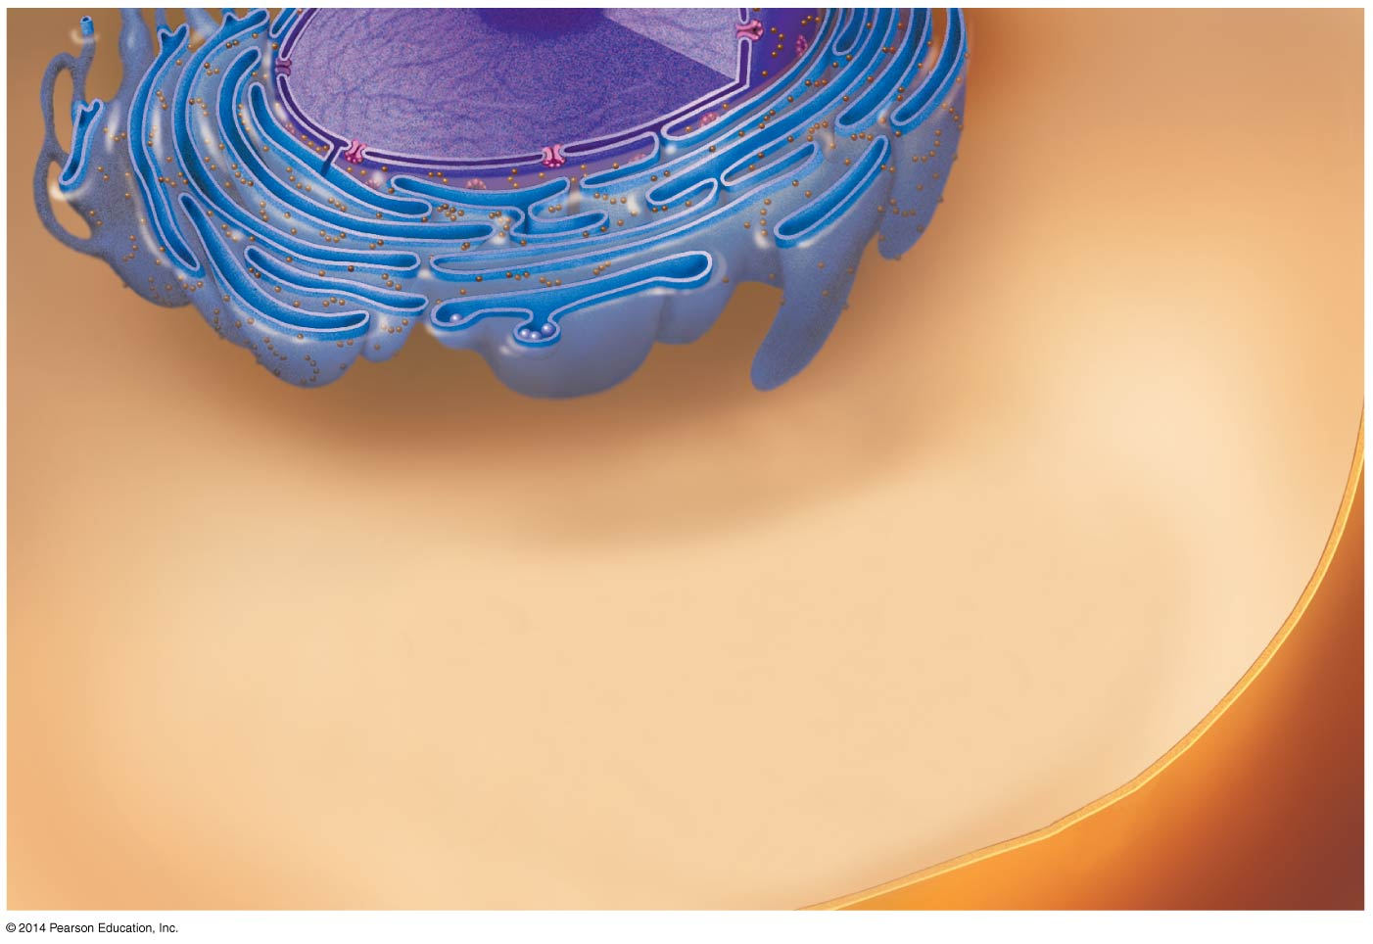
Figure 4.15-1
Nucleus
Rough ER
Smooth ER
Plasma
membrane
Notes:
14
Figure 4.15-1 Review: relationships among organelles of the endomembrane system (step 1)

Slide 15
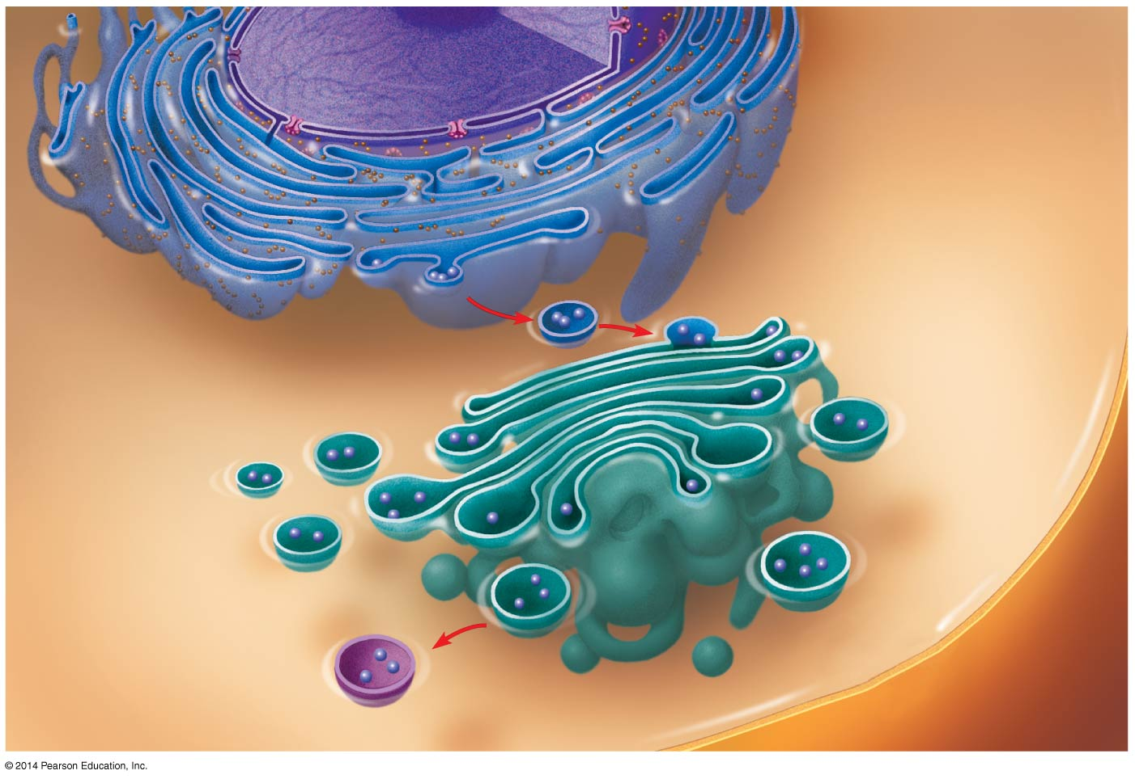
Figure 4.15-2
Nucleus
Rough ER
Smooth ER
cis Golgi
Plasma
membrane
trans Golgi
Notes:
15
Figure 4.15-2 Review: relationships among organelles of the endomembrane system (step 2)

Slide 16
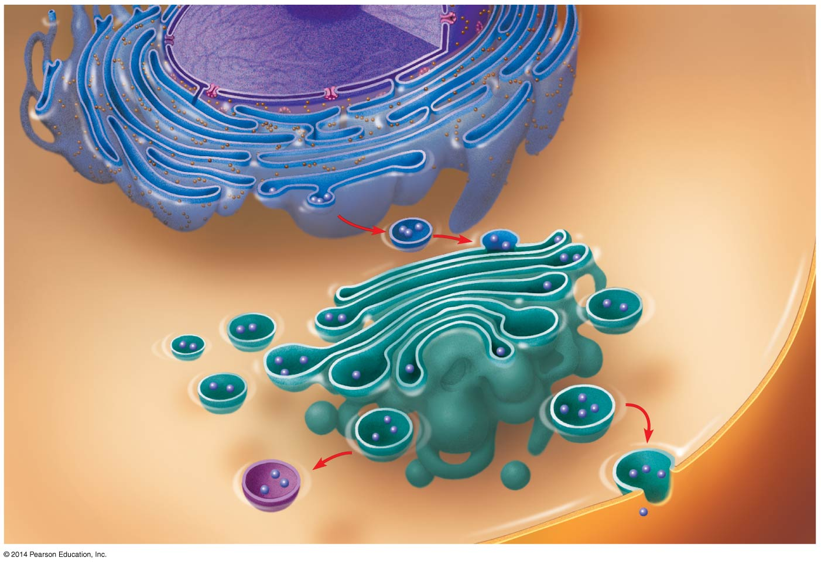
Figure 4.15-3
Nucleus
Rough ER
Smooth ER
cis Golgi
Plasma
membrane
trans Golgi
Notes:
16
Figure 4.15-3 Review: relationships among organelles of the endomembrane system (step 3)

