Slide 1
0
Chapter 4
Cytoskeleton, Cell wall and EMC

Slide 2
You Must Know
The structure and function of the cytoskeleton. (You will only be tested on the parts of the cytoskeleton that we go over in class today.)
The structure and function of the plant cell wall and the animal ECM.
Organelles found only in plant cells or only in animal cells. (Page 72-73)

Slide 3
Concept 4.6: The cytoskeleton
The cytoskeleton is a network of fibers extending throughout the cytoplasm.
It organizes the cell’s structures and activities, anchoring many organelles.
It provides motility for vesicles and organelles
© 2014 Pearson Education, Inc.
Notes:
3

Slide 4
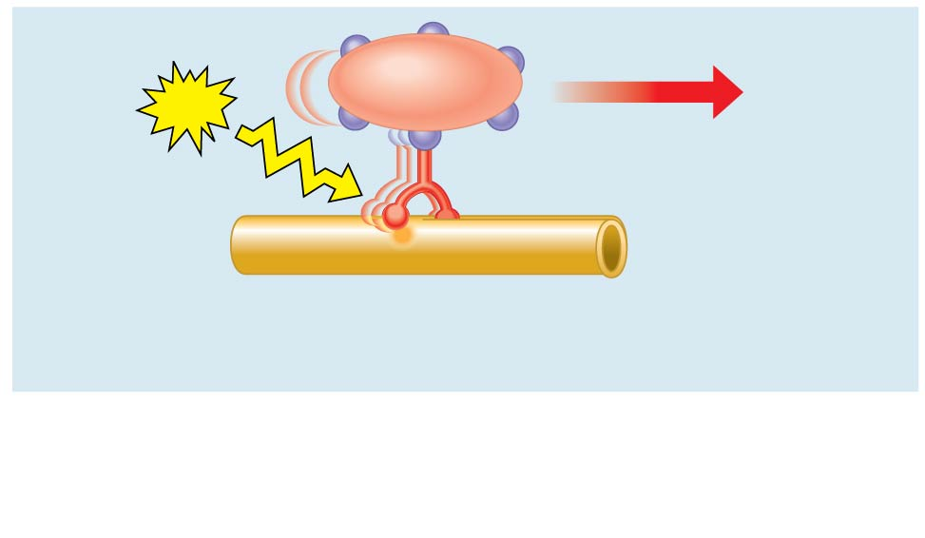
Vesicle
ATP
Motor protein
Cytoskeleton
Motor proteins “walk” vesicles along cytoskeletal
fibers.
https://www.youtube.com/watch?v=y-uuk4Pr2i8
Notes:
4
The cytoskeleton helps to support the cell and maintain its shape.
It interacts with motor proteins to produce motility.
Inside the cell, vesicles and other organelles can “walk” along the tracks provided by the cytoskeleton.

Slide 5
Cell Walls of Plants
The cell wall is an extracellular structure that distinguishes plant cells from animal cells
The cell wall
protects the plant cell,
maintains its shape, and
prevents excessive uptake of water
Plant cell walls are made of __________fibers embedded in other polysaccharides and protein
cellulose
Notes:
Prokaryotes, fungi, and some protists also have cell walls but they are not made of cellulose.
5

Slide 6
Cytosol
Plasma membrane
Plant cell walls
Plasmodesmata
Notes:
6
Plasmodesmata are channels that perforate plant cell walls. Through plasmodesmata, water and small solutes (and sometimes proteins and RNA) can pass from cell to cell

Slide 7
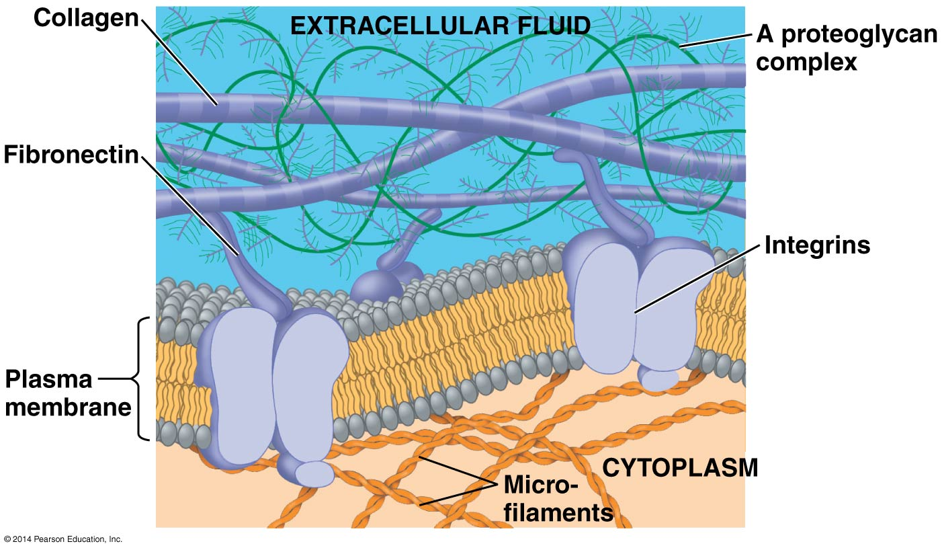
The Extracellular Matrix (ECM) of Animal Cells
The ECM is made up of glycoproteins
Notes:
7
Animal cells lack cell walls but are covered by an elaborate extracellular matrix (ECM)
The ECM is made up of glycoproteins such as collagen, proteoglycans, and fibronectin
ECM proteins bind to receptor proteins in the plasma membrane called integrins. Information is passed from the ECM to the interior of the cell via Integrins.

Slide 8
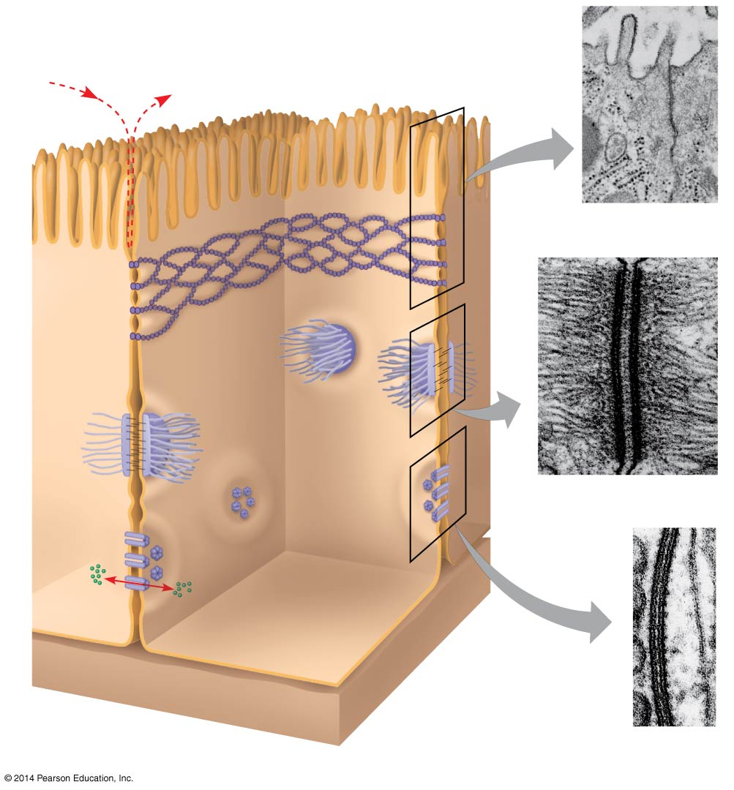
Figure 4.27
Tight junctions prevent
fluid from moving
across a layer of cells
Tight
junction
TEM
0.5 μm
Tight
junction
Intermediate
filaments
Desmosome
TEM
Gap
junction
1 μm
Ions or small
molecules
Space
between cells
TEM
Plasma membranes
of adjacent cells
Extracellular
matrix
0.1 μm
Notes:
8
Animal cells have three main types of cell junctions
Tight junctions – Proteins that form a continuous seal around the cells. They prevent the leakage of extracellular fluid.
Desmosomes – Proteins that function like rivets fastening cells together in strong sheets.
Gap junctions – Membrane proteins that surround a pore through which ions, sugars, amino acids, and other small molecules may pass.
All are especially common in epithelial tissue

