Slide 1
POGIL Quiz

Slide 2
0
Chapter 3
Proteins

Slide 3
You Must Know
How the sequence and subcomponents of proteins determine their properties.
The four structural levels of proteins and how changes at any level can affect the activity of the protein.
How proteins reach their final shape (conformation), the denaturing impact that heat and pH can have on protein structure, and how these may affect the organism.
The directionality of proteins (the amino and carboxyl ends).

Slide 4
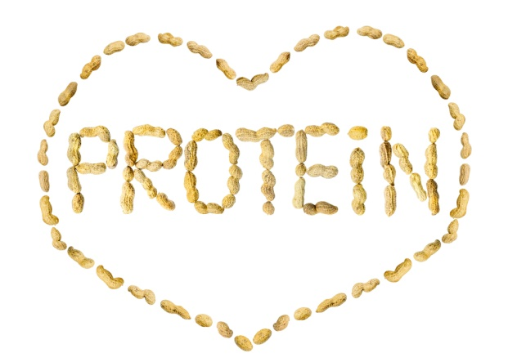
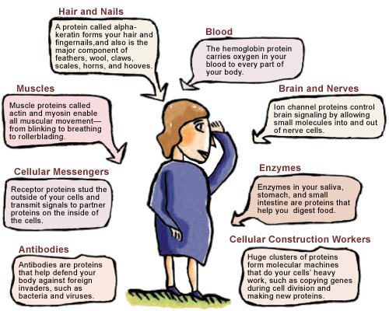
Wow! They do a lot!
Don’t worry too much about the details on this slide, we will come back to it!
Notes:
Life would not be possible without enzymes. Enzymatic proteins act as catalysts, to speed up chemical reactions without being consumed by the reaction. Proteins account for more than 50% of the dry mass of most cells. Protein functions include defense, storage, transport, cellular communication, movement, and structural support.

Slide 5
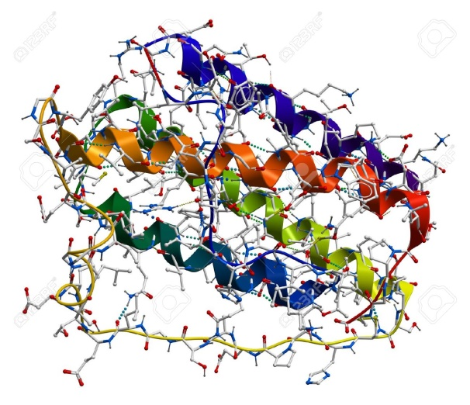
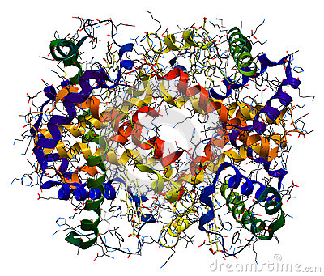
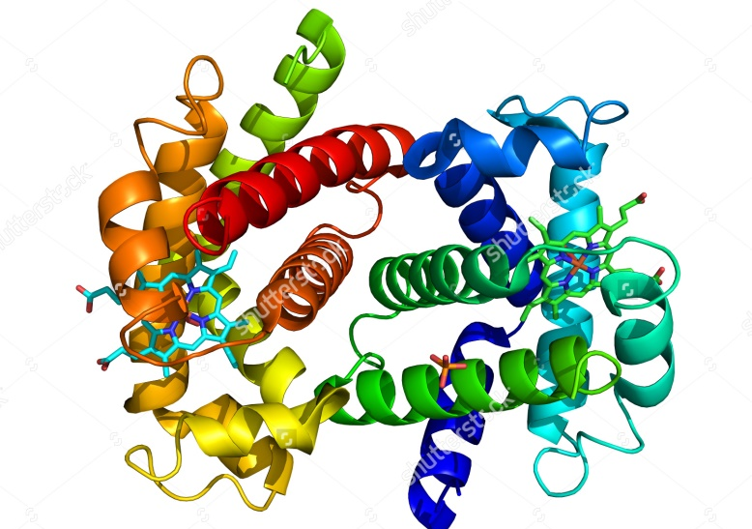
Protein Structure and Function
A protein’s structure determines its function!
© 2014 Pearson Education, Inc.
Notes:
5
Polypeptides are unbranched polymers built from the same set of 20 amino acids. A protein is a biologically functional molecule that consists of one or more polypeptides.

Slide 6
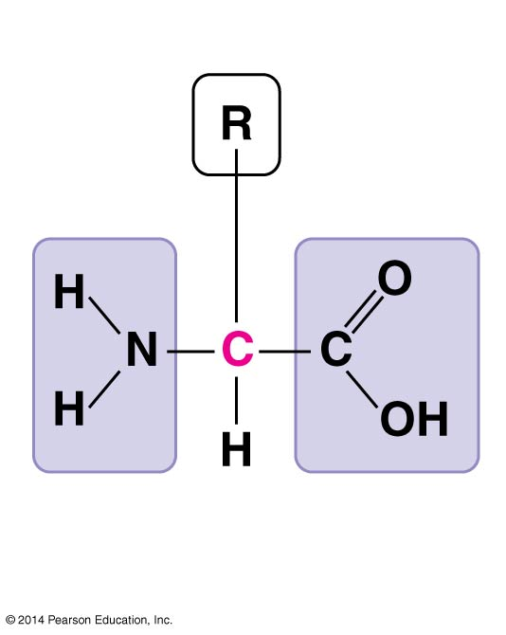
Amino Acids: the monomers of proteins
Side chain (R group)
α carbon
Amino
group
Carboxyl
group
There are 20 different amino acids.
Notes:
6
Amino acids are organic molecules with carboxyl and amino groups.
Amino acids differ in their properties due to differing side chains, called R groups.

Slide 7
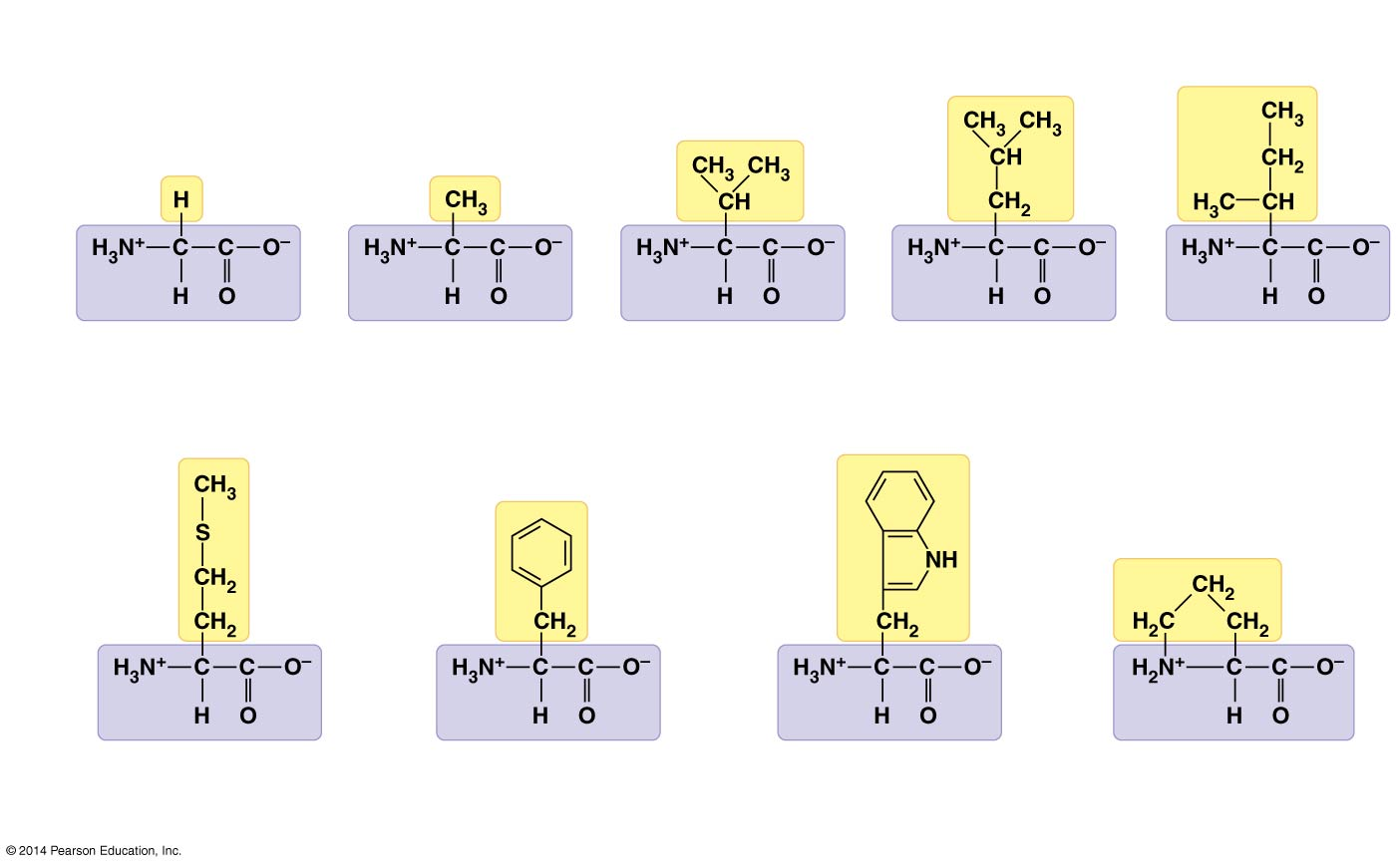
What do the side chains of these amino acids have in common?
Side chain
(R group)
Glycine
(Gly or G)
Alanine
(Ala or A)
Valine
(Val or V)
Leucine
(Leu or L)
Isoleucine
(Ιle or Ι)
Methionine
(Met or M)
Phenylalanine
(Phe or F)
Tryptophan
(Trp or W)
Proline
(Pro or P)
Nonpolar
Hydrophobic
Notes:
7
Nonpolar side chains; hydrophobic

Slide 8
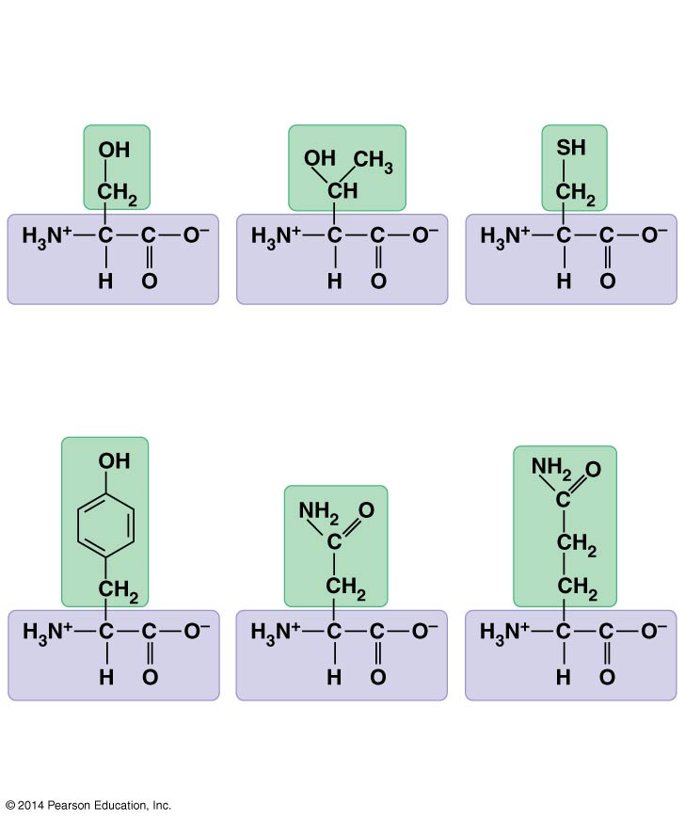
Figure 3.17b
What do the side chains of these amino acids have in common?
Serine
(Ser or S)
Threonine
(Thr or T)
Cysteine
(Cys or C)
Tyrosine
(Tyr or Y)
Asparagine
(Asn or N)
Glutamine
(Gln or Q)
Polar
Hydrophilic
Notes:
8
Figure 3.17b The 20 amino acids of proteins (part 2: polar)
Polar side chains; hydrophilic

Slide 9
Figure 3.17c
What do the side chains of these amino acids have in common?
Aspartic acid
(Asp or D)
Glutamic acid
(Glu or E)
Electrically Charged (-)
Hydrophilic
Notes:
9
Figure 3.17c The 20 amino acids of proteins (part 3: charged)
Electrically charged side chains; hydrophilic
Acidic amino acids are those with side chains that are generally negative charge owing to the presence of a carboxyl group, which is usually ionized at cellular pH.

Slide 10
Figure 3.17c
What do the side chains of these amino acids have in common?
Lysine
(Lys or K)
Arginine
(Arg or R)
Histidine
(His or H)
Electrically Charged (+)
Hydrophilic
Notes:
10
Figure 3.17c The 20 amino acids of proteins (part 3: charged)
Electrically charged side chains; hydrophilic
Basic amino acids have amino groups in their side chains that are generally positive in charge.

Slide 11
You don’t need to memorize all the different side chains of the amino acids, but when shown a side chain you should be able to identify its properties (e.g. polar, ionized, etc.).

Slide 12
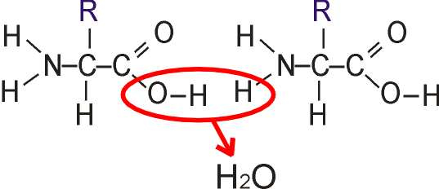
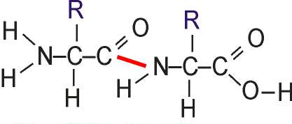
N-terminus
peptide bond
C-terminus
Notes:
Amino acids are linked by peptide bonds
A polypeptide is a polymer of amino acids
Polypeptides range in length from a few to more than a thousand monomers
Each polypeptide has a unique linear sequence of amino acids, with a carboxyl end (C-terminus) and an amino end (N-terminus)
Peptide bonds are formed by dehydration reactions, which link the carboxyl group of one amino group of the next.

Slide 13
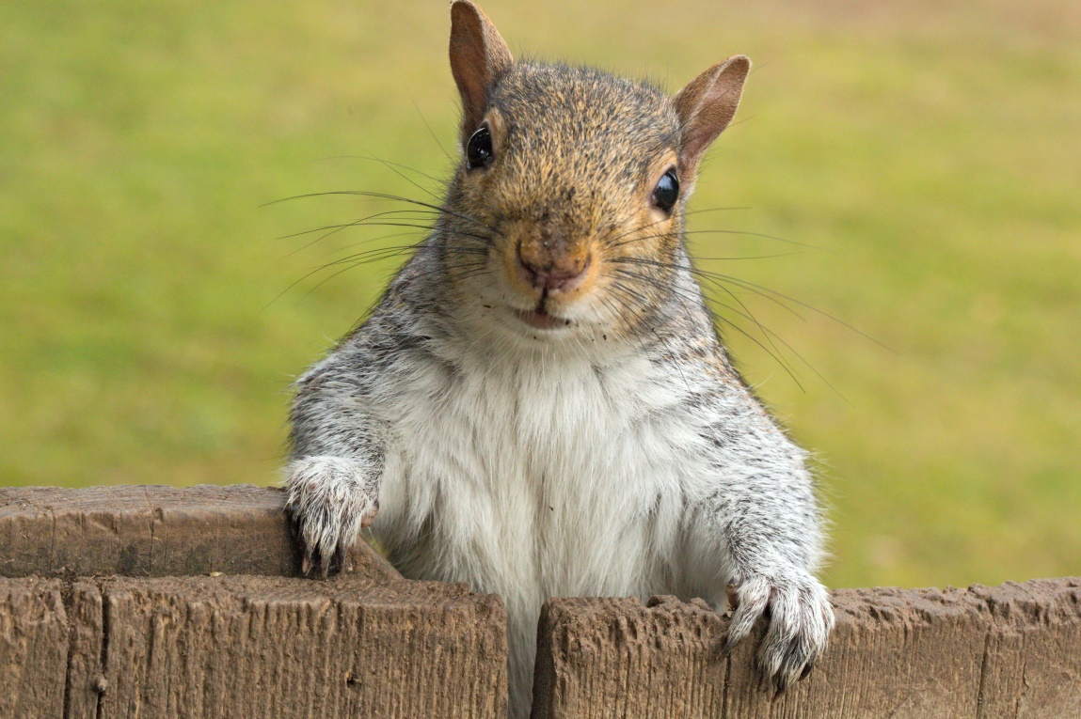
How does an organism “know” what proteins to make?
DNA dictates the sequence of amino acids.
The sequence of amino acids leads to the protein’s three-dimensional structure.

Slide 14
Four Levels of Protein Structure
Primary
Secondary
Tertiary
Quaternary (Not all proteins have quaternary structure.)
© 2014 Pearson Education, Inc.
Notes:
14
A functional protein consists of one or more polypeptides precisely twisted, folded, and coiled into a unique shape.

Slide 15
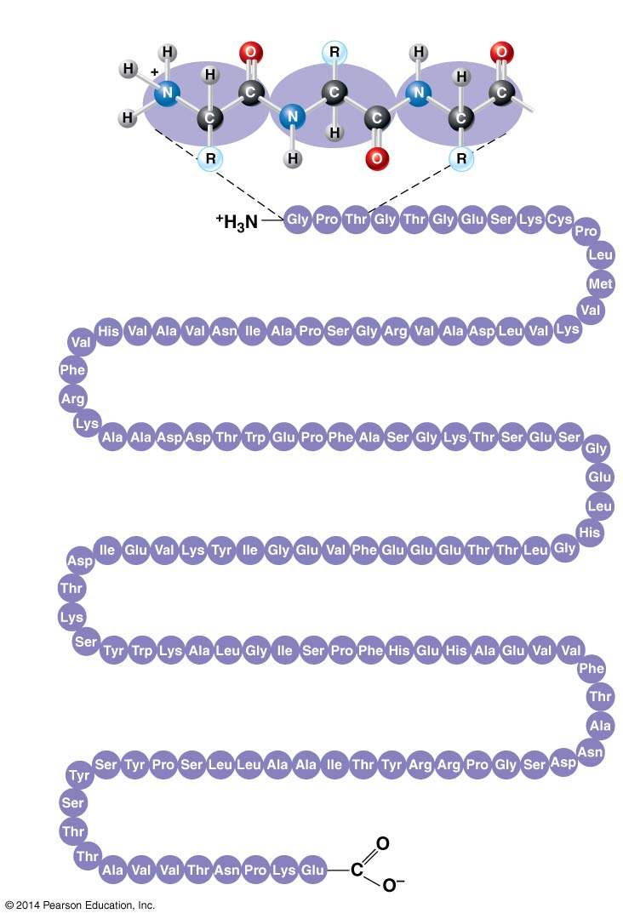
Figure 3.21a
Primary structure
Amino
acids
1
5
10
Amino end
30
25
20
15
35
40
45
50
70
65
60
55
75
80
85
90
95
115
110
105
100
120
125
Carboxyl end
Notes:
15
The sequence of amino acids make up the primary structure of a protein.

Slide 16
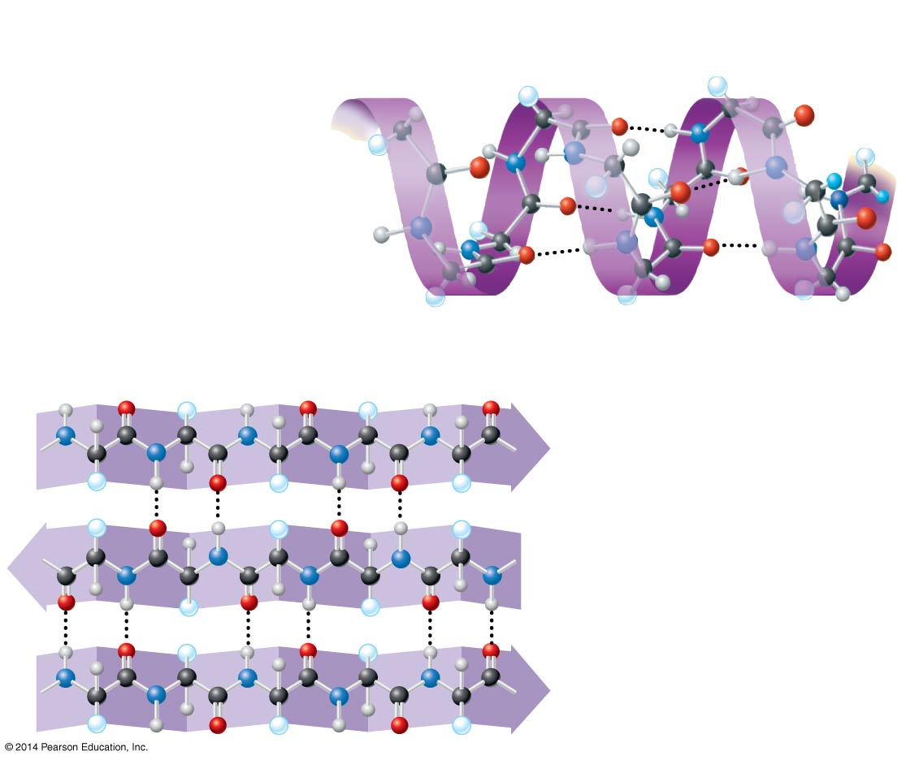
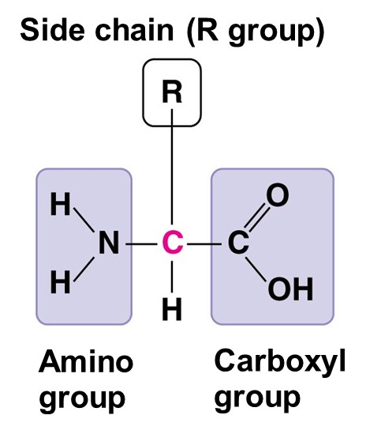
Secondary structure
α helix
Hydrogen bond
β pleated sheet
β strand
Hydrogen
bond
Notes:
16
The secondary structure is the result of hydrogen bonds between the repeating constituents of the polypeptide backbone (not the amino acid side chains).

Slide 17
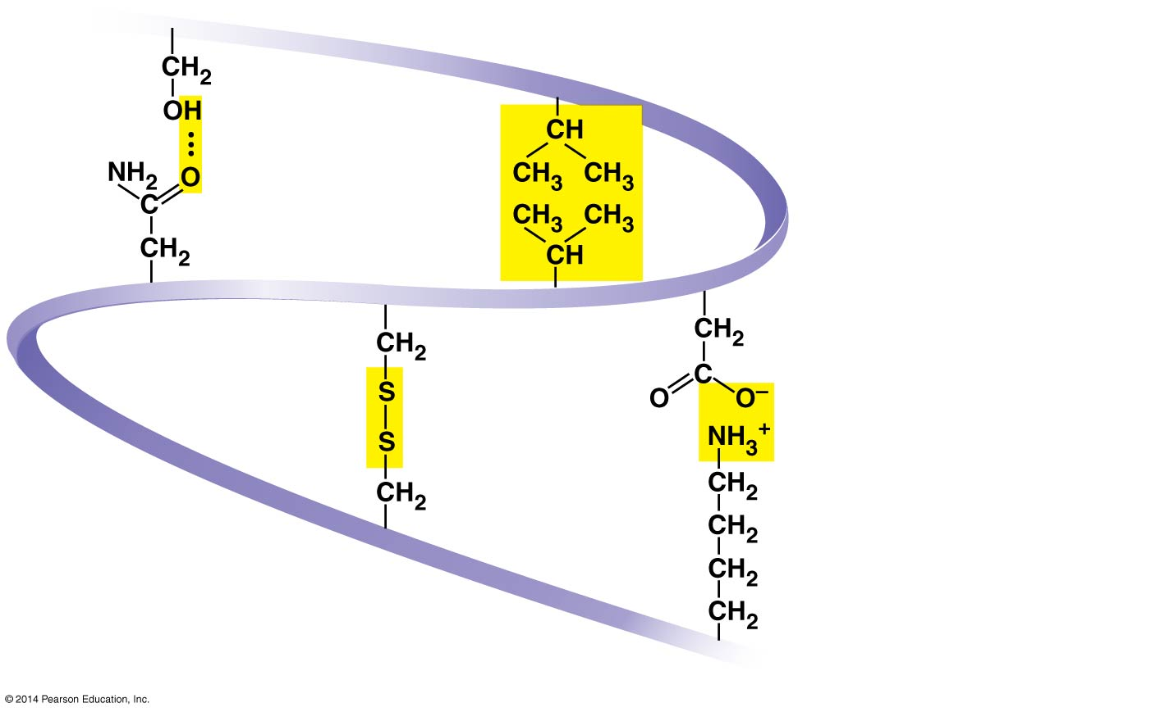
Figure 3.21d
Tertiary structure
Hydrogen
bond
Hydrophobic
interactions and
van der Waals
interactions
Disulfide
bridge
Ionic bond
Polypeptide
backbone
Notes:
17
The tertiary structure is the overall shape of a polypeptide resulting from interactions between the side chains of the various amino acids.
The disulfide bridge is a covalent bond that forms between sulfhydryl groups.

Slide 18
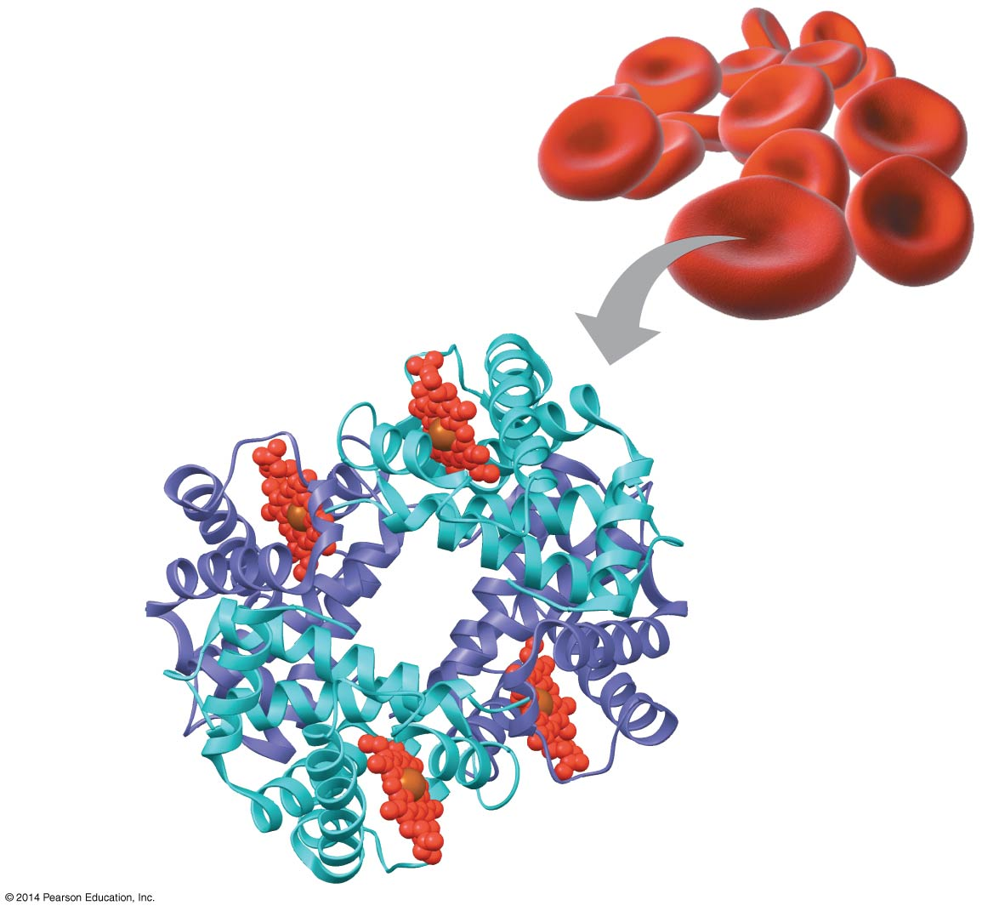
Figure 3.21f
Quaternary Structure
β subunit
α subunit
α subunit
β subunit
Notes:
18
Some proteins consist of two or more polypeptide chains aggregated into one functional macromolecule. Quaternary structure is the overall protein structure that results from the aggregation of these polypeptide subunits.

Slide 19
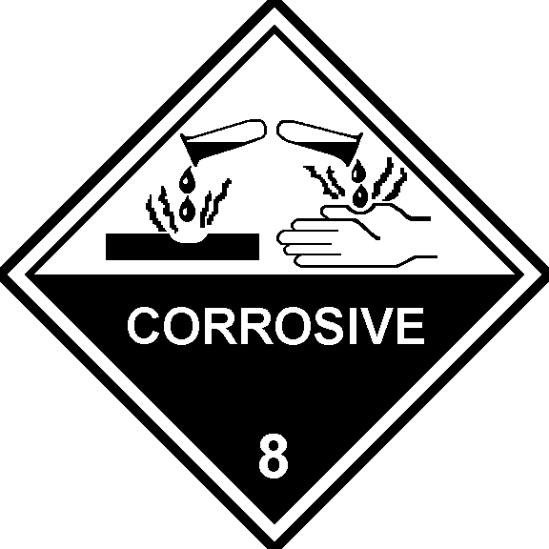
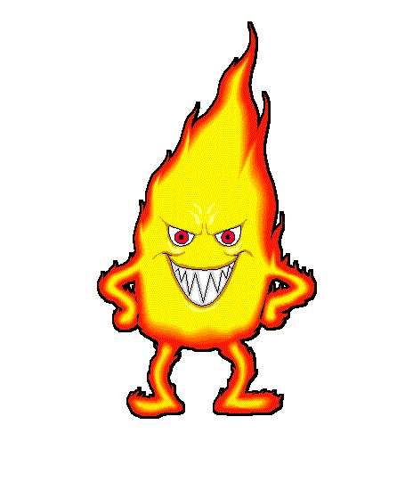
Notes:
19
In addition to primary structure, physical and chemical conditions can affect structure.
Alterations in pH, salt concentration, temperature, or other environmental factors can cause a protein to unravel.
This loss of a protein’s native structure is called denaturation.
A denatured protein is biologically inactive.

Slide 20
Figure 3.23-1
Normal protein
Notes:
20
Figure 3.23-1 Denaturation and renaturation of a protein (step 1)

Slide 21
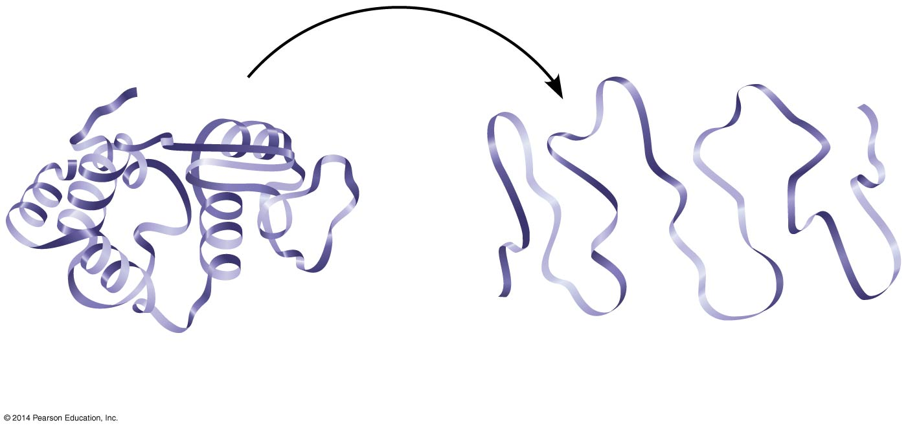
Figure 3.23-2
Normal protein
Denatured protein
Notes:
21
Figure 3.23-2 Denaturation and renaturation of a protein (step 2)

Slide 22
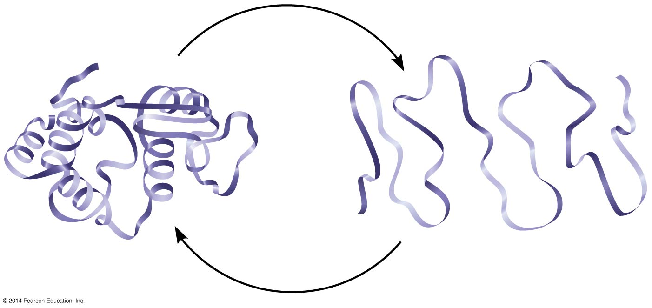
Figure 3.23-3
Normal protein
Denatured protein
Notes:
22
Figure 3.23-3 Denaturation and renaturation of a protein (step 3)

