Slide 1
0
Chapter 3
Carbohydrates and Lipids

Slide 2
You Must Know
The cellular functions of carbohydrates and lipids.
How the sequence and subcomponents of carbohydrates and lipids determine their properties.

Slide 3
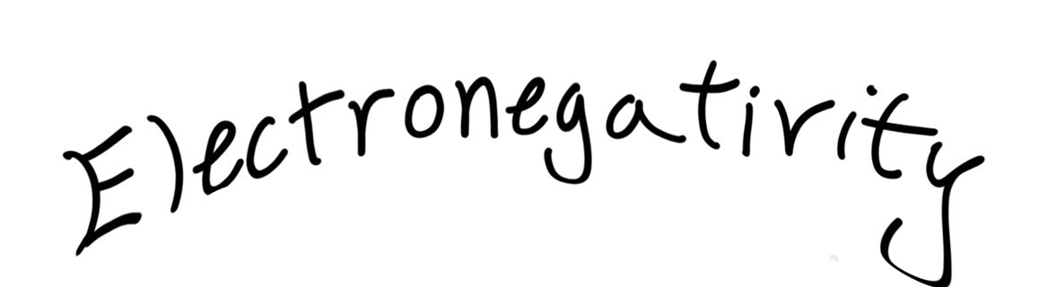
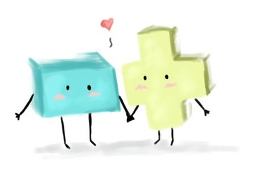
How do we find and use patterns.

Slide 4
Concept 3.3: Carbohydrates serve as fuel and building material
Carbohydrates include sugars and the polymers of sugars. They can be monosaccharides, disaccharides, or polysaccharides.
Disaccharide
Polysaccharide
Monosaccharide
Notes:
4
The simplest carbohydrates are monosaccharides, or simple sugars
Carbohydrate macromolecules are polysaccharides, polymers composed of many sugar building blocks

Slide 5
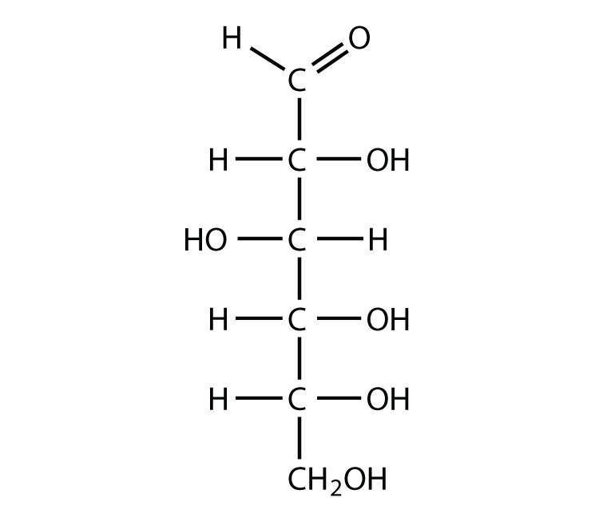
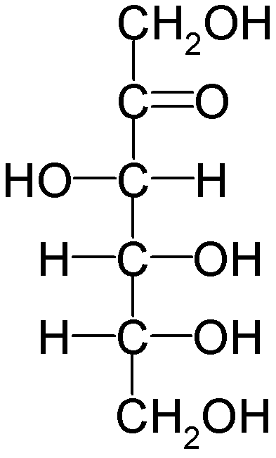
How many carbon atoms are there?
How many hydrogen?
How many oxygen?
What are the functional groups?
Major difference?
Fructose
Glucose

Slide 6
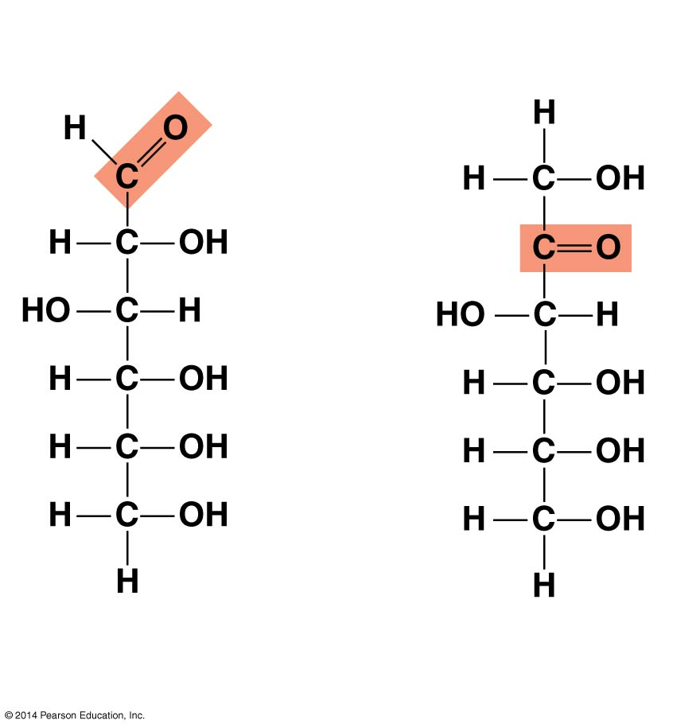
Figure 3.7c
6-carbon sugars (C₆H₁₂O₆)
You don’t need to remember the details of glucose and fructose.
Carbonyl
Glucose
Fructose
Aldehyde – because the carbonyl group is at the end of the carbon skeleton.
Ketone – because the carbonyl group is within the carbon skeleton.
Notes:
6

Slide 7
Glucose and Fructose are both six carbon sugars, but they have different functions because they have different structures.

Slide 8
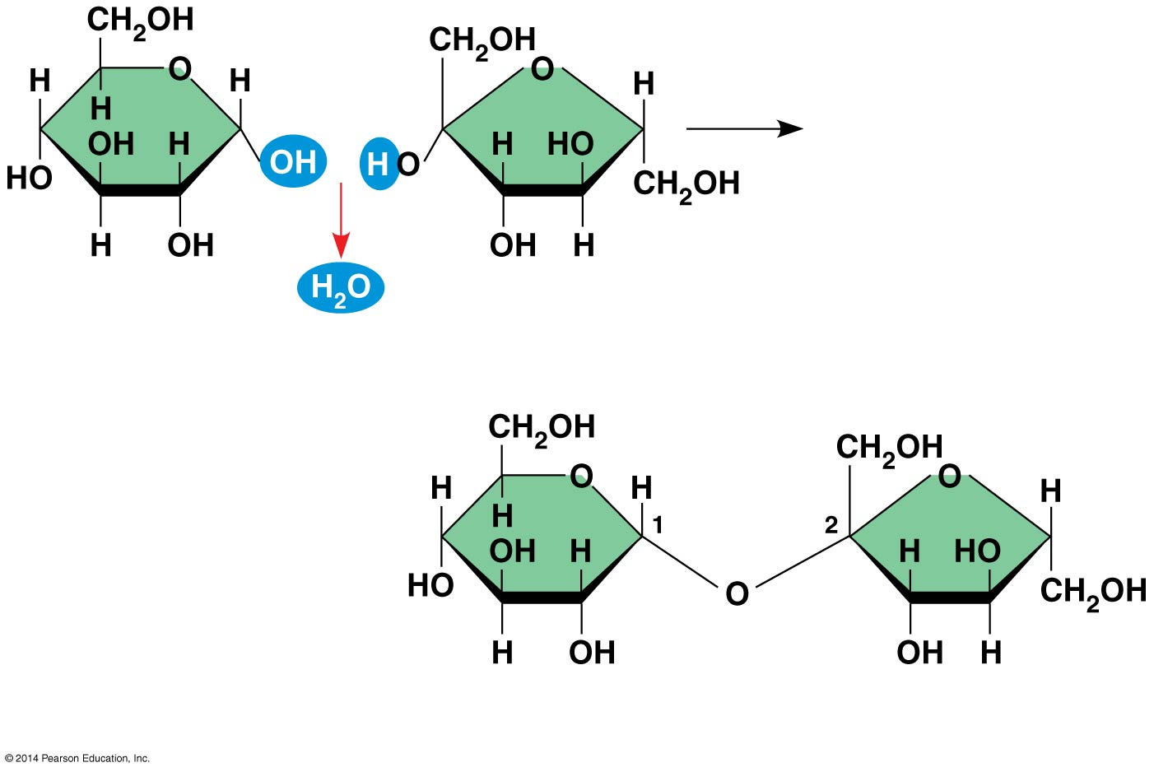
Figure 3.9-2
Glucose
Fructose
glycosidic
linkage
Sucrose
Notes:
8
A disaccharide is formed when a dehydration reaction joins two monosaccharides.
This covalent bond is called a glycosidic linkage

Slide 9
Polysaccharides
Polysaccharides, the polymers of sugars, have storage and structural roles
The structure and function of a polysaccharide are determined by its sugar monomers and the positions of glycosidic linkages.
© 2014 Pearson Education, Inc.
Notes:
9

Slide 10
Storage Polysaccharides
Starch, a storage polysaccharide of plants, consists entirely of glucose monomers
Starch granules
in a potato tuber cell
Starch (amylose)
Glucose
monomer
© 2014 Pearson Education, Inc.
Notes:
10
Plants store surplus starch as granules. The simplest form of starch is amylose

Slide 11
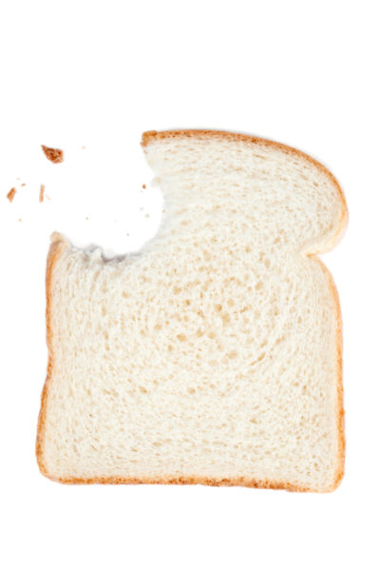
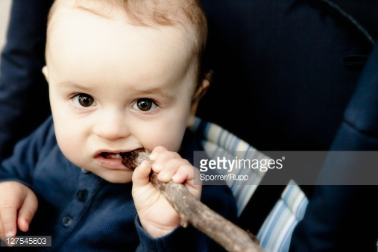
Glucose!

Slide 12
Figure 3.11
(a) α and β glucose
ring structures
α Glucose
β Glucose
Hydroxyl
Hydroxyl
Starch (and glycogen) are largely helical
(b) Starch: 1–4 linkage of α glucose monomers
Cellulose molecules are relatively straight.
(c) Cellulose: 1–4 linkage of β glucose monomers
Notes:
12
The polysaccharide cellulose is a major component of the tough wall of plant cells.
Like starch and glycogen, cellulose is a polymer of glucose, but the glycosidic linkages in cellulose differ.
The difference is based on two ring forms for glucose.
In starch, the glucose monomers are arranged in the alpha (α) conformation.
Starch (and glycogen) are largely helical.
In cellulose, the monomers are arranged in the beta (β) conformation
Cellulose molecules are relatively straight.

Slide 13
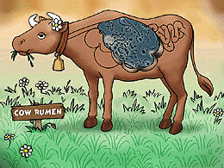
Cellulose microfibrils
in a plant cell wall
Hydrogen bonds
between —OH
Groups.
Cellulose
molecules
Notes:
13
In straight structures (cellulose), H atoms on one strand can form hydrogen bonds with hydroxyl (OH) groups on other strands.
Parallel cellulose molecules held together this way are grouped into microfibrils, which form strong building materials for plants.
Enzymes that digest starch by hydrolyzing α linkages can’t hydrolyze β linkages in cellulose.
Cellulose in human food passes through the digestive tract as insoluble fiber.
Some microbes use enzymes to digest cellulose.
Many herbivores, from cows to termites, have symbiotic relationships with these microbes

Slide 14
Enzymes that digest starch by hydrolyzing α linkages can’t hydrolyze β linkages in cellulose.

Slide 15
Lipids

Slide 16
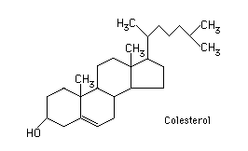
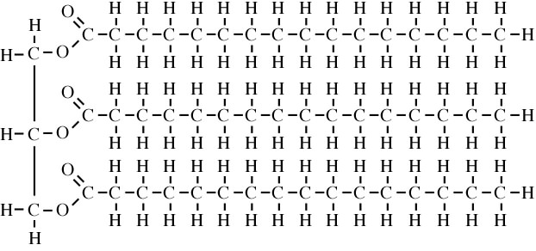
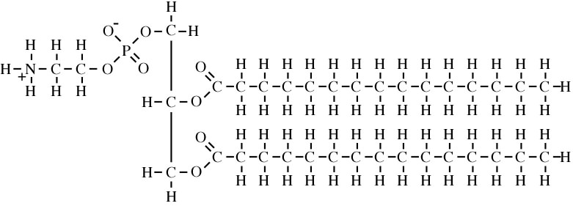
Concept 3.4: Lipids are a diverse group of molecules
Steroid
fat
What do these molecules have in common?
phospholipid
© 2014 Pearson Education, Inc.
Notes:
16
Lipids do not form true polymers. The unifying feature of lipids is having little or no affinity for water. Lipids are hydrophobic because they consist mostly of hydrocarbons, which form nonpolar covalent bonds. The most biologically important lipids are fats, phospholipids, and steroids. (Hydrocarbons are organic molecules consisting of only carbon and hydrogen. Hydrocarbons can undergo reactions that release a large amount of energy.)

Slide 17
Fats
Hydroxyl
Ester linkage
OH
HO
OH
HO
OH
HO
Glycerol
Fatty Acid
triglyceride
carboxyl
Notes:
Fats are constructed from two types of smaller molecules: glycerol and fatty acids.
Glycerol is a three-carbon alcohol with a hydroxyl group (OH) attached to each carbon.
A fatty acid consists of a carboxyl group attached to a long carbon skeleton.
In a fat, three fatty acids are joined to glycerol by an ester linkage, creating a triacylglycerol, or triglyceride

Slide 18
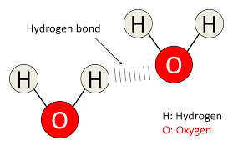
Why?
Notes:
Fats separate from water because water molecules hydrogen-bond to each other and exclude the fats.

Slide 19
Fatty acids vary in length (number of carbons) and in the number and locations of double bonds
Saturated fatty acids have the maximum number of hydrogen atoms possible and no carbon carbon double bonds.
Unsaturated fatty acids have one or more carbon carbon double bonds.
© 2014 Pearson Education, Inc.
Notes:
19

Slide 20
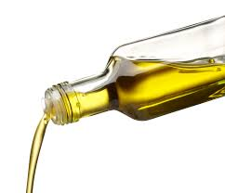
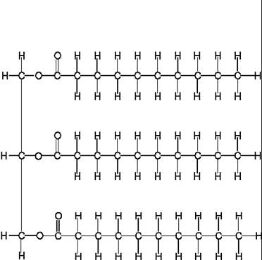
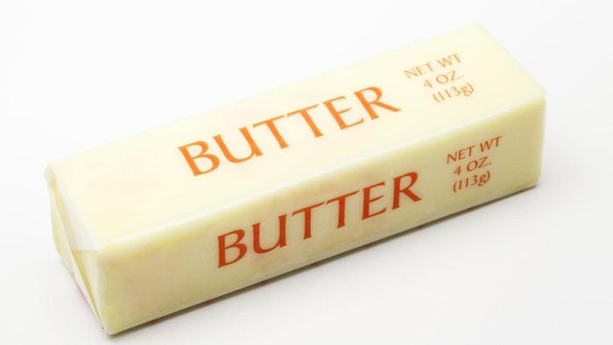
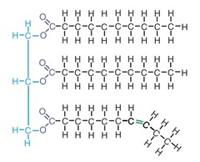
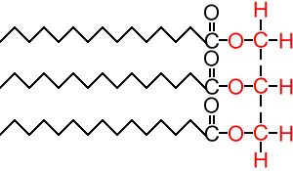
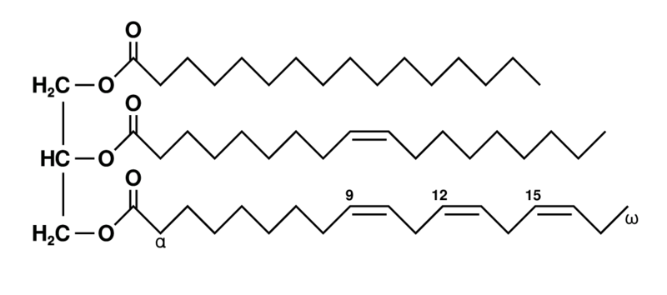
Saturated
Unsaturated
Saturated
Saturated
Unsaturated
Notes:
Fats made from saturated fatty acids are called saturated fats and are solid at room temperature
Most animal fats are saturated.
Fats made from unsaturated fatty acids, called unsaturated fats or oils, are liquid at room temperature.
Plant fats and fish fats are usually unsaturated.

Slide 21
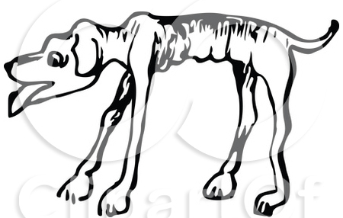
What is fat good for?
The major function of fats is energy storage.
Fat is a compact way for animals to carry their energy stores with them.
© 2014 Pearson Education, Inc.
Notes:
21

Slide 22
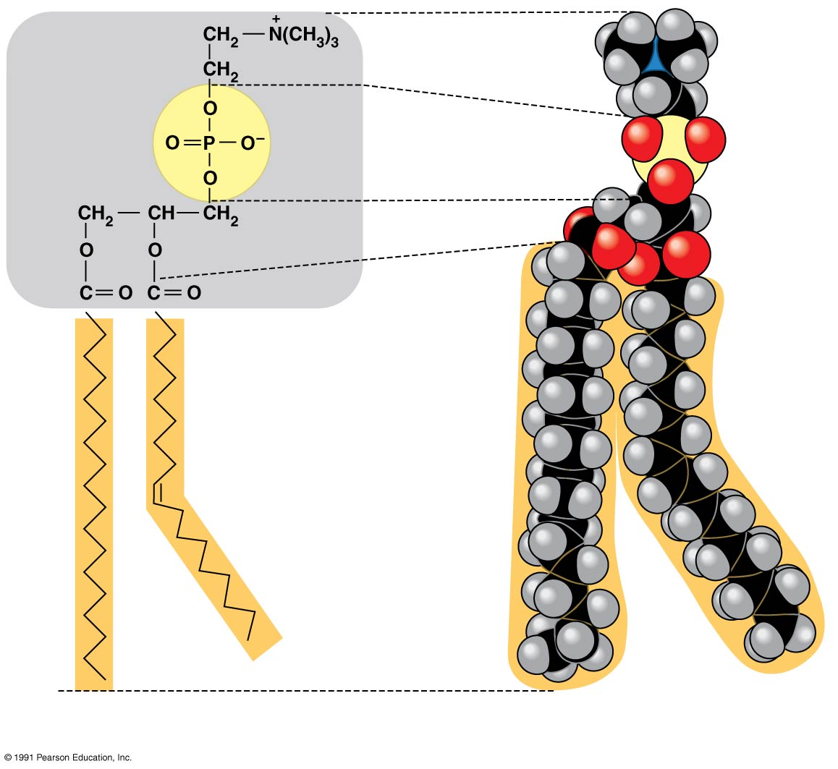
Figure 3.14ab
Hydrophilic head
Phosphate
Glycerol
Fatty acids
Hydrophobic tails
Phospholipids
(a) Structural formula
(b) Space-filling model
Notes:
22
In a phospholipid, two fatty acids and a phosphate group are attached to glycerol
The two fatty acid tails are hydrophobic, but the phosphate group and its attachments form a hydrophilic head

Slide 23
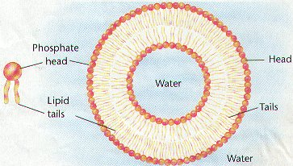
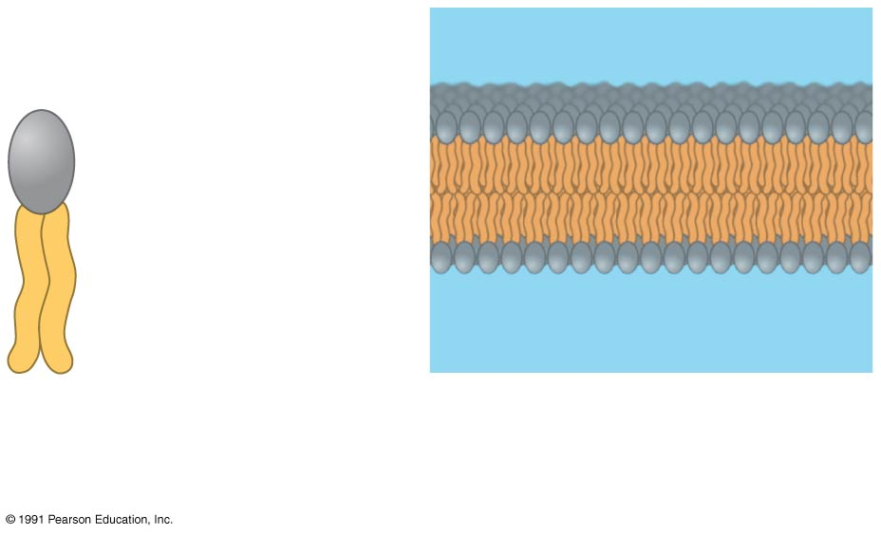
Hydrophilic
head
Hydrophobic
tails
Phospholipid
Phospholipid
bilayer
Notes:
23
Phospholipids are major constituents of cell membranes.
When phospholipids are added to water, they self-assemble into a bilayer, with the hydrophobic tails pointing toward the interior.
This feature of phospholipids results in the bilayer arrangement found in cell membranes.

Slide 24
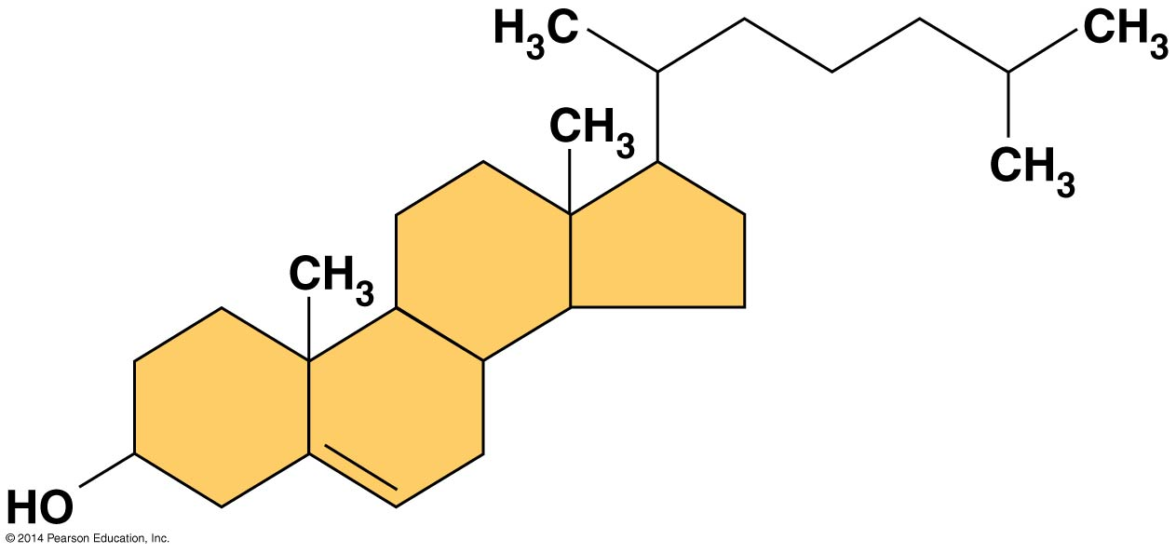
Steroids
Notes:
24
Figure 3.15 Cholesterol, a steroid
Steroids are lipids characterized by a carbon skeleton consisting of four fused rings
Cholesterol, an important steroid, is a component in animal cell membranes
Although cholesterol is essential in animals, high levels in the blood may contribute to cardiovascular disease

