Slide 1
There will be a test over Chapter 2 and Chapter 3 on Monday (There won’t be any questions about nucleic acids on the test. I will give you a list of the seven functional groups that you can use on the test.)
The Chapter 3 Homework is due on Sunday, September 15 at 11:59 pm

Slide 2
0
Chapter 3
(The Molecular Diversity of Life)
Carbon, Dehydration, Hydrolysis and Functional Groups

Slide 3
You Must Know
The properties of carbon that make it so important.
The role of dehydration and hydrolysis reactions
The seven functional groups

Slide 4
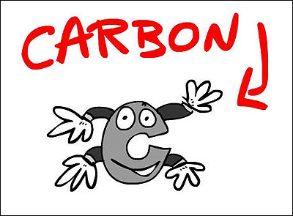
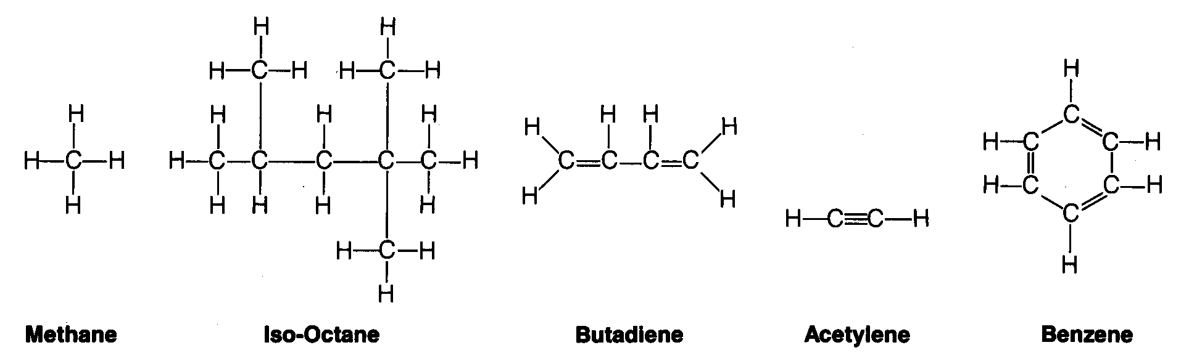
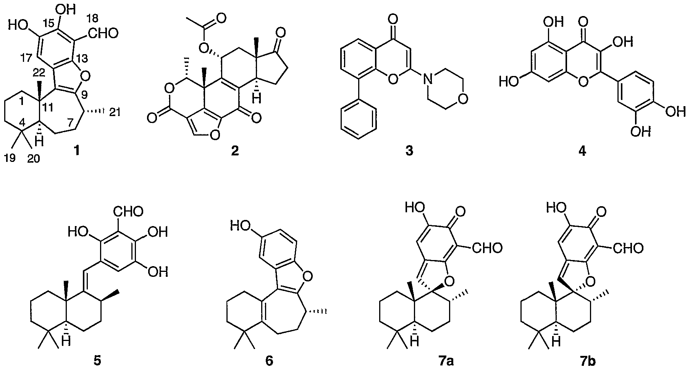

Importance of Carbon
4
Carbon can form _____ covalent bonds.
You don’t need to memorize these carbon skeletons.
Notes:
Aside from water, living organisms consist mostly of carbon-based compounds. Carbon is unparalleled in its ability to form large, complex, and diverse molecules. A compound containing carbon is said to be an organic compound. Carbon atoms can form diverse molecules by bonding to four other atoms. An atom’s electron configuration determines the kinds and number of bonds the atom will form with other atoms. This is the source of carbon’s versatility. With four valence electrons, carbon can form four covalent bonds with a variety of atoms. This ability makes large, complex molecules possible. Carbon chains form the skeletons of most organic molecules.

Slide 5
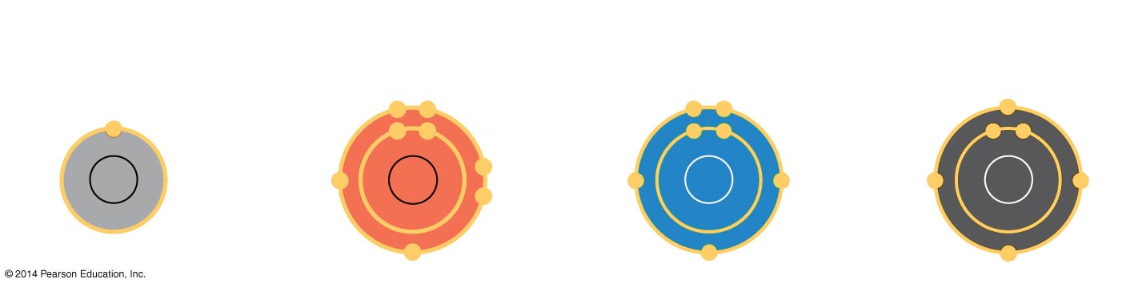
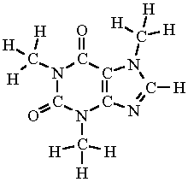
Valences of the major elements of organic molecules
Hydrogen
Hydrogen
(valence = 1)
Nitrogen
Nitrogen
(valence = 3)
Carbon
Oxygen
Carbon
(valence = 4)
Oxygen
(valence = 2)
Molecular structure of caffeine
Notes:
5

Slide 6
Critically important molecules of all living things fall into four main classes
  Carbohydrates
  Nucleic acids
  Proteins
  Lipids
The first three of these can form huge molecules called macromolecules
© 2014 Pearson Education, Inc.
Notes:
6

Slide 7
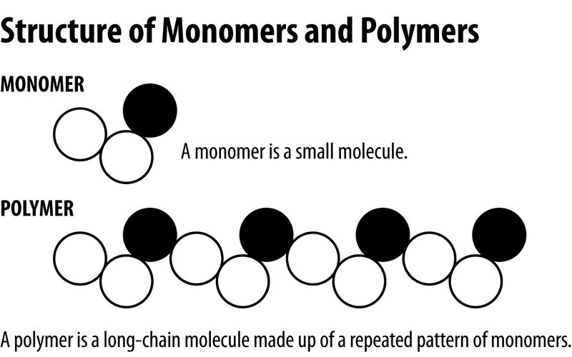
Concept 3.2: Macromolecules are polymers, built from monomers
© 2014 Pearson Education, Inc.
Notes:
7
A polymer is a long molecule consisting of many similar building blocks.
These small building-block molecules are called monomers.
Some molecules that serve as monomers also have other functions of their own.

Slide 8
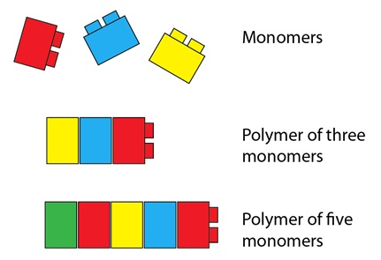
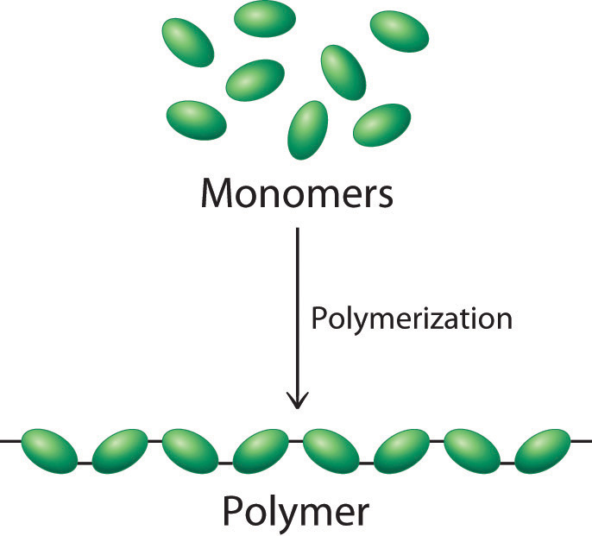
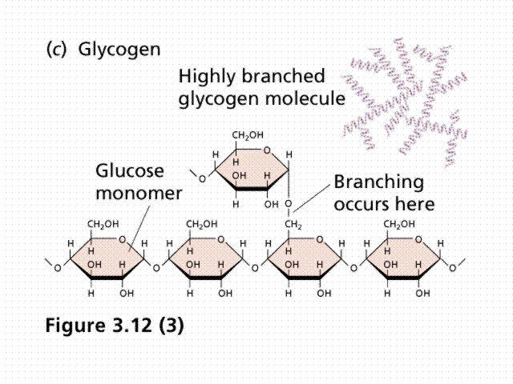
Identify the following as monomers or polymers
Monomer
Polymer
A
A
B
B
Polymer
Monomer
A
Monomer
B
Polymer

Slide 9
Monomer
Polymer

Slide 10
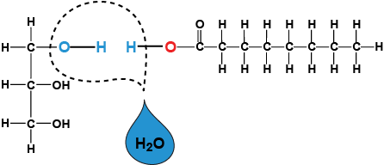
The Synthesis and Breakdown of Polymers
A dehydration reaction occurs when two monomers bond together through the loss of a water molecule
© 2014 Pearson Education, Inc.
Notes:
10
These processes are facilitated by enzymes, which speed up chemical reactions.

Slide 11
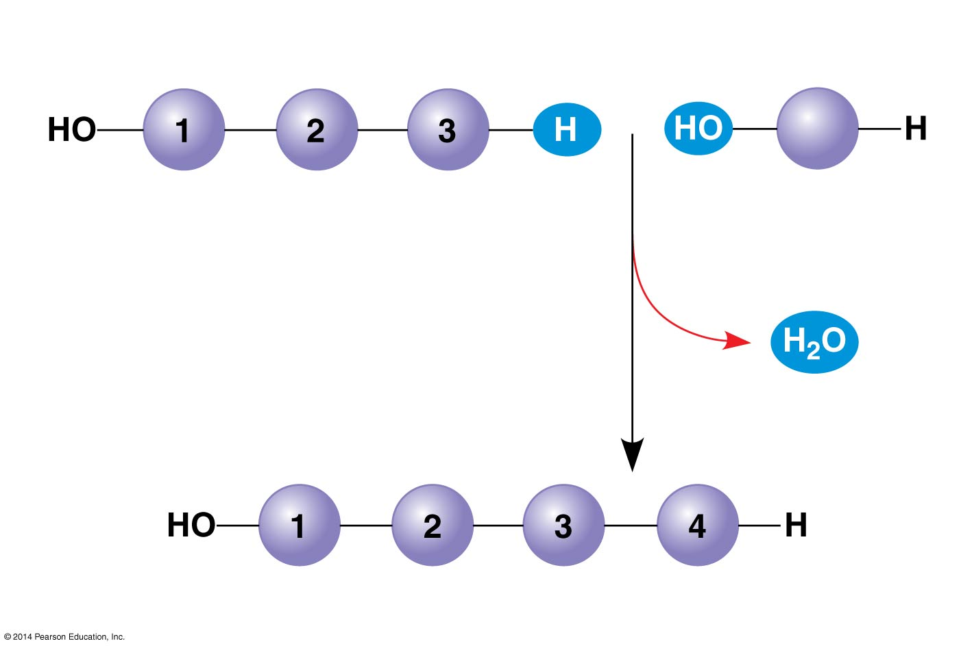
Figure 3.6a
(a) Dehydration reaction: synthesizing a polymer
Short polymer
Unlinked monomer
Dehydration removes
a water molecule,
forming a new bond.
Longer polymer
Notes:
11
Figure 3.6a The synthesis and breakdown of polymers (part 1: dehydration)

Slide 12
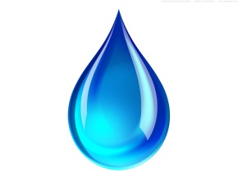

The Synthesis and Breakdown of Polymers
Polymers are disassembled to monomers by hydrolysis, a reaction that is essentially the reverse of the dehydration reaction
© 2014 Pearson Education, Inc.
Notes:
12
These processes are facilitated by enzymes, which speed up chemical reactions.

Slide 13
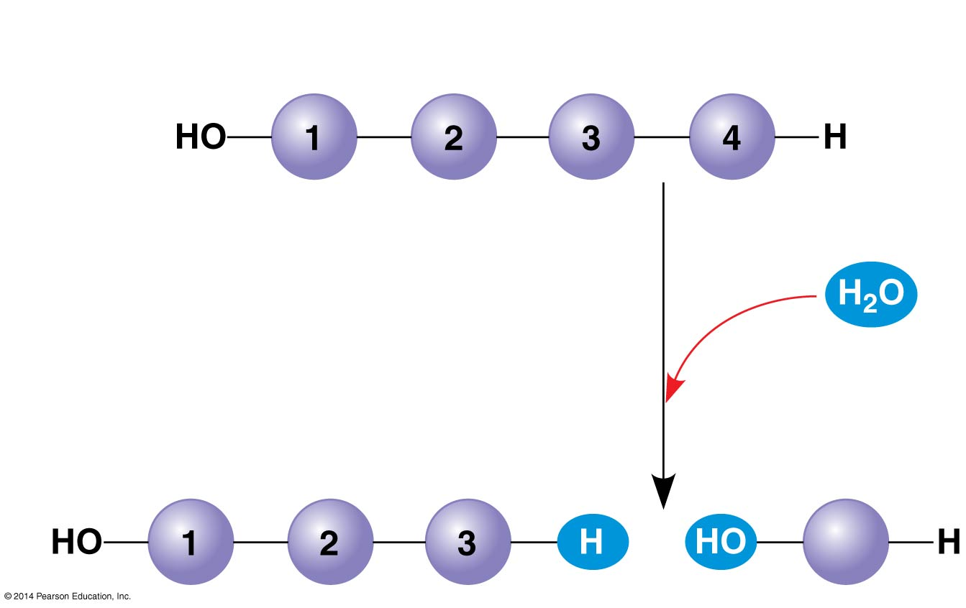
Figure 3.6b
(b) Hydrolysis: breaking down a polymer
Hydrolysis adds
a water molecule,
breaking a bond.
Notes:
13

Slide 14
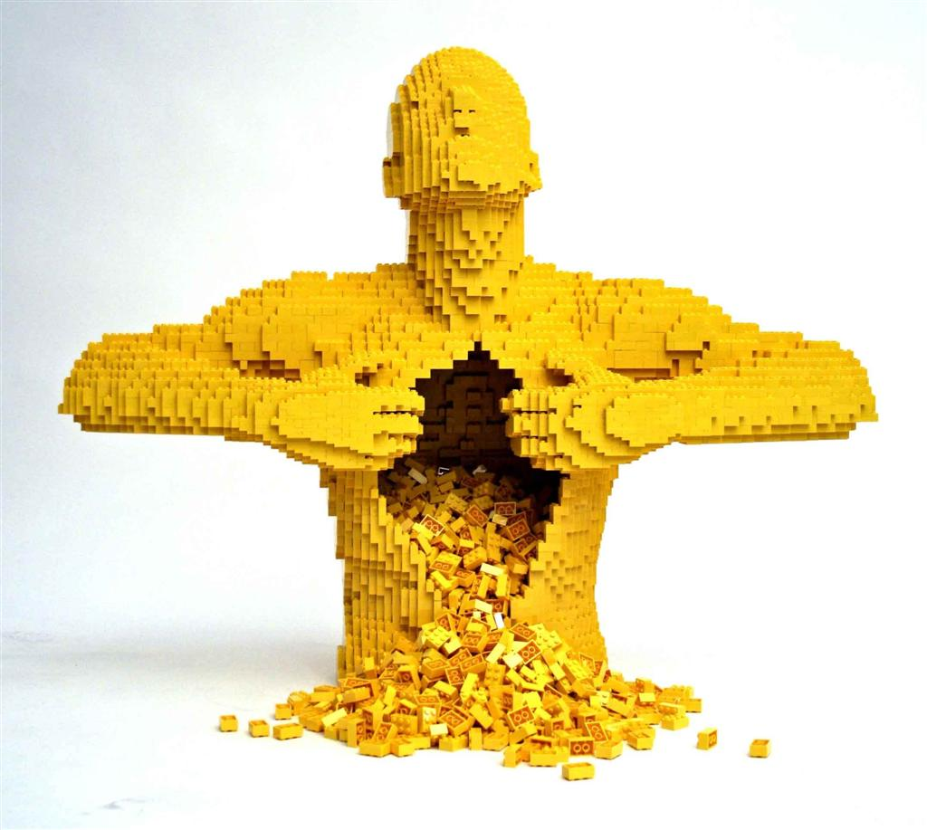
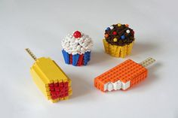
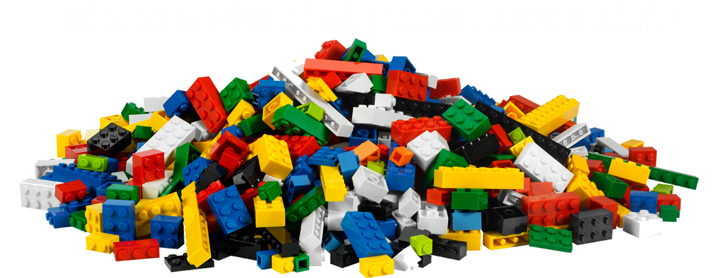
Why are Monomers and Polymers Important?
HO
Notes:
14
Each cell has thousands of different macromolecules. Macromolecules vary among cells of an organism, vary more within a species, and vary even more between species. An immense variety of polymers can be built from a small set of monomers.

Slide 15
The Chemical Groups Most Important to Life
Functional groups are the components of organic molecules that are most commonly involved in chemical reactions.
The number and arrangement of functional groups give each molecule its unique properties.
© 2014 Pearson Education, Inc.
Notes:
15

Slide 16
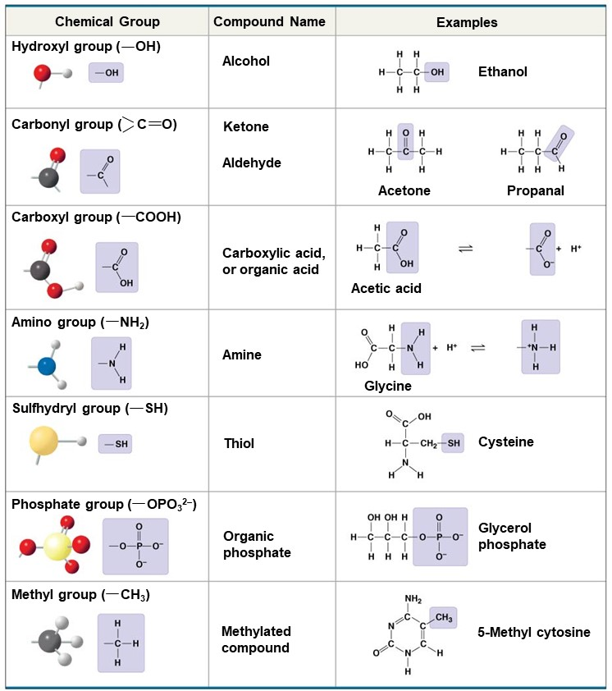
Figure 3.5
The seven functional groups that are most important in the chemistry of life.
Notes:
16

Slide 17
Identify all of the terms that apply
Polar
Nonpolar
Hydrophilic
Hydrophobic
How did you know?
Notes:
17

Slide 18
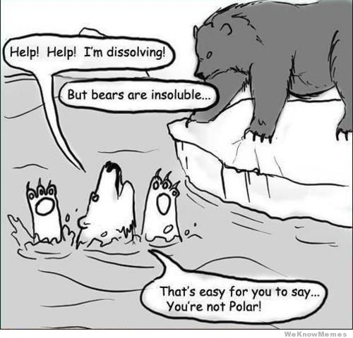

Slide 19
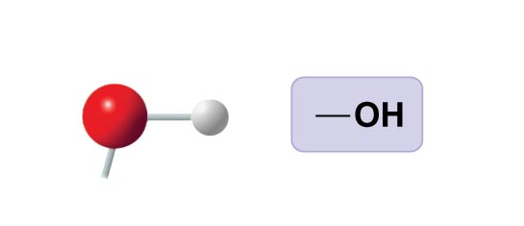
Identify all of the terms that apply
Hydroxyl group ( OH)
Polar
Nonpolar
Hydrophilic
Hydrophobic
Notes:
19

Slide 20
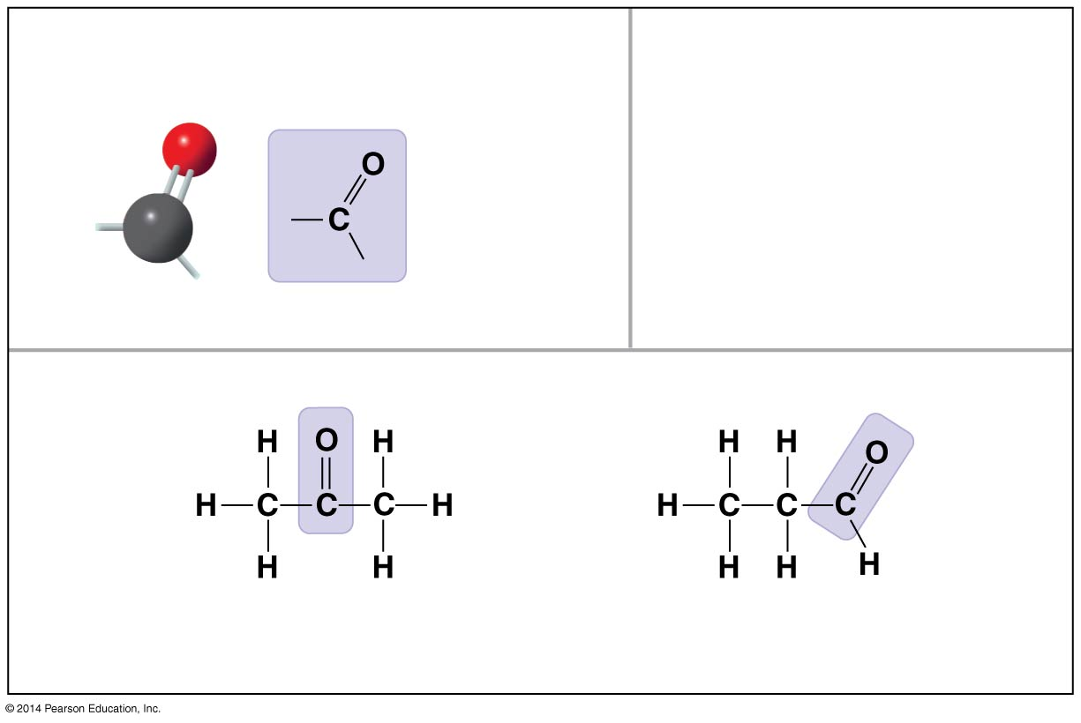
Identify all of the terms that apply
Carbonyl group ( C O)
Polar
Nonpolar
Hydrophilic
Hydrophobic
Notes:
20

Slide 21
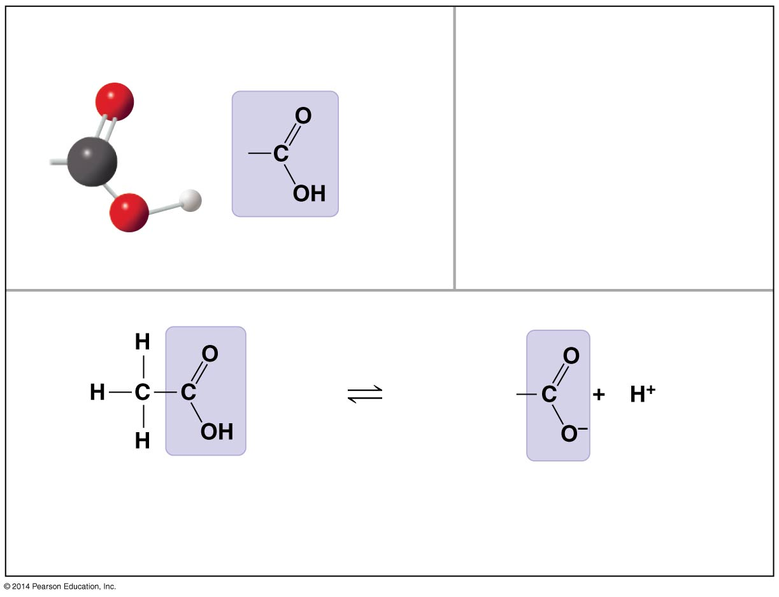
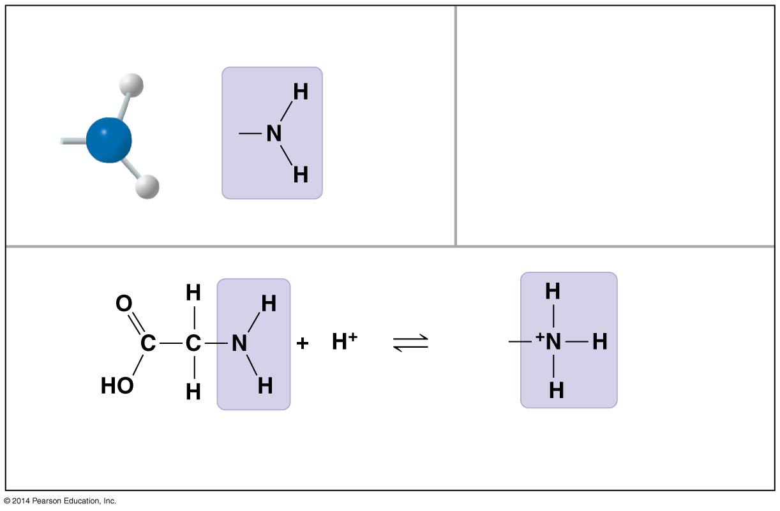
Identify all of the terms that apply
Carboxyl group ( COOH)
Polar
Nonpolar
Hydrophilic
Hydrophobic
Tends to act as a base
Tends to act as an acid
Notes:
21

Slide 22
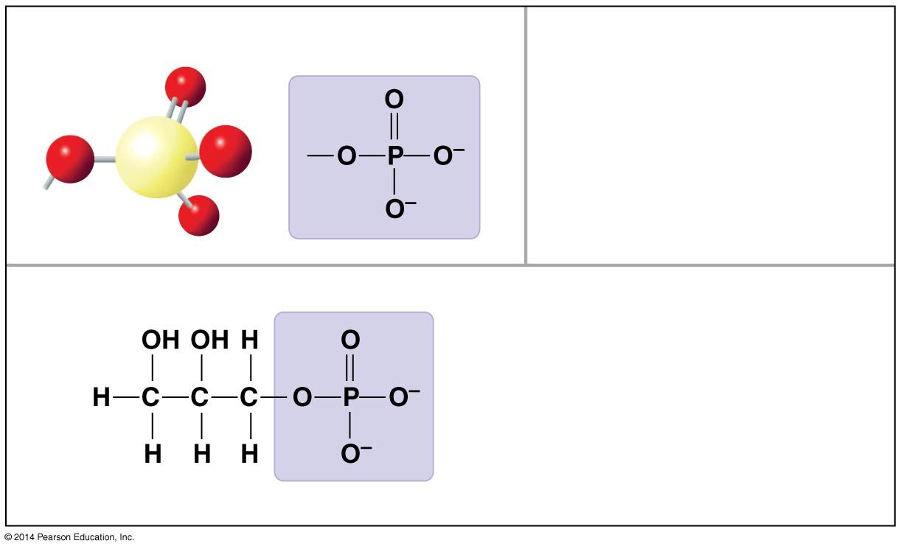
Identify all of the terms that apply
Phosphate group ( OPO₃^{2–})
Polar
Nonpolar
Hydrophilic
Hydrophobic
Notes:
22

Slide 23
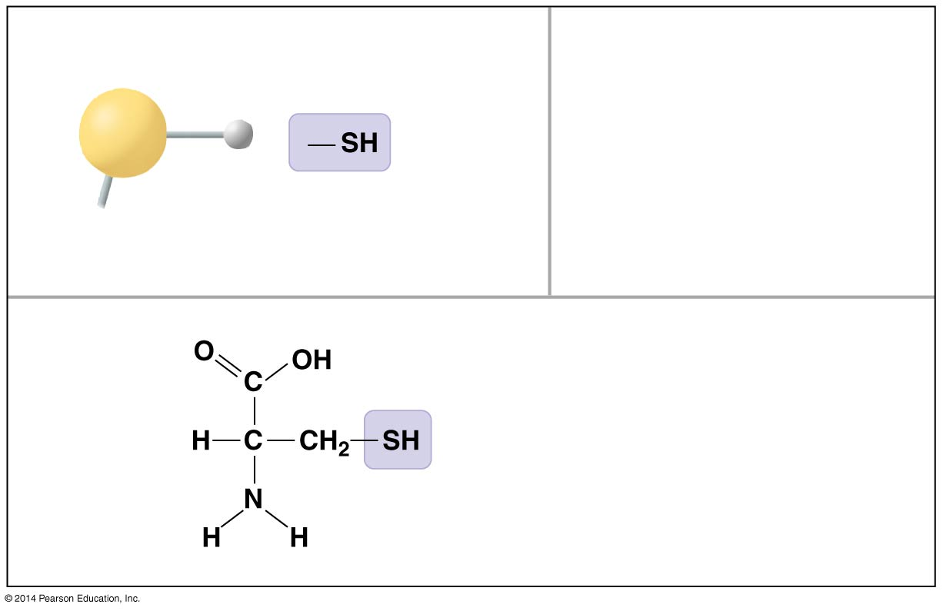
Identify all of the terms that apply
Sulfhydryl group ( SH)
Polar
Nonpolar
Hydrophilic
Hydrophobic
Notes:
23

Slide 24
Identify all of the terms that apply
Amino group ( NH₂)
Polar
Nonpolar
Hydrophilic
Hydrophobic
Tends to act as a base
Tends to act as an acid
Notes:
24

Slide 25
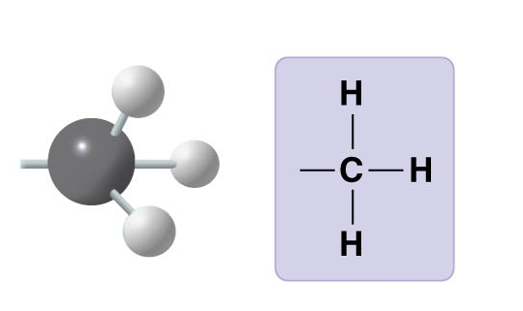
Identify all of the terms that apply
Methyl group ( CH₃)
Polar
Nonpolar
Hydrophilic
Hydrophobic
Notes:
25

