Slide 1
Please get your plant

Slide 2
G= Green (no purple);
P = Purple (at least some purple);
P+ = Very Purple

Slide 3
0
Chapter 4
Plasma membrane, nucleus and ribosomes

Slide 4
What to Know
The structure and function of the plasma membrane, nucleus and ribosomes.

Slide 5
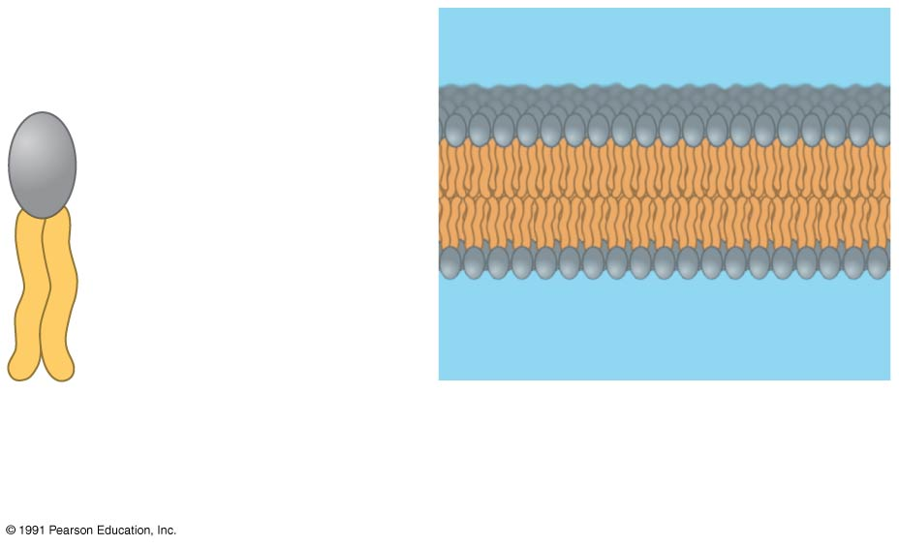
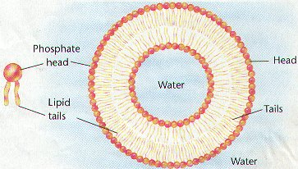
Hydrophilic
head
Hydrophobic
tails
Phospholipid
Phospholipid
bilayer
Notes:
5
All cells are surrounded by a plasma membrane. Eukaryotic cells have some internal structures (organelles) that are also surrounded by a membrane.

Slide 6
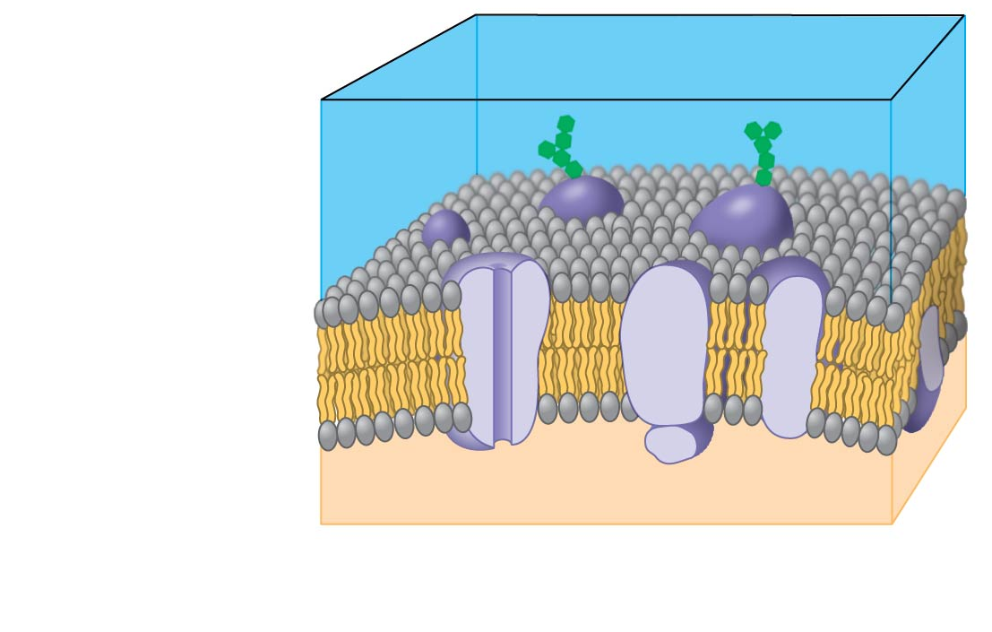
Plasma Membrane
Carbohydrate side chains
Hydrophilic
region
Hydrophobic
region
Hydrophilic
region
Phospholipid
Proteins
The plasma membrane is a selective barrier
Notes:
6
The plasma membrane is a selective barrier that allows sufficient passage of oxygen, nutrients, and waste to service the volume of every cell.
The general structure of a biological membrane is a double layer of phospholipids. A eukaryotic cell has internal membranes that divide the cell into compartments—organelles.
The plasma membrane and organelle membranes participate directly in the cell’s metabolism.

Slide 7
nucleus
The _________contains most of the DNA in a
eukaryotic cell.
__________use the information from the DNA to make proteins.
Ribosomes
© 2014 Pearson Education, Inc.
Notes:
Concept 4.3: The eukaryotic cell’s genetic instructions are housed in the nucleus and carried out by the ribosomes
7

Slide 8
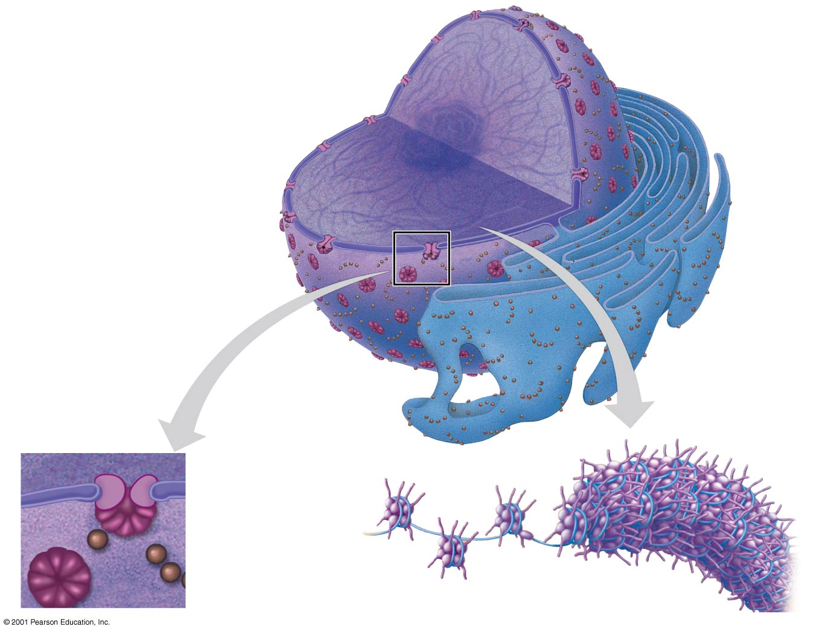
Nucleus
Nucleus
Nucleolus
Chromatin
Nuclear envelope:
Inner membrane
Outer membrane
Nuclear pore
Rough ER
Pore
complex
Ribosome
Close-up
of nuclear
envelope
Chromosome
Notes:
8
The nucleus contains most of the cell’s genes and is usually the most conspicuous organelle.
In the nucleus, DNA is organized into discrete units called chromosomes.
Each chromosome is one long DNA molecule associated with proteins.
The DNA and proteins of chromosomes are together called chromatin.
Chromatin condenses to form discrete chromosomes as a cell prepares to divide.
The nuclear envelope encloses the nucleus, separating it from the cytoplasm.
The nuclear membrane is a double membrane; each membrane consists of a lipid bilayer.
Pores regulate the entry and exit of molecules from the nucleus.
The shape of the nucleus is maintained by the nuclear lamina, which is composed of protein.
The nucleolus is located within the nucleus and is the site of ribosomal RNA (rRNA) synthesis

Slide 9
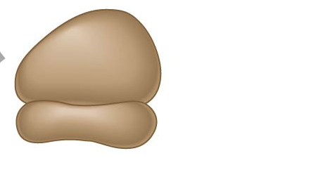
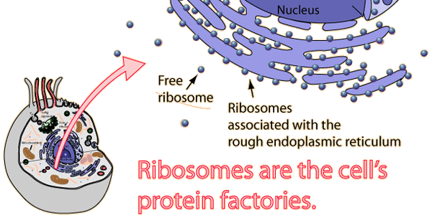
Ribosomes are complexes of ribosomal RNA and protein.
Ribosomes carry out protein synthesis in two locations.
Large
subunit
Small
subunit
Diagram of a ribosome
Notes:
9
Ribosomes carry out protein synthesis in two locations: in the cytosol (free ribosomes) and on the outside of the endoplasmic reticulum or the nuclear envelope (bound ribosomes)

Slide 10
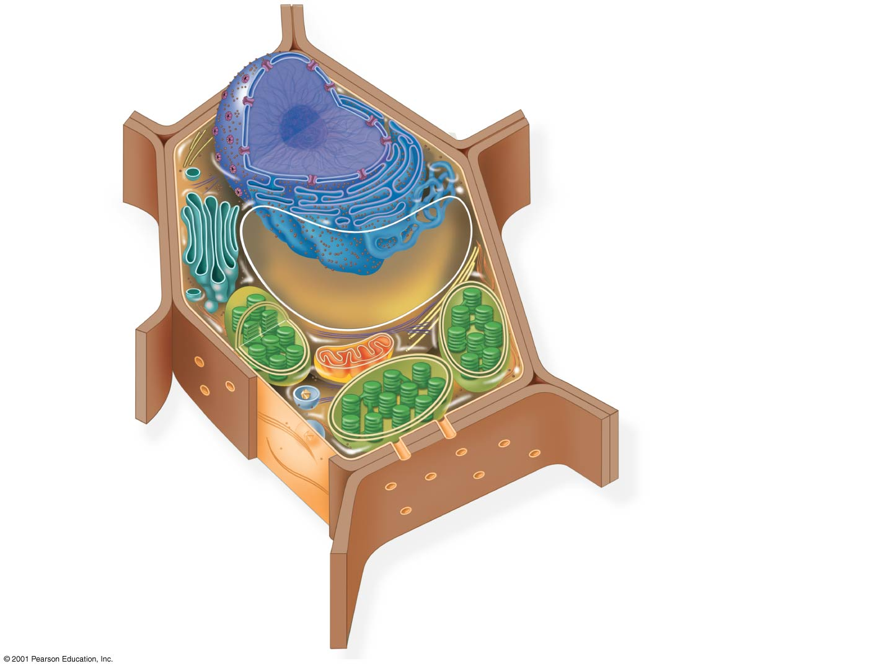
Figure 4.7b
Nuclear envelope
Rough endoplasmic
reticulum
Nucleolus
Smooth endoplasmic
reticulum
Chromatin
NUCLEUS
Ribosomes
Golgi
apparatus
Central vacuole
Microfilaments
Intermediate
filaments
CYTO-
SKELETON
Microtubules
Mitochondrion
Peroxisome
Plasma membrane
Chloroplast
Cell wall
Plasmodesmata
You should be familiar with the parts of a cell.
Wall of adjacent cell
Notes:
10
Figure 4.7b Exploring eukaryotic cells (part 2: plant cell cutaway)

Slide 11
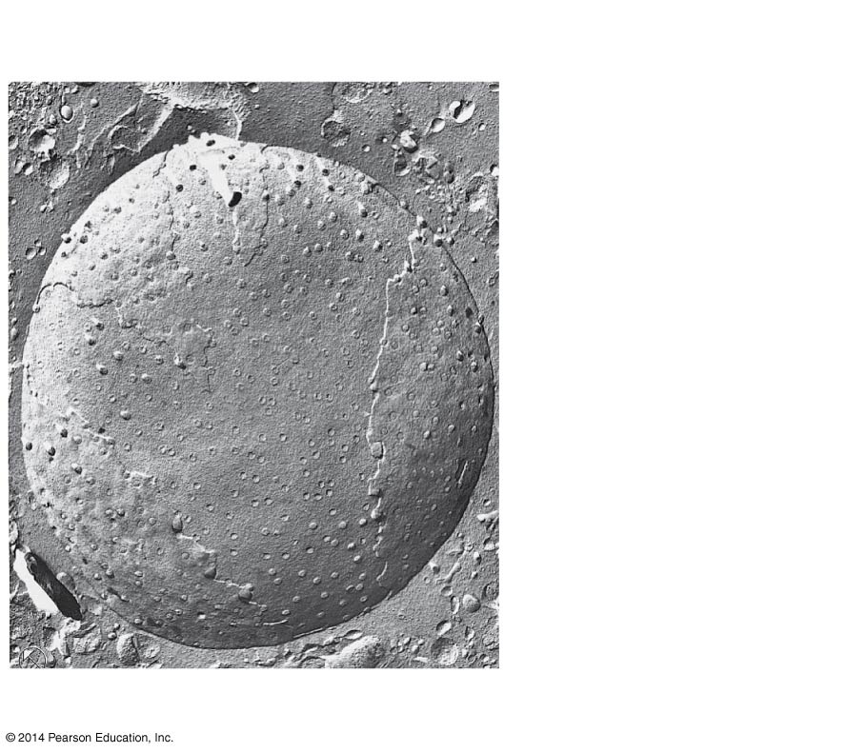
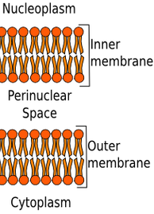
1 μm
Inner membrane
Outer membrane
Nuclear envelope
back

