Slide 1
0
Chapter 4
Prokaryotes and Eukaryotes
Cell Size

Slide 2
You Must Know
Three differences between prokaryotic and eukaryotic cells.
How cell size and shape affect the overall rate of nutrient intake and waste elimination.

Slide 3
Overview: The Fundamental Units of Life
All organisms are made of cells.
The cell is the simplest collection of matter that can be alive.
All cells are related by their descent from earlier cells.
Though cells can differ substantially from one another, they share common features.
© 2014 Pearson Education, Inc.
Notes:
3

Slide 4
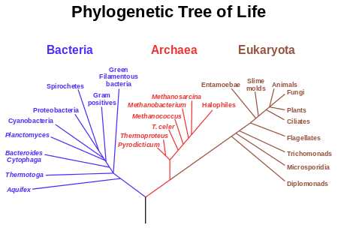
Two Types of Cells: Prokaryotic and Eukaryotic
Prokaryotes
Eukaryotes
© 2014 Pearson Education, Inc.
Notes:
The basic structural and functional unit of every organism is one of two types of cells: prokaryotic or eukaryotic.
Organisms of the domains Bacteria and Archaea consist of prokaryotic cells.
Protists, fungi, animals, and plants all consist of eukaryotic cells.
4

Slide 5
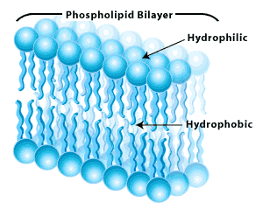
Basic features of all cells
Plasma membrane
Semifluid substance called cytosol
Chromosomes___________
Ribosomes______________
(carry genes)
(make proteins)
© 2014 Pearson Education, Inc.
Notes:
5

Slide 6
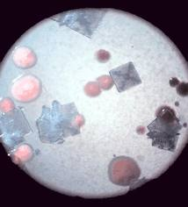
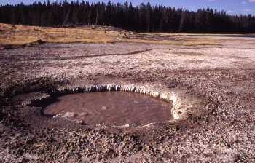
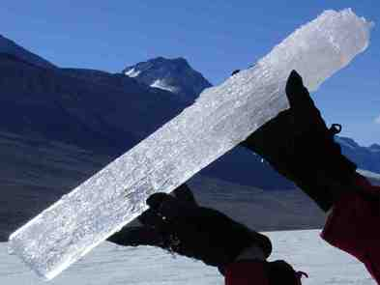
Prokaryotic cells
Don’t have a nucleus
Don’t have membrane-bound organelles
Tend to be smaller than eukaryotic cells
acidophile
psychrophile
halophile
Notes:
(You don’t need to remember what a halophile, acidophile, or psychrophile is.
6

Slide 7
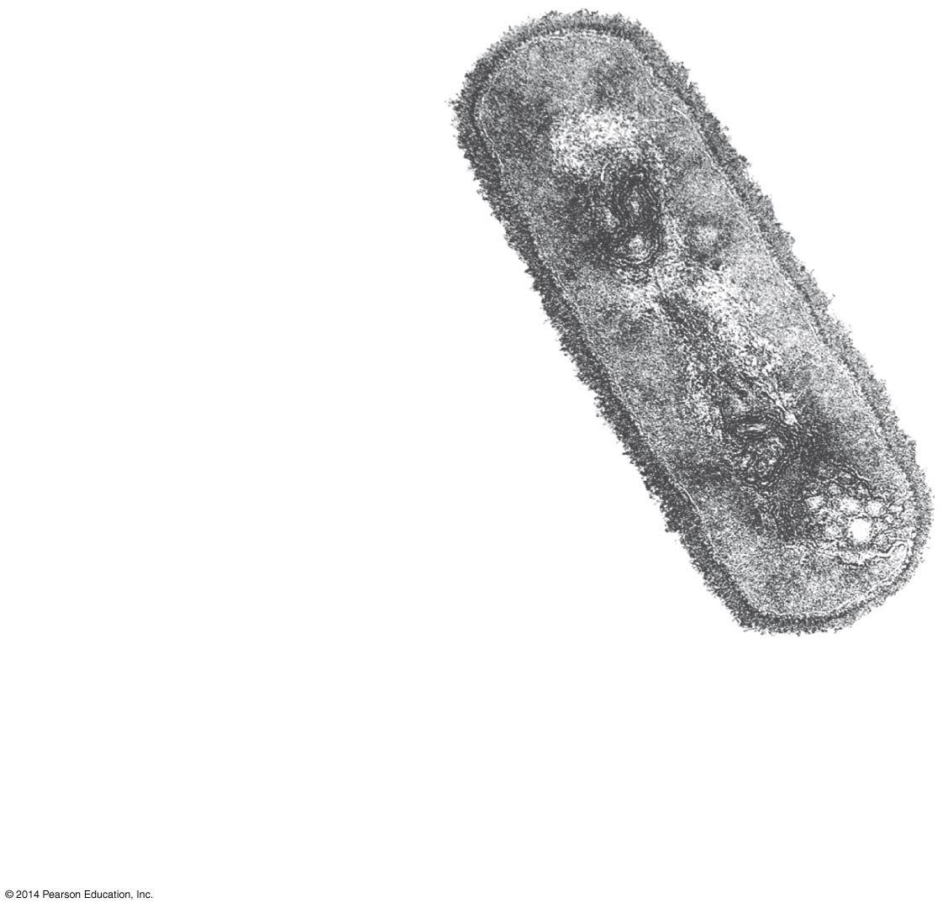
Prokaryote
Nucleoid
Ribosomes
Plasma membrane
Cell wall
0.5 μm
Notes:
7
Prokaryotic DNA is located in an unbound region of the cell called the nucleoid

Slide 8
Eukaryotic cells are characterized by having
DNA in a nucleus that is bounded by a membranous nuclear envelope.
Membrane-bound organelles.
© 2014 Pearson Education, Inc.
Notes:
8

Slide 9
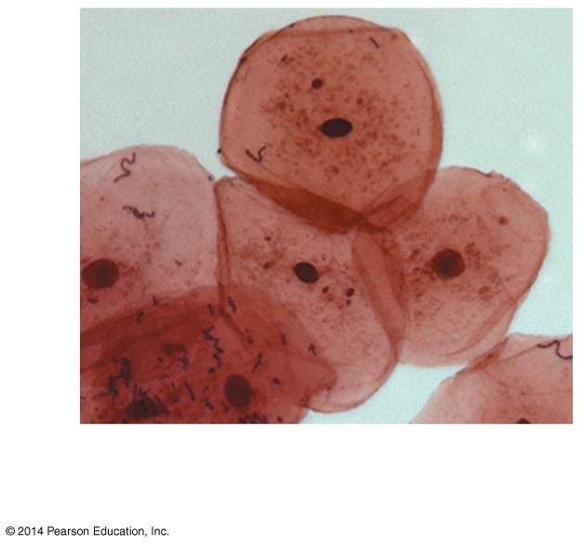
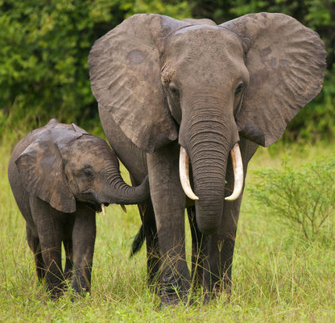
Most cells are between 1 and 100 μm in diameter.
50 μm
1 mm = 1,000 μm
© 2014 Pearson Education, Inc.
Notes:
9

Slide 10
Metabolic requirements set upper limits on the size of cells.
Surface area increases while
total volume remains constant
5
1
1
Total surface area
[sum of the surface areas
(height × width) of all box
sides × number of boxes]
6
150
750
Total volume
[height × width × length
× number of boxes]
1
125
125
Surface-to-volume
ratio
[surface area ÷ volume]
6
1.2
6
A smaller object has a greater ratio of surface area to volume.
Notes:
10
The ratio of surface area to volume of a cell is critical.
As the surface area increases by a factor of n², the volume increases by a factor of n^{3.}
Small cells have a greater surface area relative to volume.
“Metabolic requirements impose the theoretical upper limits on the size that is practical for a single cell. At the boundary of every cell, the plasma membrane functions as a selective barrier that allows passage of enough oxygen, nutrients, and wastes to service the entire cell. For each square micrometer of membrane, only a limited amount of a particular substance can cross per second, so the ratio of surface area to volume is critical. As a cell increases in size, its volume grows proportionately more than its surface area. (Area is proportional to a linear dimension squared, whereas volume is proportional to the linear dimension cubed.) Thus, a smaller object has a greater ratio of surface area to volume.” (From page 70)

Slide 11
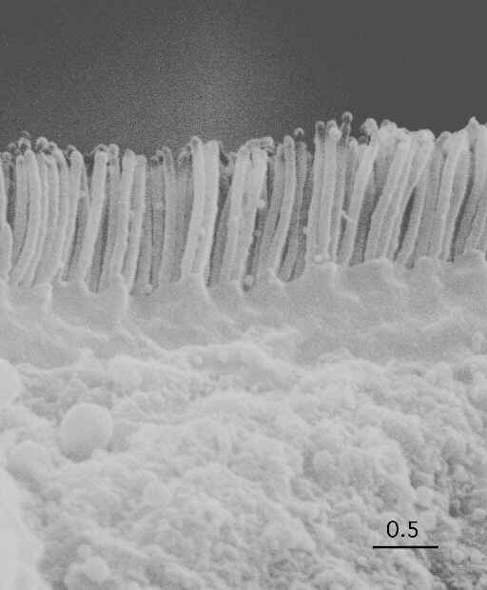
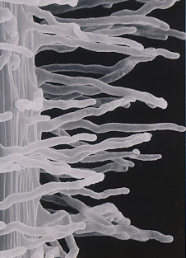
How do these structures enhance the rate of diffusion?
Notes:
Microvilli and root hairs

Slide 12
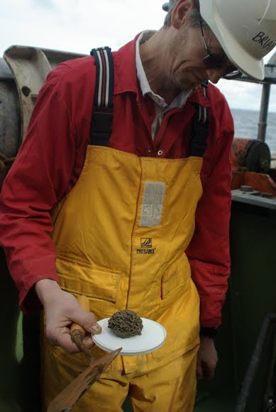
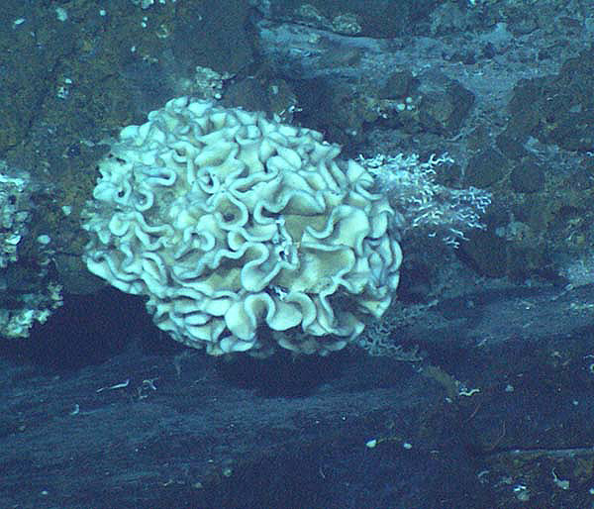
Xenophyophores
20 cm!
200,000 μm
Notes:
(You will not be tested on this information)
Xenophyophores are giant unicellular organisms found throughout the world's oceans, at depths of up to 10,641 meters (6.6 miles)
The image (taken 2005) is of a large 20-cm wide Xenophyophore. Xenophyophores are protists, single cell animals (or animal like creatures actually ;3). As benthic particulate feeders, xenophyophores normally sift through the sediments on the sea floor. and excrete a slimy substance; in locations with a dense population of xenophyophores, such as at the bottoms of oceanic trenches, this slime may cover large areas. Local population densities may be as high as 2,000 individuals per 100 square meters.

