Slide 1
The deadline for all missing assignments is this Friday at 2:30
There will be a cumulative final on Monday (2nd period) or Tuesday (3rd and 5th periods)
Please turn in the Chapter 24 Reading Packet

Slide 2
Speed of Sound

Slide 3
Sound waves must travel through matter. (The matter is called the medium.)
The closer together the molecules in the medium are, the faster the sound travels.

Slide 4
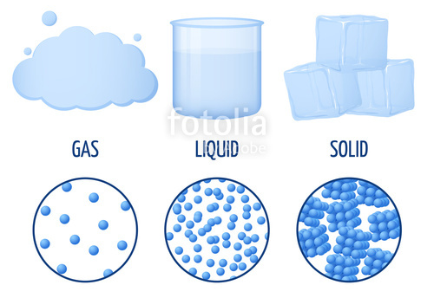
Sound travels most slowly in:
gas

