Slide 1
The deadline for all missing assignments is Friday, June 14 at 2:30

Slide 2
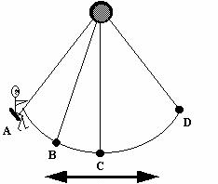
Harmonic Motion and Oscillations
Motion that repeats in cycles.
A cycle is one complete oscillation or one unit of harmonic motion

Slide 3
Review
What is energy?
Ability to do work
What is work?
Force x Distance

Slide 4
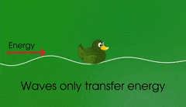
Wave
Traveling oscillation that transfers energy through matter or space.

Slide 5
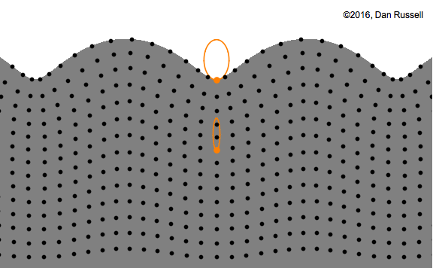
Waves carry energy without transporting matter from place to place.

Slide 6
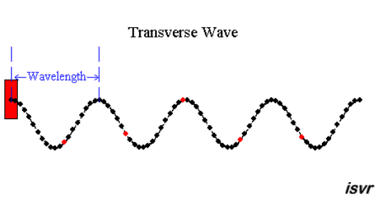
Two types of waves
1. Transverse wave
Ex. Water, light, x-ray, microwaves
Matter is disturbed perpendicular to the wave direction.

Slide 7
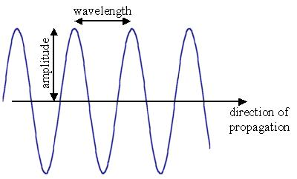
Crest
Trough
http://www.acs.psu.edu/drussell/Demos/waves/wavemotion.html

Slide 8
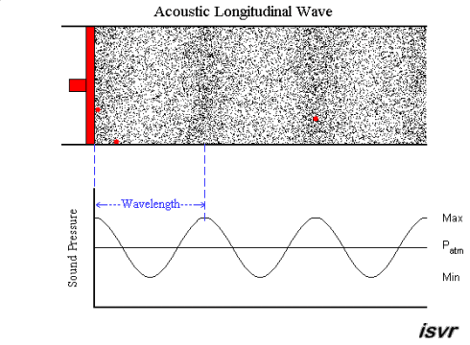
2. Longitudinal wave
Ex. Sound
matter is disturbed parallel to the wave direction

Slide 9
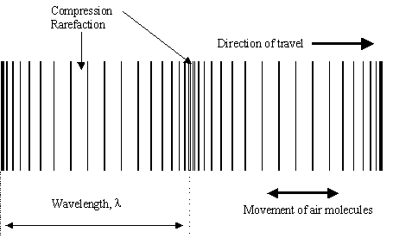
http://www.acs.psu.edu/drussell/Demos/waves/wavemotion.html
compression

