Slide 1
The deadline for all missing assignments is this Friday at 2:30.

Slide 2
Frequency:
number of waves passing a given point each second
unit is Hertz (1 Hz = 1 wave/second)
Period:
length of time it takes for 1 complete wave to happen.

Slide 3
Freq: = 10,000 Hz,
Period = 1/10,000 sec.
Period = 2 sec.,
Freq. = ½ Hz.

Slide 4
Frequency = 10 Hz because ten waves pass by each second.
Period = 1/10 second because it takes 1/10th of a second for a complete wave to pass.

Slide 5
What is the frequency?
5 Hz
What is the period?
1/5 second

Slide 6
Waves with longer wavelengths have a lower pitch.
300 Hz
Waves with shorter wavelength have a higher pitch.
500 Hz

Slide 7
Waves with greater amplitude are louder

Slide 8
View Sound Waves
https://www.youtube.com/watch?v=px3oVGXr4mo

Slide 10
What is the formula for wave Speed?
v = f x λ
Frequency?
f = v/ λ
Wavelength?
λ = v/f
__v__
f x λ

Slide 11
If the frequency of a wave is 10 Hz and the wavelength is 0.5 m, what is the wave speed?
v = fλ
v = (10 Hz)(0.5 m) = 5 m/s

Slide 12
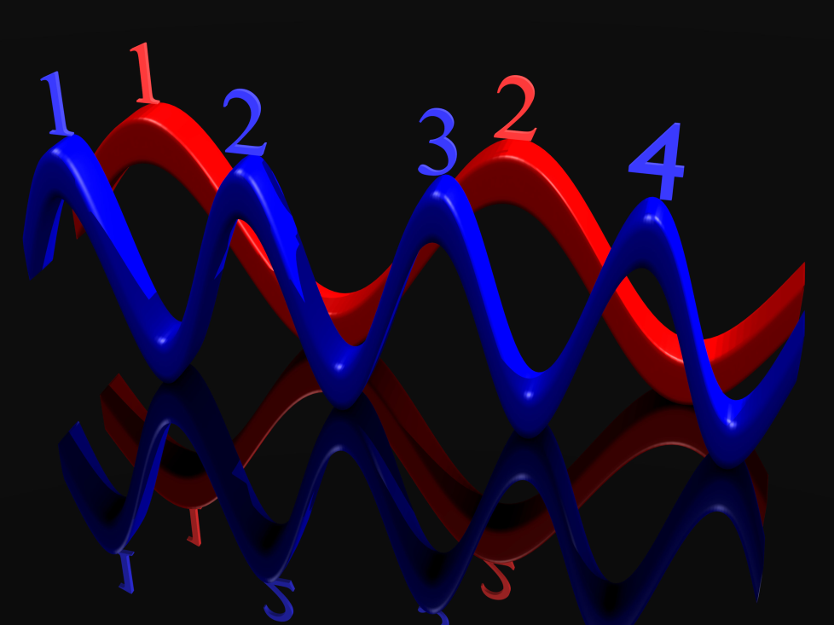
If the speed of a wave is 4 m/s and the wavelength is 2 m. What is the frequency of the wave?
f = v/λ
f = 4m/s / 2m = 2 Hz

Slide 13
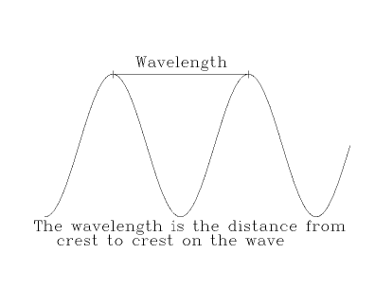
If a wave is going 50 m/s and the frequency is 10 Hz, what is the wavelength?
λ = v/f
λ = 50 m/s / 10 Hz = 5 m

Slide 14
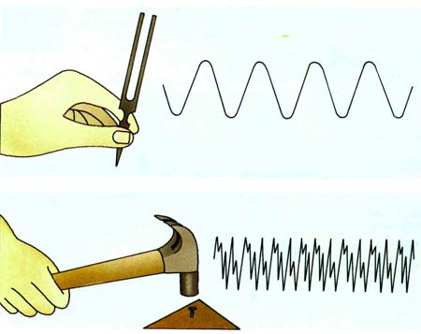
If the frequency is 8 Hz and the wavelength is 2 m how fast is the wave going?
v = fλ
v= (8Hz)(2m) = 16 m/s

Slide 15
A wave has a frequency of 13 Hz.
What is the period of the wave?
1/13 s
How many waves go by each second?
13

Slide 16
A wave generator produces 30. pulses per second. The speed of the wave is 4.0m/s.
What is the period of the wave?
1/30 sec.
What is the frequency of the wave?
30 Hz.
What is the wavelength?
Wavelength = v/f
Wavelength = 4/30
0.13 m

