Slide 1
Please Turn in your Rocket report if you haven’t done so already

Slide 2
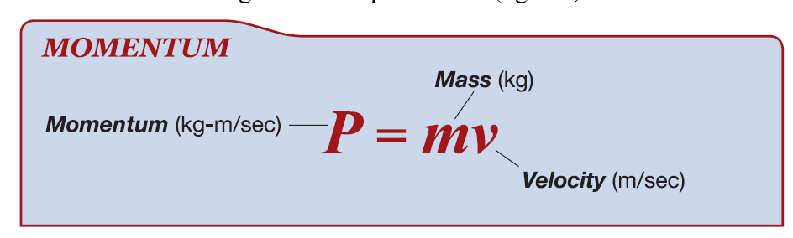
6.3 Momentum
Momentum is the mass of a object times its velocity.
The units for momentum are kilogram-meter per second (kg·m/s).

Slide 3
Law of Conservation of Momentum
As long as the interacting objects are not influenced by outside forces (like friction) the total amount of momentum is constant.

Slide 4
momentum
__ P___
v x m
⬅
Momentum = v x m
Velocity = p/m
Mass = p/v

Slide 5

A 3 kg goldfish is traveling in a straight line at 2 m/s. What is its momentum?
p = (m)(v)
P = (3kg)(2m/s)
P = 6 kg . m/s

Slide 6
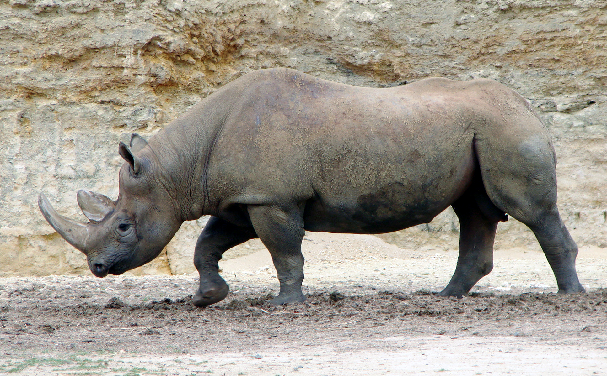
A rhinoceros is jogging in a straight line at the speed of 5 m/s. Its momentum is 11,000 kg . m/s. What is its mass?
m = p/v
m= 11,000 kg . m/s ÷ 5 m/s
m=2,200 kg

Slide 7
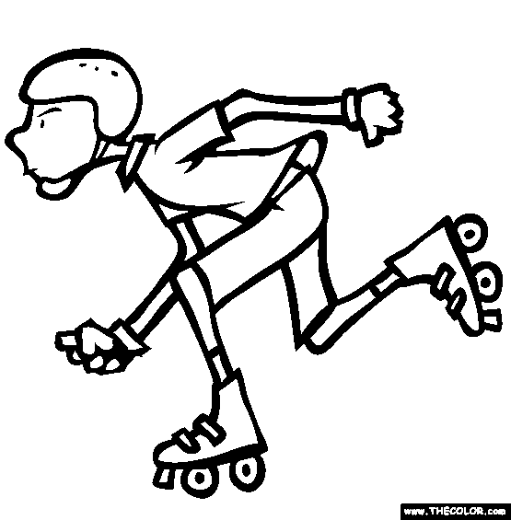
A 60. kg boy is traveling in a straight line. His momentum is 125 kg . m/s. What is his velocity? (Use the correct number of significant digits.)
v = p/m
v = 125 kg. m/s / 60.
v = 2.08333333333 m/s
v = 2.1 m/s

Slide 8
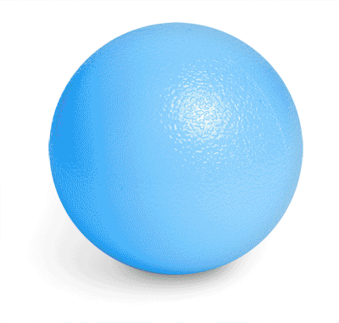
Which would take more force to stop:
a 16 kg ball rolling in a straight line at a speed of 0.2 m/s or a 8 kg ball rolling along the same path at a speed of 1.0 m/s?
16 kg ball
  p = (16kg)(0.2 m/s)
  P = 3.2 kg . m/s
8 kg ball
  p = (8kg)(1.0 m/s)
  p= 8 kg . m/s
The 8 kg ball would be harder to stop.
16 kg
8 kg

