Slide 1
Please turn in the Chapter 5 Crossword
The Chapter 5 Test is on Thursday

Slide 2
Net Force Section 5.3
The sum of all the forces on an object
The word net means total but also means the direction of the forces has been taken into account.
0N
20N
2N

Slide 3
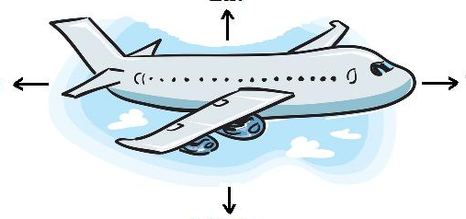
Balanced Forces
Net force = 0
Object is in equilibrium
An object at rest will stay at rest.
An object in motion will continue at a constant velocity.
50,000 N
20,000 N
20,000 N
50,000 N

Slide 4
Unbalanced Forces
Net force ≠ 0
Object is not in equilibrium
The motion of the object will change
60,000 N
20,000 N
20,000 N
50,000 N

Slide 5
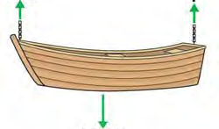
The boat is in equilibrium
5 N
5 N
_____N

Slide 6
The boat is in equilibrium
10 N
10 N
____N

Slide 7
The boat is in equilibrium
15 N
___ N
20 N

Slide 8
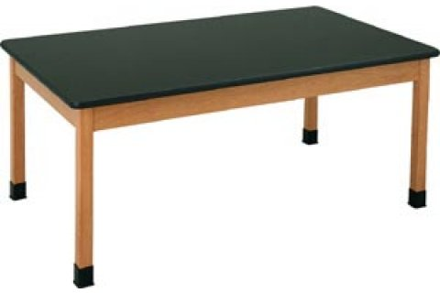
What is the net force on your desk?
0 newtons (You know this because the desk is not moving.)

Slide 9
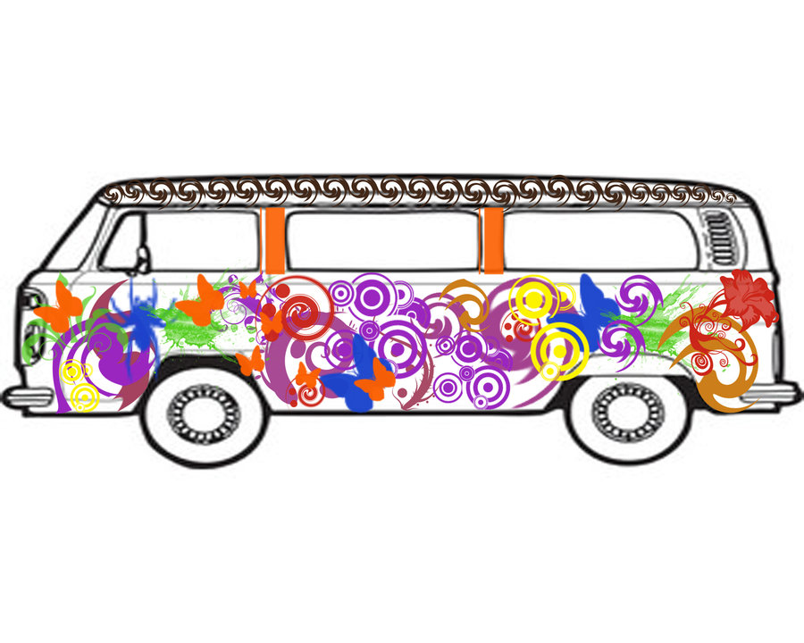
What is the net force on a bus that is going at a constant velocity?
0 newtons (You know this because it is going at a constant velocity.)

Slide 10
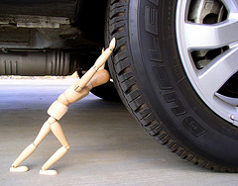
The wooden guy is pushing on the car with a force of 2 N. The car is not moving. What is the force of friction?
2 N

Slide 11
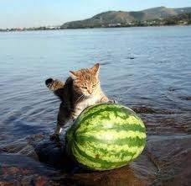
The cat is pushing the watermelon. The watermelon is gaining speed. The net force on the watermelon is:
Zero
or
Greater than zero

Slide 12
Which would be capable of generating more friction force? (Which would be harder to slide across the floor?)
1. A crate on a rough wooden floor
2. the same crate on a polished linoleum floor
1. the crate on the rough floor.
Why?
Rougher surface = more friction = harder to move

Slide 13
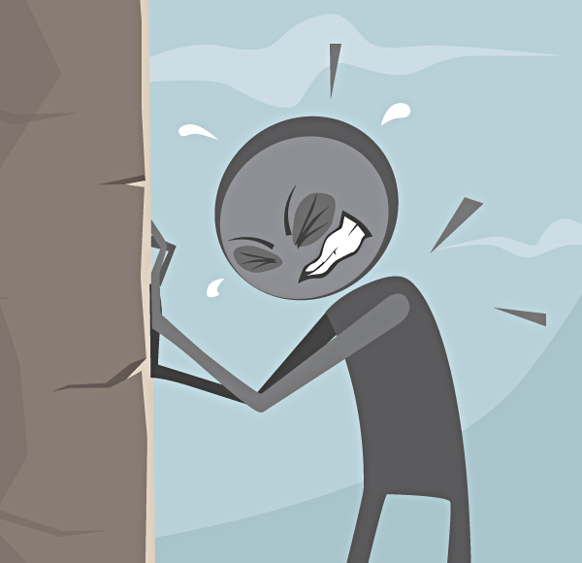
The cartoon guy is pushing on the stone with a force of 70 N. The stone is not moving. What is the force of friction?
70 N
What is the net force on the stone?
Zero

Slide 14
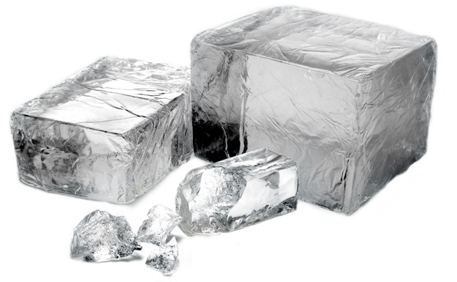
Which would be capable of generating more friction force? (Which would be harder to slide across the floor?)
A 5 kg block of ice
The 60 kg block of ice
Why?
More mass means there is more force pushing the two surfaces together.
A 60 kg block of ice

Slide 15
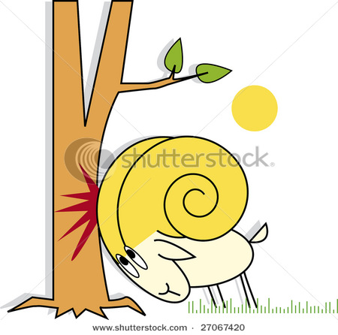
The ram is pushing the tree. The tree is not moving. This is an example of:
Static friction
or
Sliding friction
The net force on the tree is:
Zero
or
Greater than zero

Slide 16
If there is 15 N of friction slowing your bicycle down, how much force do you need to apply to keep your bicycle moving at a constant velocity?
15 N

