Slide 2
Newton’s 2nd Law Section 6.2
The acceleration caused by a net force is directly proportional to the force and inversely proportional to the mass.

Slide 3
  Force is directly proportional to acceleration.
  If twice the force is applied, the acceleration is twice as great.

Slide 4
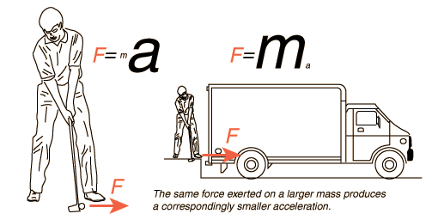
  Acceleration is inversely proportional to mass.
  An object with twice the mass will have half the acceleration if the same force is applied.

Slide 5
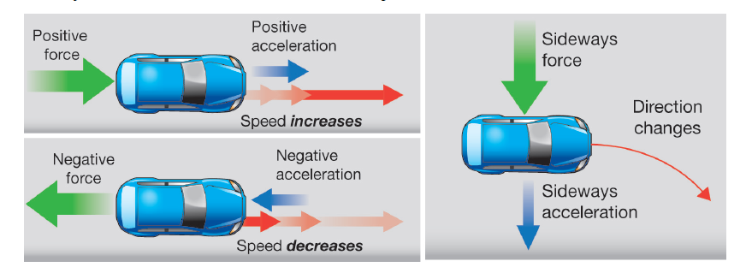
Acceleration is always in the same direction as the net force.

Slide 6
Formula for acceleration
  a = F/m
Formula for force
  F=(m)(a)
Formula for mass
  m = F/a
__ F___
m x a

Slide 7
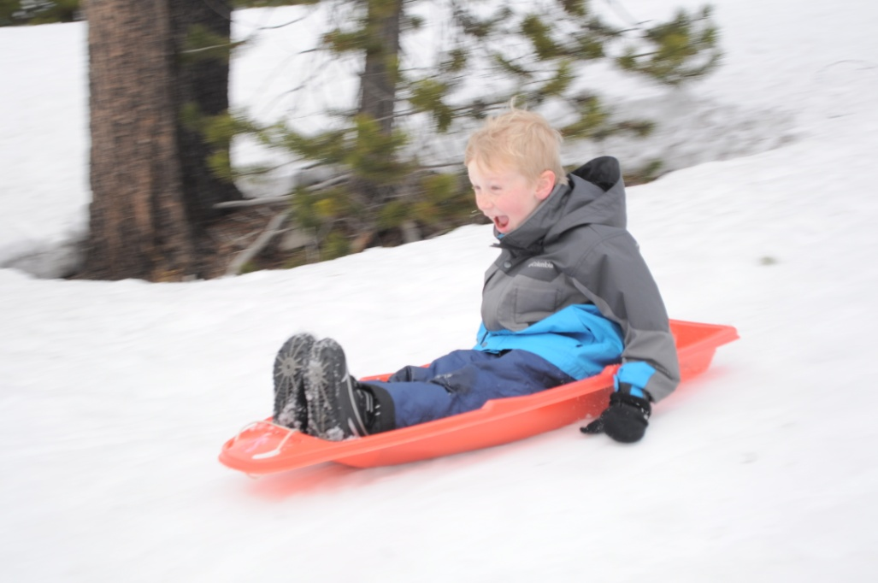
A boy gets pushed on a sled with a force of 120 N. The boy and the sled together have a mass of 60 kg. Ignoring friction, what is the acceleration of the boy on the sled?
a= 120 N/60 kg
a = 2 m/s²

Slide 8
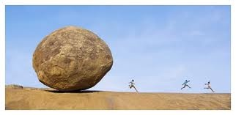
A rock with a mass of 500 kg is accelerating at the rate of 2 m/s² How much force does it have?
F= (500 kg)(2 m/s²)
F= 1,000 N

Slide 9
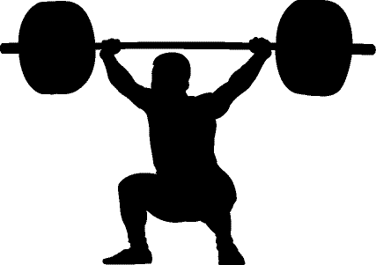
A person lifts a barbell above his head with an acceleration of 2 m/s². The barbell exerts a force of 400 N. What is the mass of the barbell?
m= 400 / 2
m = 200 kg

Slide 10
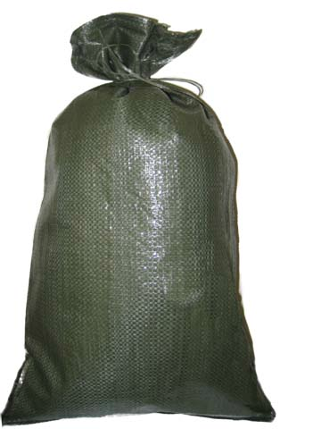
What is the force of a _____ kg sandbag in a free fall?
F = (m)(a)

Slide 11
What is the force of a 500 kg sandbag in a free fall?
F = (500 kg)(9.8 m/s²)
F = 4900 N

Slide 12


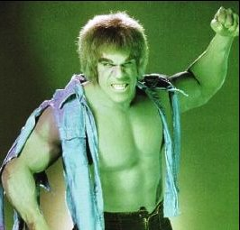
Which cart will accelerate more?
1. A cart pushed by a toddler. (The toddeler is pushing as hard as he can.)
2. The same cart pushed by a body builder. (The body builder is pushing as hard as he can
1. The cart pushed by the body builder
Why?
More force = more acceleration

Slide 13
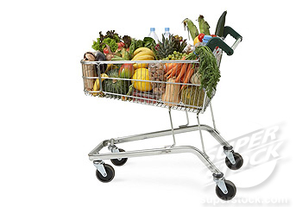

When pushed with the same force, which cart will accelerate more?
Cart A
Cart B
Why?
  Greater mass = less acceleration
Cart B

Slide 14
You will be building your rockets tomorrow and Friday. Rockets must be ready to launch at the start of class on Monday.

