Slide 2
Velocity page 78 - 84
Includes both speed and direction.
  Ex. 5 mph north
A vector quantity (vectors have both magnitude and direction.) (video clip)
Velocity can change even if speed doesn’t.

Slide 3

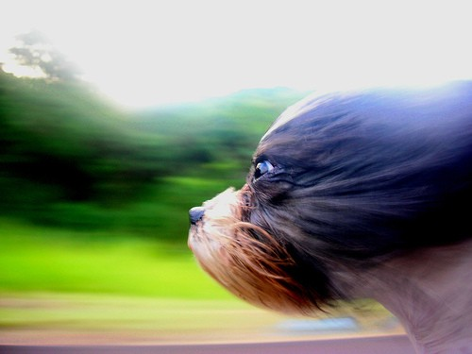
Acceleration Section4.3
Rate of change in velocity
If velocity changes, then acceleration occurs. That means if speed and/or direction change, acceleration occurs.
Positive acceleration = speeding up
Negative acceleration = slowing down

Slide 4
Acceleration = change in velocity / time
A = V _{finish} – V _{start} / T
Calculate the acceleration of a runner who goes from 2.0 m/s to 5.0 m/s in 2.0 seconds.
A = 5.0 m/s – 2.0 m/s ÷ 2.0 s
A = 1.5 m/s²

Slide 5
Graphing Motion
Slope = steepness of the line
Slope of the line represents the speed of the object
Straight line = constant speed

Slide 6
Graphing acceleration
You don’t get a straight line because speed and/or direction is changing.

Slide 7


Two dogs are running at 20 mph in opposite directions.
Do they have the same speed?
  Yes – they are both going 20 mph
Do they have the same velocity?
  No – because they are going in opposite directions.

Slide 8
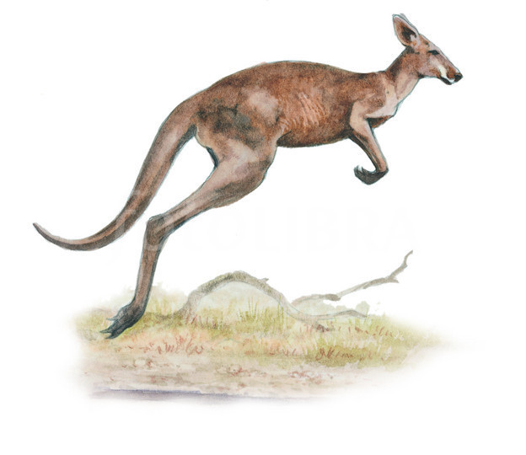
A kangaroo hopped at a constant 10 m/s as it rounded a rock.
Is it going at a constant speed?
  Yes
Is it going at a constant velocity?
  No – because its direction is changing.

Slide 9
Who went faster, Blue or Red?
  Blue
Which line has a greater slope?
  Blue

Slide 10
True or false: Both runners ran at a more or less constant speed.
  True
Which runner went farther?
  Blue

Slide 11
Is Ruth traveling at a constant velocity?
  No
What section of the graph shows Ruth going the fastest? (orange, black or yellow)
  Yellow

Slide 12
What section of the graph shows that Ruth stopped? (orange, black, or yellow)
  Black

Slide 13
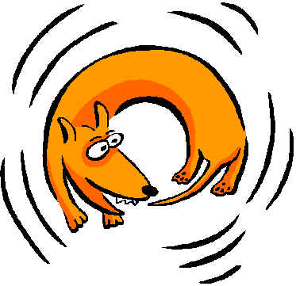
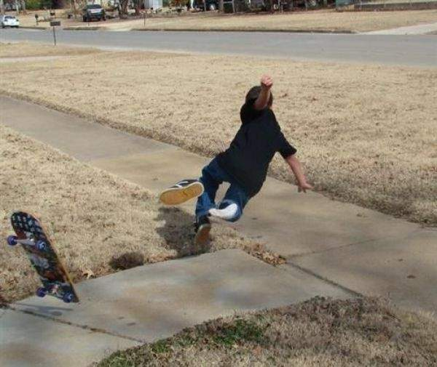
White board
If a dog is going at a constant speed as it chases its tail, is it accelerating?
  Yes (because it is changing direction)
If a skateboarder slows down to avoid running over a little kid, is he accelerating?
  Yes, slowing down is negative acceleration

Slide 14
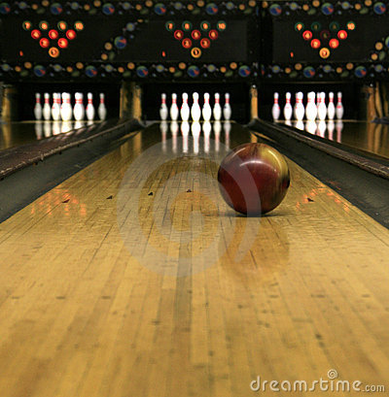
White board
If a bowling ball is rolling at a constant speed in a straight line, is it accelerating?
  No, because it is not changing its speed or direction.

Slide 15
Does this graph show acceleration?
  No, it is a straight line which means the car was going at a constant velocity.

Slide 16
Does this graph show acceleration?
  Yes, because it shows the car changing direction.

Slide 17
Does this graph show acceleration?
  Yes, because it shows the car slowing down (negative acceleration).

Slide 18
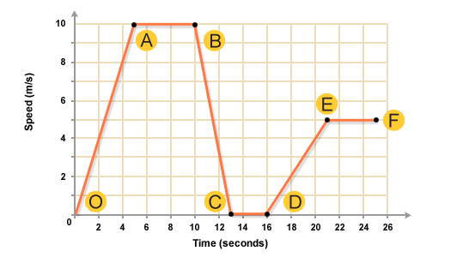
What part of the graph shows the jogger speeding up?
  O-A and D-E

Slide 19
What part of the graph shows the jogger slowing down?
  B-C

Slide 20
What part of the graph shows the jogger going the fastest?
  A-B

Slide 21
What part of the graph shows the jogger stopped?
  C-D

Slide 22
What parts of the graph shows the jogger going at a constant speed?
  A-B and C-D and E-F

Slide 23
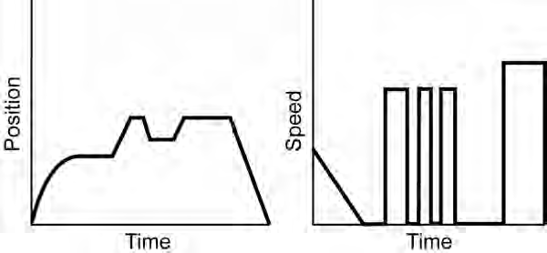
What’s happening?
  A. speeding up
  B. slowing down
  C. stopped

Slide 24
What’s happening?
  A. speeding up
  B. slowing down
  C. stopped

Slide 25
What’s happening?
  A. going forward
  B. going backward
  C. stopped

Slide 26
What’s happening?
  A. going forward
  B. going backward
  C. stopped

Slide 27
What’s happening?
  A. going forward
  B. going backward
  C. stopped

Slide 28
What’s happening?
  A. going forward
  B. going backward
  C. stopped

Slide 29
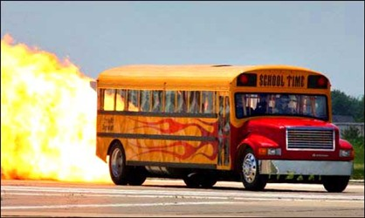
Calculate the acceleration of a bus that goes from 10 m/s to 20 m/s in 5 seconds.
20 m/s – 10 m/s ÷ 5s = 2 m/s²

Slide 30
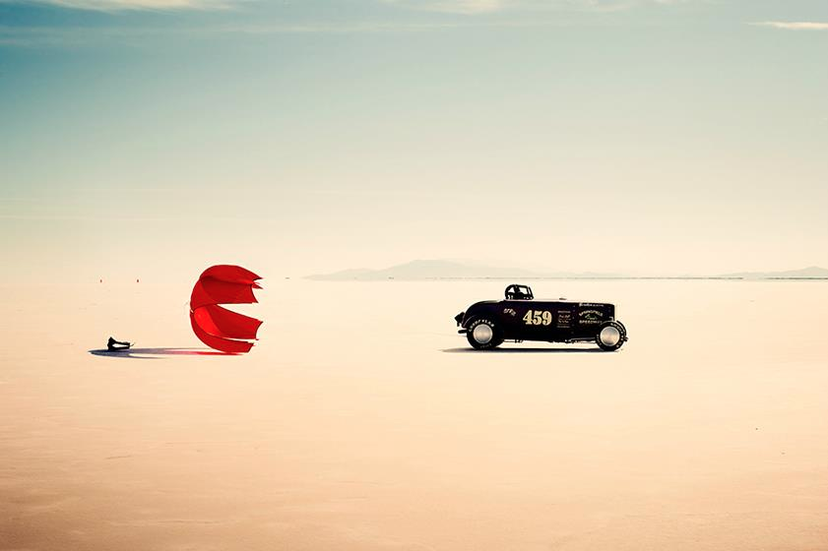
Calculate the acceleration of a car that slows from 50 m/s to 30 m/s in 10 seconds.
30 m/s – 50 m/s ÷ 10s = -2 m/s²

