Slide 1
Remember that the Chapter 5 Reading Packet is due tomorrow

Slide 2
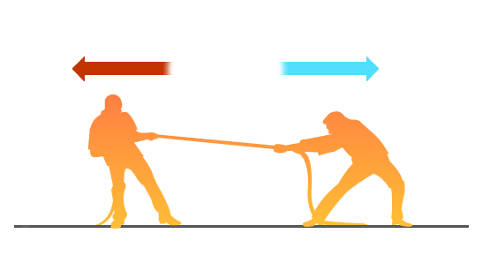
Force section 5.1
A push or a pull that one body exerts on another.
Forces can increase or decrease the speed of a moving object.
Forces can also change the direction in which an object is moving.

Slide 3
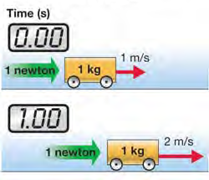
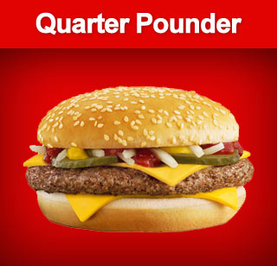
Units of Force
SI unit of force = newton
One newton (N) is the force it takes to change the speed of a 1kg mass by 1 m/s in 1 second.
1 pound = 4.448 newtons
1 N = ~

Slide 4
5.1 Drawing a force vector
The arrow points in the direction of the force.
The length of the line is proportional to the amount of force.

Slide 5


