Slide 1
Active and Passive Transport (page 12)

Slide 2
Active and Passive Transport (page 12)
Passive Transport = Moves particles from areas of high concentration to areas of low concentration. Does not require energy

Slide 3
Active and Passive Transport (page 12)
Passive Transport = Moves particles from areas of high concentration to areas of low concentration. Does not require energy
Active Transport = Moves particles from areas of low concentration to areas of high concentration. Requires energy

Slide 4
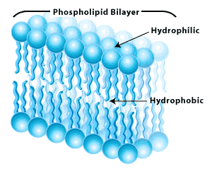
Types of Passive Transport
Diffusion: Lipids and lipid-soluble substances can pass through the plasma membrane by diffusion.

Slide 5
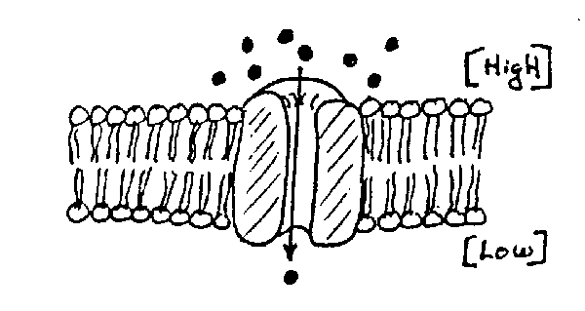
Types of Passive Transport
Diffusion: Lipids and lipid-soluble substances can pass through the plasma membrane by diffusion.
Facilitated diffusion: Channel proteins provide openings through which specific particles can diffuse. Water, sugars, amino acids, and ions enter cells this way.

Slide 6
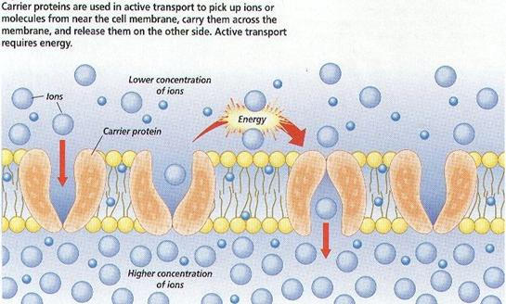
Types of Active Transport
Carrier proteins: Bind to specific molecules and move them from an area of low concentration to an area of high concentration.

Slide 7
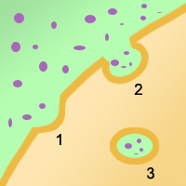
Types of Active Transport
Carrier proteins: Bind to specific molecules and move them from an area of low concentration to an area of high concentration.
Endocytosis: large particles are engulfed by a portion of the cell membrane. The membrane then breaks off and travels into the cell, carrying the large particle with it

Slide 8
Types of Active Transport
Carrier proteins: Bind to specific molecules and move them from an area of low concentration to an area of high concentration.
Endocytosis: large particles are engulfed by a portion of the cell membrane. The membrane then breaks off and travels into the cell, carrying the large particle with it
a. Phagocytosis: Food
b. Pinocytosis: Water

Slide 9
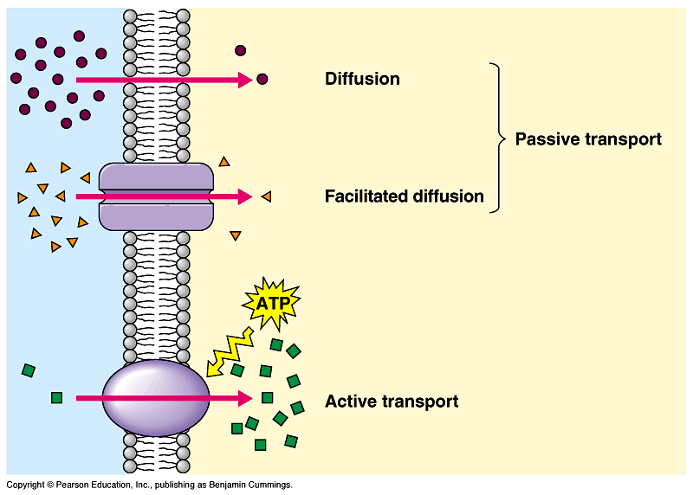

Slide 10
Output (page 13)
Fold-It 4 for the following terms:
Diffusion
Facilitated diffusion
Carrier proteins
Endocytosis

