Slide 1
Big Ideas in Biology (pg 10-11)

Slide 2
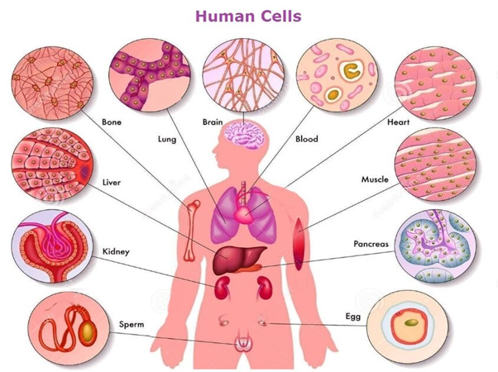
1. Cellular Basis of Life
All living things are made of one or more cells
Cells in multicellular organisms have different sizes, shapes, and functions
The human body has over 200 different cell types

Slide 3
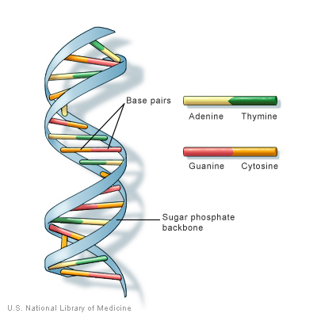
2. Information and heredity
Living things have a universal genetic code
The information coded in DNA forms an unbroken chain that stretches back 3.5 billion years

Slide 4
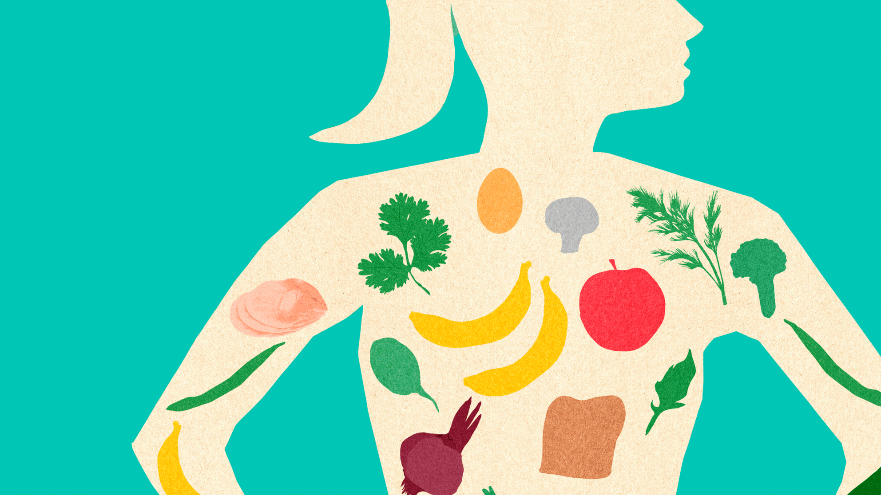
3. Matter and energy
Life requires matter that serves as nutrients to build body structures and energy that fuels life’s processes
Autotrophs, such as plants, make their own food using energy from the sun
Heterotrophs, such as animals, eat other living things to obtain nutrients and energy

Slide 5
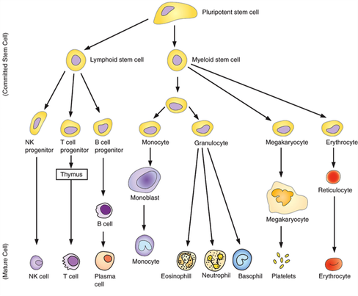
4. Growth, Development, and Reproduction
All living things reproduce
Newly produced individuals grow and develop as they mature
During development, cells become specialized to form different tissues and organs

Slide 6
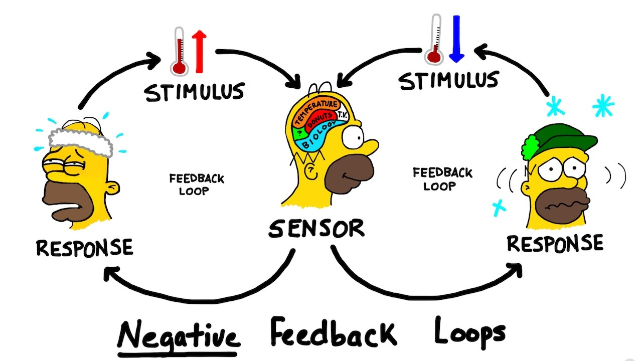
5. Homeostasis
Living things maintain a relatively stable internal environment through negative feedback loops

Slide 7
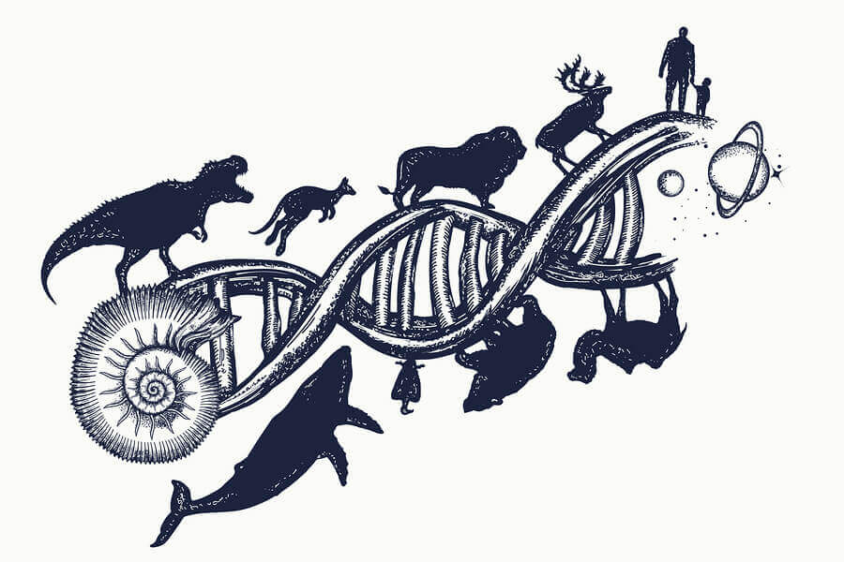
6. Evolution (pg 11)
All living things are related and have changed over time due to evolution
Evolution is the central organizing principle of all biology

Slide 8
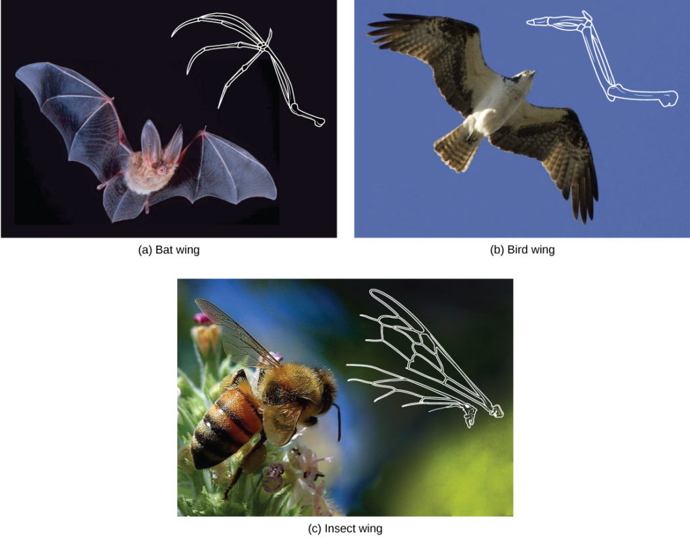
7. Structure and Function
Structures in living things have evolved in ways to make particular functions possible.
For example, the structure of wings allows birds, bats, and insects to fly

Slide 9
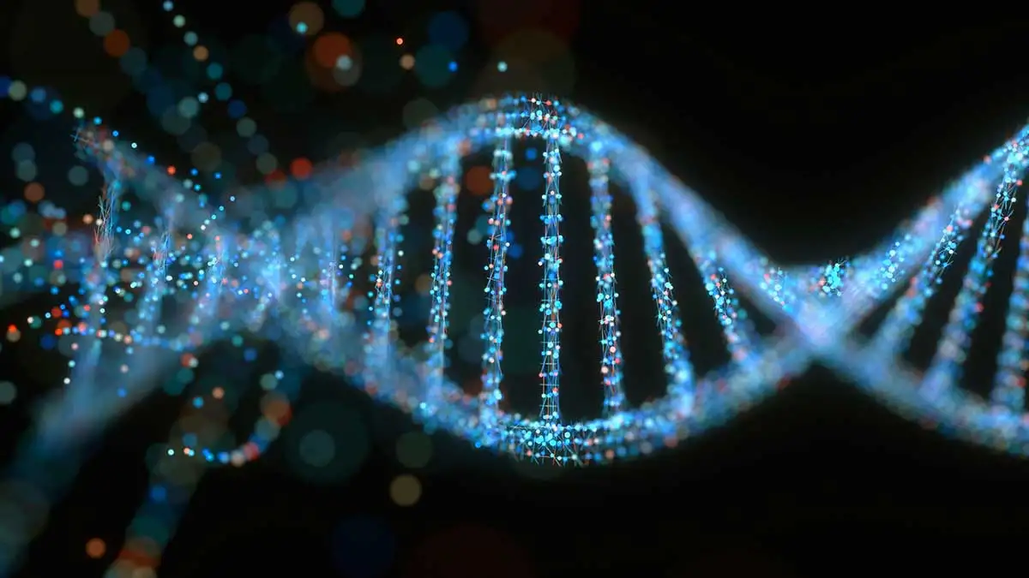
8. Unity and Diversity of Life
Although life takes a wide variety of forms, at the molecular level all living things are fundamentally similar

Slide 10
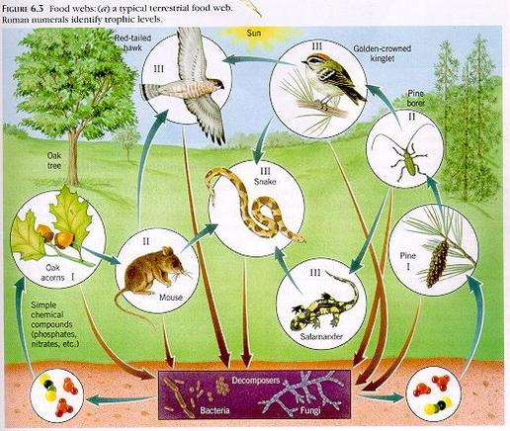
9. Interdependence in Nature
All life on Earth is connected into a biosphere
Organisms are affected by other living things and by the non-living environment (land, water, and air)

Slide 11
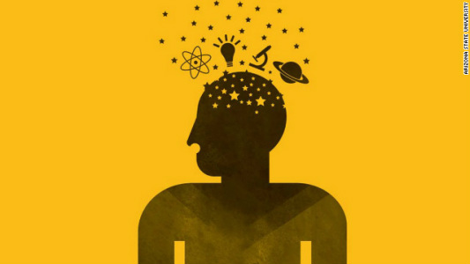
10. Science as a way of knowing
Science is not a list of facts, but a way of learning about the world

