Slide 1
Notes: Symbiosis (pg 10)

Slide 2
Notes: Symbiosis (pg 10)
Symbiosis = Close association between two different species

Slide 3
Types of symbiosis
 | Partner #1 | Partner #2
Commensalism | + | 0
Mutualism | + | +
Parasitism | + | -

Slide 4
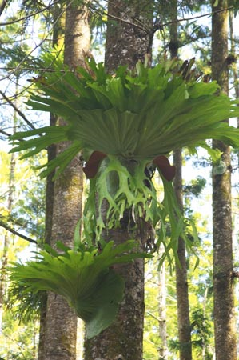
Examples
Commensalism: Epiphytes are small plants that live on the branches of other trees. This allows the epiphyte to get more light, and neither helps nor harms the tree

Slide 5
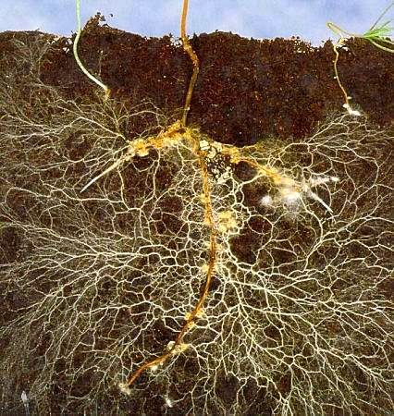
Examples
Mutualism: Mycorrhizae are fungi that live on the roots of plants. The fungus gives the plant water and nutrient and the plant gives the fungus food.

Slide 6
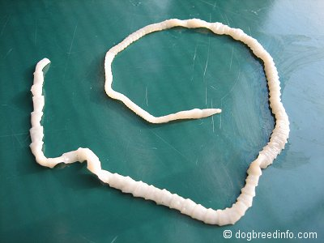
Examples
Parasitism: Tapeworms live in the digestive tracts of animals, stealing food and nutrients from their hosts.

Slide 7
Output (pg 11)
Homework: Research one mutualism and one parasitism and write a paragraph about each

