Slide 1
Trophic Levels (pg 8)

Slide 2
Trophic Levels (pg 8)
Primary producers: Use solar or chemical energy to produce food by assembling inorganic compounds into complex organic molecules

Slide 3
Consumers: Rely on other organisms for energy and nutrients

Slide 4
Consumers: Rely on other organisms for energy and nutrients
Herbivores: Eat plants

Slide 5
Consumers: Rely on other organisms for energy and nutrients
Herbivores: Eat plants
Carnivores: Kill and eat other animals

Slide 6
Consumers: Rely on other organisms for energy and nutrients
Herbivores: Eat plants
Carnivores: Kill and eat other animals
Omnivores: Eat both plants and animals

Slide 7
Consumers: Rely on other organisms for energy and nutrients
Herbivores: Eat plants
Carnivores: Kill and eat other animals
Omnivores: Eat both plants and animals
Scavengers: Eat carcasses of animals that have died from other causes

Slide 8
Consumers: Rely on other organisms for energy and nutrients
Herbivores: Eat plants
Carnivores: Kill and eat other animals
Omnivores: Eat both plants and animals
Scavengers: Eat carcasses of animals that have died from other causes
Decomposers: Chemically break down dead plant and animal matter, turning it into detritus. Includes bacteria and fungi

Slide 9
Consumers: Rely on other organisms for energy and nutrients
Herbivores: Eat plants
Carnivores: Kill and eat other animals
Omnivores: Eat both plants and animals
Scavengers: Eat carcasses of animals that have died from other causes
Decomposers: Chemically break down dead plant and animal matter, turning it into detritus. Includes bacteria and fungi
Detritivores: Eat small particles of dead plants and animals. Includes earthworms and crabs

Slide 10
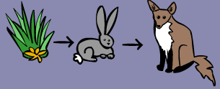
Food chain: Series of steps in an ecosystem in which organisms transfer energy by eating and being eaten

Slide 11
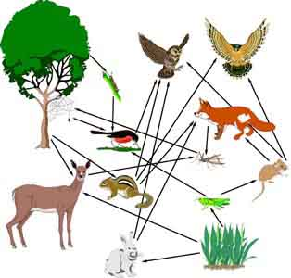
Food Web: Network of complex interactions formed by the feeding relationships among the various organisms in an ecosystem

Slide 12
Ecological Pyramids
Each step in a food chain or web is called a trophic level

Slide 13
Ecological Pyramids
Each step in a food chain or web is called a trophic level
Primary producers form the base of the pyramid, then first-level consumers, second-level consumers, etc.

Slide 14
Ecological Pyramids
Each step in a food chain or web is called a trophic level
Primary producers form the base of the pyramid, then first-level consumers, second-level consumers, etc.
Only about 10% of the energy available within one trophic level is transferred to the next trophic level

Slide 15
