Slide 1
Succession (pg 12)

Slide 2
Succession (pg 12)
Ecological succession: series of predictable changes that occur in a community over time. Over the course of succession, the number of different species present typically increases.

Slide 3
Succession (pg 12)
Ecological succession: series of predictable changes that occur in a community over time. Over the course of succession, the number of different species present typically increases.
Succession answers these questions:
How do communities change over time?

Slide 4
Succession (pg 12)
Ecological succession: series of predictable changes that occur in a community over time. Over the course of succession, the number of different species present typically increases.
Succession answers these questions:
How do communities change over time?
How do ecosystems return to “normal” following a disturbance (flood, fire, logging, etc.)

Slide 5
Primary succession
Succession that occurs in an area in which no trace of a previous community is present

Slide 6
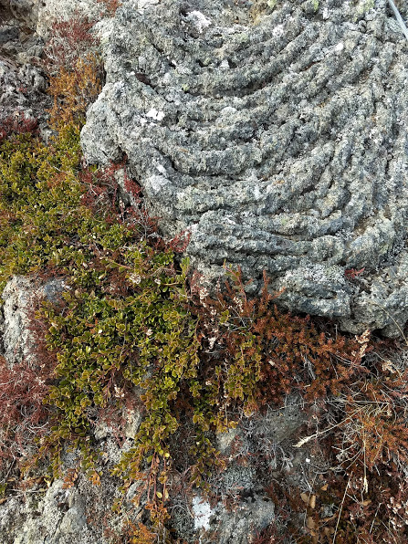
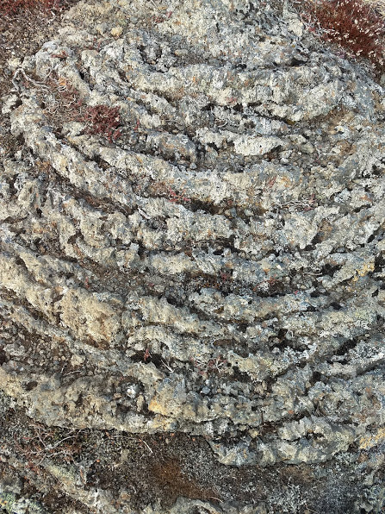
Primary succession
Succession that occurs in an area in which no trace of a previous community is present
Examples: Newly cooled lava, bare rock exposed by retreating glaciers

Slide 7
Primary succession
Succession that occurs in an area in which no trace of a previous community is present
Examples: Newly cooled lava, bare rock exposed by retreating glaciers
First species to colonize are called pioneer species. Lichens come first and begin the break the rock down into soil, then grasses arrive

Slide 8
Secondary Succession
Type of succession that occurs in areas that were only partially destroyed by disturbances

Slide 9
Secondary Succession
Type of succession that occurs in areas that were only partially destroyed by disturbances
Proceeds faster than primary succession because soil survives the disturbance

Slide 10
Secondary Succession
Type of succession that occurs in areas that were only partially destroyed by disturbances
Proceeds faster than primary succession because soil survives the disturbance
Examples: Wildfire, hurricane, flood, logging, farming

Slide 11
Why does Succession occur?
Pioneer species alter the environment, making it easier for other species to survive

Slide 12
Why does Succession occur?
Pioneer species alter the environment, making it easier for other species to survive
Example: Lichens and grasses add organic matter to the soil, making it suitable for larger plants like shrubs and trees.

Slide 13
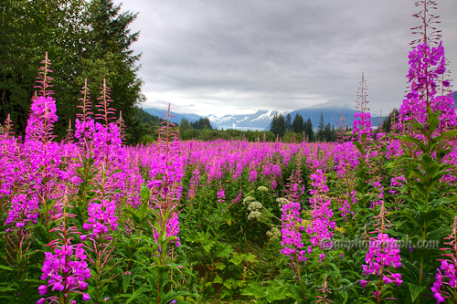
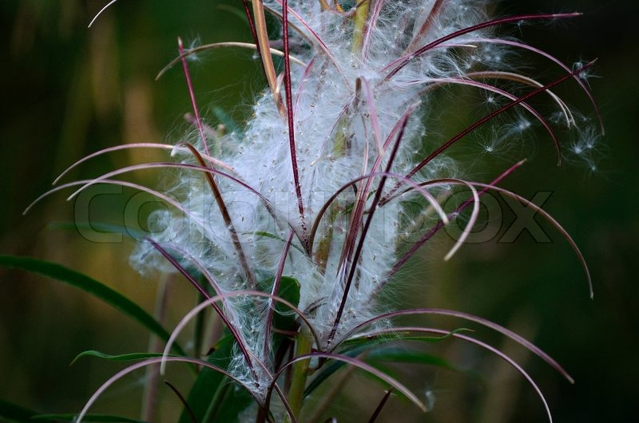
Steps of Secondary Succession
Grasses and herbaceous plants (fireweed)

Slide 14
Steps of Secondary Succession
Grasses and herbaceous plants (fireweed)
Shrubs and small trees (willow and alder)

Slide 15
Steps of Secondary Succession
Grasses and herbaceous plants (fireweed)
Shrubs and small trees (willow and alder)
Sun-loving trees (douglas fir, ponderosa pine)

Slide 16
Steps of Secondary Succession
Grasses and herbaceous plants (fireweed)
Shrubs and small trees (willow and alder)
Sun-loving trees (douglas fir, ponderosa pine)
Shade-tolerant trees (spruce, hemlock)

Slide 17
Climax community
The final stage of succession. Community remains relatively stable until damaged or destroyed by a disturbance

Slide 18
Output (pg 13)
Draw primary and secondary succession
Use pictures on pg 106 and 107 as a guide

