Slide 1
Notes: Evolution of Complex Traits (pg 10)

Slide 2
Notes: Evolution of Complex Traits (pg 10)
Complex Traits include structures or systems with multiple interacting parts

Slide 3
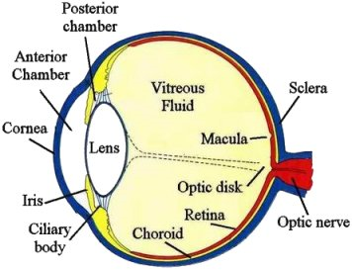
Notes: Evolution of Complex Traits (pg 10)
Complex Traits include structures or systems with multiple interacting parts
Examples: Eyes, blood clotting, flagella

Slide 4
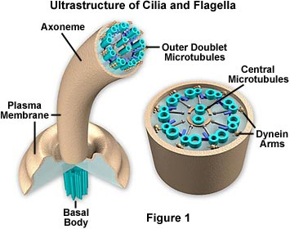
Notes: Evolution of Complex Traits (pg 10)
Complex Traits include structures or systems with multiple interacting parts
Examples: Eyes, blood clotting, flagella

Slide 5
Opponents of evolution say that some traits are “irreducibly complex” and could not have evolved through small changes

Slide 6
Opponents of evolution say that some traits are “irreducibly complex” and could not have evolved through small changes
However, biologists have shown that this is not true

Slide 7
Evolution can produce very complex traits because:

Slide 8
Evolution can produce very complex traits because:
1. Natural selection allows small beneficial changes to accumulate over time

Slide 9
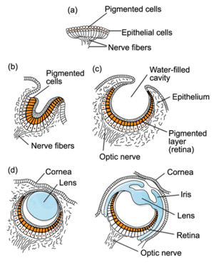
Evolution can produce very complex traits because:
1. Natural selection allows small beneficial changes to accumulate over time
Example: Eyes

Slide 10
Evolution can produce very complex traits because:
1. Natural selection allows small beneficial changes to accumulate over time
Example: Eyes
2. Traits may have had a different function in the past

Slide 11
Evolution can produce very complex traits because:
1. Natural selection allows small beneficial changes to accumulate over time
Example: Eyes
2. Traits may have had a different function in the past
Example: Lungs (for breathing) evolved from swim bladders (for floatation)

