Slide 1
Notes: Competition (pg 8)

Slide 2
Niche: The range of physical and biological conditions in which a species lives and the way the species obtains what it needs to survive and reproduce.

Slide 3
Niche: The range of physical and biological conditions in which a species lives and the way the species obtains what it needs to survive and reproduce.
The niche explains how a species fits into an ecosystem

Slide 4
Niche: The range of physical and biological conditions in which a species lives and the way the species obtains what it needs to survive and reproduce.
The niche explains how a species fits into an ecosystem
Habitat is an organism’s “address”, niche is an organism’s habitat plus its “occupation.”

Slide 5
Niche: The range of physical and biological conditions in which a species lives and the way the species obtains what it needs to survive and reproduce.
The niche explains how a species fits into an ecosystem
Habitat is an organism’s “address”, niche is an organism’s habitat plus its “occupation.”
Example: The niche of a tropical tree lizard includes the temperature range it tolerates, the size of branches on which it perches, the time of day when it is active, and the type of insects it eats

Slide 6
Competition
Occurs when organisms attempt to use the same limited ecological resource in the same place at the same time

Slide 7
Competition
Occurs when organisms attempt to use the same limited ecological resource in the same place at the same time
Intraspecific competition: Occurs between members of the same species

Slide 8
Competition
Occurs when organisms attempt to use the same limited ecological resource in the same place at the same time
Intraspecific competition: Occurs between members of the same species
Interspecific competition: Occurs between members of different species

Slide 9
Competition
Occurs when organisms attempt to use the same limited ecological resource in the same place at the same time
Intraspecific competition: Occurs between members of the same species
Interspecific competition: Occurs between members of different species
Example: Competition for mates is always intraspecific

Slide 10
Competitive Exclusion Principle
No two species can occupy exactly the same niche. One species will be better at competing for resources and will eventually exclude the other species

Slide 11
Niche partitioning
Instead of competing for resources, species will divide a resource. Therefore, each species ends up with its own niche and they can coexist

Slide 12
Niche partitioning
Instead of competing for resources, species will divide a resource. Therefore, each species ends up with its own niche and they can coexist
Example: Species of warblers feed in different parts of spruce trees. Can have 5 different warbler species in one tree

Slide 13
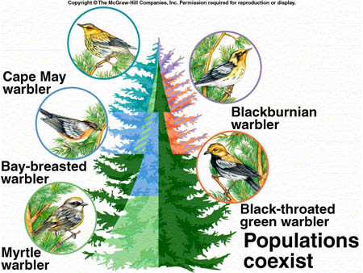

Slide 14
Squirrel simulation (pg 9)
Were you a red squirrel or a gray squirrel?
How many acorns did you collect?
Squirrels that gathered less than 10 acorns are likely to die of starvation. Over time, what will happen to the red squirrel population?
How does this activity simulate the competitive exclusion principle?

