Slide 1
Notes: Small and Large Intestines (pg 8)

Slide 2
Small Intestine
2.5 cm in diameter and 6 meters long

Slide 3
Small Intestine
2.5 cm in diameter and 6 meters long
Functions: Finishes process of digestion, absorbs nutrients, passes residue to large intestine

Slide 4
Small Intestine
2.5 cm in diameter and 6 meters long
Functions: Finishes process of digestion, absorbs nutrients, passes residue to large intestine
Regions: Duodenum (25 cm), Jejunum (2.5 meters), Ileum (3.5 meters)

Slide 5
Output (pg 9)
Paste in small intestine diagram. Label and use arrows to show the direction chyme travels

Slide 6
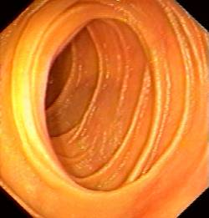
Structure of Small Intestine (pg 8)
Surface area greatly increased by presence of:
Plicae circulares: Circular folds

Slide 7
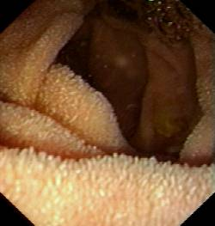
Structure of Small Intestine (pg 8)
Surface area greatly increased by presence of:
Plicae circulares: Circular folds
Villi: Finger-like extensions. Villi contain numerous blood and lymph capillaries

Slide 8
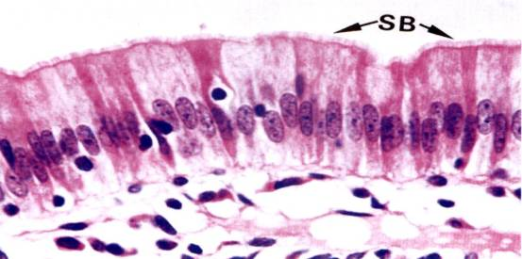
Structure of Small Intestine (pg 8)
Surface area greatly increased by presence of:
Plicae circulares: Circular folds
Villi: Finger-like extensions. Villi contain numerous blood and lymph capillaries
Microvilli: tiny hair-like extensions of the cell membrane of the epithelial cells. “Brush border”

Slide 9
Output (pg 9)
Draw cross section of small intestine wall

Slide 10
Secretions of the Small Intestine (pg 8)
Enzymes
Peptidase: breaks down proteins
Maltase, Sucrase, Lactase: break disaccharides into monosaccharides
Lipase: breaks down fats

Slide 11
Secretions of the Small Intestine
Enzymes
Peptidase: breaks down proteins
Maltase, Sucrase, Lactase: break disaccharides into monosaccharides
Lipase: breaks down fats
Hormones
Secretin: Stimulates pancreas to secrete bicarbonate (neutralizes chyme)
Cholecystokinin: Stimulates release of bile from gall bladder and digestive enzymes from pancreas

Slide 12
Large Intestine
Larger in diameter, but only 1.5 meters long

Slide 13
Large Intestine
Larger in diameter, but only 1.5 meters long
No villi

Slide 14
Large Intestine
Larger in diameter, but only 1.5 meters long
No villi
Series of pouches called haustra

Slide 15
Large Intestine
Larger in diameter, but only 1.5 meters long
No villi
Series of pouches called haustra
Functions: Absorption of fluids and electrolytes, elimination of solid wastes

Slide 16
Large Intestine
Larger in diameter, but only 1.5 meters long
No villi
Series of pouches called haustra
Functions: Absorption of fluids and electrolytes, elimination of solid wastes
Only secretion is mucus

Slide 17
Regions of the Large Intestine
Cecum: blind pouch that extends inferiorly from the ileocecal junction (where small and large intestines meet). Appendix is attached

Slide 18
Regions of the Large Intestine
Cecum: blind pouch that extends inferiorly from the ileocecal junction (where small and large intestines meet). Appendix is attached
Colon: Main portion. Divided into ascending, transverse, descending, and sigmoid portions

Slide 19
Regions of the Large Intestine
Cecum: blind pouch that extends inferiorly from the ileocecal junction (where small and large intestines meet). Appendix is attached
Colon: Main portion. Divided into ascending, transverse, descending, and sigmoid portions
Rectum: Stores feces

Slide 20
Regions of the Large Intestine
Cecum: blind pouch that extends inferiorly from the ileocecal junction (where small and large intestines meet). Appendix is attached
Colon: Main portion. Divided into ascending, transverse, descending, and sigmoid portions
Rectum: Stores feces
Anal canal: Contains internal and external sphincters

Slide 21
Colonoscopy Video!

