Slide 1
Notes: Mouth Anatomy (pg 4)

Slide 2
Notes: Mouth Anatomy (pg 4)
Oral Cavity: receives food (ingestion), breaks it apart (mastication), and mixes it with saliva

Slide 3
Notes: Mouth Anatomy (pg 4)
Oral Cavity: receives food (ingestion), breaks it apart (mastication), and mixes it with saliva
Boundaries are lips, cheeks, and palate

Slide 4
Output (pg 5)
Draw and label the features of the mouth

Slide 5
Tongue (pg 4)
Largest and most moveable organ in the oral cavity. Made of skeletal muscle

Slide 6
Tongue (pg 4)
Largest and most moveable organ in the oral cavity. Made of skeletal muscle
Attachment point in the back is called the root, which is anchored to the hyoid bone. Also connected to the floor of the mouth by the frenulum

Slide 7
Tongue (pg 4)
Largest and most moveable organ in the oral cavity. Made of skeletal muscle
Attachment point in the back is called the root, which is anchored to the hyoid bone. Also connected to the floor of the mouth by the frenulum
Lingual tonsils are embedded in posterior dorsal surface

Slide 8
Tongue (pg 4)
Largest and most moveable organ in the oral cavity. Made of skeletal muscle
Attachment point in the back is called the root, which is anchored to the hyoid bone. Also connected to the floor of the mouth by the frenulum
Lingual tonsils are embedded in posterior dorsal surface
Functions of tongue: taste, speech, manipulate food, form into a bolus and direct toward the pharynx for swallowing

Slide 9
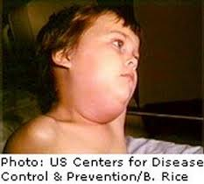
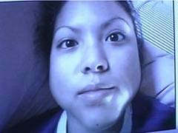
Salivary Glands
Parotid glands: largest. In cheek just in front of the ear (Mumps = viral infection of parotid glands)

Slide 10
Salivary Glands
Parotid glands: largest. In cheek just in front of the ear (Mumps = viral infection of parotid glands)
Submandibular glands: on floor of mouth near mandible

Slide 11
Salivary Glands
Parotid glands: largest. In cheek just in front of the ear (Mumps = viral infection of parotid glands)
Submandibular glands: on floor of mouth near mandible
Sublingual glands: smallest. On floor of mouth in front of submandibular glands

Slide 12
Functions of Saliva
Cleanses the teeth

Slide 13
Functions of Saliva
Cleanses the teeth
Moistens and lubricates food during chewing and swallowing

Slide 14
Functions of Saliva
Cleanses the teeth
Moistens and lubricates food during chewing and swallowing
Allows certain molecules to dissolve so food can be tasted

Slide 15
Functions of Saliva
Cleanses the teeth
Moistens and lubricates food during chewing and swallowing
Allows certain molecules to dissolve so food can be tasted
Begins chemical digestion of starches. Contains enzyme amylase, which breaks down polysaccharides into disaccharides

Slide 16
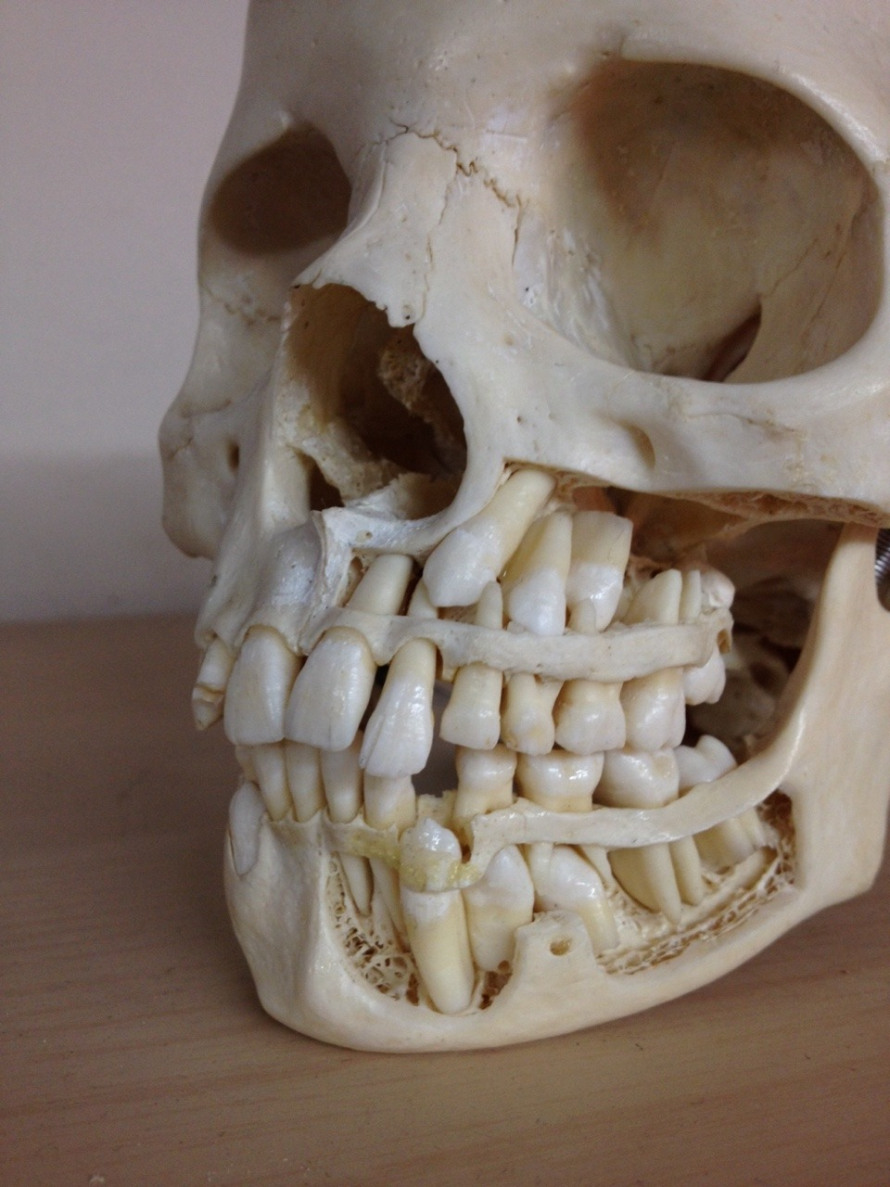
Teeth
Primary (deciduous or “baby”): 20 teeth. Begin to appear around 6 months. Fall out starting around age 6.

Slide 17
Teeth
Primary (deciduous or “baby”): 20 teeth. Begin to appear around 6 months. Fall out starting around age 6.
Secondary (permanent): 32 teeth. The last to appear are third molars (wisdom teeth) around age 17 to 25.

Slide 18
Output (pg 5)
Paste in tooth diagram

Slide 19
Output (pg 5)
Write a fairy tale about the parts of the mouth. Must include at least 5 different parts

