Slide 1
Notes: Red Blood Cells and Hemoglobin (page 4)

Slide 2
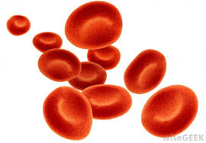
Notes: Red Blood Cells and Hemoglobin (page 4)
Erythrocytes (Red Blood Cells)
Tiny biconcave disks. Shape increases flexibility (to fit through tiny capillaries) and surface area (to make diffusion of gases more efficient)

Slide 3
Notes: Red Blood Cells and Hemoglobin (page 4)
Erythrocytes (Red Blood Cells)
Tiny biconcave disks. Shape increases flexibility (to fit through tiny capillaries) and surface area (to make diffusion of gases more efficient)
Mature RBC lacks a nucleus and most other organelles. Lost during development to make room for more hemoglobin

Slide 4
Notes: Red Blood Cells and Hemoglobin (page 4)
Erythrocytes (Red Blood Cells)
Tiny biconcave disks. Shape increases flexibility (to fit through tiny capillaries) and surface area (to make diffusion of gases more efficient)
Mature RBC lacks a nucleus and most other organelles. Lost during development to make room for more hemoglobin
RBCs can’t undergo mitosis (because they have no nucleus) so new RBCs come from stem cells

Slide 5
Erythrocyte production
Kidney produces renal erythropoietic factor that activates erythropoietin made in the liver

Slide 6
Erythrocyte production
Kidney produces renal erythropoietic factor that activates erythropoietin made in the liver
Active erythropoietin stimulates red bone marrow to produce RBCs

Slide 7
Erythrocyte production
Kidney produces renal erythropoietic factor that activates erythropoietin made in the liver
Active erythropoietin stimulates red bone marrow to produce RBCs
2 million RBCs are made and destroyed each second in your body

Slide 8
Erythrocyte production
Kidney produces renal erythropoietic factor that activates erythropoietin made in the liver
Active erythropoietin stimulates red bone marrow to produce RBCs
2 million RBCs are made and destroyed each second in your body
Life span of RBCs = 120 days

Slide 9
Erythrocyte production
Kidney produces renal erythropoietic factor that activates erythropoietin made in the liver
Active erythropoietin stimulates red bone marrow to produce RBCs
2 million RBCs are made and destroyed each second in your body
Life span of RBCs = 120 days
RBC production requires Vitamin B12, Folic acid, and Iron

Slide 10
Hemoglobin
Each RBC contains about 280 million hemoglobin molecules

Slide 11
Hemoglobin
Each RBC contains about 280 million hemoglobin molecules
Heme (Iron containing pigment) + Globin (protein)

Slide 12
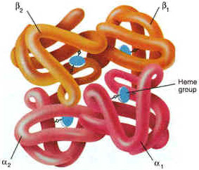
Hemoglobin
Each RBC contains about 280 million hemoglobin molecules
Heme (Iron containing pigment) + Globin (protein)
Globin protein has 4 subunits (2 alpha and 2 beta). Each subunit has one heme group

Slide 13
In the lungs, heme binds oxygen to form oxyhemoglobin (bright red)

Slide 14
In the lungs, heme binds oxygen to form oxyhemoglobin (bright red)
In the tissues, oxygen is released leaving deoxyhemoglobin (dark red). Carbon dioxide binds to the globin (not the heme) and is carried to the lungs to be exhaled.

Slide 15
Hemoglobin simulation
Build a hemoglobin molecule. Make 4 subunits and put a heme molecule (white) on each. Put a piece of tape on each heme
Make 4 O₂ (blue) and 4 CO₂ (green) from colored paper
Show me how oxygen and carbon dioxide are carried between the lungs and a muscle cell

