Slide 1
Make Interactive Notes
Staple 6 pg binder paper to cover
Number pages
Cover: Chapter 15 and 16
Urinary and Reproductive Systems
Name, period, Seat #
Color drawing

Slide 2
Notes: Urinary System (pg 2)

Slide 3
Notes: Urinary System (pg 2)
Function: maintain the volume and composition of body fluids within normal limits

Slide 4
Notes: Urinary System (pg 2)
Function: maintain the volume and composition of body fluids within normal limits
Rids body of waste (excretion)

Slide 5
Notes: Urinary System (pg 2)
Function: maintain the volume and composition of body fluids within normal limits
Rids body of waste (excretion)
Maintains appropriate fluid volume

Slide 6
Notes: Urinary System (pg 2)
Function: maintain the volume and composition of body fluids within normal limits
Rids body of waste (excretion)
Maintains appropriate fluid volume
Regulates pH and concentration of electrolytes

Slide 7
Notes: Urinary System (pg 2)
Function: maintain the volume and composition of body fluids within normal limits
Rids body of waste (excretion)
Maintains appropriate fluid volume
Regulates pH and concentration of electrolytes
Produces hormones erythropoietin (involved in red blood cell production) and renin (maintains blood pressure)

Slide 8
Components of Urinary System
Kidneys, ureters, urinary bladder, urethra

Slide 9
Components of Urinary System
Kidneys, ureters, urinary bladder, urethra
Kidneys filter the blood and form the urine. The rest of the components allow urine to exit the body.

Slide 10
Ureters
Slender tubes 25-30 cm long that carry urine from the kidneys to the bladder

Slide 11
Urinary Bladder
Smooth, collapsible, muscular sac that stores urine until it is convenient to release it

Slide 12
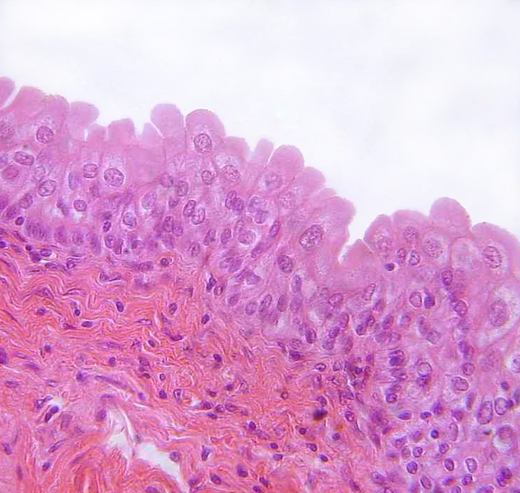
Urinary Bladder
Smooth, collapsible, muscular sac that stores urine until it is convenient to release it
Lining is transitional epithelium, a special tissue that is capable of stretching

Slide 13
Urinary Bladder
Smooth, collapsible, muscular sac that stores urine until it is convenient to release it
Lining is transitional epithelium, a special tissue that is capable of stretching
Empty bladder is only 5 cm long. Full bladder can be over 20 cm long and hold 2 pints

Slide 14
Urethra
Thin walled tube that carries urine from the bladder to the outside of the body

Slide 15
Urethra
Thin walled tube that carries urine from the bladder to the outside of the body
Females: 3-4 cm long, Males: 20 cm long

Slide 16
Urethra
Thin walled tube that carries urine from the bladder to the outside of the body
Females: 3-4 cm long, Males: 20 cm long
Shorter urethra makes females much more susceptible to urinary tract infections

Slide 17
Kidneys
Located between 12th thoracic and 3rd lumbar vertebrae on posterior abdominal wall. Partially protected by lower ribs

Slide 18
Kidneys
Located between 12th thoracic and 3rd lumbar vertebrae on posterior abdominal wall. Partially protected by lower ribs
Bean shaped. 6 cm wide 12 cm long

Slide 19
Output (pg 3)
Label the components of the urinary system

Slide 20
Characteristics of Urine (pg 2)
Urine contains nitrogenous waste (urea) that is a byproduct of cellular metabolism and other unneeded substances

Slide 21
Characteristics of Urine (pg 2)
Urine contains nitrogenous waste (urea) that is a byproduct of cellular metabolism and other unneeded substances
Yellow color is due to urochrome, a pigment from the breakdown of hemoglobin

Slide 22
Characteristics of Urine (pg 2)
Urine contains nitrogenous waste (urea) that is a byproduct of cellular metabolism and other unneeded substances
Yellow color is due to urochrome, a pigment from the breakdown of hemoglobin
Usually slightly acidic (pH around 6).

Slide 23
Dialysis
Diabetes, hypertension, and aging can cause kidneys to lose function or fail

Slide 24
Dialysis
Diabetes, hypertension, and aging can cause kidneys to lose function or fail
Dialysis uses an artificial kidney to filter the patient’s blood. 3 times per week for 4 to 8 hours each time.

