Slide 1
Heart Anatomy, Part 2 (pg 4)

Slide 2
Valves of the Heart
Valves prevent blood from flowing backward

Slide 3
Valves of the Heart
Valves prevent blood from flowing backward
1. Atrioventricular (AV) valves: Between atria and ventricles

Slide 4
Valves of the Heart
Valves prevent blood from flowing backward
1. Atrioventricular (AV) valves: Between atria and ventricles
Anchored by strings called the chordae tendineae, which prevents the valve from letting blood back into the atria

Slide 5
Valves of the Heart
Valves prevent blood from flowing backward
1. Atrioventricular (AV) valves: Between atria and ventricles
Anchored by strings called the chordae tendineae, which prevents the valve from letting blood back into the atria
Right = tricuspid valve

Slide 6
Valves of the Heart
Valves prevent blood from flowing backward
1. Atrioventricular (AV) valves: Between atria and ventricles
Anchored by strings called the chordae tendineae, which prevents the valve from letting blood back into the atria
Right = tricuspid valve
Left = bicuspid (mitral) valve

Slide 7
2. Semilunar Valves: located at the bases of blood vessels that carry blood from the ventricles

Slide 8
2. Semilunar Valves: located at the bases of blood vessels that carry blood from the ventricles
Each valve has 3 cup-like cusps. When blood flows back toward the ventricles, the cups fill with blood, causing the valve to close

Slide 9
2. Semilunar Valves: located at the bases of blood vessels that carry blood from the ventricles
Each valve has 3 cup-like cusps. When blood flows back toward the ventricles, the cups fill with blood, causing the valve to close
Pulmonary SL valve: at exit of right ventricle

Slide 10
2. Semilunar Valves: located at the bases of blood vessels that carry blood from the ventricles
Each valve has 3 cup-like cusps. When blood flows back toward the ventricles, the cups fill with blood, causing the valve to close
Pulmonary SL valve: at exit of right ventricle
Aortic SL valve: at exit of left ventricle

Slide 11
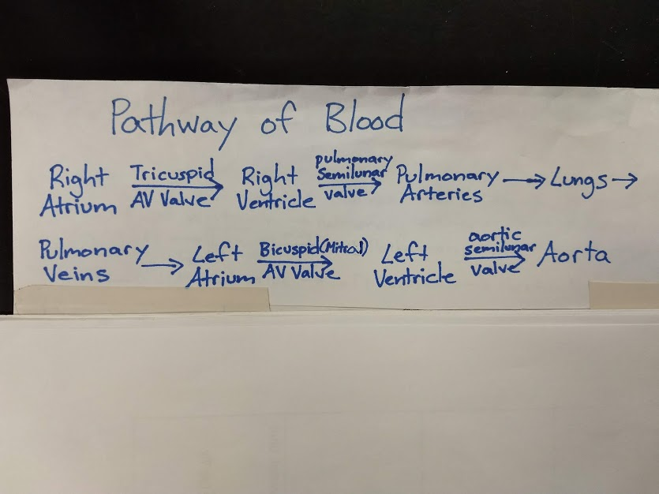
Pathway of Blood

