Slide 1
Notes: Blood Vessels (pg 8)

Slide 2
Arteries
Arteries carry blood AWAY from the heart

Slide 3
Arteries
Arteries carry blood AWAY from the heart
Transport oxygenated blood

Slide 4
Arteries
Arteries carry blood AWAY from the heart
Transport oxygenated blood (Except Pulmonary Arteries which carry deoxygenated blood from heart to the lungs)

Slide 5
Arteries
Arteries carry blood AWAY from the heart
Transport oxygenated blood (Except Pulmonary Arteries which carry deoxygenated blood from heart to the lungs)
Blood moves rapidly through arteries and is under high pressure

Slide 6
Arteries
Arteries carry blood AWAY from the heart
Transport oxygenated blood (Except Pulmonary Arteries which carry deoxygenated blood from heart to the lungs)
Blood moves rapidly through arteries and is under high pressure
Arteries branch until they become microscopic arterioles

Slide 7
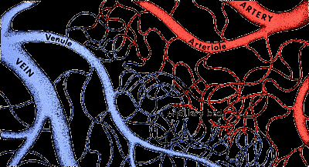
Capillaries
Capillaries form the connection between arteries and veins

Slide 8
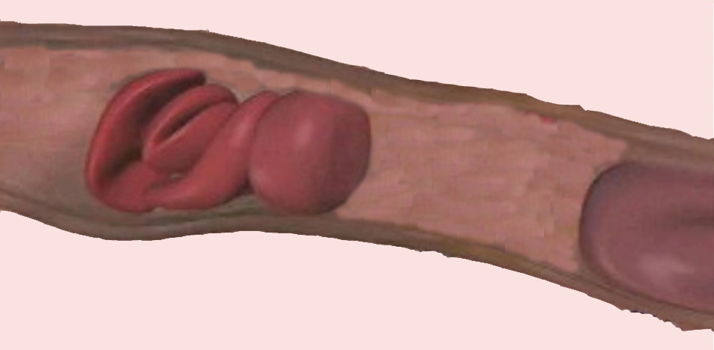
Capillaries form the connection between arteries and veins
Smallest blood vessels. Walls are only 1 cell thick. Tiny diameter (RBCs must go through single file).

Slide 9
Capillaries form the connection between arteries and veins
Smallest blood vessels. Walls are only 1 cell thick. Tiny diameter (RBCs must go through single file).
Very numerous (total length of capillaries in your body is around ______________

Slide 10
Capillaries form the connection between arteries and veins
Smallest blood vessels. Walls are only 1 cell thick. Tiny diameter (RBCs must go through single file).
Very numerous (total length of capillaries in your body is around 25,000 miles!)

Slide 11
Capillaries form the connection between arteries and veins
Smallest blood vessels. Walls are only 1 cell thick. Tiny diameter (RBCs must go through single file).
Very numerous (total length of capillaries in your body is around 25,000 miles!)
Function = Exchange of gases and nutrients between blood and tissues

Slide 12
Capillaries form the connection between arteries and veins
Smallest blood vessels. Walls are only 1 cell thick. Tiny diameter (RBCs must go through single file).
Very numerous (total length of capillaries in your body is around 25,000 miles!)
Function = Exchange of gases and nutrients between blood and tissues
Blood travels very slowly through capillaries

Slide 13
Veins
Veins carry blood TOWARD the heart

Slide 14
Veins carry blood TOWARD the heart
Transport deoxygenated blood (Except Pulmonary veins – carry oxygenated blood from the lungs to the left atrium)

Slide 15
Veins carry blood TOWARD the heart
Transport deoxygenated blood (Except Pulmonary veins – carry oxygenated blood from the lungs to the left atrium)
After flowing through capillaries, blood enters microscopic venules which converge into veins

Slide 16
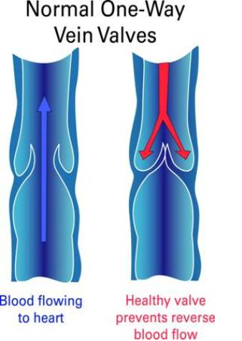
3. Veins: Carry blood TOWARD the heart
Transport deoxygenated blood (Except Pulmonary veins – carry oxygenated blood from the lungs to the left atrium)
After flowing through capillaries, blood enters microcopic venules which converge into veins
Have valves that prevent backflow of blood

Slide 17
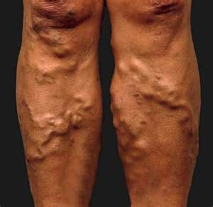
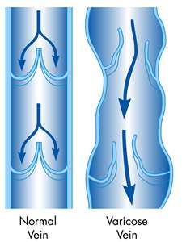
3. Veins: Carry blood TOWARD the heart
Transport deoxygenated blood (Except Pulmonary veins – carry oxygenated blood from the lungs to the left atrium)
After flowing through capillaries, blood enters microcopic venules which converge into veins
Have valves that prevent backflow of blood

Slide 18
Veins carry blood TOWARD the heart
Transport deoxygenated blood (Except Pulmonary veins – carry oxygenated blood from the lungs to the left atrium)
After flowing through capillaries, blood enters microcopic venules which converge into veins
Have valves that prevent backflow of blood
Blood travels more slowly and under much lower pressure than in arteries

Slide 19
Blood Vessel Identification
Arteries
Aorta: leaves left ventricle. Largest artery

Slide 20
Blood Vessel Identification
Arteries
Aorta: leaves left ventricle. Largest artery
Coronary: Branches from ascending aorta. Supplies oxygenated blood to myocardium of heart

Slide 21
Blood Vessel Identification
Arteries
Aorta: leaves left ventricle
Coronary: Branches from ascending aorta. Supplies oxygenated blood to myocardium of heart
Pulmonary: from right ventricle to lungs

Slide 22
Blood Vessel Identification
Arteries
Aorta: leaves left ventricle
Coronary: Branches from ascending aorta. Supplies oxygenated blood to myocardium of heart
Pulmonary: from right ventricle to lungs
Carotid: Supplies brain and head. Pulse point in neck

Slide 23
Blood Vessel Identification
Arteries
Aorta: leaves left ventricle
Coronary: Branches from ascending aorta. Supplies oxygenated blood to myocardium of heart
Pulmonary: from right ventricle to lungs
Carotid: Supplies brain and head. Pulse point in neck
Brachial: Supplies arm. Where blood pressure is taken

Slide 24
Blood Vessel Identification
Arteries
Aorta: leaves left ventricle
Coronary: Branches from ascending aorta. Supplies oxygenated blood to myocardium of heart
Pulmonary: from right ventricle to lungs
Carotid: Supplies brain and head. Pulse point in neck
Brachial: Supplies arm. Where blood pressure is taken
Iliac: Forms from the bifurcation of the aorta. Supplies reproductive organs and legs

Slide 25
Blood Vessel Identification
Arteries
Aorta: leaves left ventricle
Coronary: Branches from ascending aorta. Supplies oxygenated blood to myocardium of heart
Pulmonary: from right ventricle to lungs
Carotid: Supplies brain and head. Pulse point in neck
Brachial: Supplies arm. Where blood pressure is taken
Iliac: Forms from the bifurcation of the aorta. Supplies reproductive organs and legs
Femoral: Supplies thigh muscles

Slide 26
Blood Vessel Identification
Veins
Superior and Inferior Vena Cava: largest veins. Empty into right atrium

Slide 27
Blood Vessel Identification
Veins
Superior and Inferior Vena Cava: largest veins. Empty into right atrium
Pulmonary: from lungs to left atrium

Slide 28
Blood Vessel Identification
Veins
Superior and Inferior Vena Cava: largest veins. Empty into right atrium
Pulmonary: from lungs to left atrium
Jugular: Drains blood from brain and head. Visible in neck when angry

Slide 29
Blood Vessel Identification
Veins
Superior and Inferior Vena Cava: largest veins. Empty into right atrium
Pulmonary: from lungs to left atrium
Jugular: Drains blood from brain and head. Visible in neck when angry
Hepatic portal: Drains blood from the digestive system and carries it to liver. Allows liver to store nutrients and filter out toxins

