Slide 1
Notes: Blood Pressure (pg 10)

Slide 2
Notes: Blood Pressure
Systole = Ventricles contracting
Diastole = Ventricles relaxed

Slide 3
Blood Pressure
If your blood vessels were completely rigid then blood pressure would spike very high during systole and drop to zero during diastole

Slide 4
Blood Pressure
If your blood vessels were completely rigid then blood pressure would spike very high during systole and drop to zero during diastole
Luckily, our vessels are elastic

Slide 5
Blood Pressure
If your blood vessels were completely rigid then blood pressure would spike very high during systole and drop to zero during diastole
Luckily, our vessels are elastic
During Systole: vessels stretch (widen), absorbing some of the pumping force. BP is high, but not nearly as high as it would be with rigid vessels

Slide 6
Blood Pressure
If your blood vessels were completely rigid then blood pressure would spike very high during systole and drop to zero during diastole
Luckily, our vessels are elastic
During Systole: vessels stretch (widen), absorbing some of the pumping force. BP is high, but not nearly as high as it would be with rigid vessels
During Diastole: Stretched vessels gradually return to normal size, keeping some pressure on the blood. BP is low, but not zero.

Slide 7
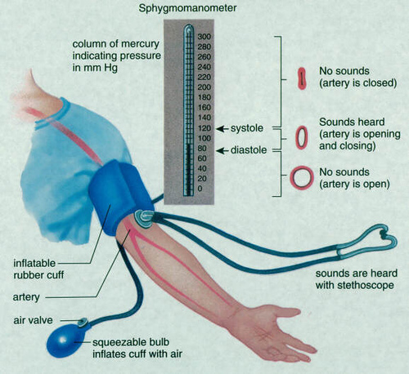
me

Slide 8
Blood Pressure Reading
Two numbers (Example: 120 / 80)
Higher number = Systolic. Pressure when ventricles are contracting
Lower number = Diastolic. Pressure when ventricles are relaxed

Slide 9
Factors that affect blood pressure
1. Cardiac output (heart rate x stroke volume)

Slide 10
Factors that affect blood pressure
1. Cardiac output (heart rate x stroke volume)
2. Blood volume

Slide 11
Factors that affect blood pressure
1. Cardiac output (heart rate x stroke volume)
2. Blood volume
3. Resistance (vasoconstriction, atherosclerosis)

Slide 12
Factors that affect blood pressure
1. Cardiac output (heart rate x stroke volume)
2. Blood volume
3. Resistance (vasoconstriction, atherosclerosis)
4. Viscosity of blood

