Slide 1
Notes: Thyroid and Parathyroid (pg 6)

Slide 2
Thyroid gland
Located at the base of the throat, just below the Adam’s apple
Butterfly-shaped
Produces 2 hormones

Slide 3
Thyroid Hormone: Consists of 2 hormones
95% is Thyroxine (contains 4 Iodine atoms) and 5% is Triiodothyronine (contains 3 Iodine atoms). Have the same function: Control the rate at which glucose is turned into energy. Target tissue: Every cell in the body

Slide 4
2. Calcitonin: Decreases blood calcium levels by causing calcium to be deposited in the bones.

Slide 5
Thyroid Disorders

Slide 6
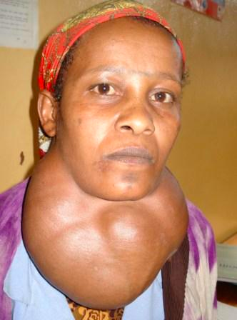
Goiters
Usually caused by iodine deficiency
Without iodine, thyroid can’t make thyroid hormone
Hypothalamus tells pituitary to release more Thyroid Stimulating Hormone, which makes the thyroid grow

Slide 7
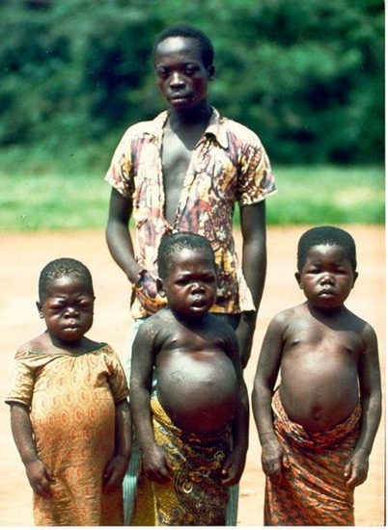
Cretinism
Caused by low levels of thyroid hormones in newborns
Often caused by iodine deficiency in the mother
Results in short stature and mental retardation

Slide 8
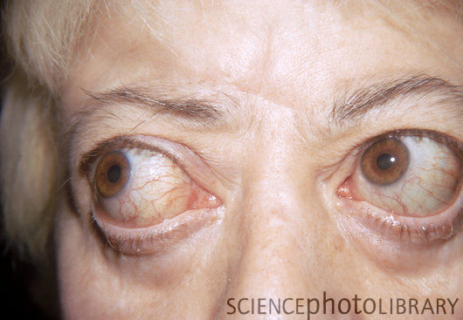
Hyperthyroidism
Thyroid produces too much hormone
High metabolic rate, nervousness, irritability, insomnia, weight loss, exopthalmos (bulging eyes)

Slide 9
Parathyroid Glands
4 small masses of glandular tissue found on the posterior surface of the thyroid gland

Slide 10
Parathyroid Glands
4 small masses of glandular tissue found on the posterior surface of the thyroid gland
Make Parathyroid Hormone (PTH): Raises blood calcium levels by stimulating bone destroying cells (osteoclasts) to break down bone and release calcium into the blood.

Slide 11
Parathyroid Glands
4 small masses of glandular tissue found on the posterior surface of the thyroid gland
Make Parathyroid Hormone (PTH): Raises blood calcium levels by stimulating bone destroying cells (osteoclasts) to break down bone and release calcium into the blood.
PTH and Calcitonin are antagonists and maintain blood calcium levels through negative feedback

Slide 12
Drawing (pg 7)
Illustrate negative feedback loop for blood calcium

